Slide 1
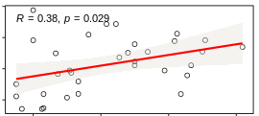
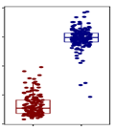
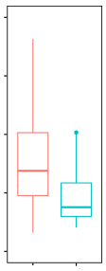
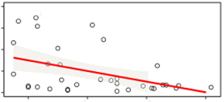
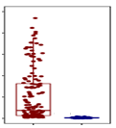
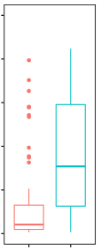
1.6
1.2
0.8
0.4
P = 4.16E−170
P = 5.70E−05
CAediting_524911 in hsa-miR-589-3p
4
3
2
1
0
2.0
1.5
1.0
0.5
0
P = 2.94E−02, R = 0.38
miRNA-589 binding gain in LEFTY1
miRNA-589 binding loss in DLEU1
DLEU1 Expression
DLEU1 Expression
Low expression of LEFTY1
High expression of DLEU1
0.2 0.4 0.6 0.8
P = 3.40E−07
P = 5.56E−03
20
15
10
5
0
50
40
30
20
10
0
50
40
30
20
10
0
P = 1.09E−02, R = −0.44
Key gene in nodal signaling to be associated with germ cell pluripotency, the presence of carcinoma in situ, and TGCT
DLEU1 may be a tumor suppressor gene for TGCT cancer
LEFTY1 Expression
LEFTY1 Expression
0.2 0.4 0.6 0.8
Stage > 1
Stage = 1
GTEX testis
Better condition of TGCT cancer
TCGA TGCT
Editing frequency of CAediting_524911

