Slide 1
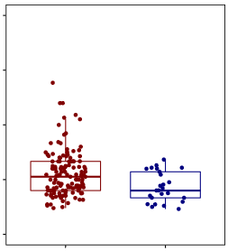
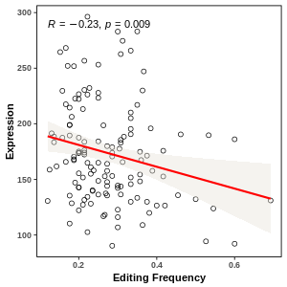
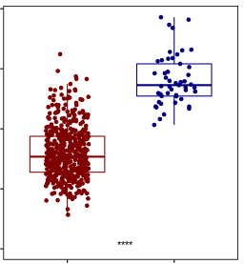
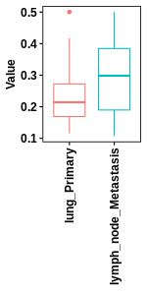
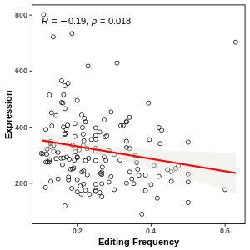
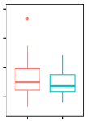
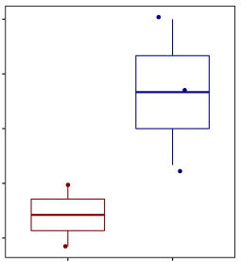
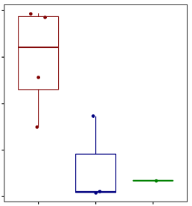
A CAediting_279186 of RHOA in TCGA-LUSC
1.00
0.75
0.50
0.25
0.00
P = 6.14E−04
300
250
200
150
100
P = 9.02E−03，R = −0.23
400
300
200
100
0
CAediting_279186
RHOA expression
RHOA expression
P = 4.68E−27
Tumor Normal
0.2 0.4 0.6
Tumor Normal
Editing frequency of CAediting_279186
B CAediting_279186 of RHOA in CCLE (metastasis tumors from lung)
0.50
0.40
0.30
0.20
0.10
P = 0.04
800
600
400
200
P = 0.02，R = −0.19
800
600
400
200
Primary > LN meta
P = 0.15
CAediting_279186
RHOA expression
RHOA expression
0.2 0.4 0.6
Primary lung
Primary lung
Editing frequency of CAediting_279186
Metastasis to lymph node
Metastasis to lymph node
C CAediting_279186 of RHOA in MET500 (metastasis tumors from lung)
0.40
0.35
0.30
0.25
0.20
P = 0.25，R = −0.64
600
500
400
300
200
P = 1.70E−02
RHOA expression
P = 0.03
CAediting_279186
Primary < metastasis
P = 0.10
RHOA expression
Primary lung
Metastasis to liver
Primary lung
Metastasis to brain
Metastasis to Liver
Editing frequency of CAediting_279186

