Slide 1
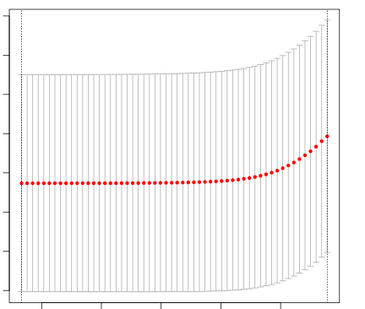
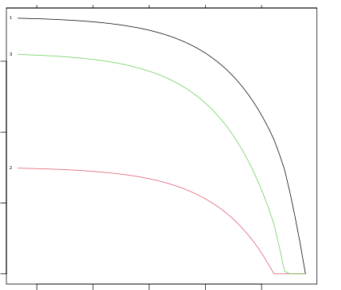
A Formula
B LASSO process to calculate the contributions of editing sites to APOL1 expressions
C Contribution coefficients of three editing events to APOL1 expressions
3 3 3 3 3 3 3 3 3 3 3 3 3 2 1
3 3 3 3 3
3.4
3.2
3.0
2.8
2.6
2.4
2.2
2.0
150
100
50
0
Mean square error (10⁴)
Coefficients
-1 0 1 2 3
-1 0 1 2 3
log₁₀(λ)
log₁₀(λ)

