Slide 1
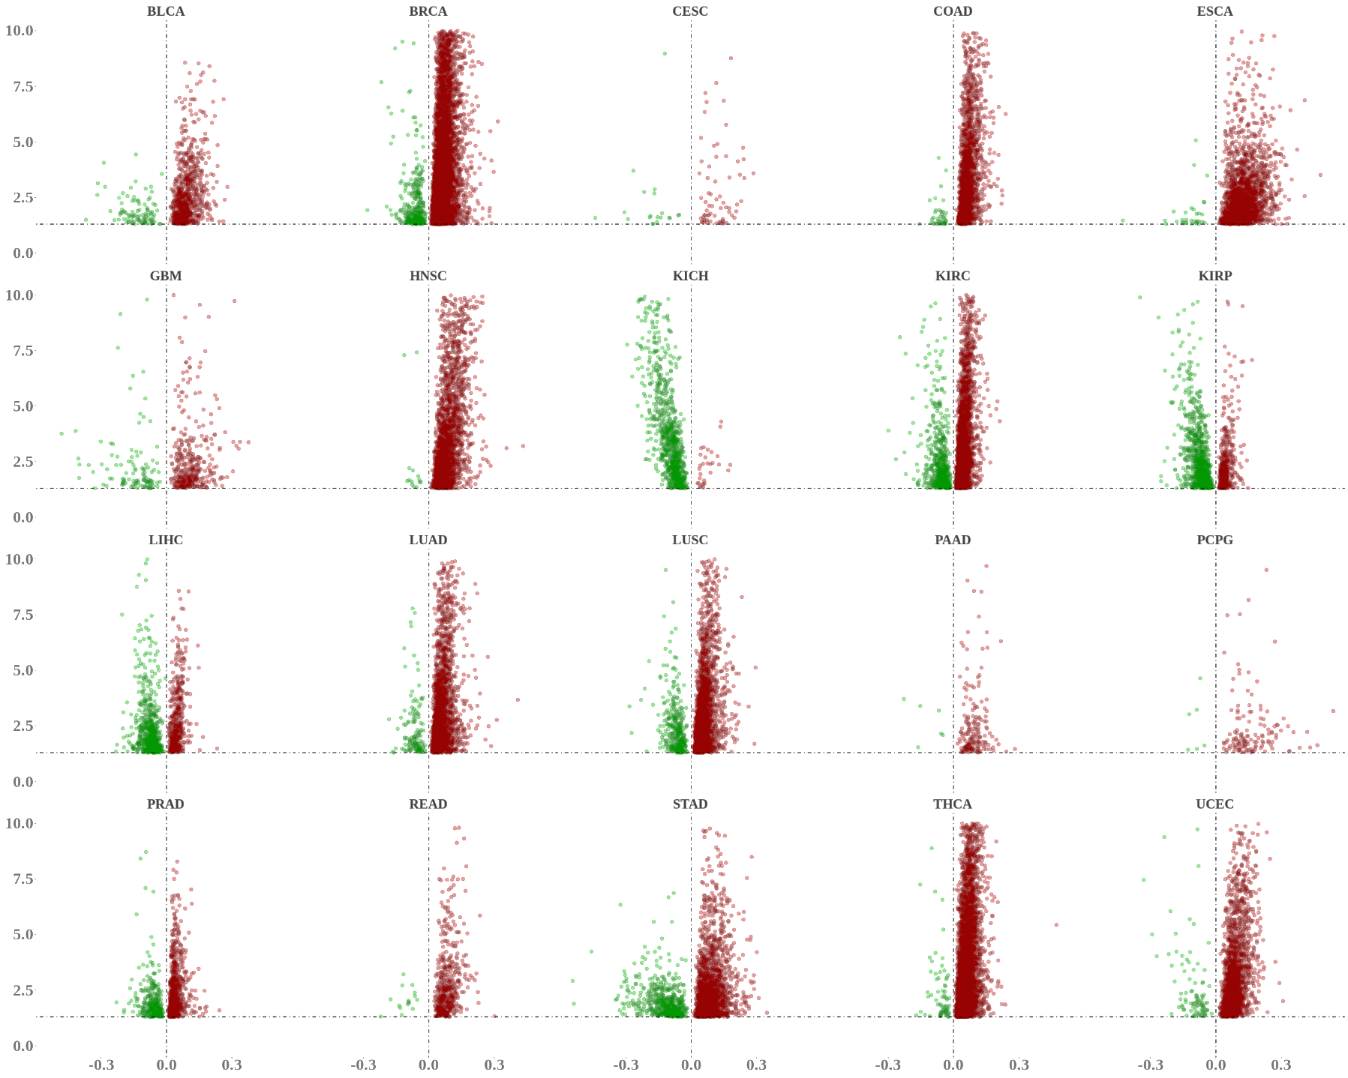
BLCA BRCA CESC COAD ESCA
10.0
7.5
5.0
2.5
0.0
LPP
CAediting_1478179
APOL1
TPM4
RAB25
DDX58
GBM HNSC KICH KIRC KIRP
10.0
7.5
5.0
2.5
0.0
DCUN1D3
CAediting_1478179
APOL1
CAediting_390714
GRIA2
GMPS
LPP
−Log₁₀(P value)
LIHC LUAD LUSC PAAD PCPG
10.0
7.5
5.0
2.5
0.0
ERCC4
DDX58
GMPS
CYB5A
TPM4
PRAD READ STAD THCA UCEC
10.0
7.5
5.0
2.5
0.0
DAPK2
CAediting_1478179
APOL1
GMPS
BCL2
TRIM24
-0.3 0.0 0.3
-0.3 0.0 0.3
-0.3 0.0 0.3
-0.3 0.0 0.3
-0.3 0.0 0.3
Editing frequency in tumor − editing frequency in normal

