Slide 1
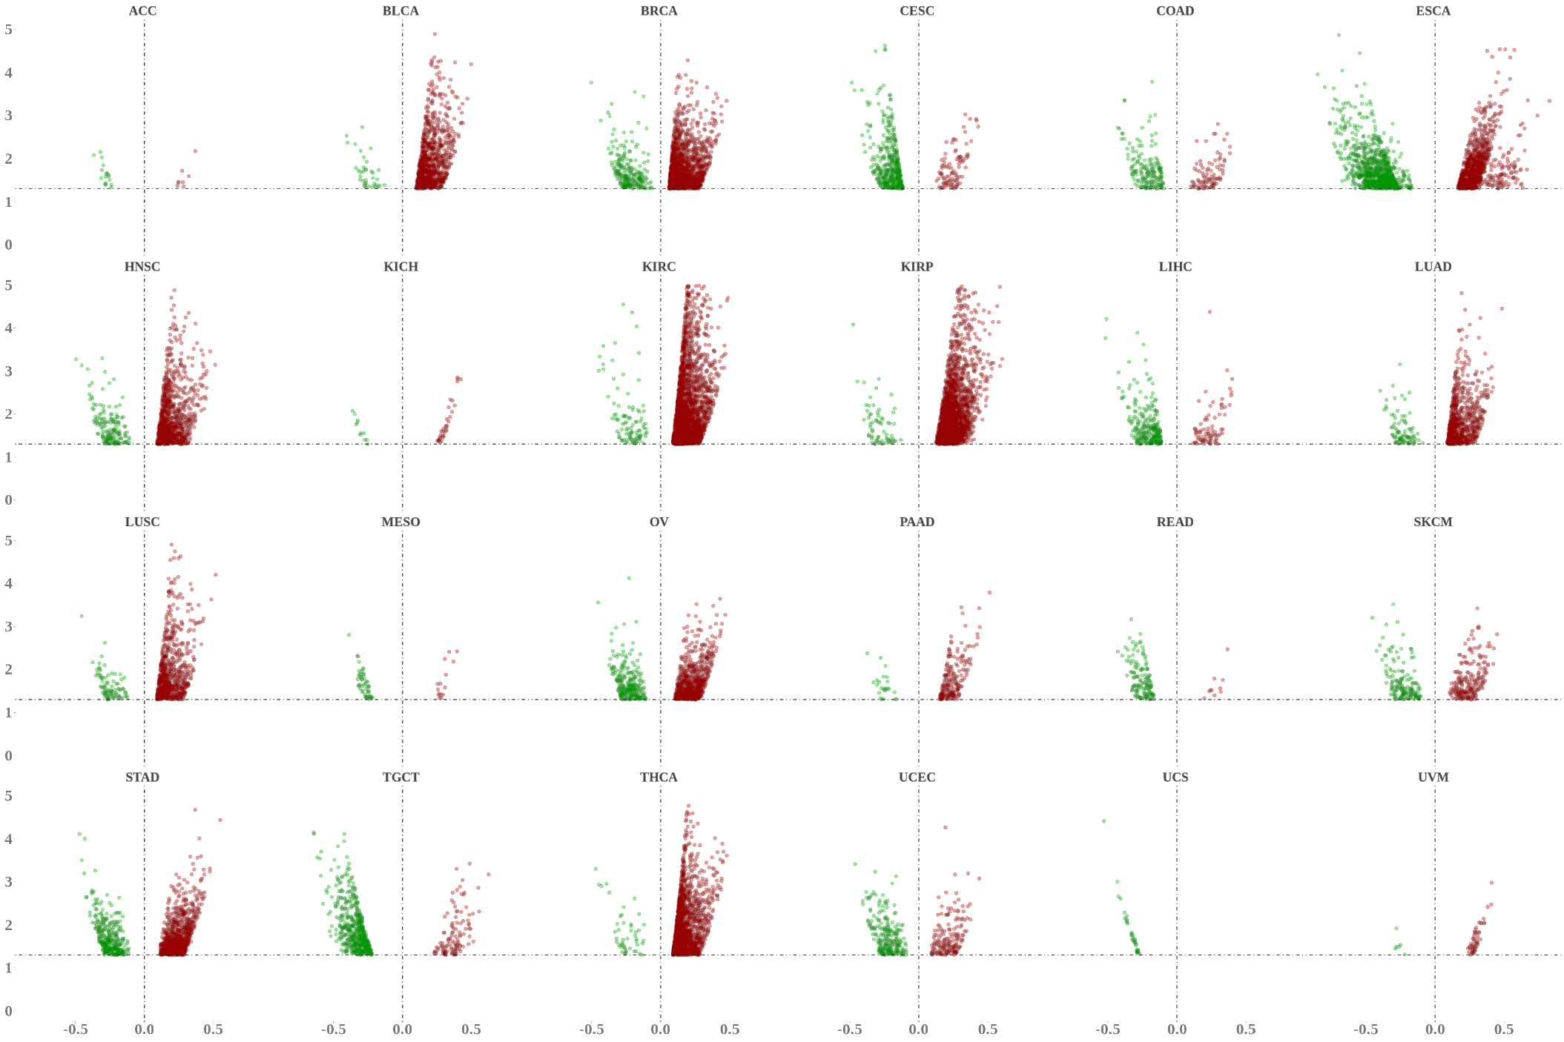
ACC BLCA BRCA CESC COAD ESCA
5
4
3
2
1
0
CCAR1
IGFBP3
RBM43
GMPS
DFFA
TMEM127
HNSC KICH KIRC KIRP LIHC LUAD
5
4
3
2
1
0
CAediting_1478179
APOL1
CAediting_543208
IGFBP3
POU5F1
DAPK3
DDX58
PHACTR4
VHL
−Log₁₀(P value)
LUSC MESO OV PAAD READ SKCM
5
4
3
2
1
0
VHL
MDM4
NACA
APOL1
PHACTR4
DDX58
STAD TGCT THCA UCEC UCS UVM
5
4
3
2
1
0
SALL4
CRTC1
CAediting_1478179
APOL1
PHACTR4
PHACTR4
HSPD1
-0.5 0.0 0.5
-0.5 0.0 0.5
-0.5 0.0 0.5
-0.5 0.0 0.5
-0.5 0.0 0.5
-0.5 0.0 0.5
Correlation coefficients between editing frequencies and tumor stages

