Slide 1
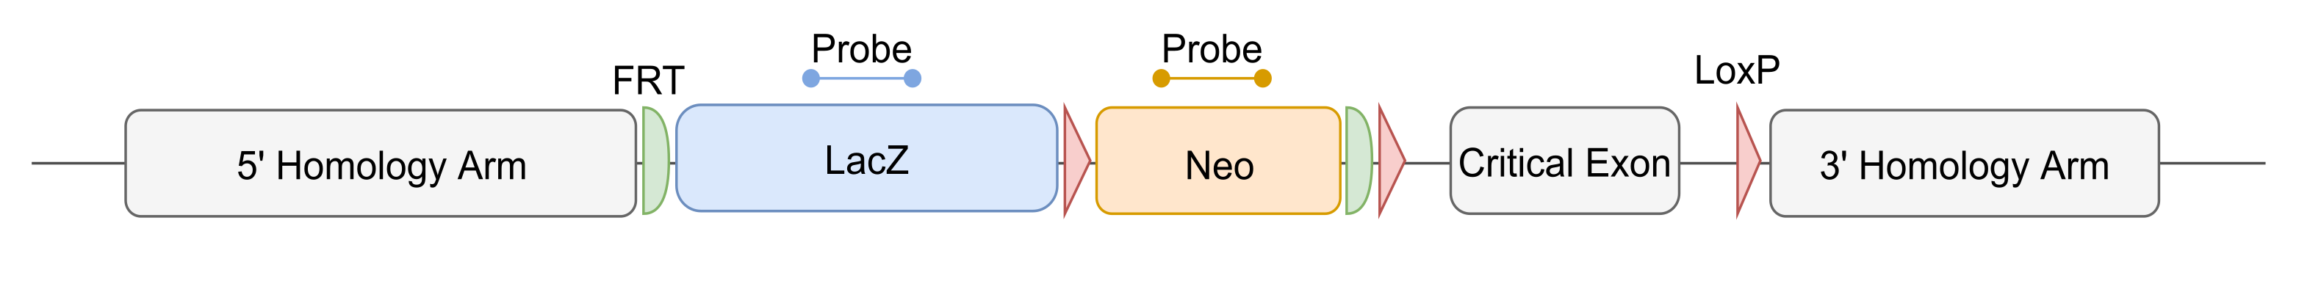
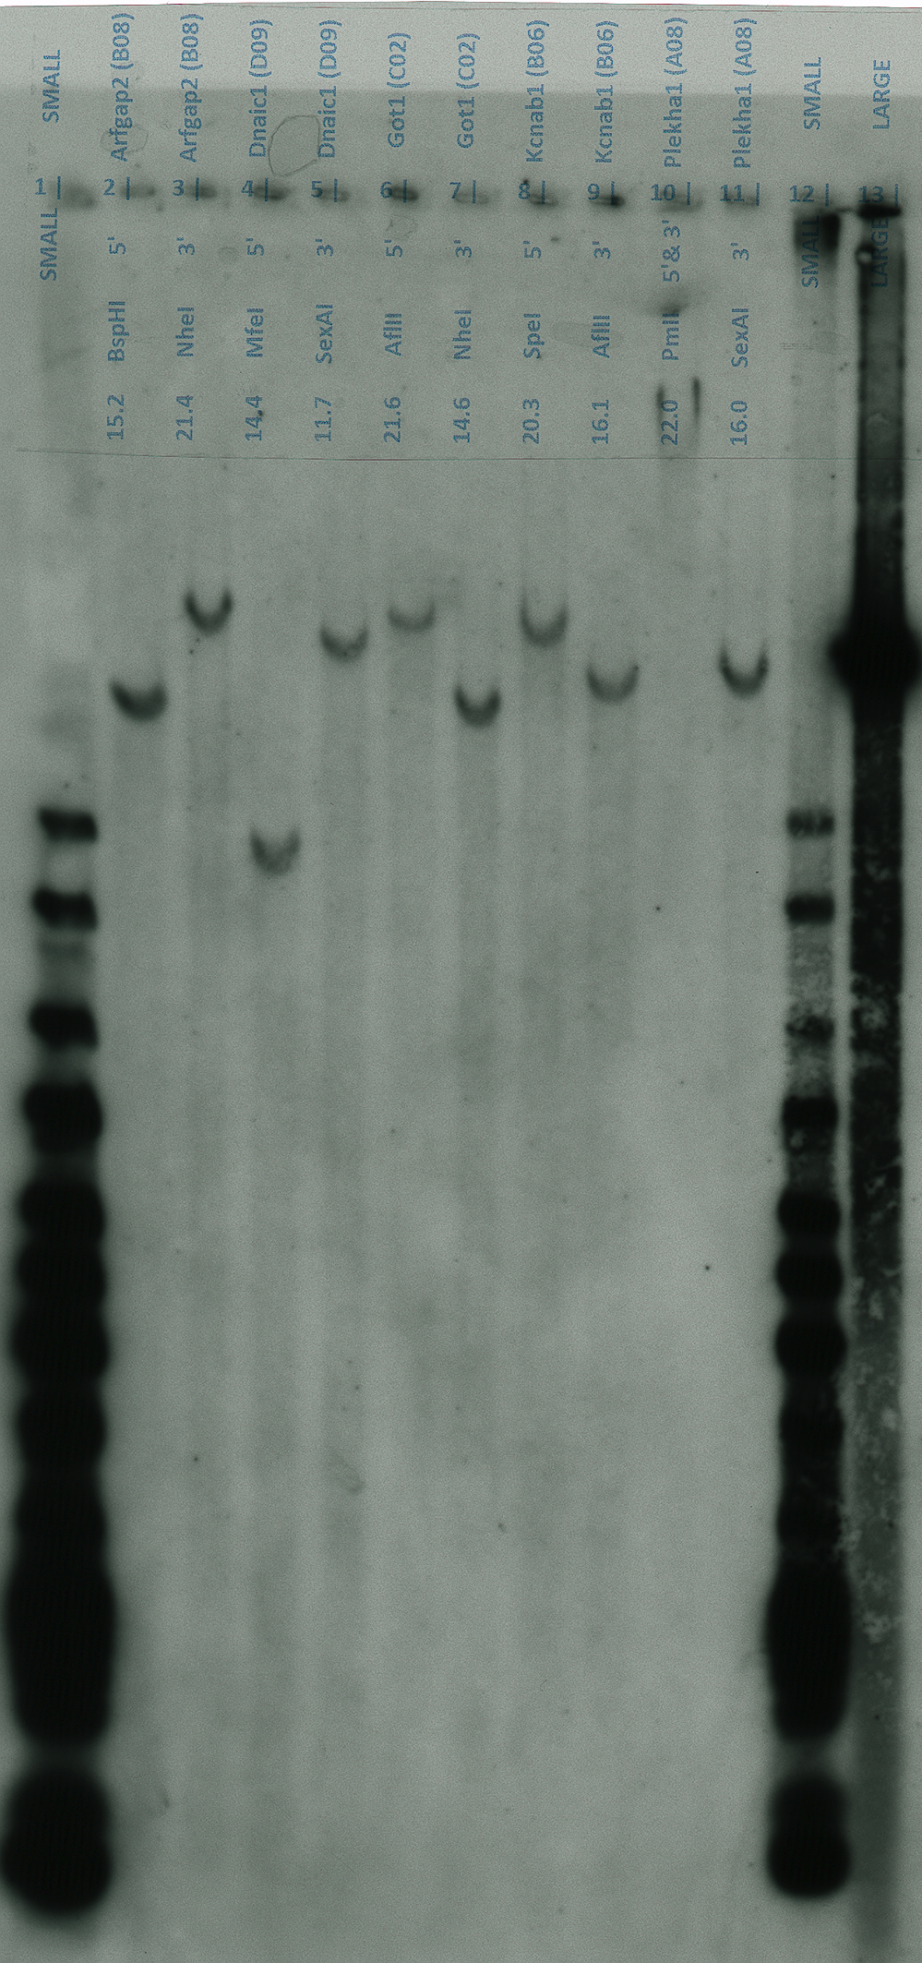
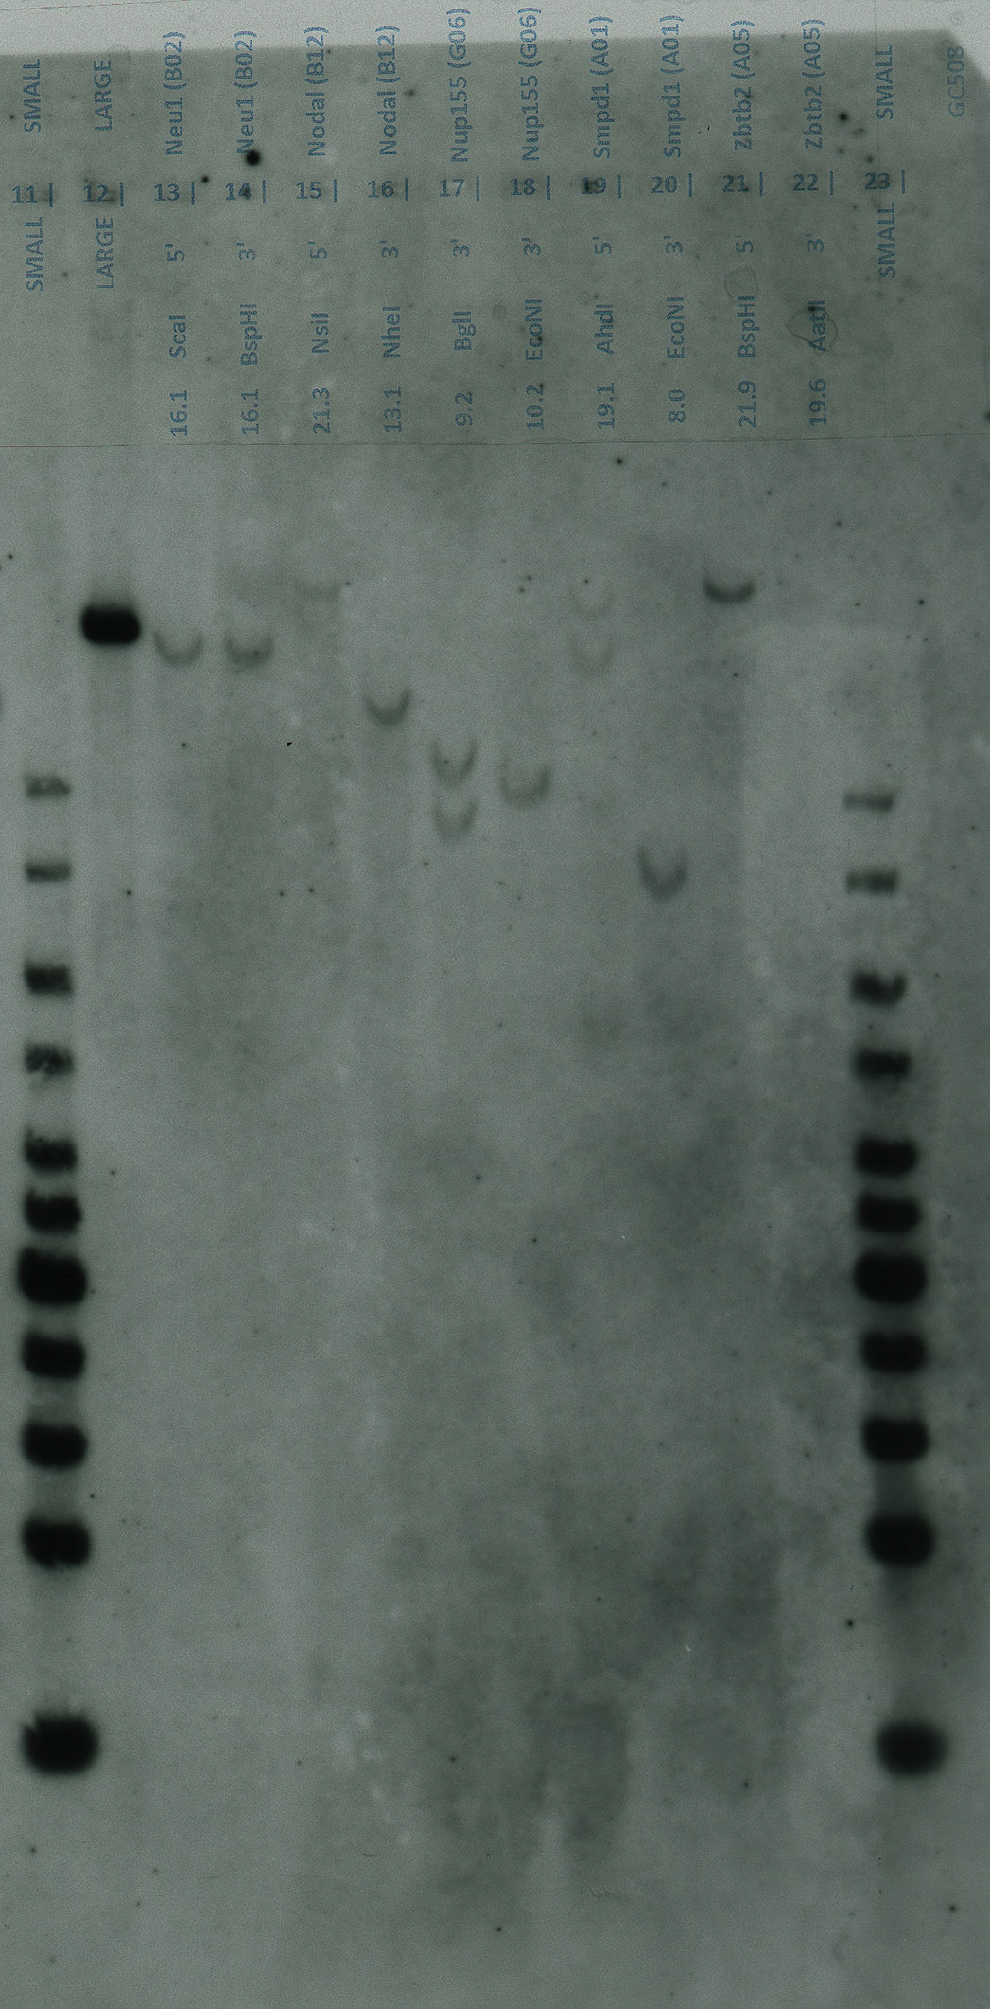
Supplemental Figure S1
17 kb
17 kb
10 kb
10 kb
10 kb
10 kb
8 kb
8 kb
8 kb
8 kb
6 kb
6 kb
6 kb
6 kb
4 kb
4 kb
4 kb
4 kb

Slide 2
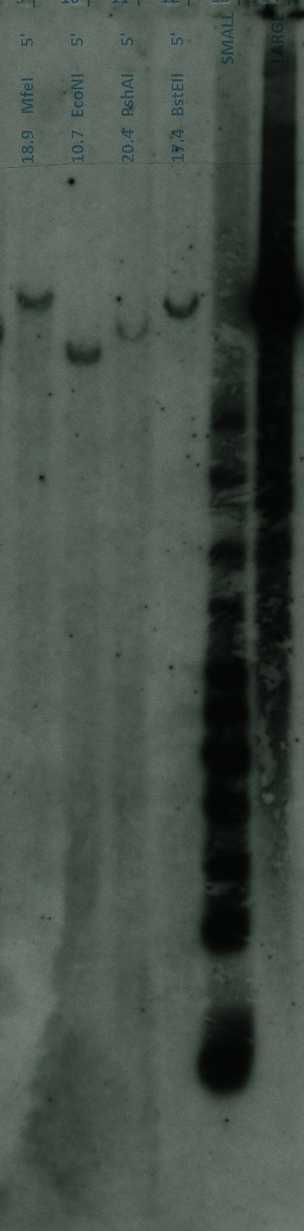
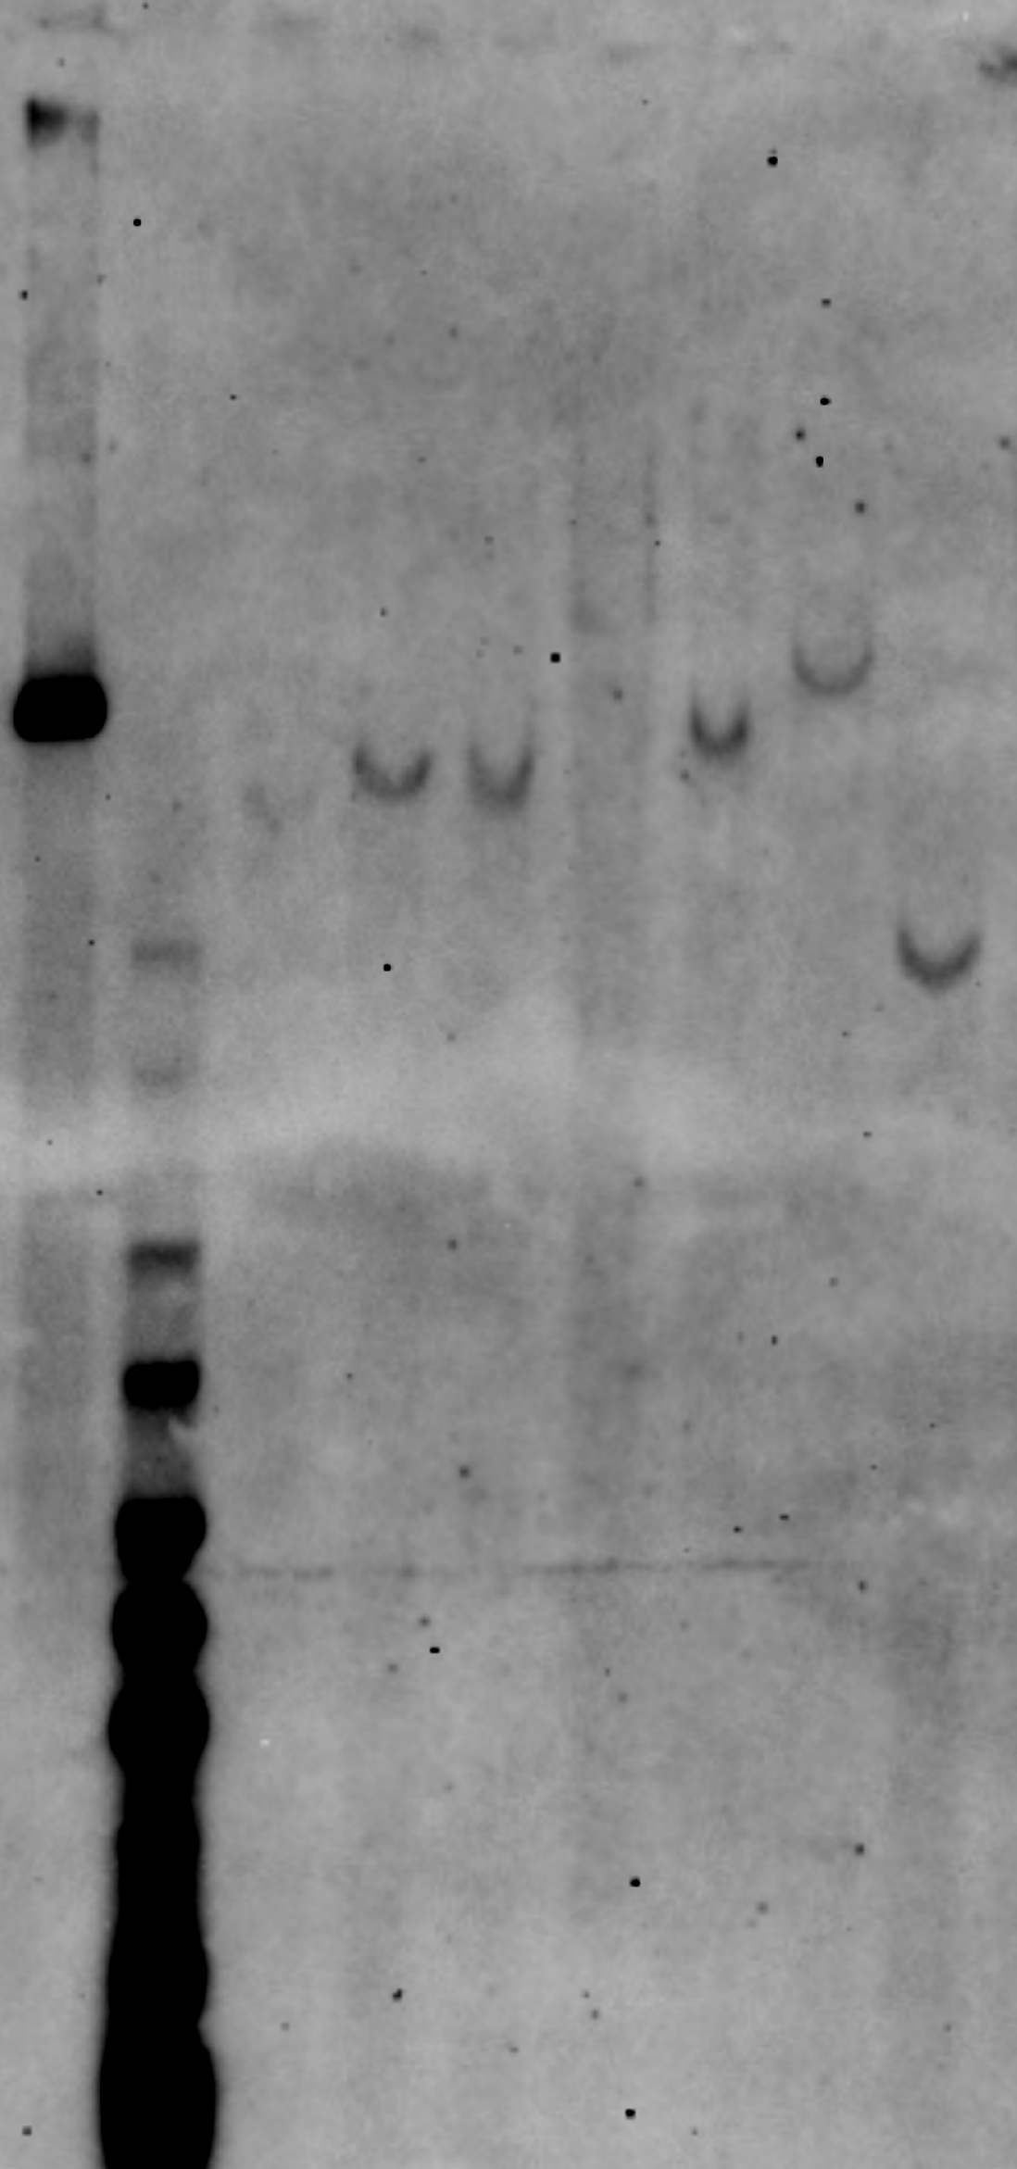
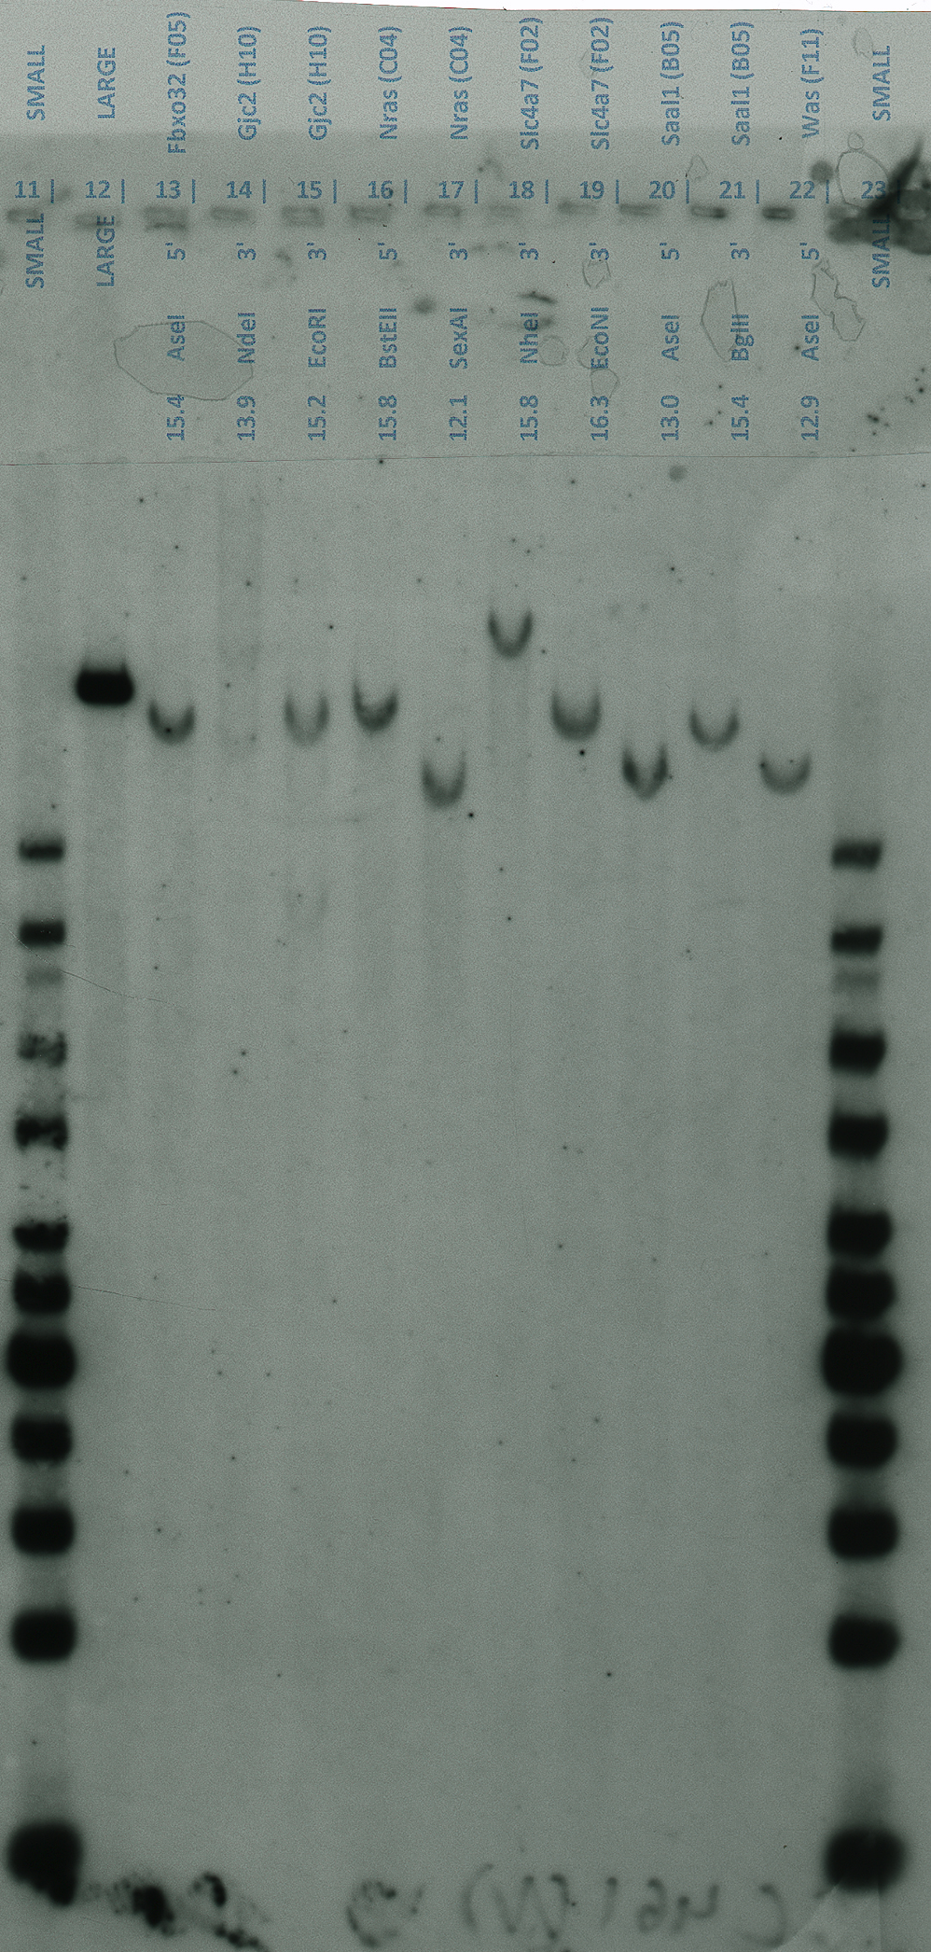
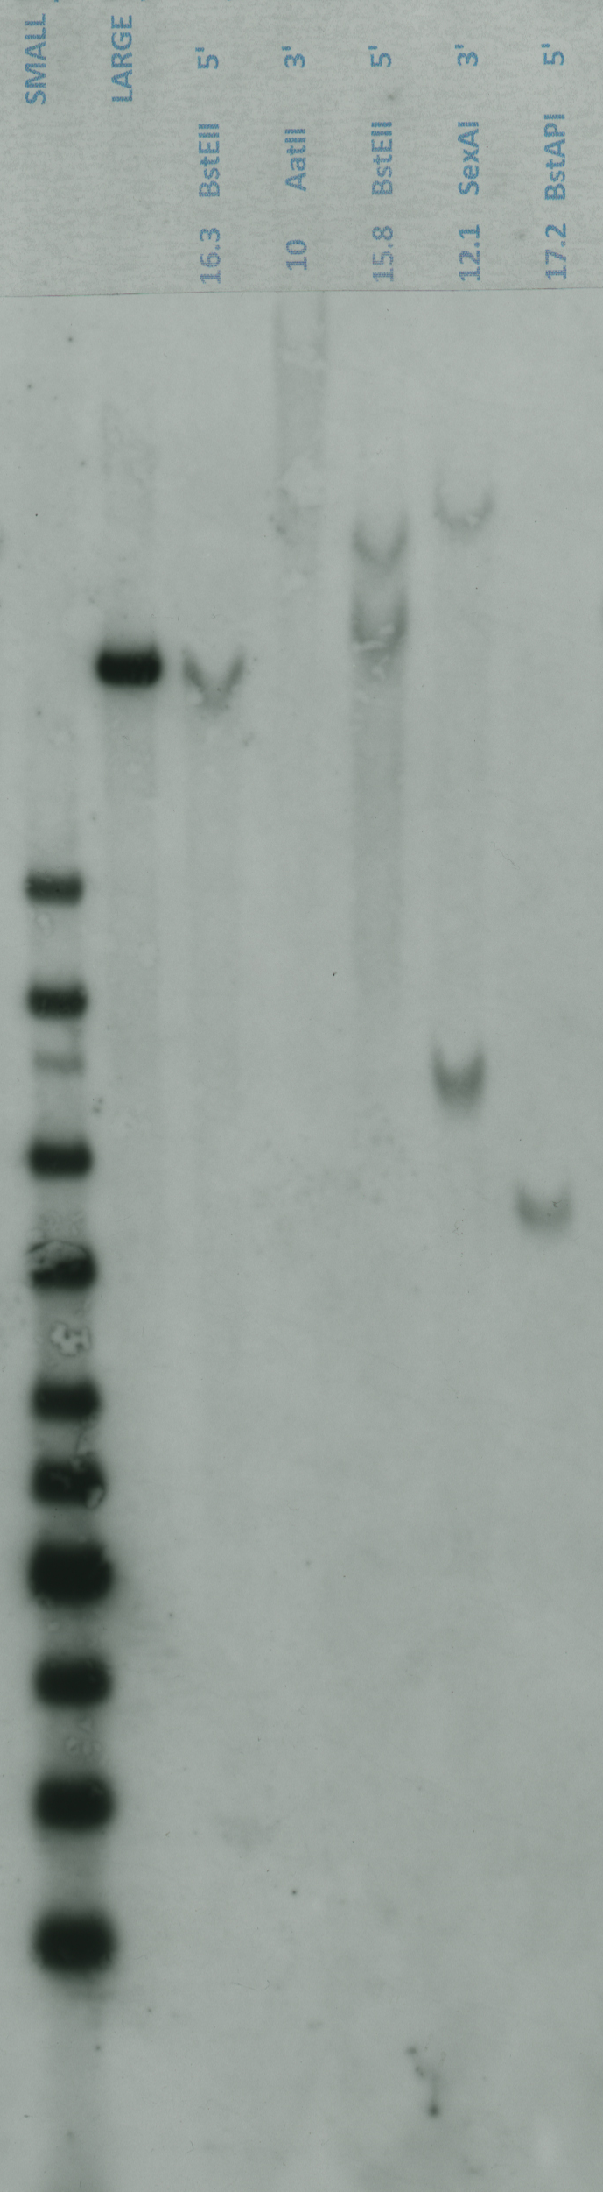
Supplemental Figure S2
LacZ probed membranes
Neo probed membranes
Nid2 tm1a (G08)
Nid2 tm1a (C07)
Nras tm1a (C04)
Nras tm1a (B03)
5’ EcoNI 10.7
5’ PshAI 20.4
5’ PshAI 20.4
5’ EcoNI 10.7
5’ BstEII 15.8
3’ SexAI 12.1
5’ BstEII 15.8
3’ SexAI 12.1
S L
S L
S L
Key:
Pass; Fail - fragment smaller than expected; Fail - fragment larger than expected; Fail - Multiple integration;
S Small ladder; L Large ladder, Above the lanes the arm interrogated, enzymes used and expected size for the digest in event of correct targeting are indicated underneath the clone IDs.
17 kb
17 kb
17 kb
17 kb
10 kb
10 kb
8 kb
10 kb
8 kb
10 kb
6 kb
8 kb
8 kb
6 kb
6 kb
4 kb
4 kb
4 kb
6 kb
4 kb
3 Pass 5’ HA
1 Pass 5’ HA
1 Pass 3’ HA
1 Fail 5’ HA
1 Fail 3’ HA
2 Fail 5’ HA

Slide 3
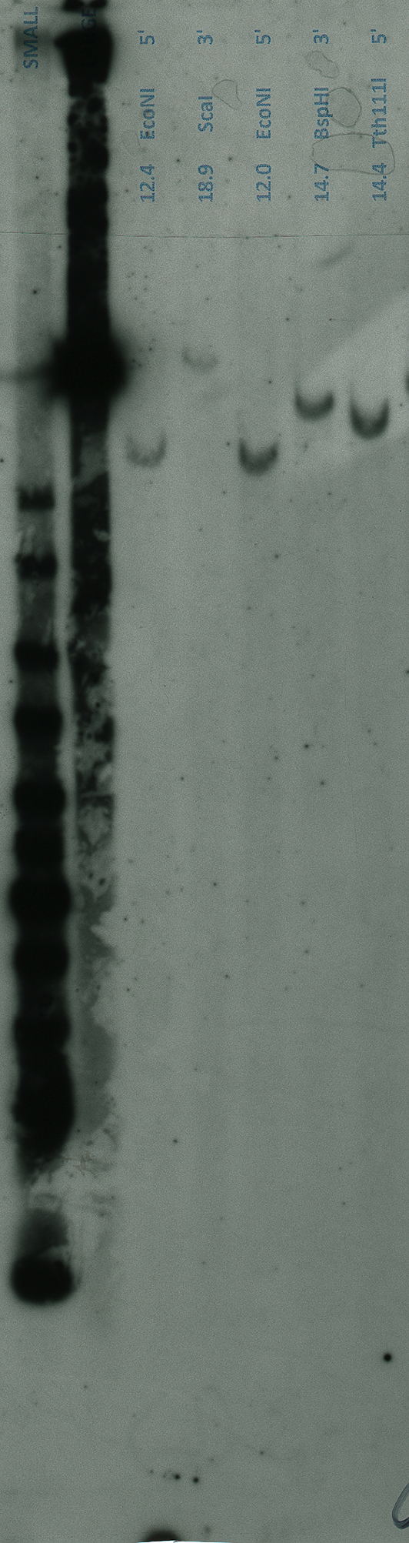
Supplemental Figure S3
LacZ probed membrane
Neo probed membranes
Nras tm1a (C04)
Nras tm1a (C04)
Nras tm1a (B03)
5’ EcoNI 12.0
3’ BspHI 14.7
5’ BstEII 15.8
3’ SexAI 12.1
5’ BstEII 15.8
3’ SexAI 12.1
Homology Arm | Enzyme (expected size Kb) | Clone
 |  | Nras (C04) | Nras (B03)
5’ | BstEII (15.8) | Correct | Fail: Double bands
 | EcoNI (12.0) | Correct | N/A
3’ | SexAI (12.1) | Correct | Fail: Double bands
 | BspHI (14.7) | Correct | N/A
FINAL RESULT |  | PASS | FAIL (Double Integrant)
S L
S L
S L
17 kb
17 kb
17 kb
10 kb
10 kb
8 kb
8 kb
10 kb
6 kb
8 kb
4 kb
6 kb
6 kb
4 kb
4 kb
Key: Pass; Fail - Multiple integration; S Small ladder; L Large ladder, Above the lanes, the arm interrogated, enzymes used and expected size for the digest in event of correct targeting are indicated underneath the clone IDs.

