Slide 1
Annals of Botany Supplementary data
Article title: Photosynthesis and leaf structure of F₁ hybrids between Cymbidium ensifolium (C₃) and C. bicolor subsp. pubescens (CAM)
Authors: Yoko Yamaga-Hatakeyama, Masamitsu Okutani, Yuto Hatakeyama, Takayuki Yabiku, Tomohisa Yukawa, and Osamu Ueno

Slide 2
Table S1. ΔMalate, ∂¹³C values, and structural traits in leaves of F₁ hybrids between Cymbidium ensifolium and C. bicolor subsp. pubescens
F₁ hybrids | ΔMalate |  |  | ∂¹³C |  |  | Leaf thickness |  |  | FW/DW ratio |  |  | Stomatal density |  |  | Guard cell length
 | (µmol g FW⁻¹) |  |  | (‰) |  |  | (mm) |  |  |  |  |  | (no. mm⁻²) |  |  | (µm)
Hybrid 1 | 5.7 | ± | 1.5 |  | -24.1 |  | 0.50 | ± | 0.05 | 7.27 | ± | 0.56 | 87.7 | ± | 6.4 | 24.6 | ± | 1.0
Hybrid 2 | 5.7 | ± | 0.8 |  | -27.1 |  | 0.47 | ± | 0.03 | 5.36 | ± | 0.43 | 82.6 | ± | 14.3 | 23.8 | ± | 1.5
Hybrid 3 | 15.3 | ± | 3.0 |  | -23.0 |  | 0.74 | ± | 0.04 | 6.93 | ± | 1.07 | 65.3 | ± | 8.7 | 22.1 | ± | 1.8
Hybrid 4 | 4.6 | ± | 2.0 |  | -25.4 |  | 0.43 | ± | 0.03 | 6.67 | ± | 0.71 | 83.7 | ± | 2.5 | 24.9 | ± | 1.2
Hybrid 5 | 7.3 | ± | 1.3 |  | -26.6 |  | 0.52 | ± | 0.03 | 6.35 | ± | 0.65 | 79.6 | ± | 8.4 | 22.0 | ± | 0.7
Hybrid 6 | 7.8 | ± | 5.3 |  | -27.2 |  | 0.43 | ± | 0.01 | 5.46 | ± | 1.59 | 87.7 | ± | 9.2 | 25.1 | ± | 2.4
Hybrid 7 | 9.1 | ± | 3.3 |  | -25.7 |  | 0.40 | ± | 0.02 | 6.10 | ± | 1.49 | 83.5 | ± | 2.0 | 25.3 | ± | 1.3
Values are means ± s.d. of 3 measurements except ∂¹³C.

Slide 3
Table S2. Structural traits of mesophyll cells and their chloroplasts in leaves of F₁ hybrids between Cymbidium ensifolium and C. bicolor subsp. pubescens
F₁ hybrids | M cell size |  |  | IAS |  |  | L_{mes}/area |  |  | Chloroplast size |  |  | Chloroplast area per M cell area (%) |  |  | Chloroplast coverage of M cell perimeter adjacent to IAS (%)
 | (µm²) |  |  | (%) |  |  | (µm⁻¹) |  |  | (µm)
Hybrid 1 | 1826 | ± | 48 | 7.3 | ± | 0.9 | 0.030 | ± | 0.001 | 26.5 | ± | 2.4 | 12.8 | ± | 1.0 | 77.5 | ± | 6.2
Hybrid 2 | 1755 | ± | 147 | 4.1 | ± | 1.3 | 0.024 | ± | 0.003 | 16.5 | ± | 1.7 | 6.7 | ± | 0.8 | 81.3 | ± | 0.5
Hybrid 3 | 2981 | ± | 729 | 6.1 | ± | 0.6 | 0.024 | ± | 0.002 | 28.0 | ± | 5.5 | 10.4 | ± | 1.0 | 75.9 | ± | 3.4
Hybrid 4 | 1410 | ± | 300 | 3.8 | ± | 1.4 | 0.030 | ± | 0.006 | 31.3 | ± | 1.4 | 16.1 | ± | 1.7 | 78.5 | ± | 4.4
Hybrid 5 | 1722 | ± | 509 | 5.0 | ± | 0.8 | 0.028 | ± | 0.004 | 19.6 | ± | 7.4 | 9.7 | ± | 0.8 | 72.2 | ± | 8.3
Hybrid 6 | 1538 | ± | 189 | 6.8 | ± | 0.3 | 0.034 | ± | 0.003 | 33.0 | ± | 7.5 | 17.0 | ± | 2.5 | 83.1 | ± | 3.7
Hybrid 7 | 2470 | ± | 133 | 6.2 | ± | 1.4 | 0.027 | ± | 0.004 | 29.7 | ± | 1.4 | 10.0 | ± | 0.5 | 79.0 | ± | 2.7
Values are means ± s.d. of 3 measurements.
M, mesophyll; IAS, intercellular air space.

Slide 4
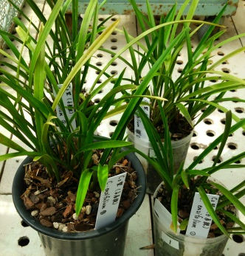
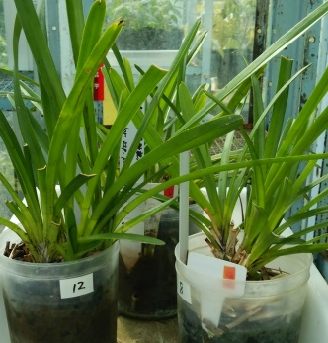
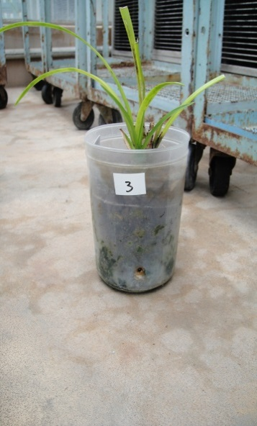
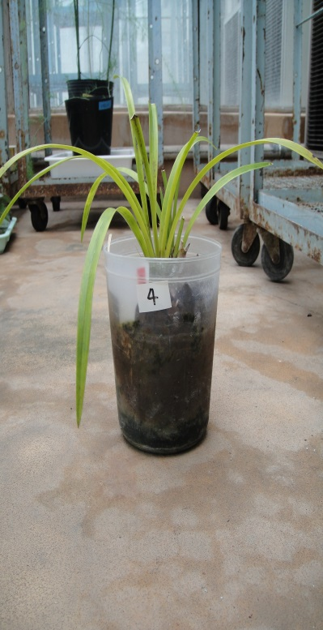
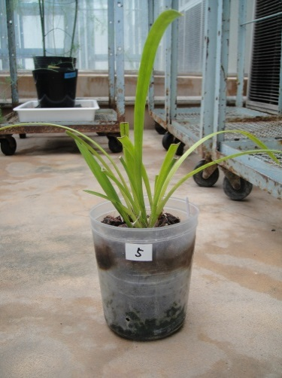
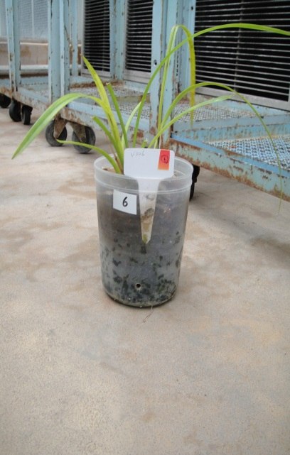
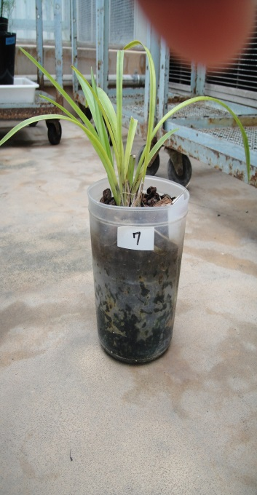
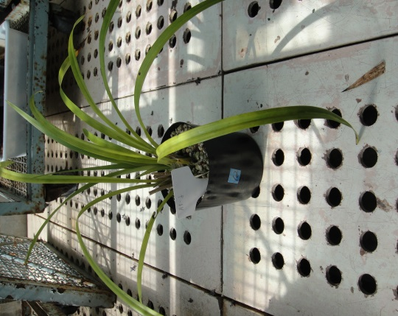
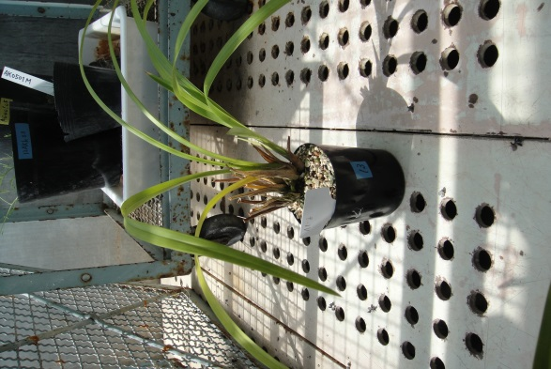
×
C. ensifolium (♂︎)
C. bicolor subsp. pubescens (♁)
Hybrid 1
Hybrid 2
Hybrid 3
Hybrid 4
Hybrid 5
Hybrid 6
Hybrid 7
Figure S1 Gross morphology of Cymbidium ensifolium (female C₃),
C. bicolor subsp. pubescens (male CAM) and their F₁ hybrids

Slide 5
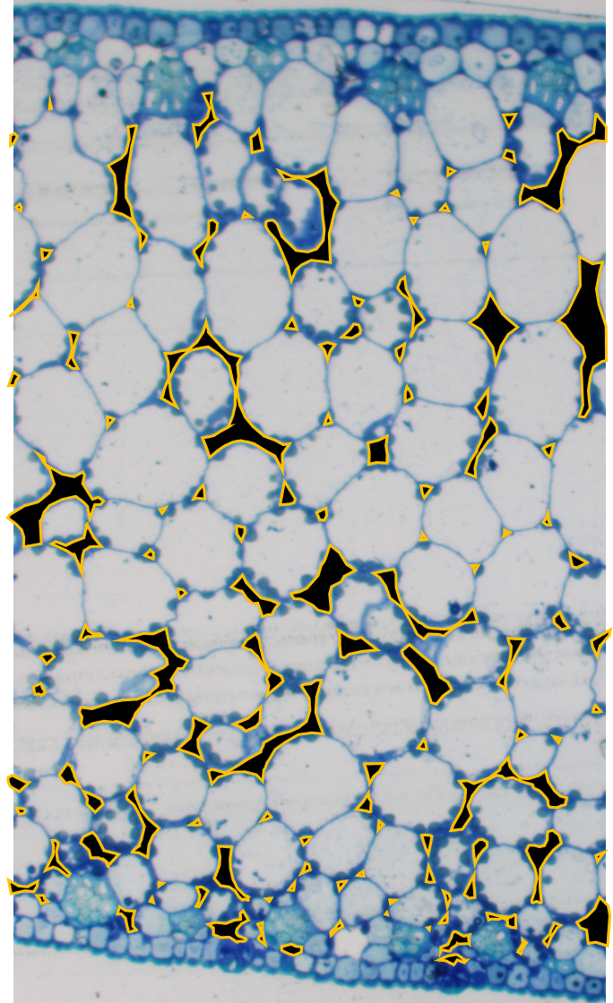
Intercellular air space (IAS)
Length of mesophyll surface exposed to IAS (L_{mes})
Mesophyll cell size = (total cross-sectional area of photosynthetic tissue – total IAS area) / number of cells
IAS (%) = total IAS area / total cross-sectional area of photosynthetic tissue X 100
L_{mes}/area = L_{mes} /total cross-sectional area of photosynthetic tissue
Figure S2 Structural traits of mesophyll cells in leaves
examined in this study

Slide 6
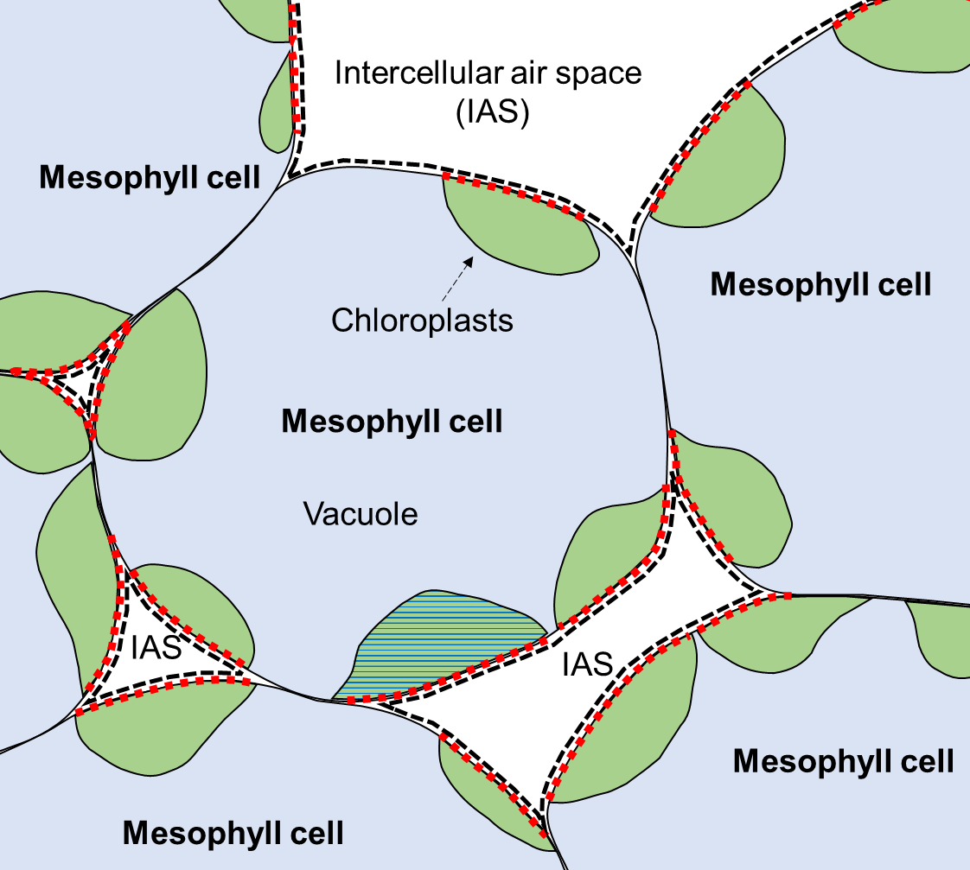

Chloroplast size
Length of chloroplast coverage
adjacent to IAS
Length of cell wall adjacent to IAS
Chloroplast coverage of mesophyll cell
perimeter adjacent to IAS (%) =
length of chloroplast coverage adjacent to IAS / length of cell wall adjacent to IAS X 100
Figure S3 Structural traits of mesophyll
chloroplasts examined in this study

Slide 7
A
C. ensifolium
B
F₁ hybrids
C
C. bicolor
Malate content
(μmol g⁻¹ FW)
5:00
11:00
17:00
23:00
D
F₁ hybrid 1-5
Malate content
(μmol g⁻¹ FW)
Hybrid 1
Hybrid 2
Hybrid 3
Hybrid 4
Hybrid 5
Figure S4 Day/night change of malate contents in leaves of Cymbidium ensifolium, F₁ hybrids, and C. bicolor subsp. pubescens. (A) C. ensifolium. (B) F₁ hybrids (mean of hybrids 1-5). (C) C. bicolor subsp. pubescens. (D) Individual F₁ hybrids.
Mean ± s.d. of 3–5 plants for (A), (B), and (C). Mean ± s.d. of 3 measurements for (D).
This experiment was preliminarily performed in 2014 using the same plants in 2015, except that the hybrids 6, 7, and 8 were not examined. The growth conditions were the same to those in the 2015 experiment.

