Slide 1
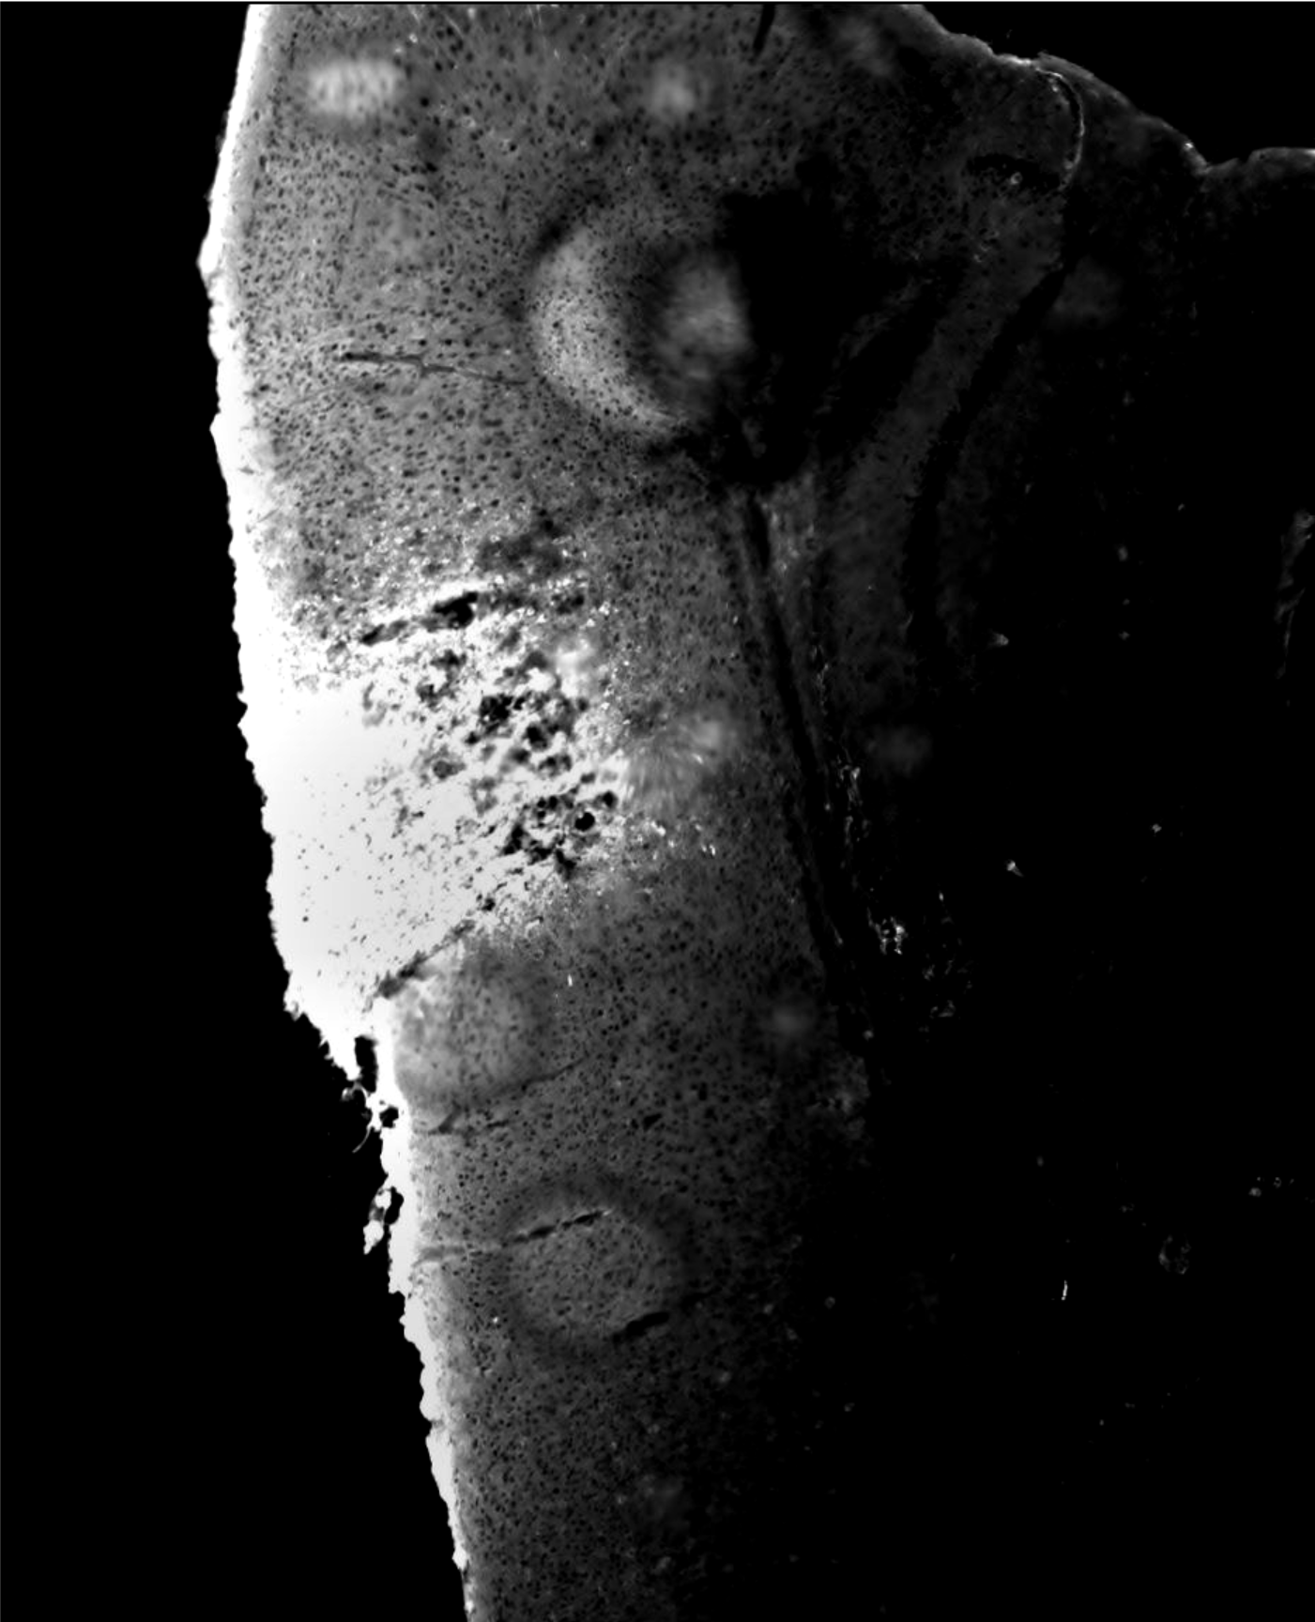
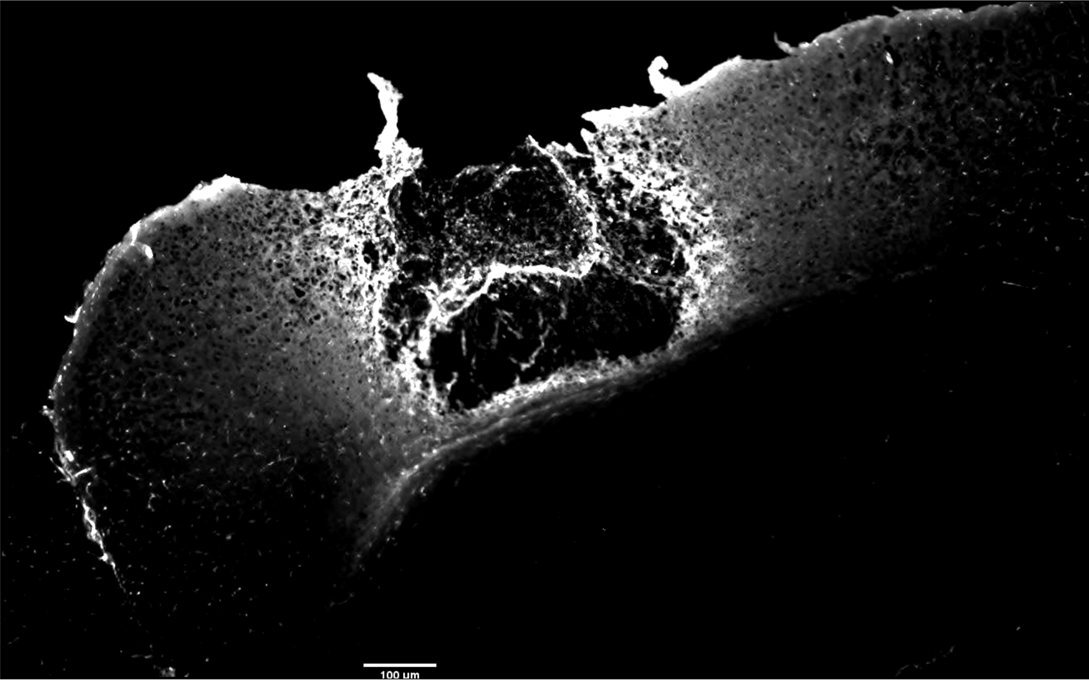
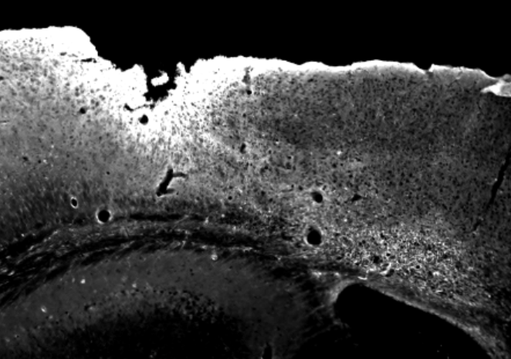
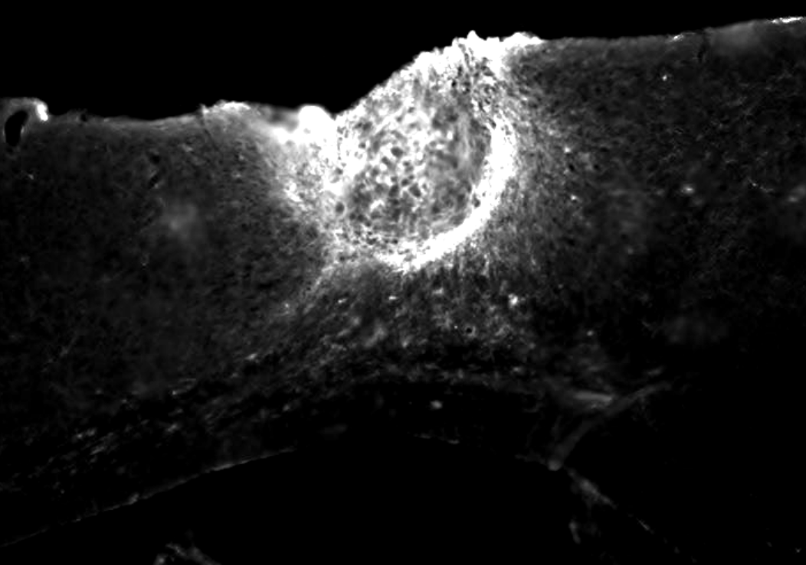
1 day after CHI
3 days after CHI
100 µm
7 days after CHI
15 days after CHI
Supplementary figure S3: Immunoglobulin G immunohistochemistry shows the presence and evolution of the blood-brain barrier breakdown at different timepoints after CHI.

