Slide 1
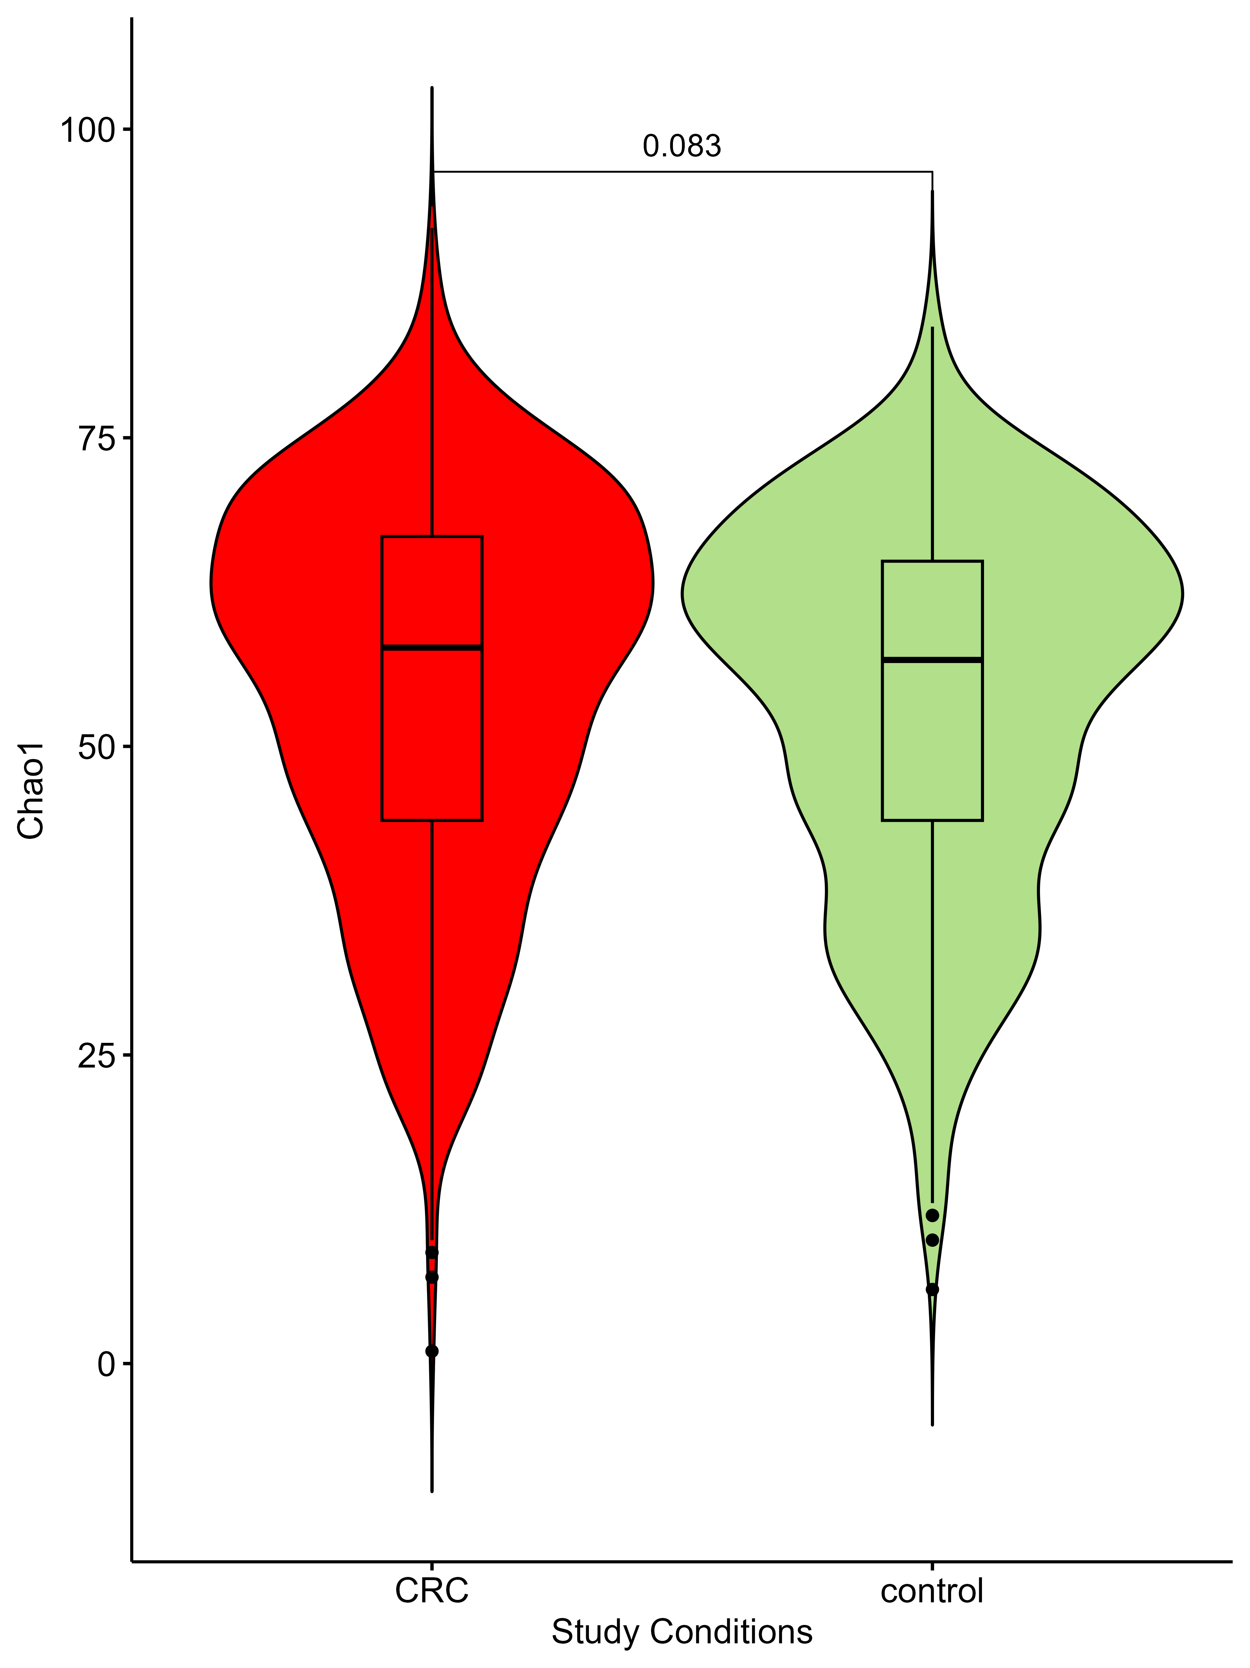
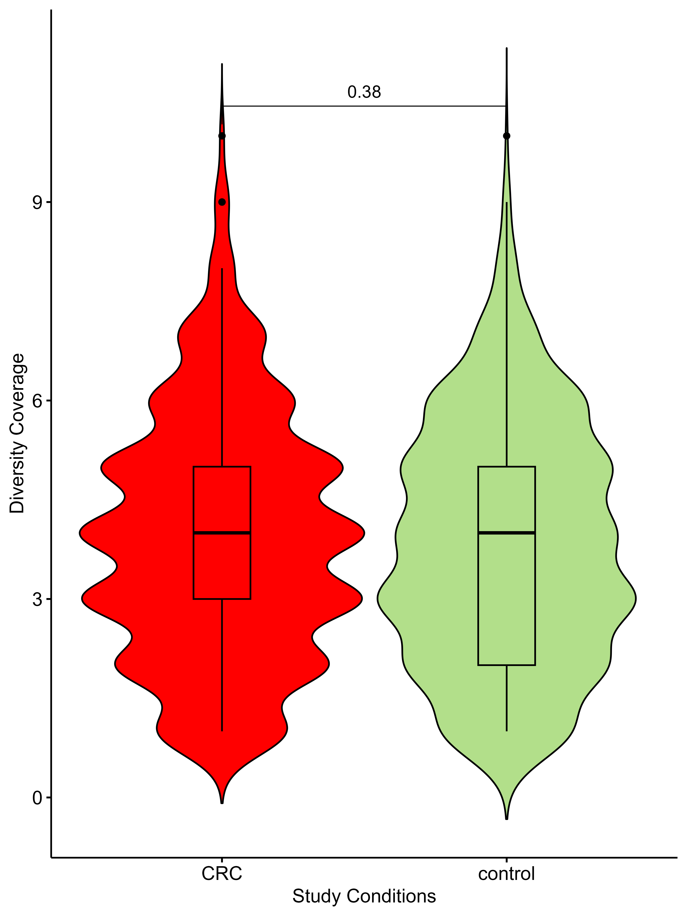
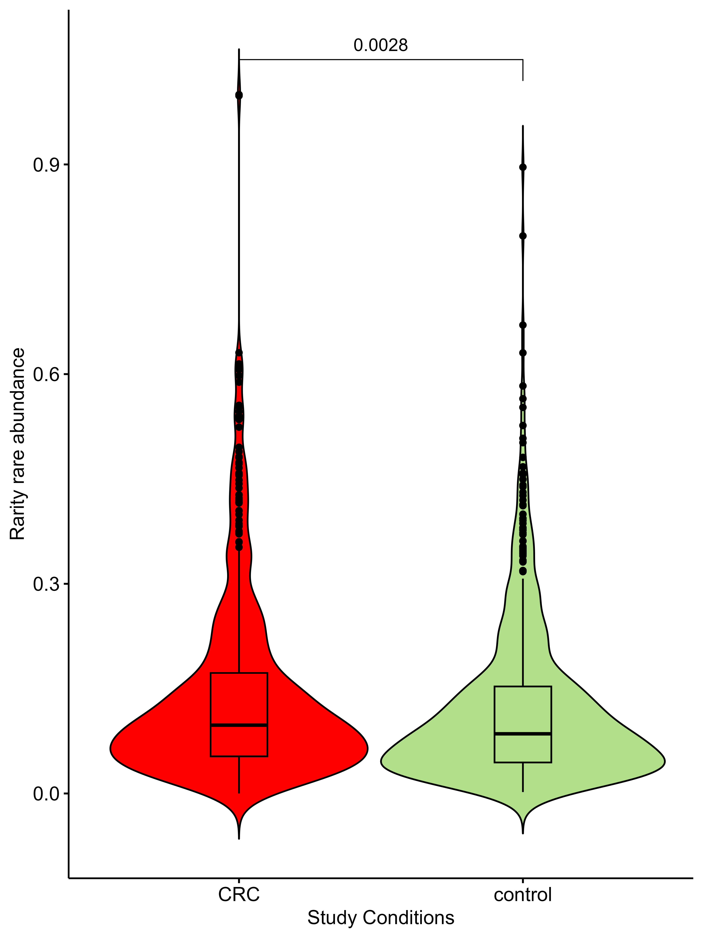
A)
B)
C)
Chaos1
Diversity Coverage
Rarity-rare abundance
Supplementary Figure 2. Alpha diversity metrices.
Plots showing analysis done using various alpha diversity metrices assessing richness (A)Chaos1, (B) Diversity Coverage, and (C) Rarity-rare abundance.

