Slide 1
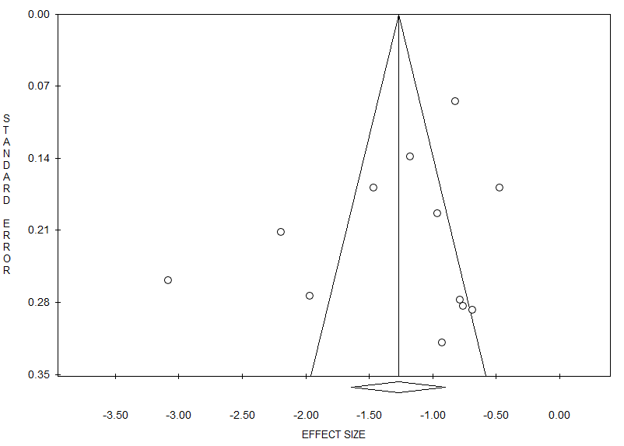
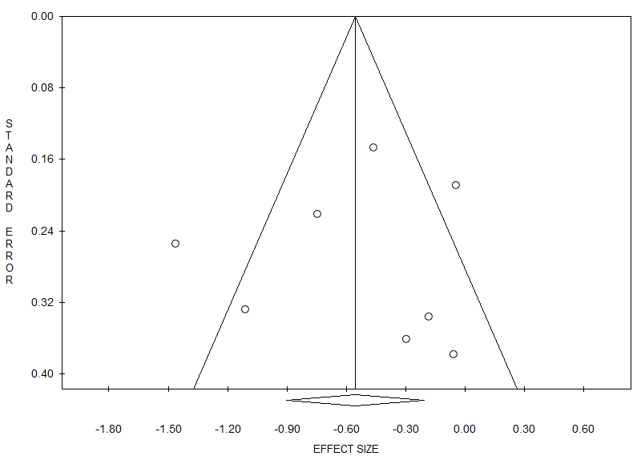
Symptom score
A
NRS
B
RCTs
Egger’s test, P=0.22
Egger’s test, P=0.77
FIGURE E1. Funnel plot showing symmetrical distribution of studies with IR-HDM SLIT-liquid indicating absence of publication bias in NRS (A) and RCTs (B).

