Slide 1
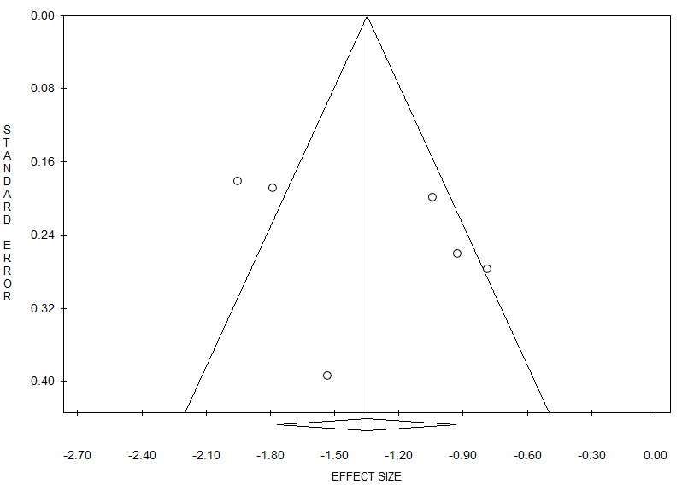
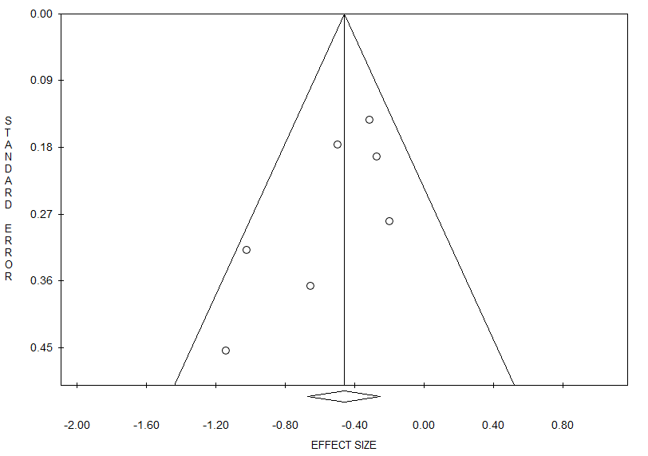
Medication score
NRS
RCTs
A
B
Egger’s test, P=0.35
Egger’s test, P=0.08
FIGURE E2. Funnel plot showing symmetrical distribution of studies with IR-HDM SLIT-liquid indicating absence of publication bias in NRS (A) and RCTs (B).

