Slide 1
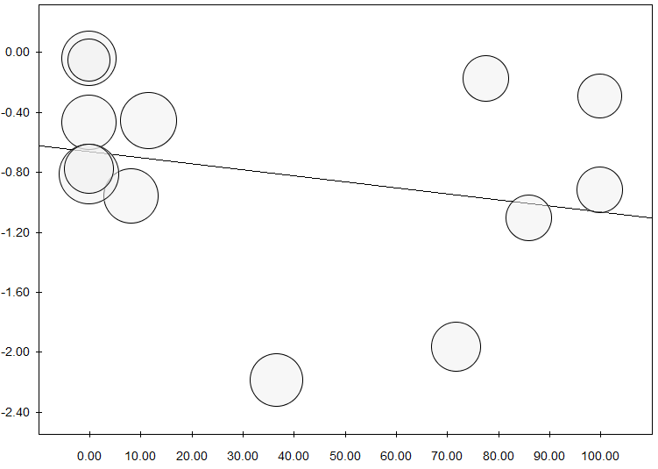
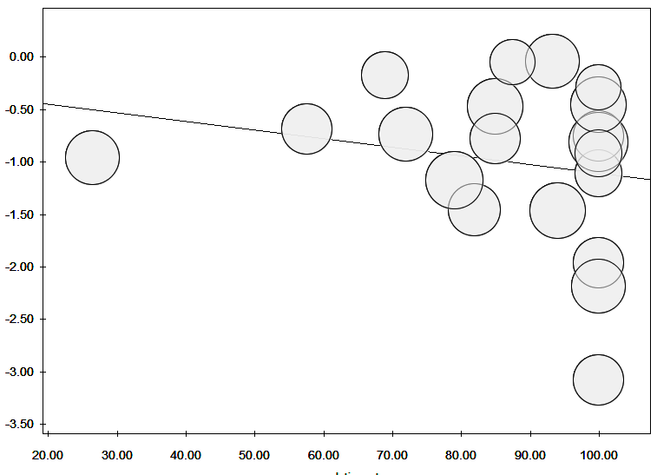
A
Asthma prevalence
B
Completion rate
SMD
SMD
P=n.s.
P=n.s.
Patients with asthma (%)
Patients who completed AIT (%)
FIGURE E3. Meta-regression analyses of symptom score for the efficacy of IR-HDM SLIT-liquid depending on the asthma prevalence (A) or completion rate (B). SMD, standardized mean difference.

