Slide 1
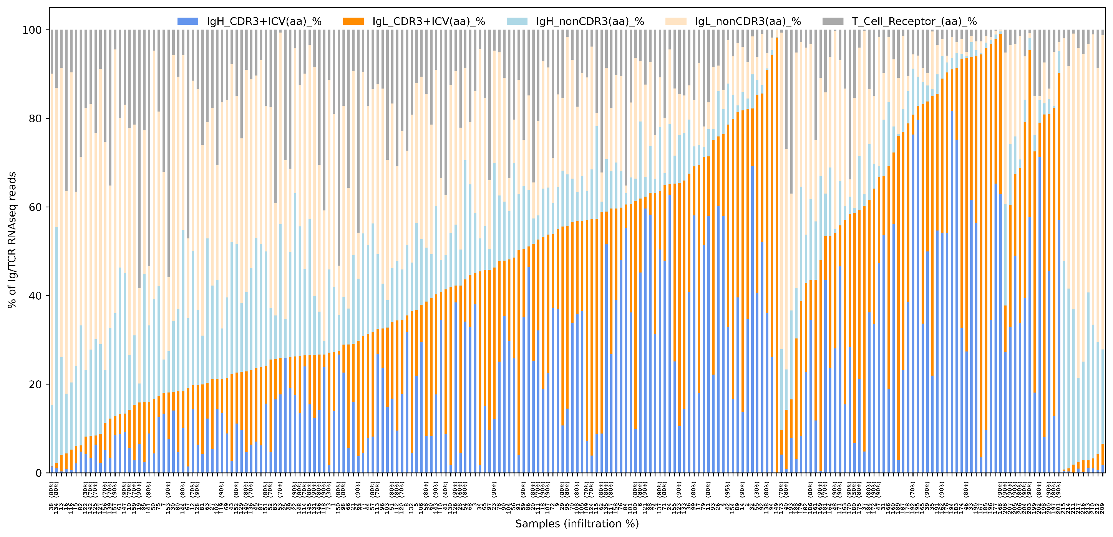
Follicular Lymphoma
DLBCL
MCL
SLL
Reac
Samples (Infiltration %)
Supplemental Figure 2

