Slide 1
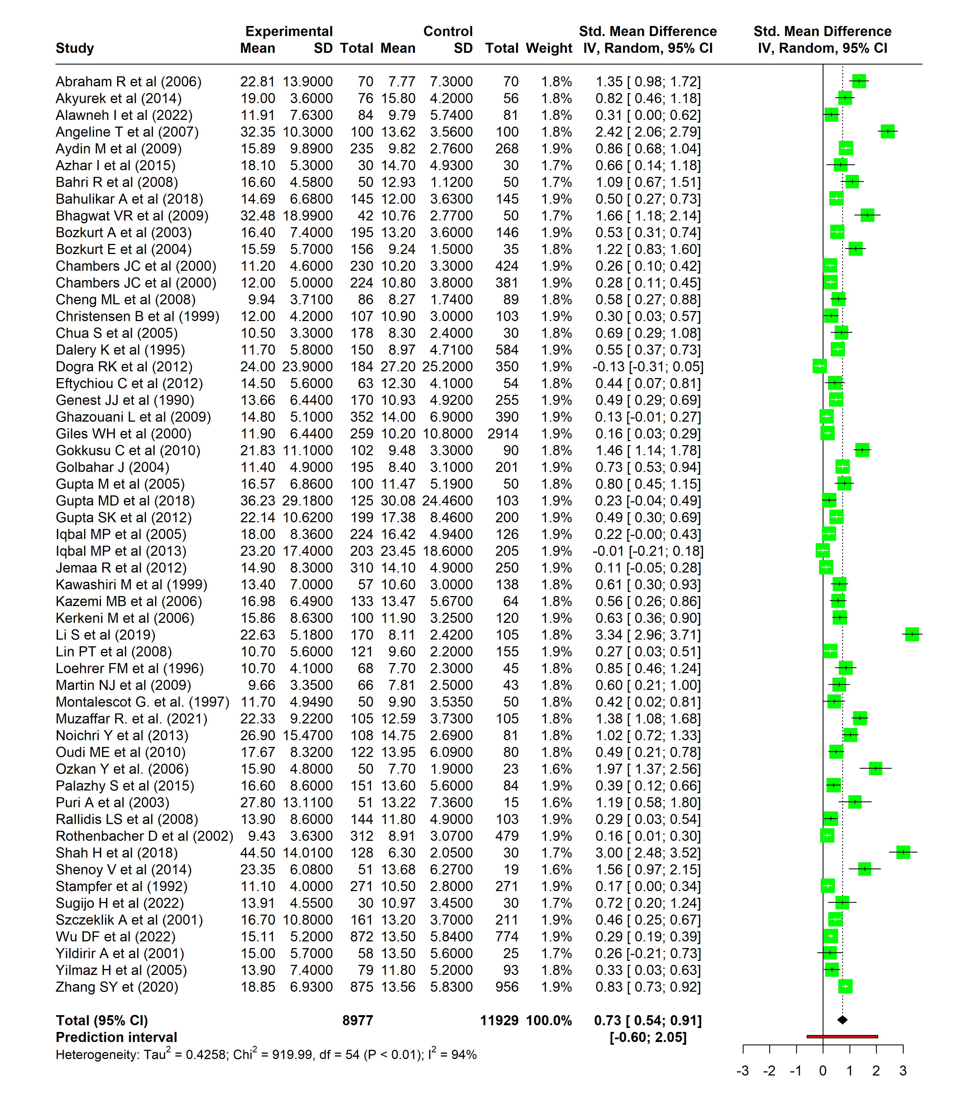
Figure S1: Forest plot showing the pooled estimates after removing poor quality studies

Slide 2
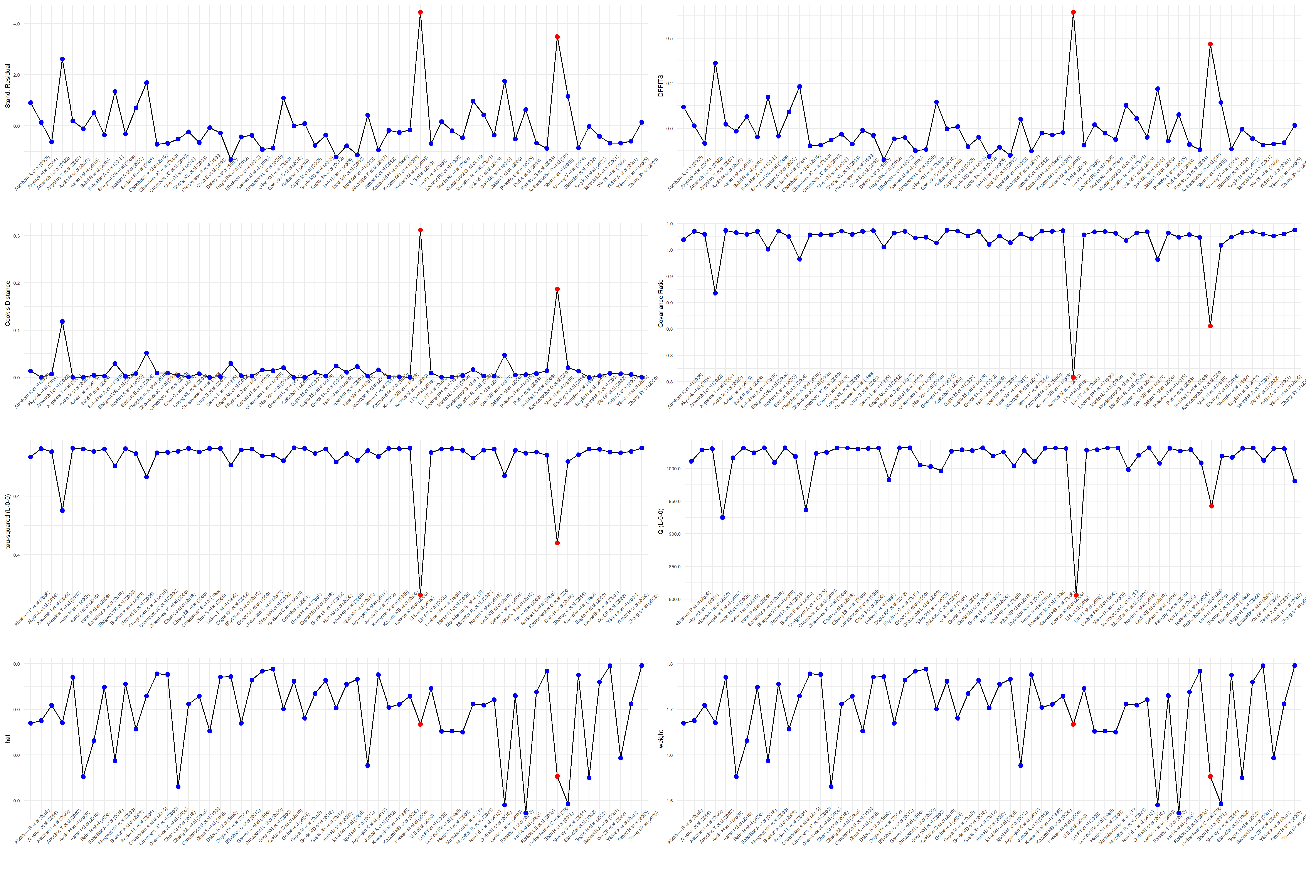
Figure S2: Influence diagnostics

Slide 3
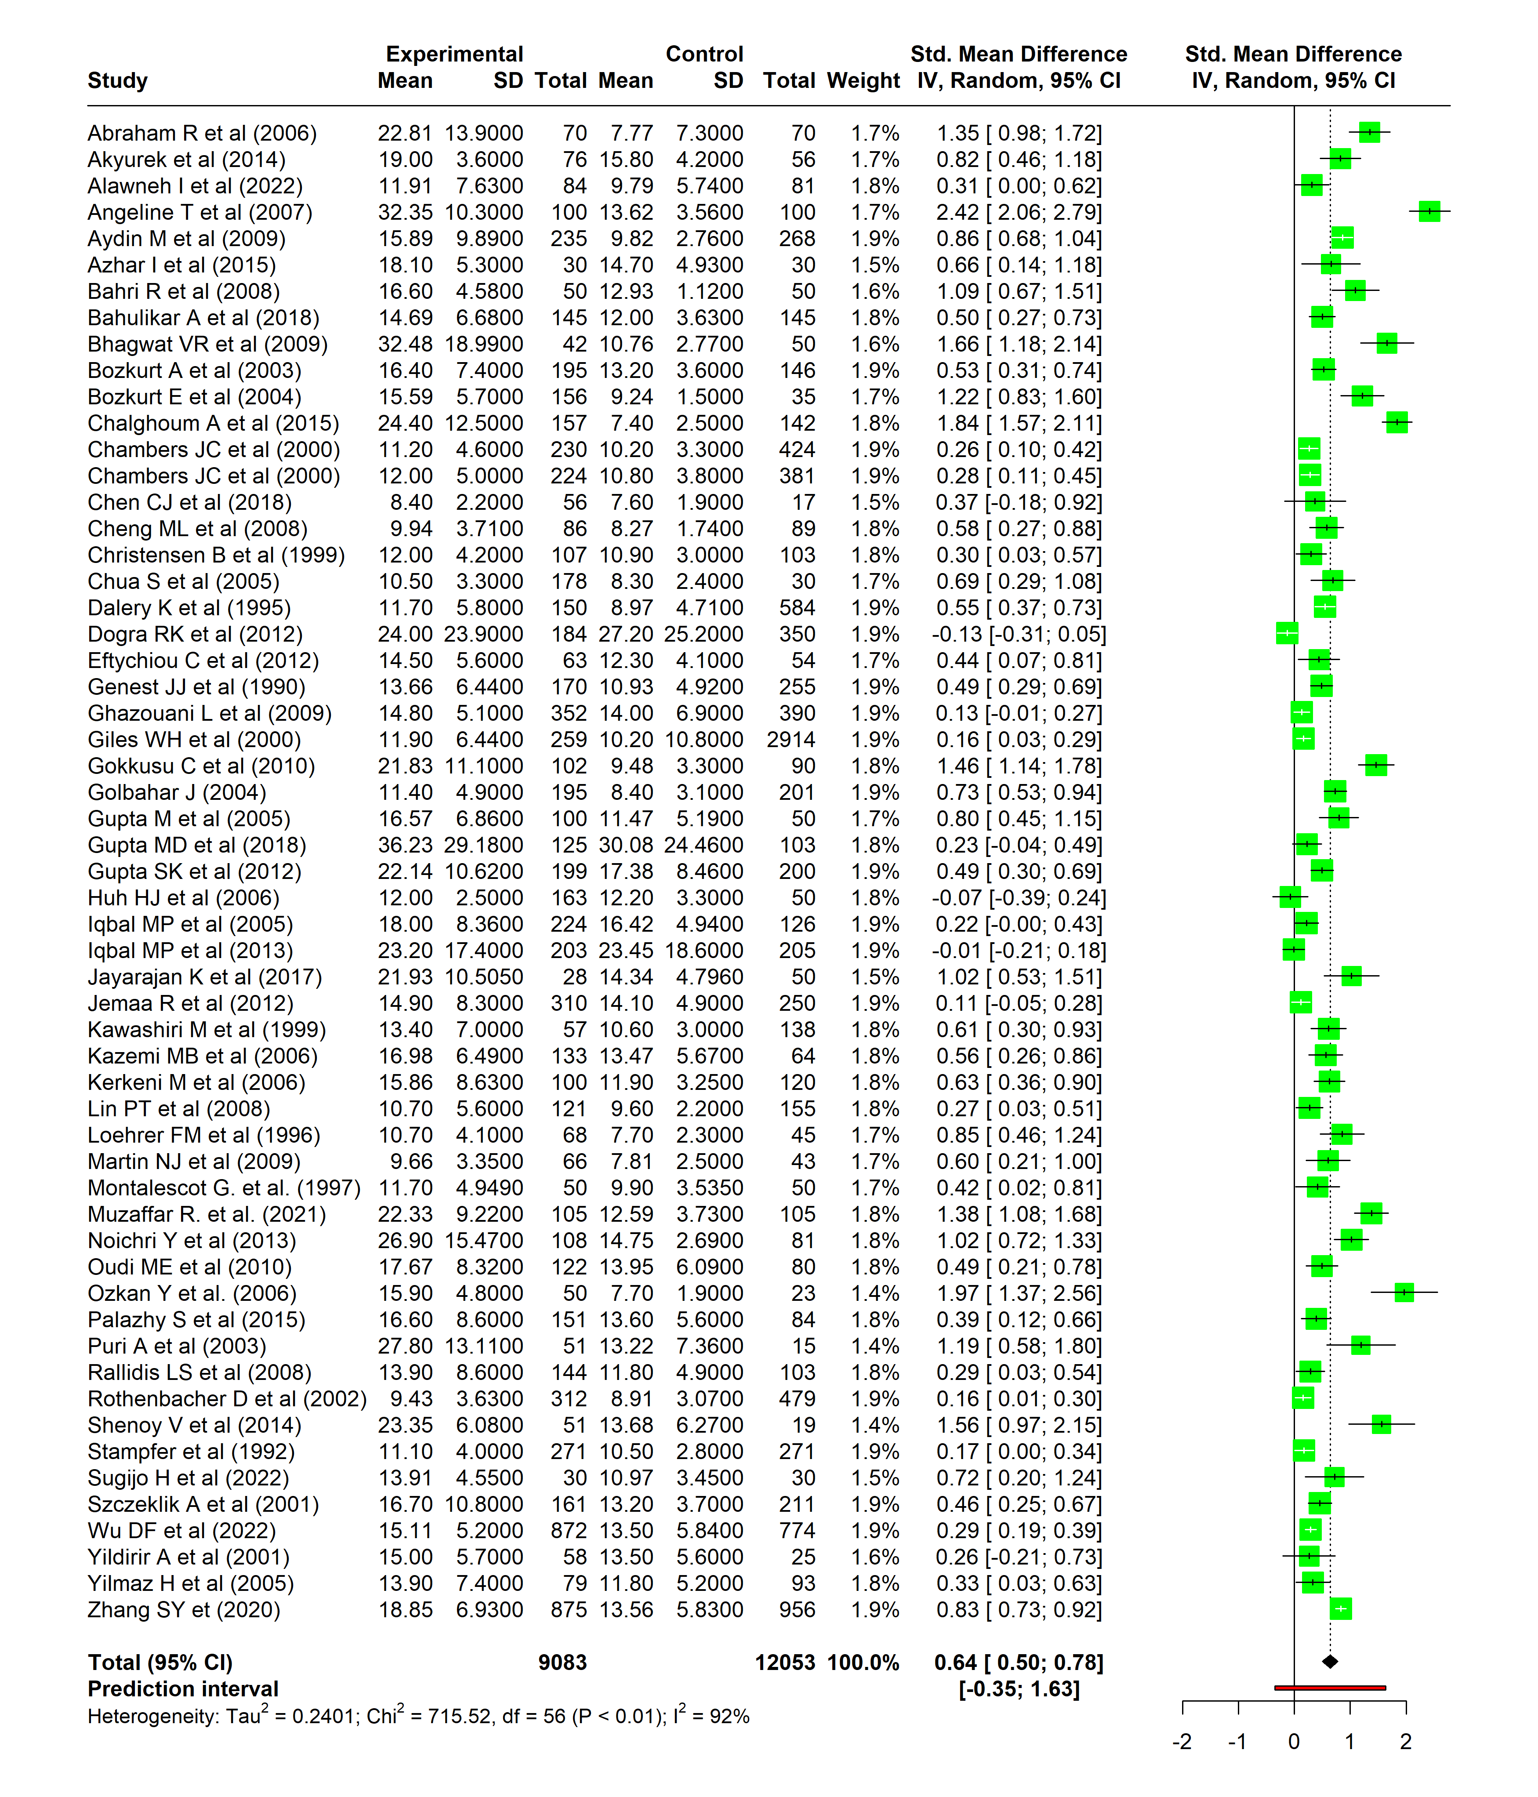
Figure S3: Forest plot showing the pooled estimates after removing two outlier studies

Slide 4
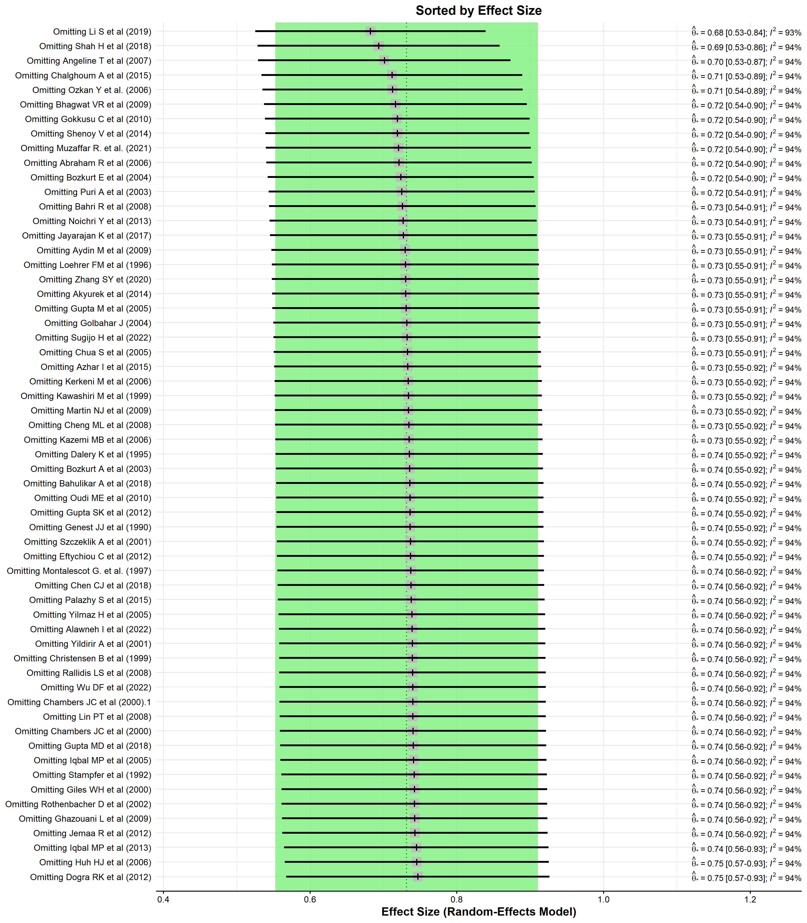
Figure S4: Leave one out analysis

