Slide 1
miR-184
Full membranes

Slide 2
WB for b-catenin in TPA-DMBA Tumors
Fig 5.A
KO WB II B-2
WT WB I B-1
KO WB II B-2
WT WB I B-1
Β-catenin
GAPDH
8% acrylamide Gel

Slide 3
WB for b-catenin in TPA-DMBA Tumors
Fig 5.A
8% acrylamide Gel

Slide 4
Fig 5.B
WB for skin SCC infected cell line
14.7.19
20.8.19
1.9.19
Control
AM
Control
AM
Control
AM
GFP
β- cat
GAPDH

Slide 5
Fig 5.B
WB for skin SCC infected cell line

Slide 6
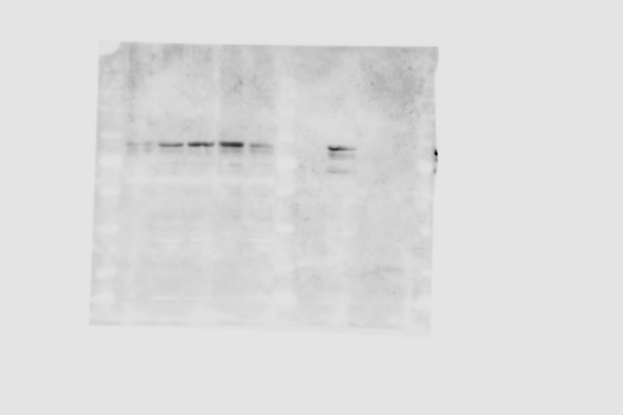
WB for NOD/SCID tumors
Fig 5.C
SCC Tumors
Ctrl NN
Ctrl
RN
AM
2RN
AM
RN
Ctrl cells
β- cat
GAPDH
8% gel

Slide 7
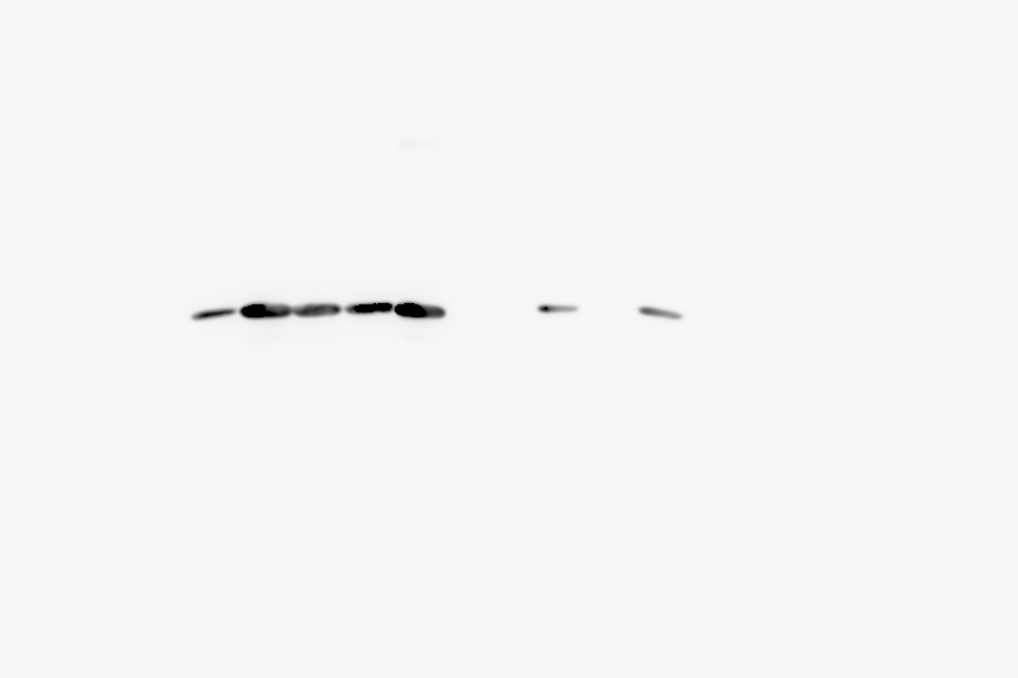
WB for NOD/SCID tumors
Fig 5.C

