Slide 1
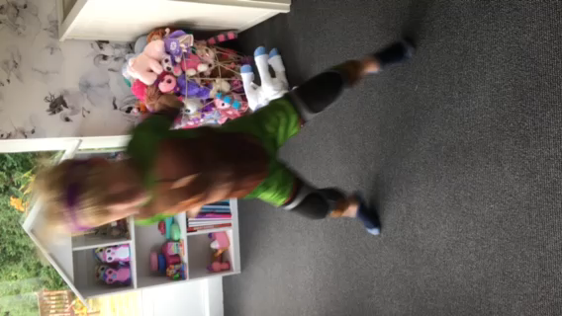
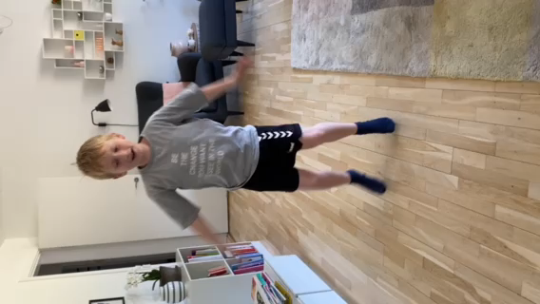
Suppplementary video 1 and 2. Showing gross motor skills in patient 2 harbouring the G239S variant in KCNQ2 at baseline (video 1) and after 3 months of amitriptyline treatment (video 2).
Video 1:
Video 2:

