Slide 1
Supplemental File 1:
Sensitivity Analyses
Forest and Funnel Plots

Slide 2
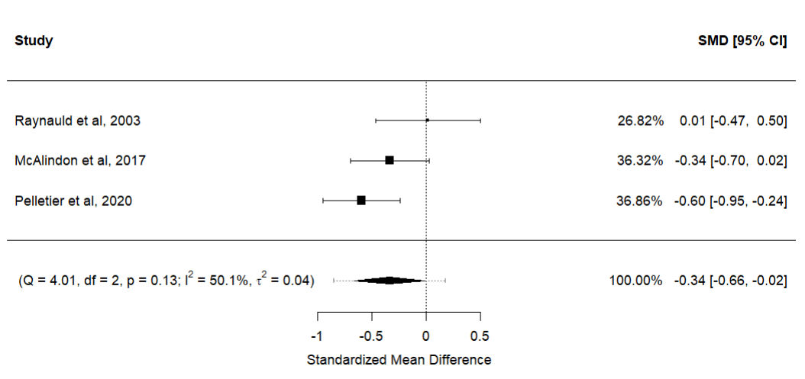
Synthesis of quantitative measures of JSW and cartilage volume change

Slide 3
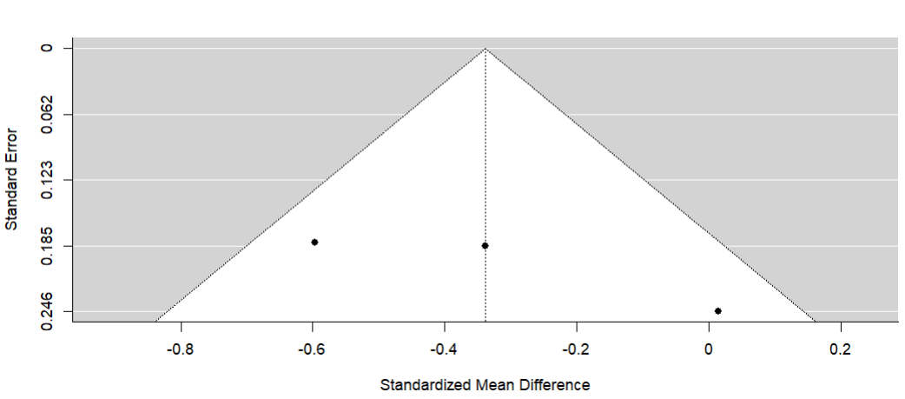
Synthesis of quantitative measures of JSW and cartilage volume change

Slide 4
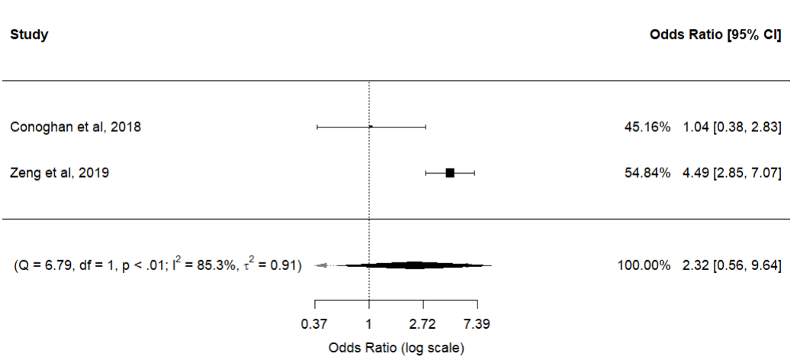
Synthesis of studies with binary outcomes – preference to JSW

Slide 5
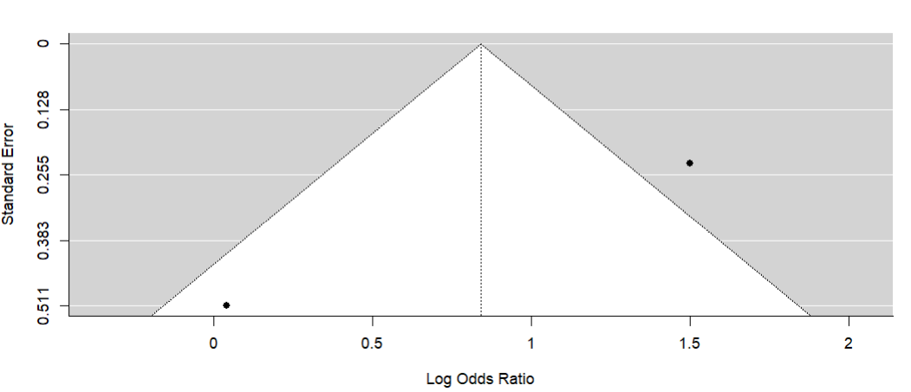
Synthesis of studies with binary outcomes – preference to JSW

Slide 6
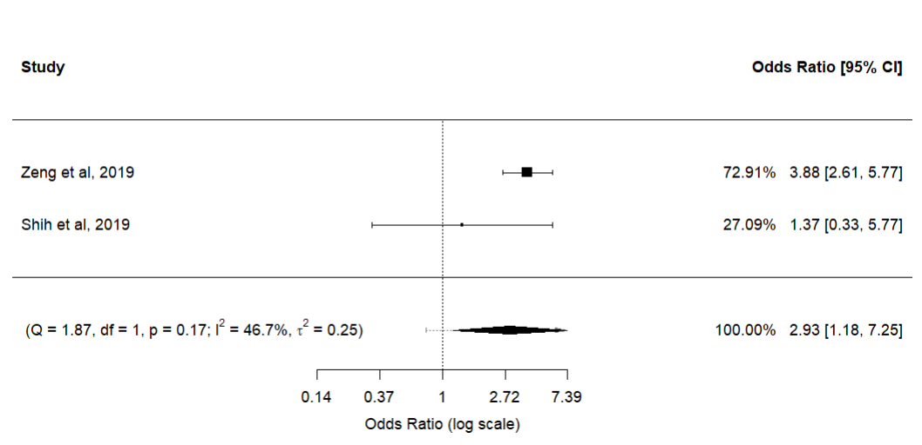
Synthesis of studies with binary outcomes – preference to KL grade

Slide 7
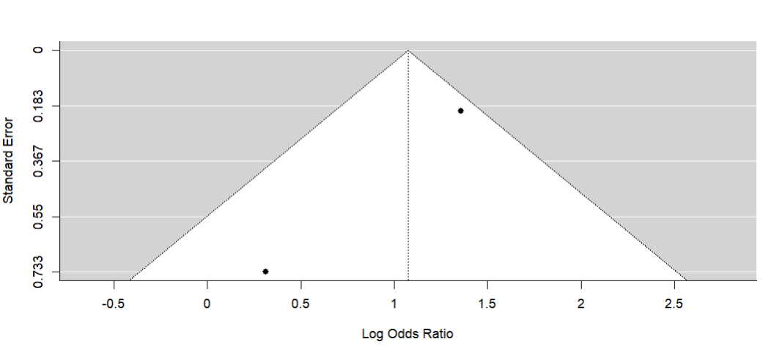
Synthesis of studies with binary outcomes – preference to KL grade

Slide 8
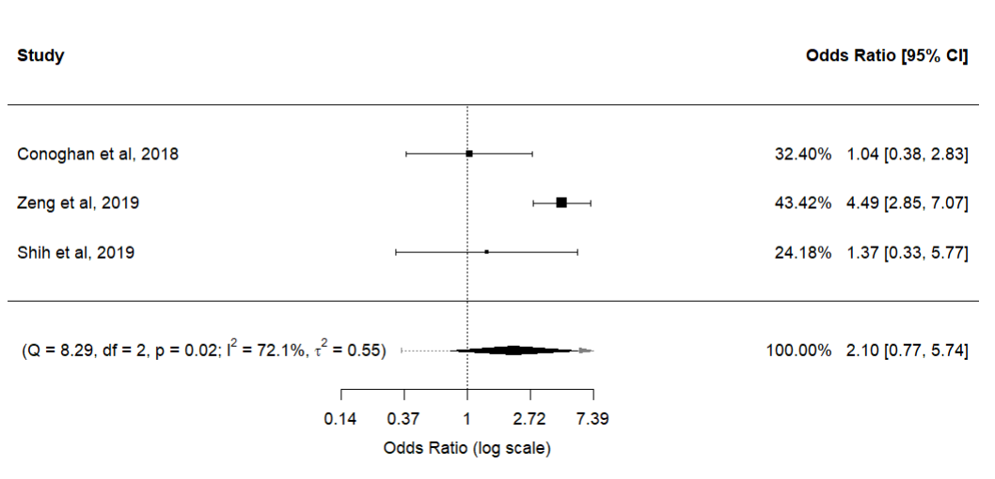
Synthesis of all studies with binary outcomes. if both reported, values for JSW used

Slide 9
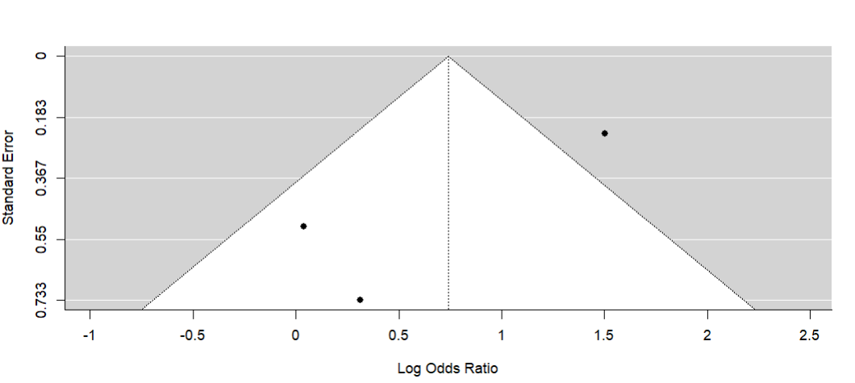
Synthesis of all studies with binary outcomes. if both reported, values for JSW used

Slide 10
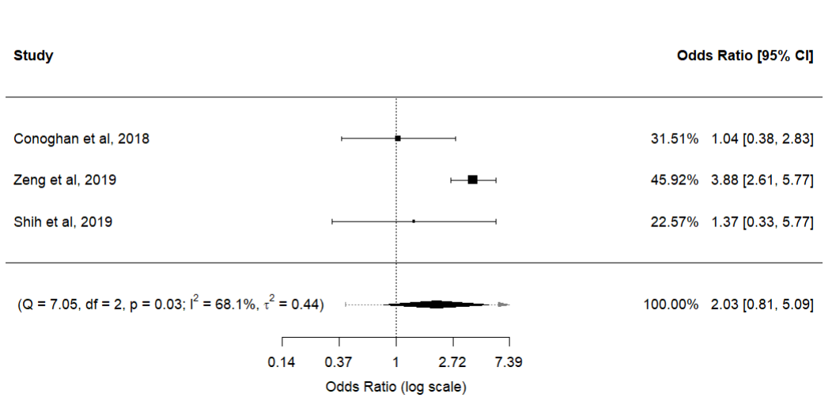
Synthesis of all studies with binary outcomes. If both reported, values for KLG used.

Slide 11
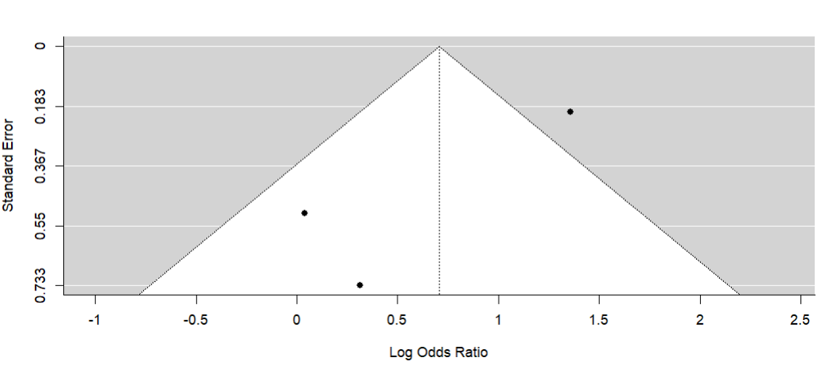
Synthesis of all studies with binary outcomes. If both reported, values for KLG used.

Slide 12
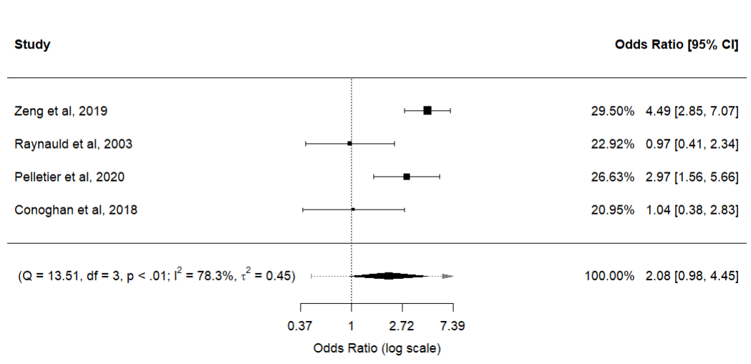
Synthesis of all studies that used radiography. If multiple measures reported, preference to JSW

Slide 13
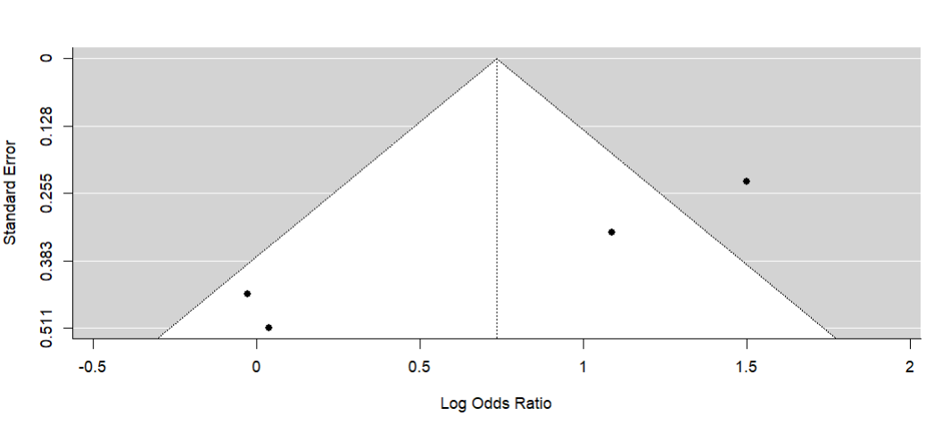
Synthesis of all studies that used radiography. If multiple measures reported, preference to JSW

Slide 14
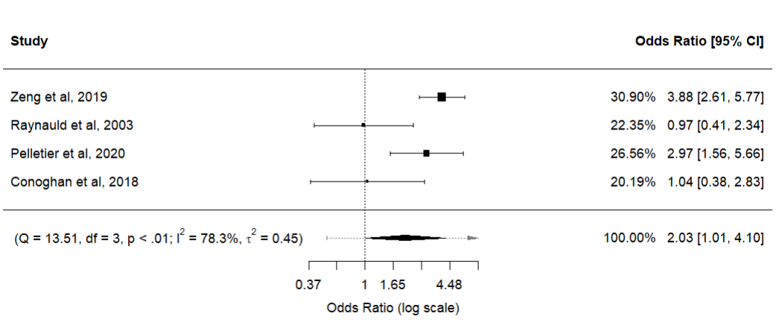
Synthesis of all studies that used radiography. If multiple measures reported, preference to KL grade

Slide 15
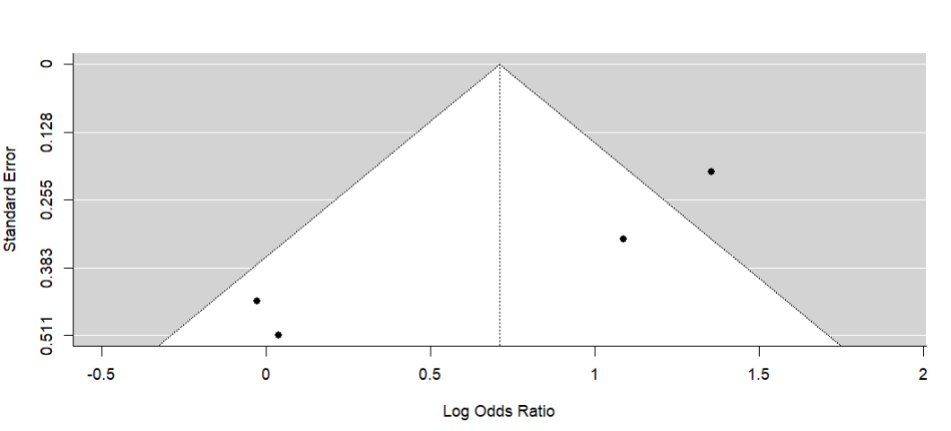
Synthesis of all studies that used radiography. If multiple measures reported, preference to KL grade

Slide 16
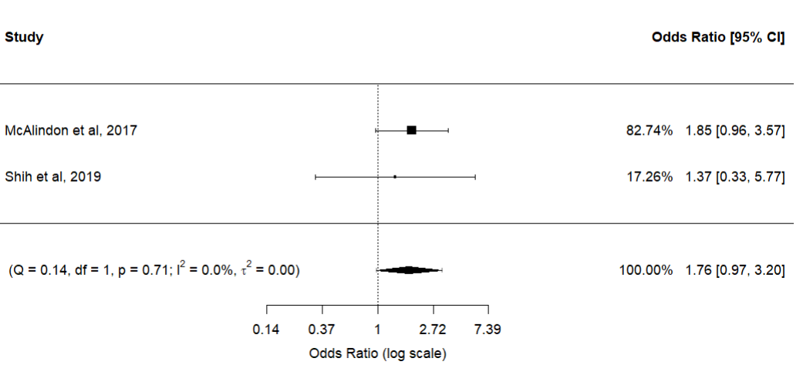
Synthesis of studies using MRI

Slide 17
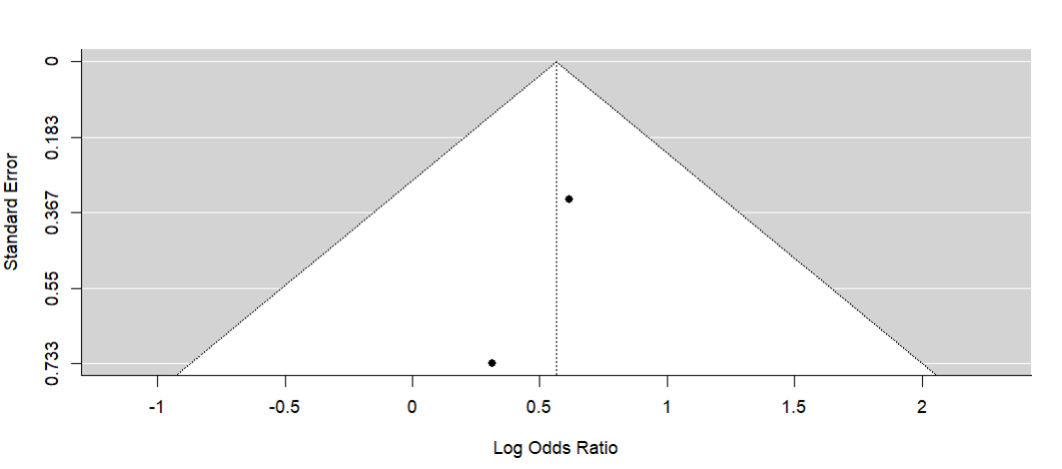
Synthesis of studies using MRI

Slide 18
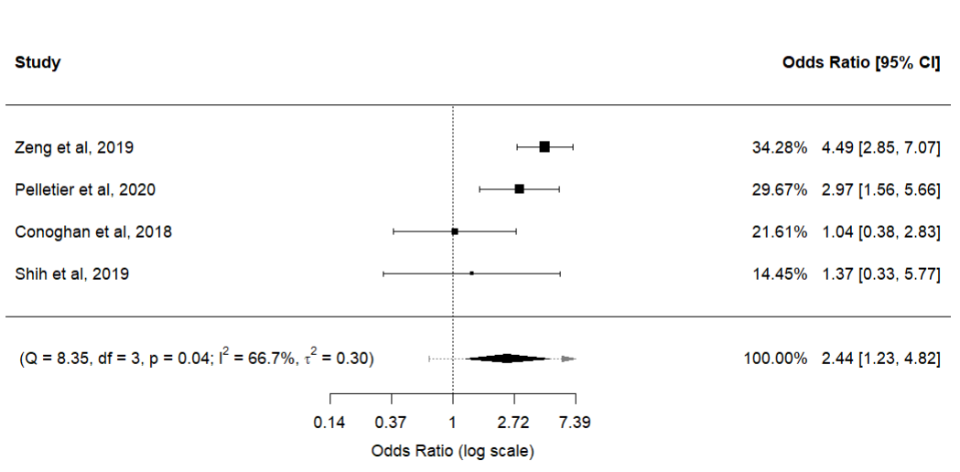
Synthesis of all studies using singular Injections. If multiple outcomes reported, preference to JSW

Slide 19
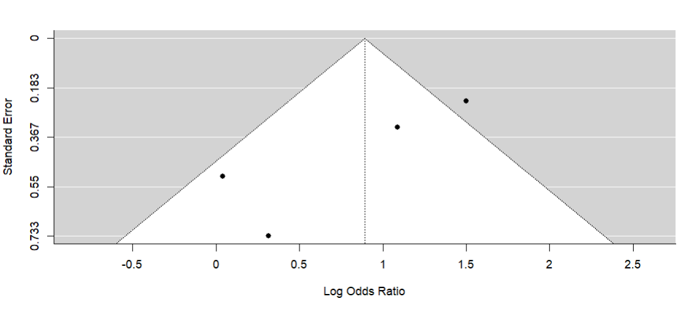
Synthesis of all studies using singular Injections. If multiple outcomes reported, preference to JSW

Slide 20
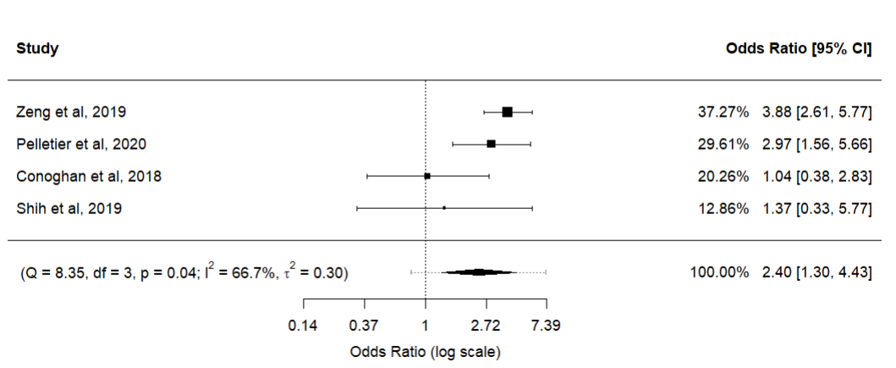
Synthesis of all studies using singular Injections. If multiple outcomes reported, preference to KL grade

Slide 21
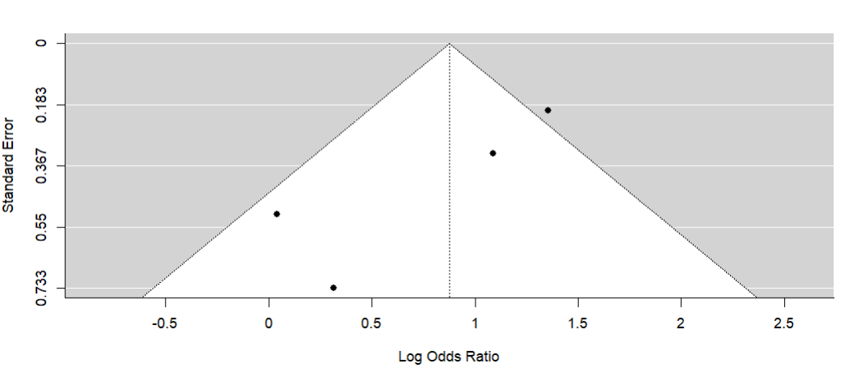
Synthesis of all studies using singular Injections. If multiple outcomes reported, preference to KL grade

Slide 22
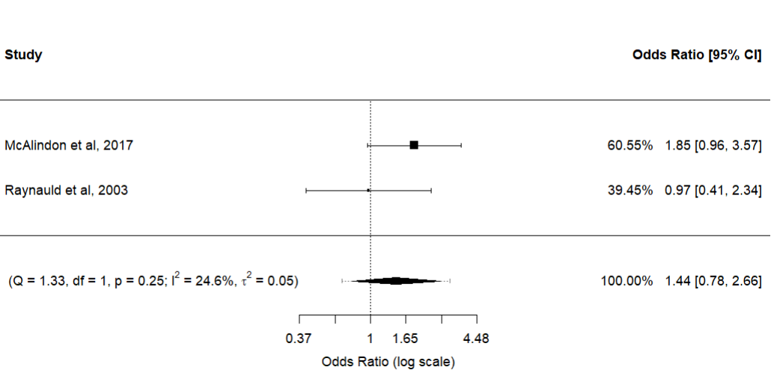
Synthesis of all studies using multiple Injections

Slide 23
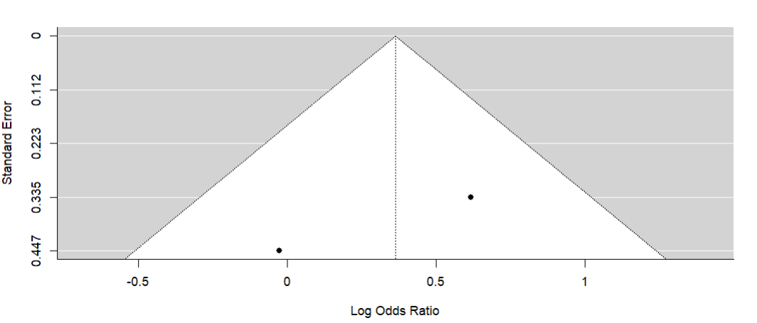
Synthesis of all studies using multiple Injections

Slide 24
