Slide 1
Supplementary Fig. 1 Flow chart of the study
Patients with PD-1 TPS ≥50% treated with
Pembrolizumab monotherapy (MONO) or ICI/Chemo (COMBO) (N = 446)
Excluded
Patients aged <70 years (N = 204)
Patients aged ≥70 years with PD-L1 TPS ≥50% treated with
MONO or COMBO (N = 242)
Excluded
Patients with PS 2–4 (N = 43)
Patients aged ≥70 years
with PD-L1 TPS ≥50% treated with MONO
(N = 131)
Patients aged ≥70 years with PD-L1 TPS ≥50% treated with COMBO
(N = 68)

Slide 2
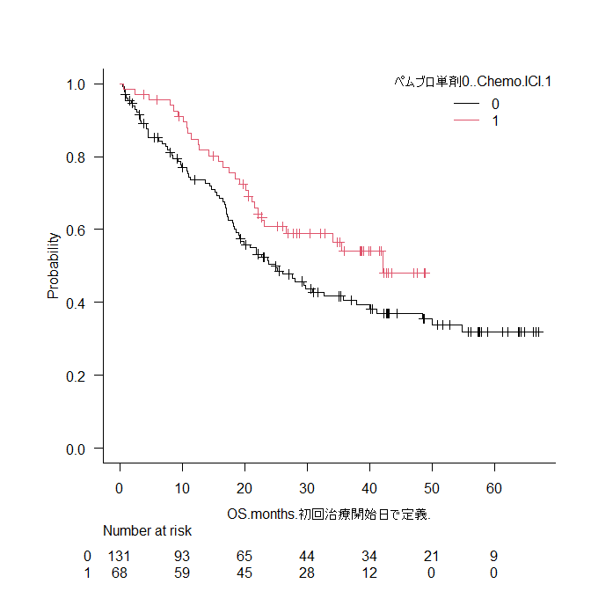
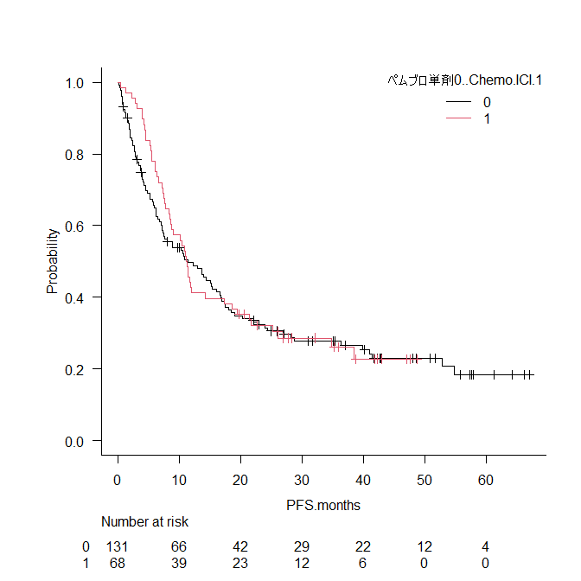
Supplementary Fig. 2 Kaplan–Meier curves for (A) OS and (B) PFS in patients aged ≥70 years with PD-L1 TPS ≥ 50% who received ICI monotherapy or combination therapy of ICI and chemotherapy (N = 199)
A
B
median OS 95% CI
── MONO 25.0 m 18.6–35.8
── COMBO 42.2 m 22.8–NA
P = 0.0502
median OS
----- MONO 25.0 (months)
----- COMBO 42.2 (
median PFS 95% CI
── MONO 11.5 m 7.2–16.1
── COMBO 11.2 m 8.5–17.3
P = 0.683
median PFS
----- MONO 11.5 (months)
----- COMBO 11.2
OS Probability
PFS Probability
OS (months)
PFS (months)
MONO
COMBO
MONO
COMBO
MONO
COMBO
MONO
COMBO

Slide 3
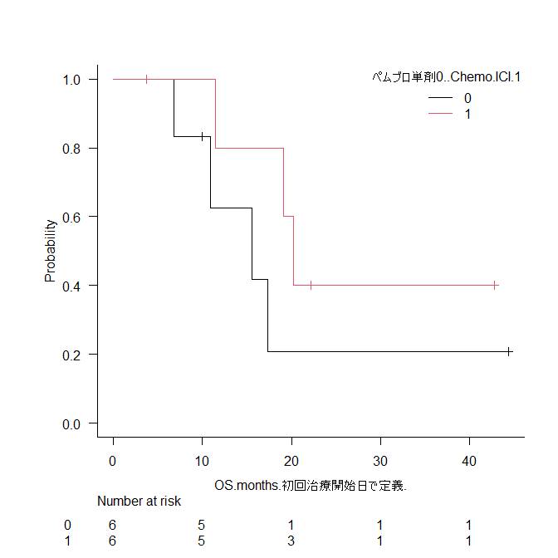
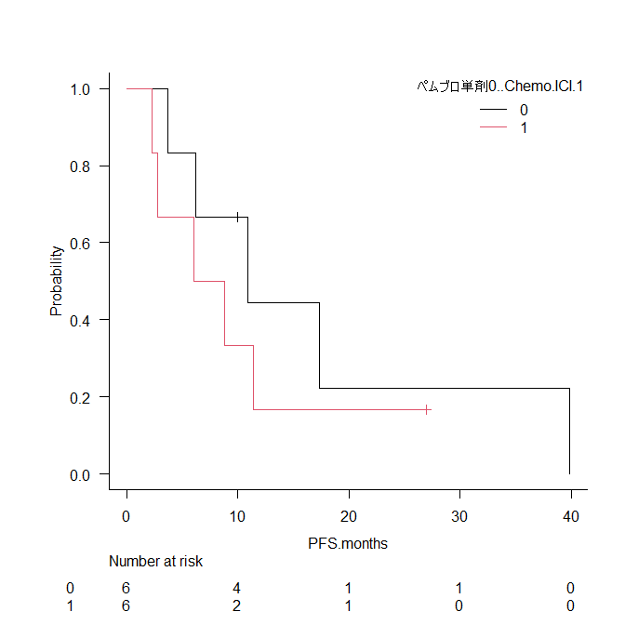
Supplementary Fig. 3 Kaplan–Meier curves for (A) OS and (B) PFS of patients aged ≥70 years without a smoking history with PD-L1 TPS ≥50% who received MONO or COMBO adjusted by PSM (N = 12)
A
B
median OS 95% CI
── MONO 15.6 m 6.9–NA
── COMBO 20.1 m 11.4–NA
P = 0.252
median PFS 95% CI
── MONO 10.9 m 3.7–NA
── COMBO 7.4 m 2.3–NA
P = 0.43
OS Probability
PFS Probability
OS (months)
PFS (months)
MONO
COMBO
MONO
COMBO

Slide 4
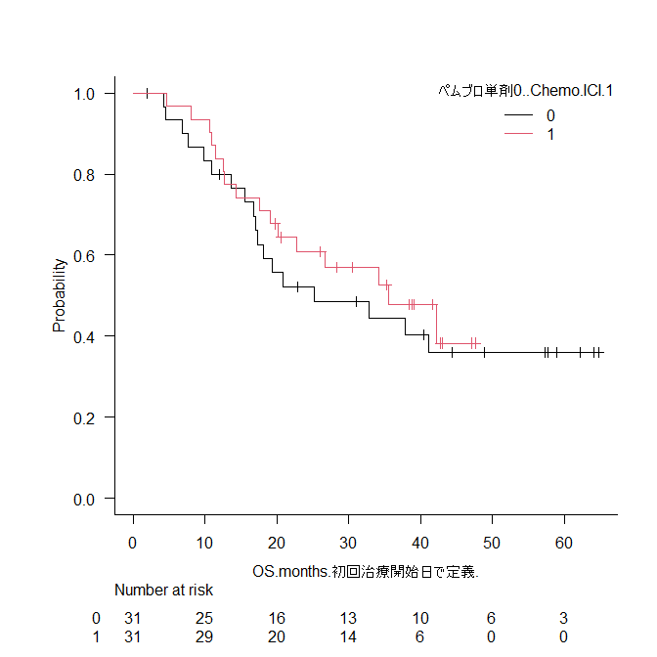
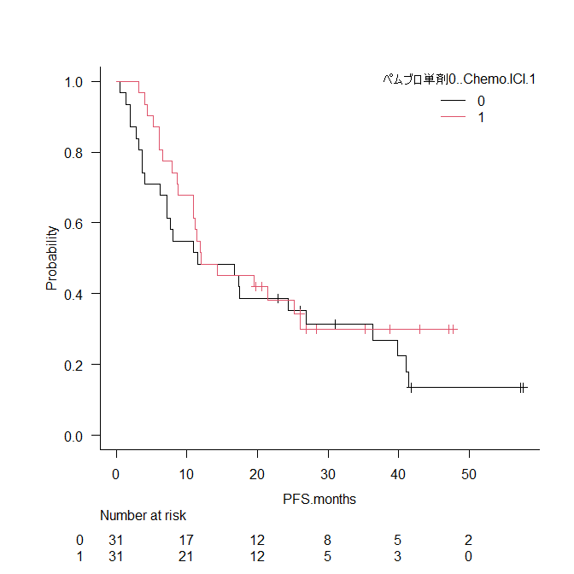
Supplementary Fig. 4 Kaplan–Meier curves for (A) OS and (B) PFS of ECOG PS 1 patients aged ≥70 years with PD-L1 TPS ≥ 50% who received ICI monotherapy or combination therapy of ICI and chemotherapy after PSM (N = 62)
A
B
median OS 95% CI
── MONO 25.5 m 16.7–NA
── COMBO 35.5 m 19.1–NA
P = 0.544
median PFS 95% CI
── MONO 11.5 m 6.2–27.0
── COMBO 12.0 m 8.8–26.1
P = 0.406
OS Probability
PFS Probability
OS (months)
PFS (months)
MONO
COMBO
MONO
COMBO

Slide 5
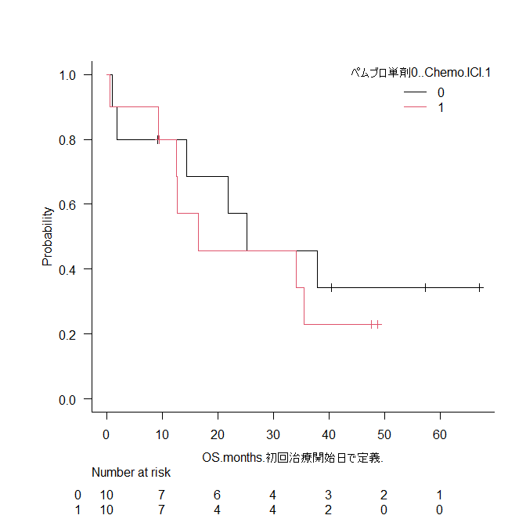
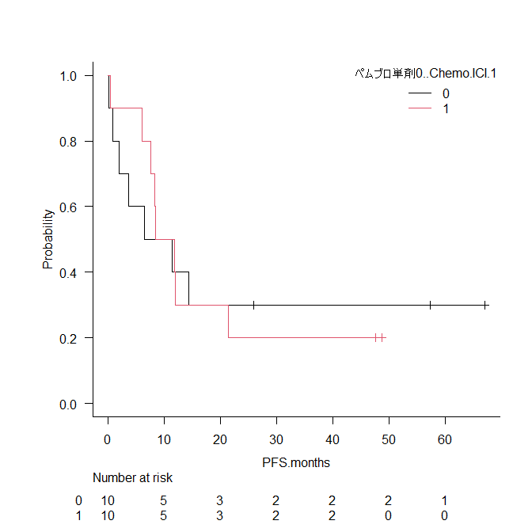
Supplementary Fig. 5 Kaplan–Meier curves for (A) OS and (B) PFS of patients aged ≥70 years with squamous cell carcinoma and with PD-L1 TPS ≥50% who received MONO or COMBO adjusted by PSM (N = 20)
A
B
median OS 95% CI
── MONO 25.2 m 1.0–NA
── COMBO 16.5 m 0.6–NA
P = 0.566
median PFS 95% CI
── MONO 9.0 m 0.2–NA
── COMBO 10.2 m 0.2 – 21.4
P = 0.993
OS Probability
PFS Probability
OS (months)
PFS (months)
MONO
COMBO
MONO
COMBO

