Slide 1
S.Fig.4A
wt
cpk
p62
nuclei
p62
nuclei
20 μm
20 μm
wt MG+CQ
cpk MG+CQ
10 μm
10 μm
S.Fig.4A. p62 expression and localization in control, untreated and MG+CQ-treated wt and cpk cells. Treatment with MG132 (8h, 5μM) and CQ (4h, 10μM) resulted in the formation of autophagic particles (autophagosomes). Images were captured on Olympus BX51 microscope with an Q-Color5 camera and CellSens Standard v1.13 software. White arrows show small p62 particles in controls. Note the presence of some cells expressing higher levels of p63 in cpk cells. Yellow arros indicate the formation of larger autophagosomes following MG+CQ treatment.

Slide 2
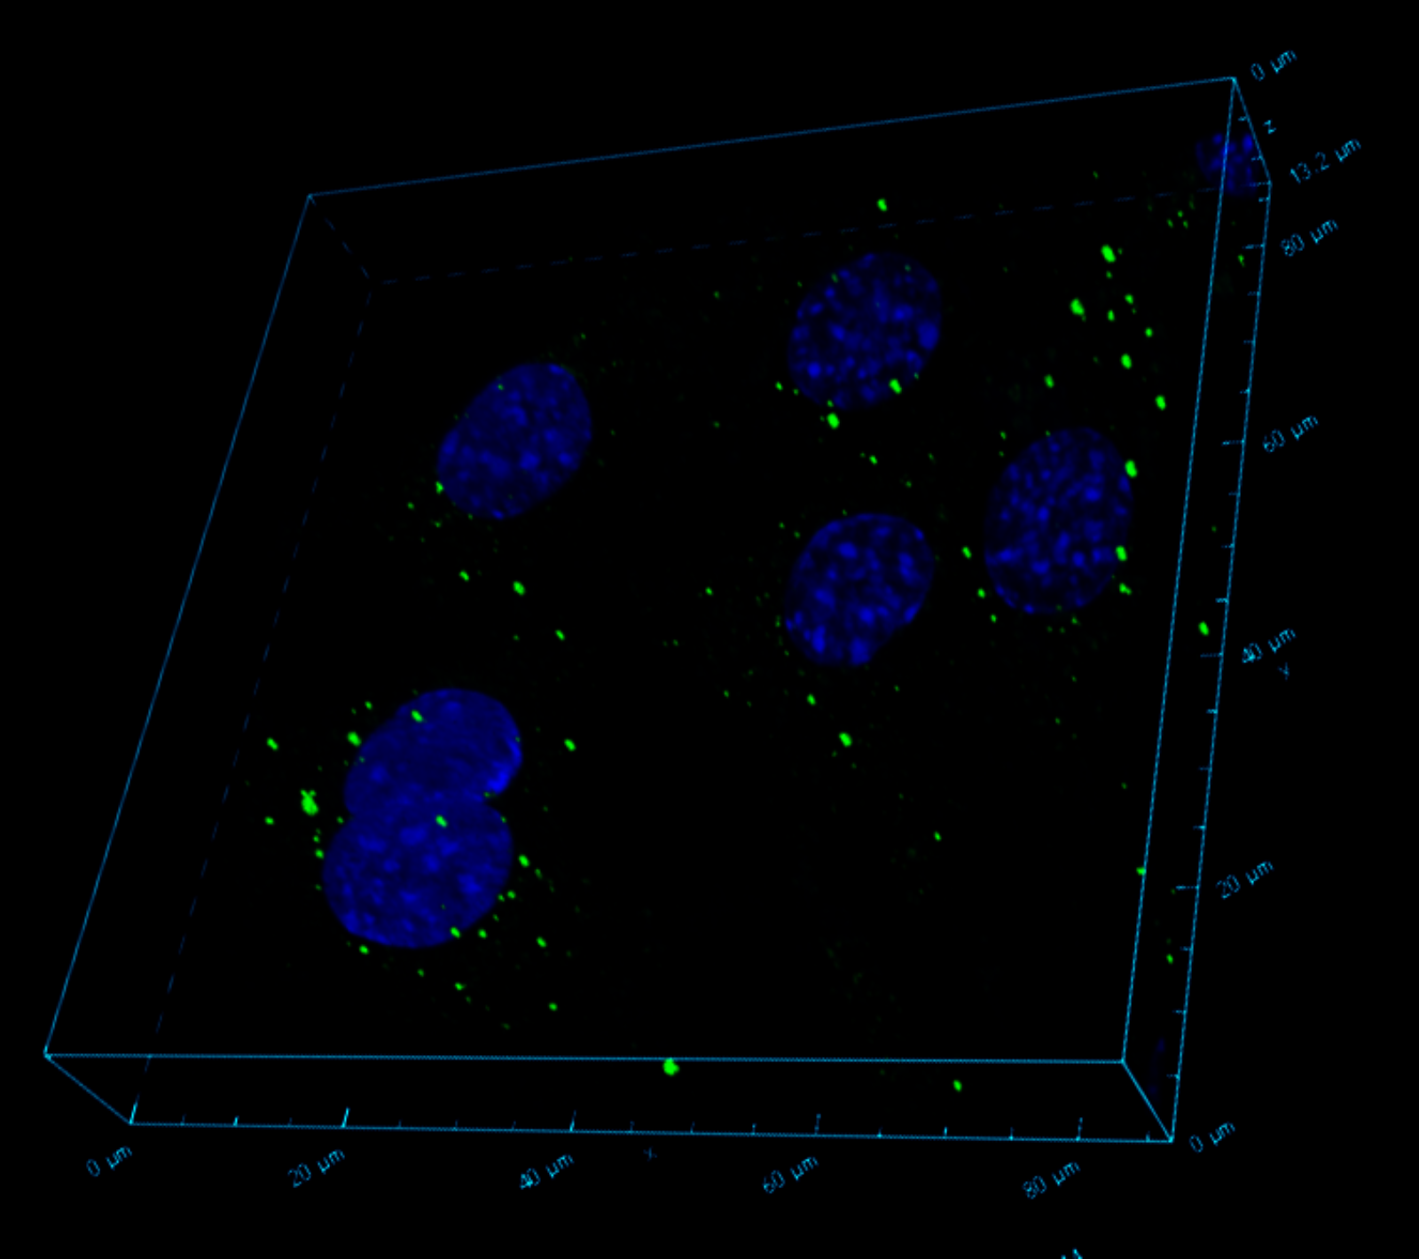
S.Fig.4B
20 μm
20 μm
S.Fig.4B. Confocal microscopy images of p62 (green) expression and localization in MG+CQ-treated wt cells (top) and co-localization of p62 with FPC (red) in MG+CQ-treated cells (bottom). Treatment with MG132 (8h, 5μM) and CQ (4h, 10μM) resulted in the formation of autophagic particles (autophagosomes). The lower image shows colocalization of FPC with p62 (yellow staining, white arrows and red staining of FPC in some cells (blue arrow). Please see the red, green and blue channels individually on the next page. Confocal images were captured using Nikon A1R Confocal Microscope and Advanced NIS-Elements software.

Slide 3
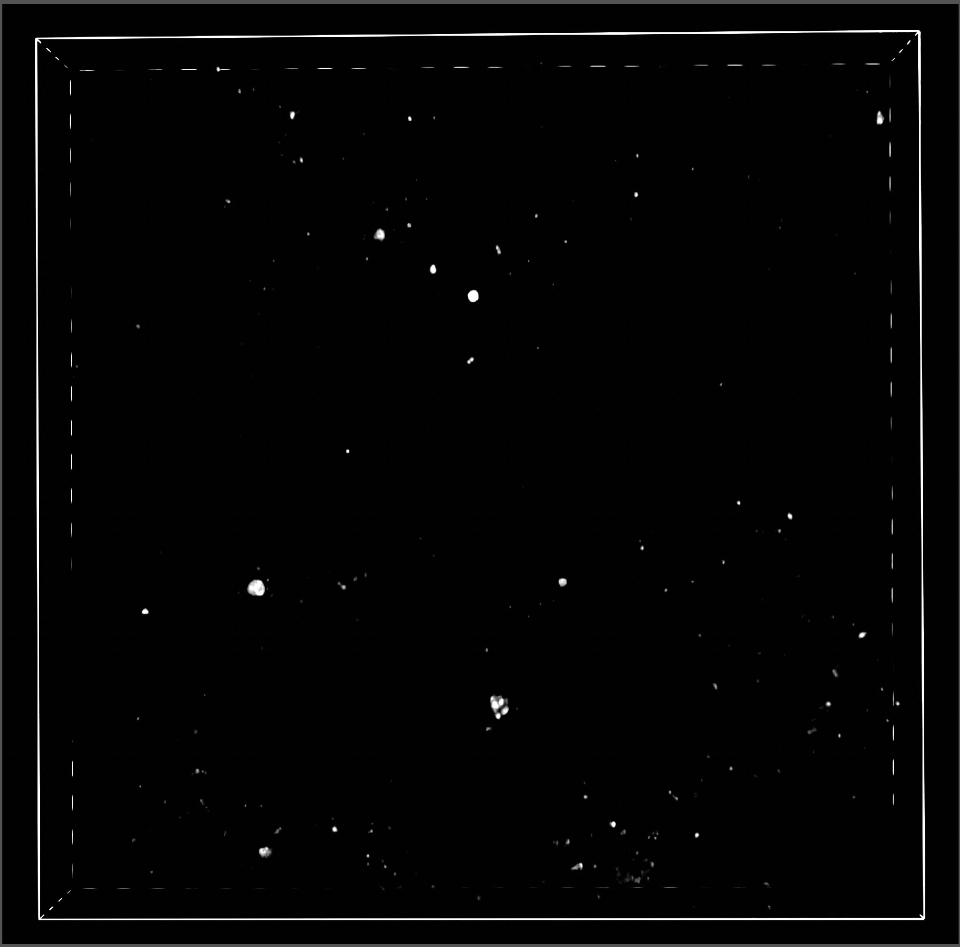
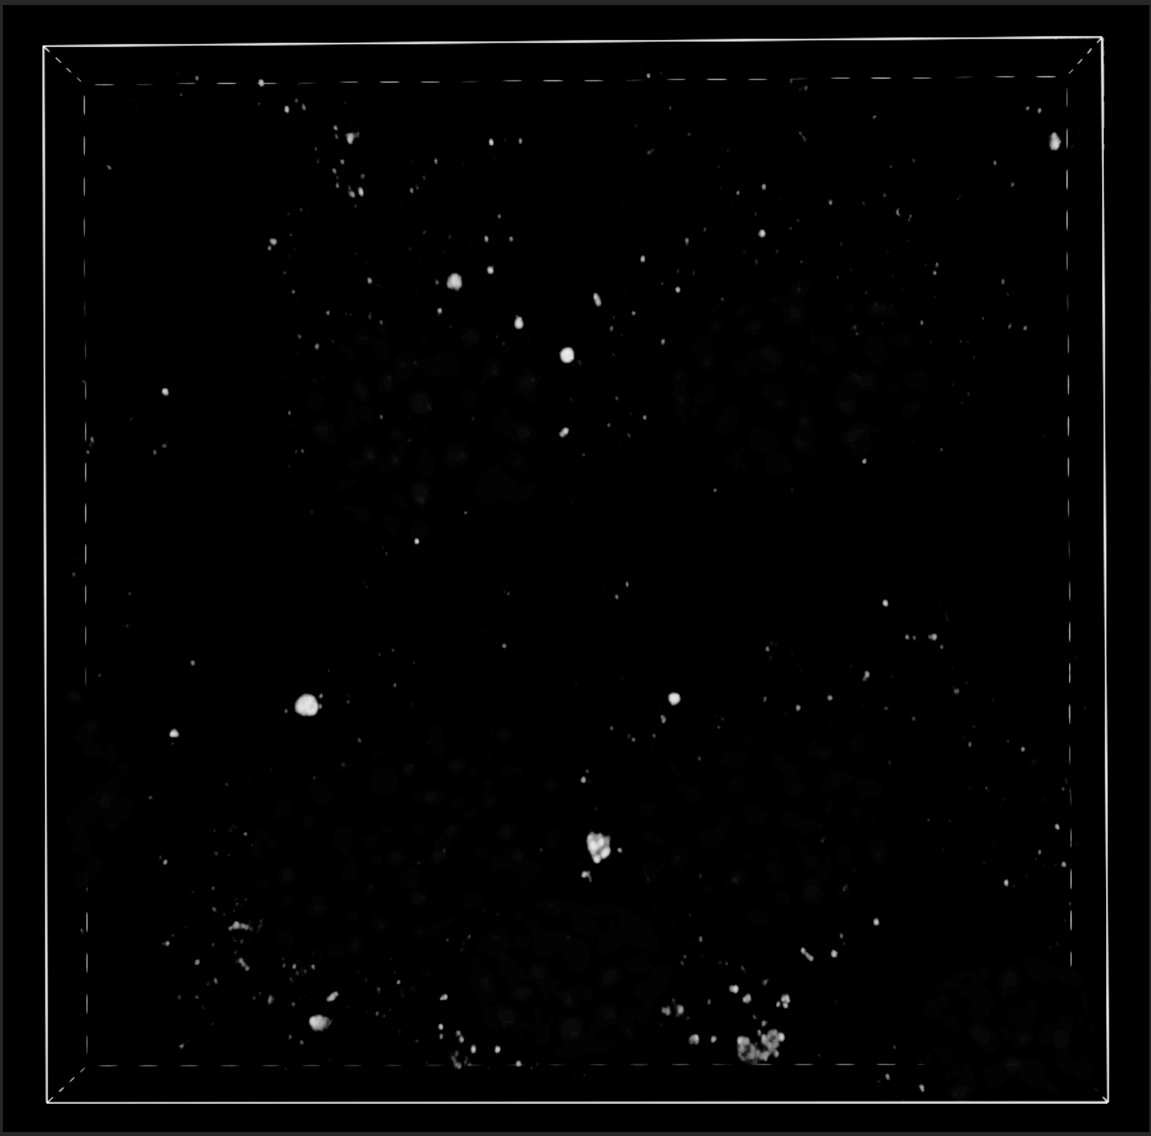
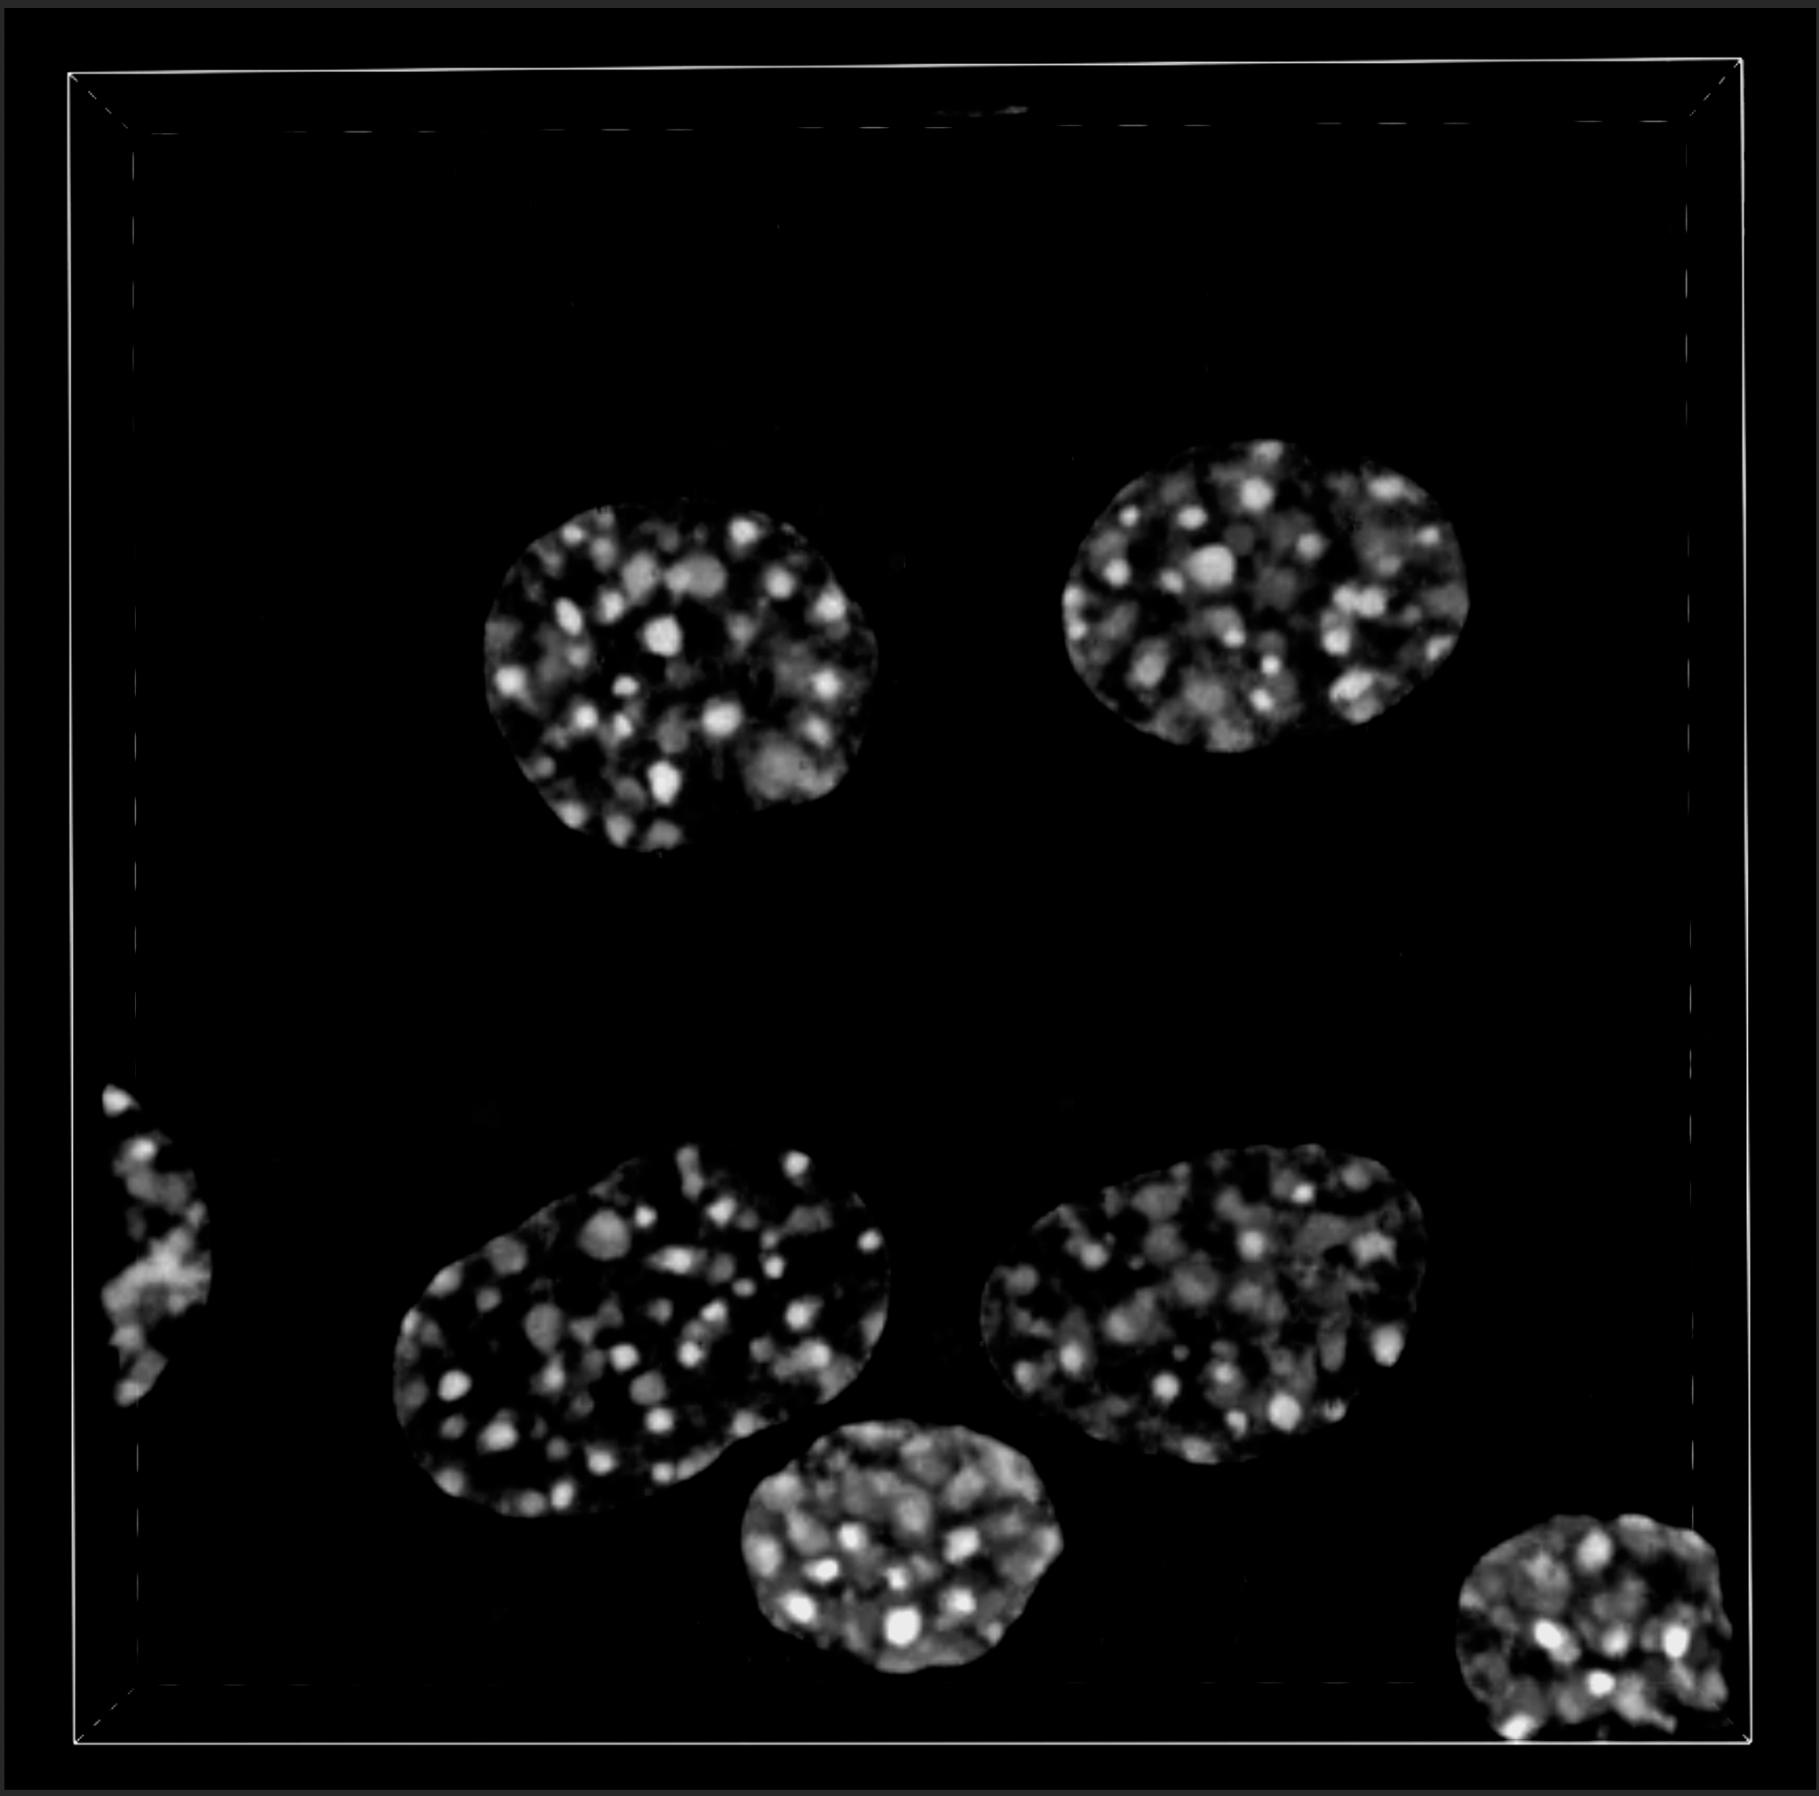
Red
(FPC)
Green
(p62)
Blue
(nuclei)

