Slide 1
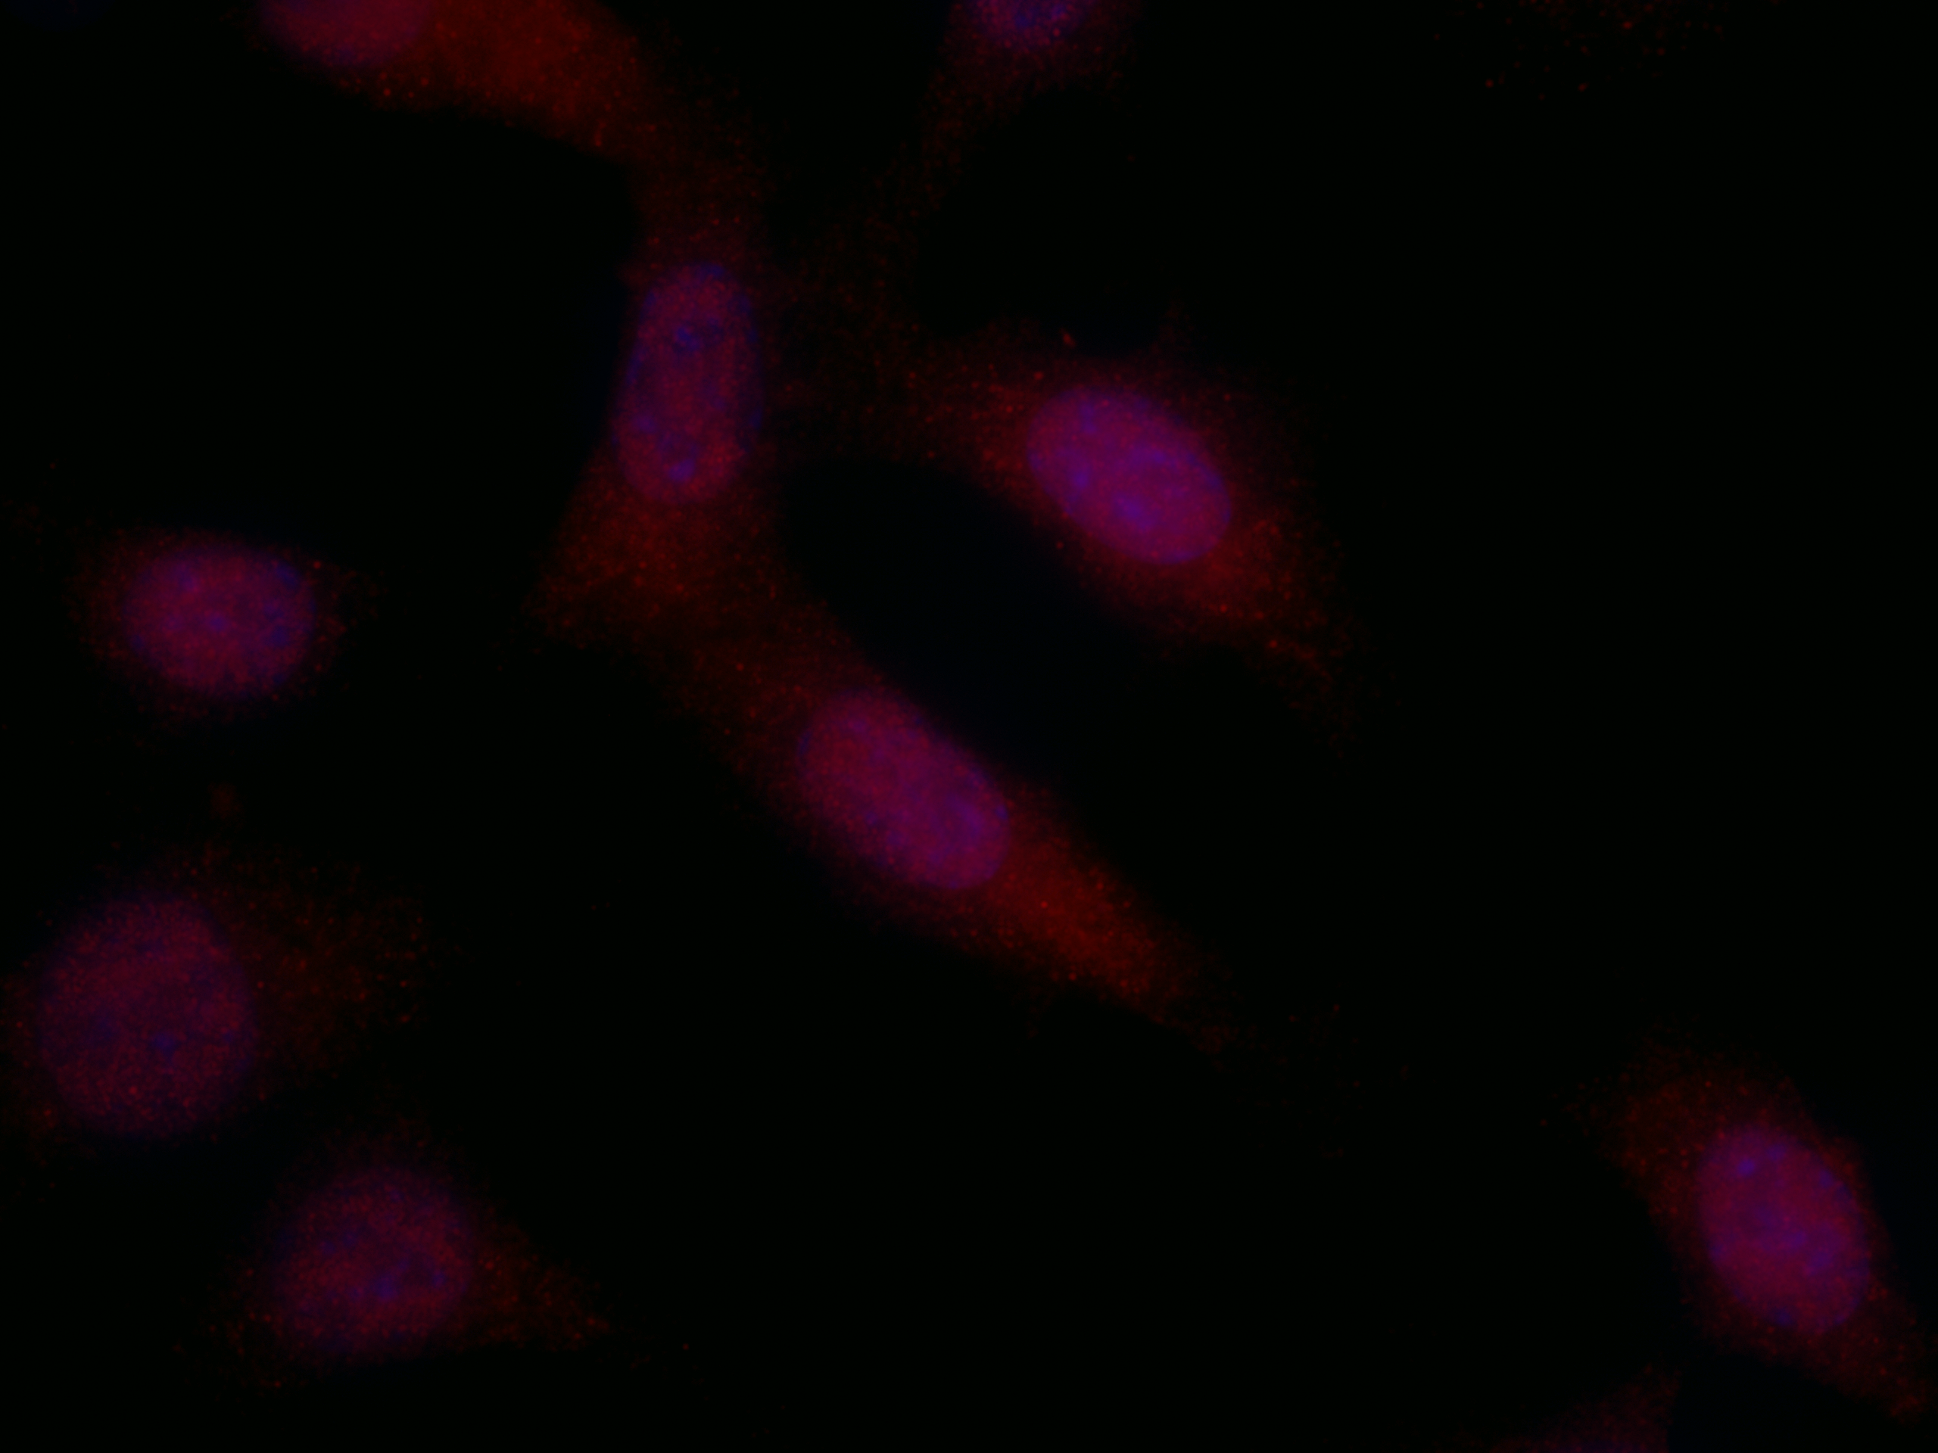
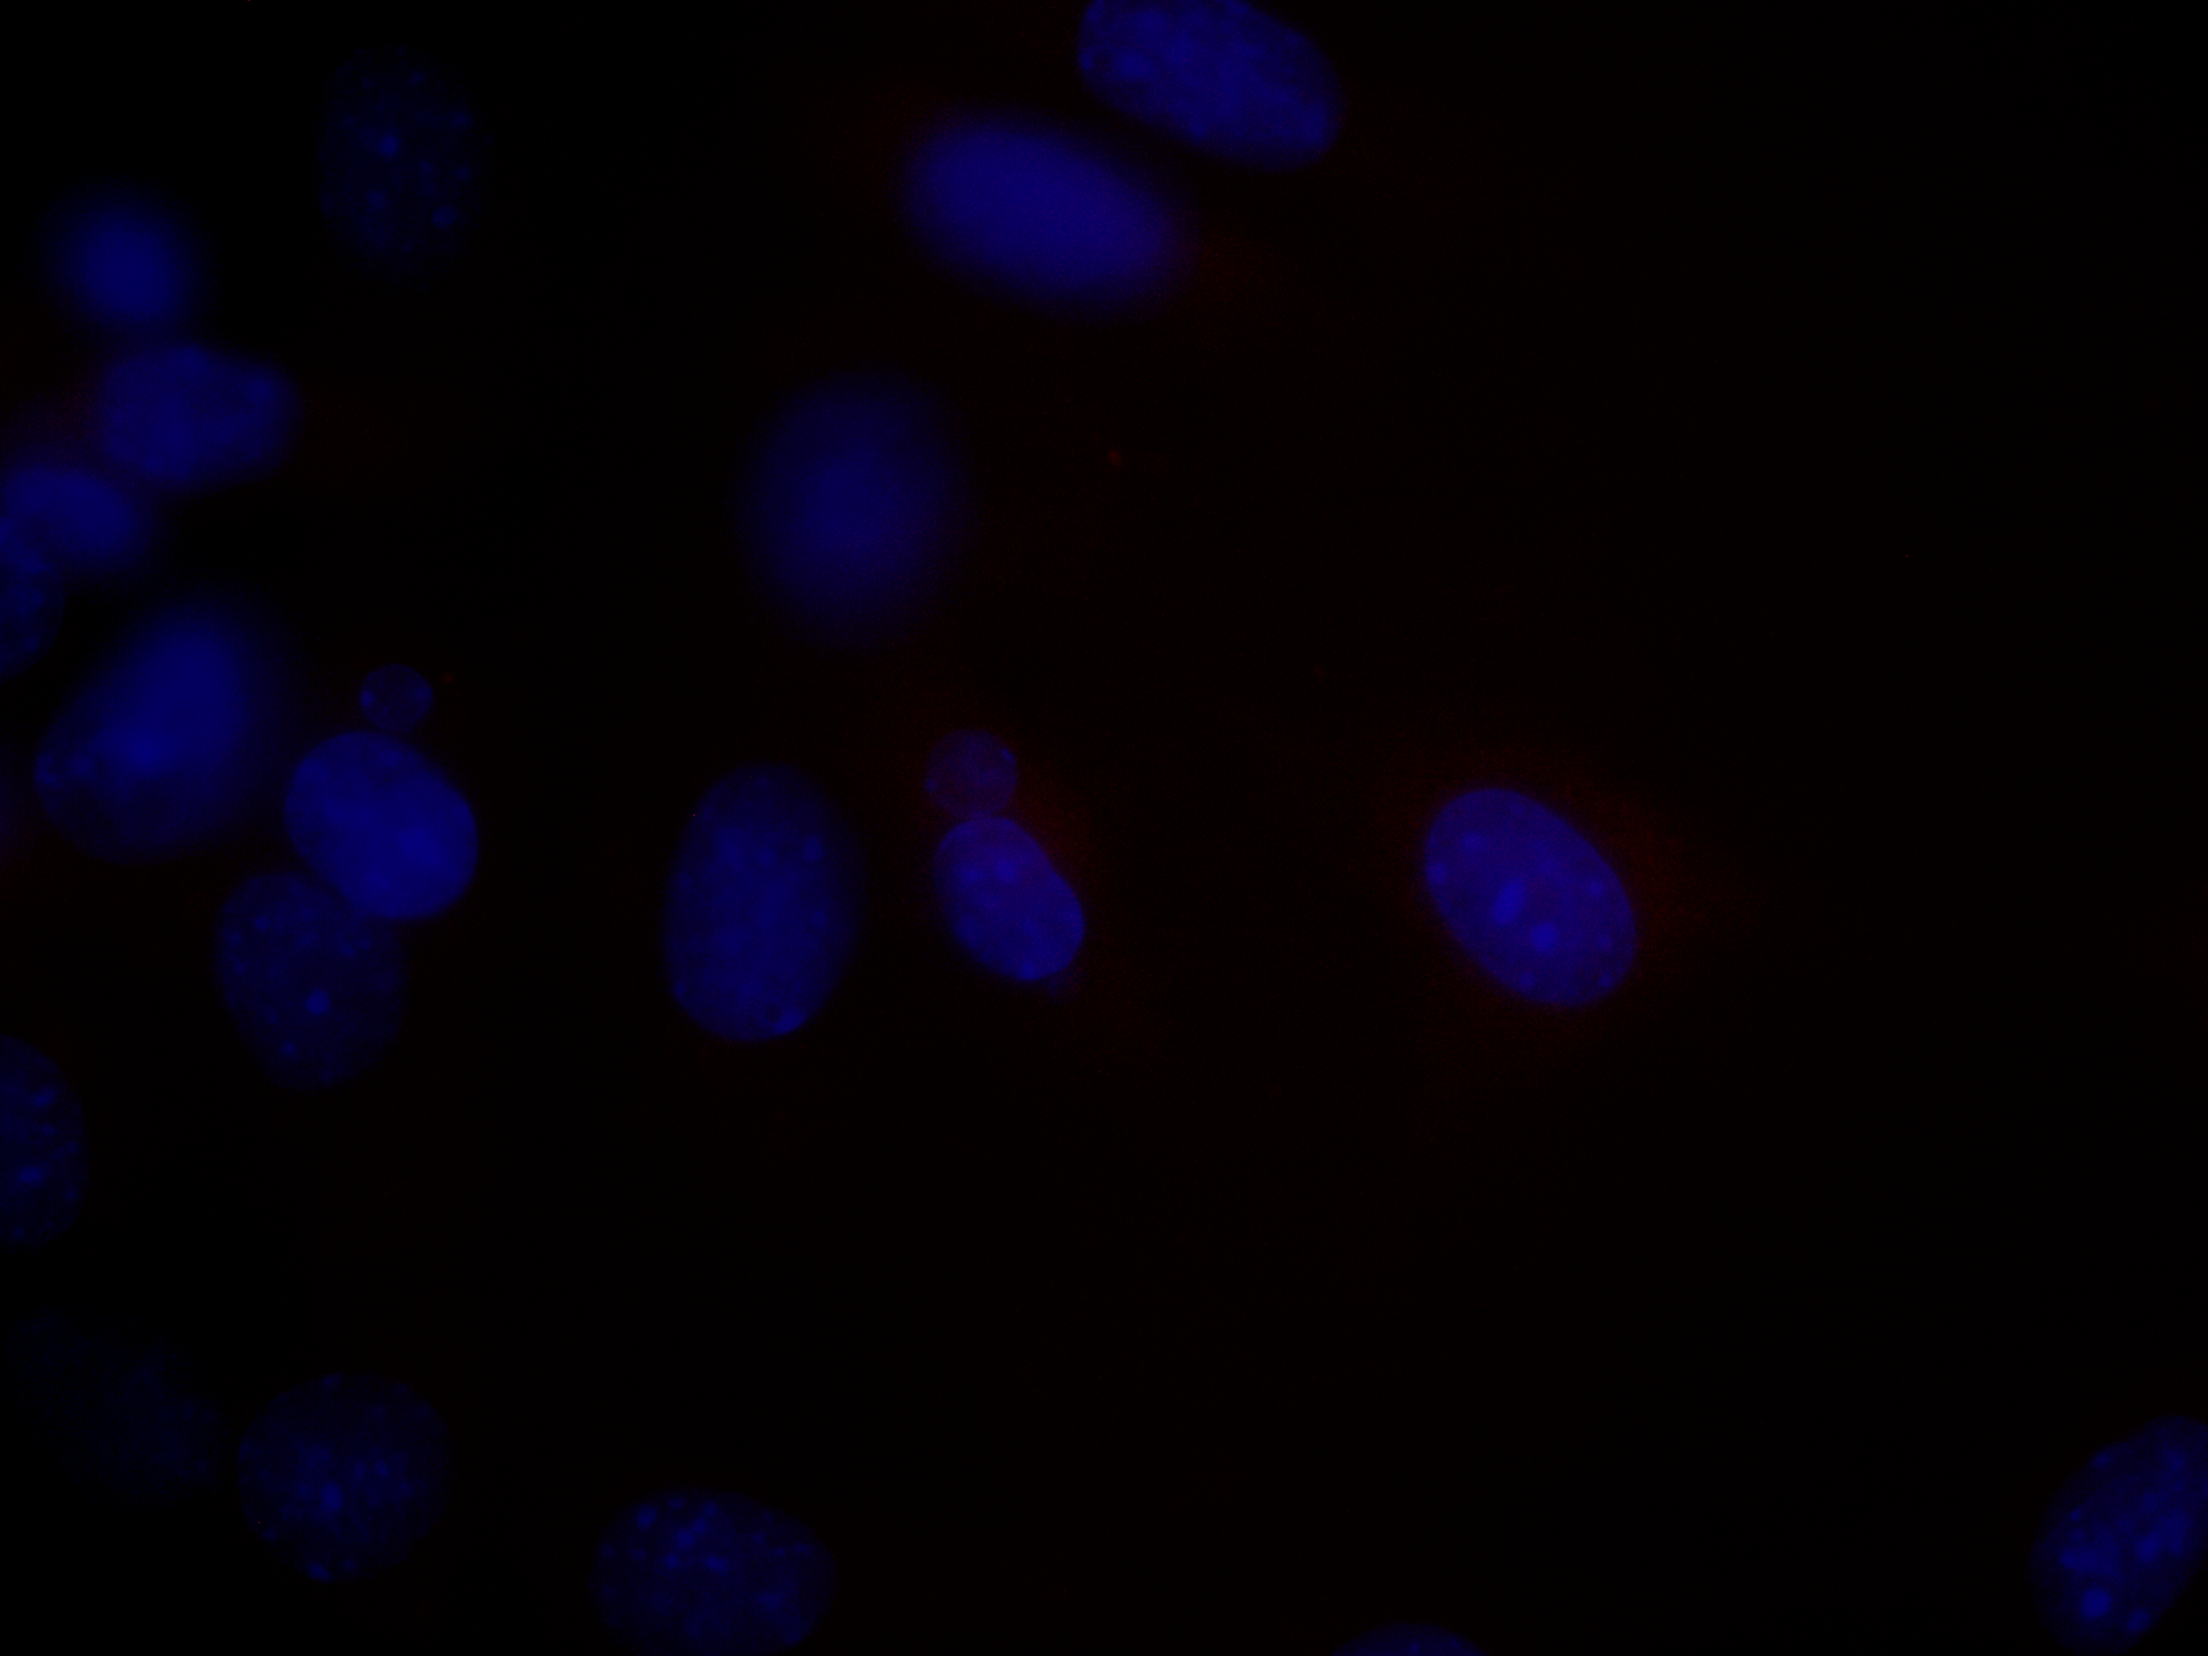
S.Fig.1A. Quality testing of the the anti-cystin antibody (rabbit IgG) on mouse wt CCD cells
Primary antibody: anti-cystin (rabbit IgG, 5μg/ml)
Primary antibody: non-immune rabbit IgG (5μg/ml)
wt
wt
S.Fig.1B. Quality testing of the the anti-FPC antibody (rabbit IgG) on mouse wt CCD cells
Primary antibody: anti-FPC (rat IgG)
Primary antibody: non-immune rat igG (5μg/ml)
wt
wt
S.Fig1.Qyality test of anti-cystin (A) and anti-FPC (B) antibodies on wt cells. Immunocytochemistry was performed on wt cells as described in the Materials and Methods. Primary antibodies were applied at 1:200 dilution of the stock solution for two hours at room temperature. In control experiments primary antibodies were substituted with 5 μg/ml concentration of rabbit or rat non-immune IgG diluted in the blocking solution. Alexa Fluor-conjugated secondary antibodies (1:500) were applied for one hour at room temperature, nuclei were stained with Hoechst 33258. Fluorescent microscopic images were captured using identical settings for experimental and control samples on Olympus BX51 microscope with an Q-Color5 camera and CellSens Standard v1.13 software.

