Slide 1
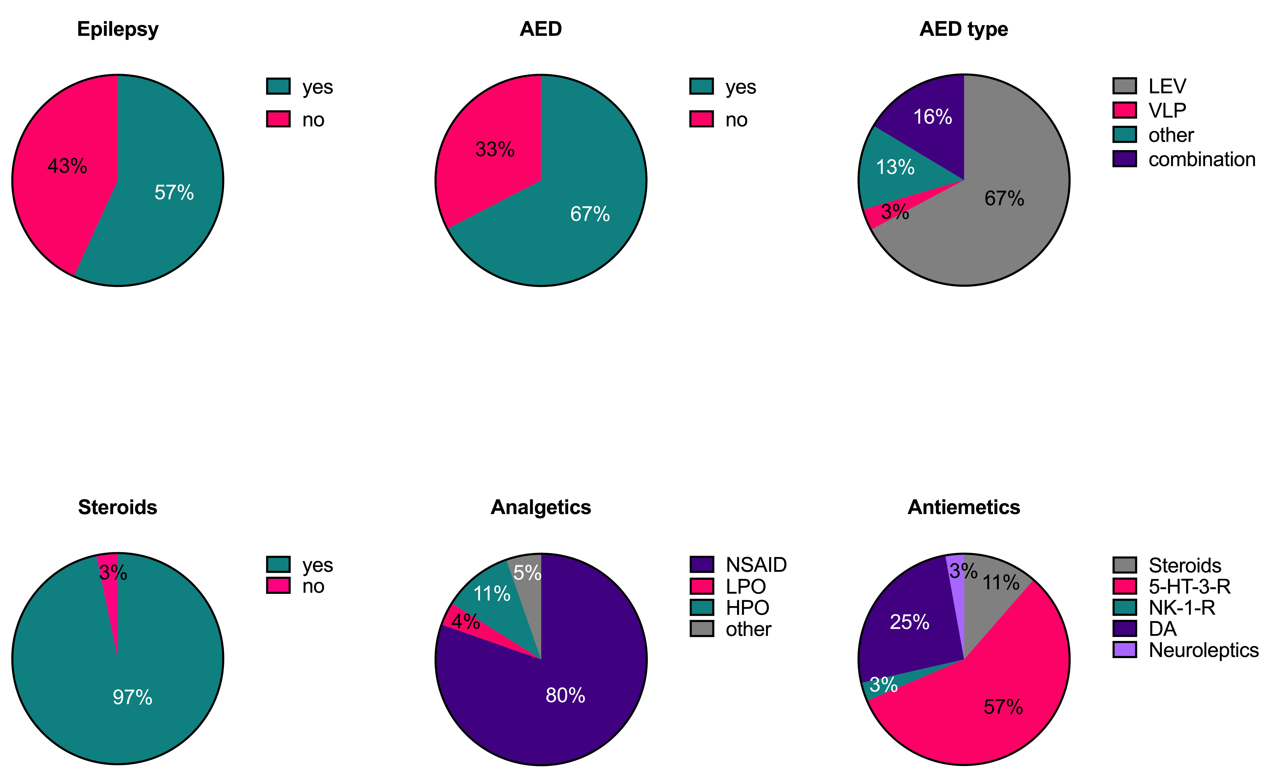
Supplementary Figure 1
VPA
Suppl. Figure 1. Frequency of epilepsy, use of antiepileptic drugs and supportive therapy in elderly glioblastoma patients. Abbreviations: AED, antiepileptic drug; LEV, levetiracetam; VPA, valproic acid; NSAID, nonsteroidal anti-inflammatory drug; LPO, low-potency opioid; HPO, high-potency opioid; 5-HT-3-R, 5-HT3 receptor antagonist; DA, dopamine antagonist; NK-1-R, neurokinin type 1 receptor antagonist
Notes:
Figure 1. Antiepileptic and supportive treatment. Epilepsy, Diagnosis of symptomatic epilepsy; AED, prescriptionof at least one antiepileptic drug; AED types, types of antiepileptic medication prescribed; LEV, Levetiracetam; VLP, Valproate; steroids, use of steroids over the course of disease; analgetics, types of analgetic drugs prescribed; NSAID, non steroid antiinflammatory drug; LPO, low potent opioid analgetic; HPO, highly potent opiod analgetic; antiemetics, types of antiemetic drugs prescribed.

