Slide 1
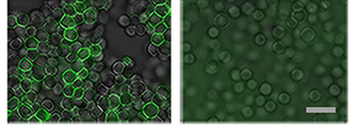
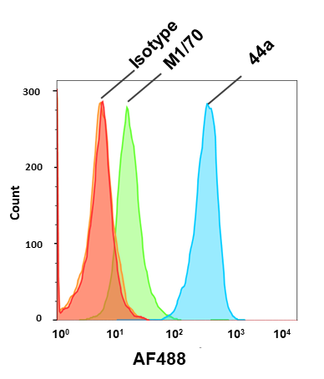
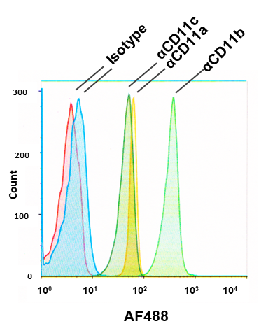
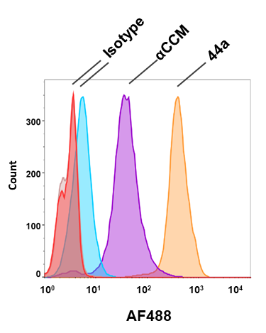
Figure S1
A
B
αCD11b (44a ) Isotype
C
opsRBCs non-opsRBCs
D
E
F

Slide 2
Figure S2
A
B
**
**
C
D
**
*
E
F
*
*
*

Slide 3
Figure S3
A
i
ii
iii
iv
v
vi
vii
B
C
D
Phase Ly6G TIV DL650

Slide 4
Figure S4
A
B
C
D
**
***
***
E
**
***
****

Slide 5
Figure S5
A
B
C
D
OpaD+
Isotype αCD11b
PMA UT

Slide 6
Figure S6
A
B
C
D
E
Neutrophils with associated Msm
Neutrophils with internalized Msm
F
G
Phase CD11b Msm Merged
Phase CD11b Msm Merged

