Slide 1
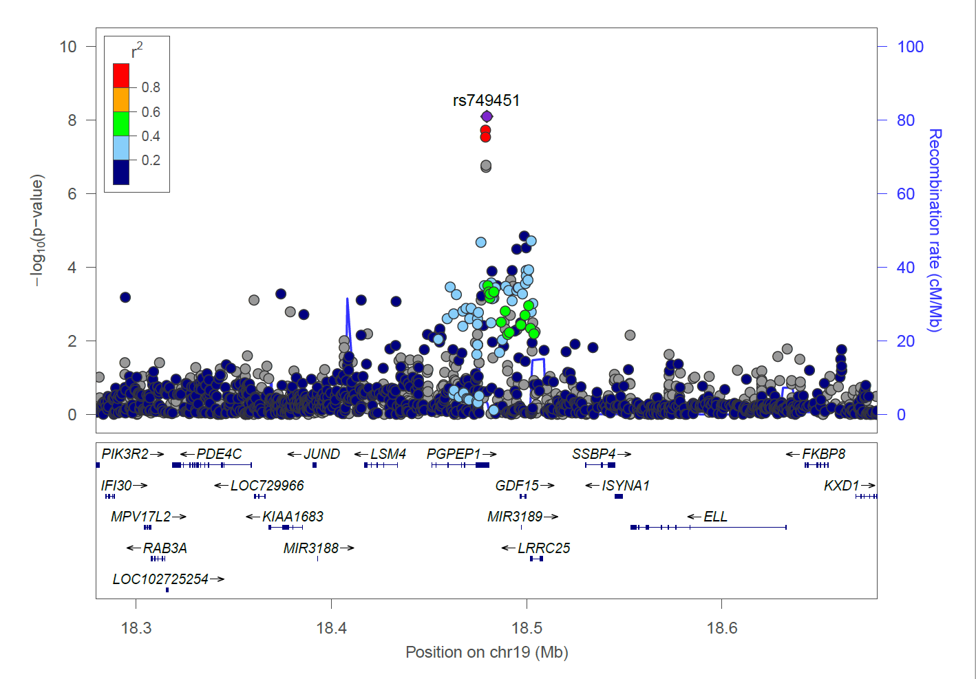
Fig. S1a. The LocusZoom plot for 19p13.11 (rs749451) at the discovery stage (binary 2)

Slide 2
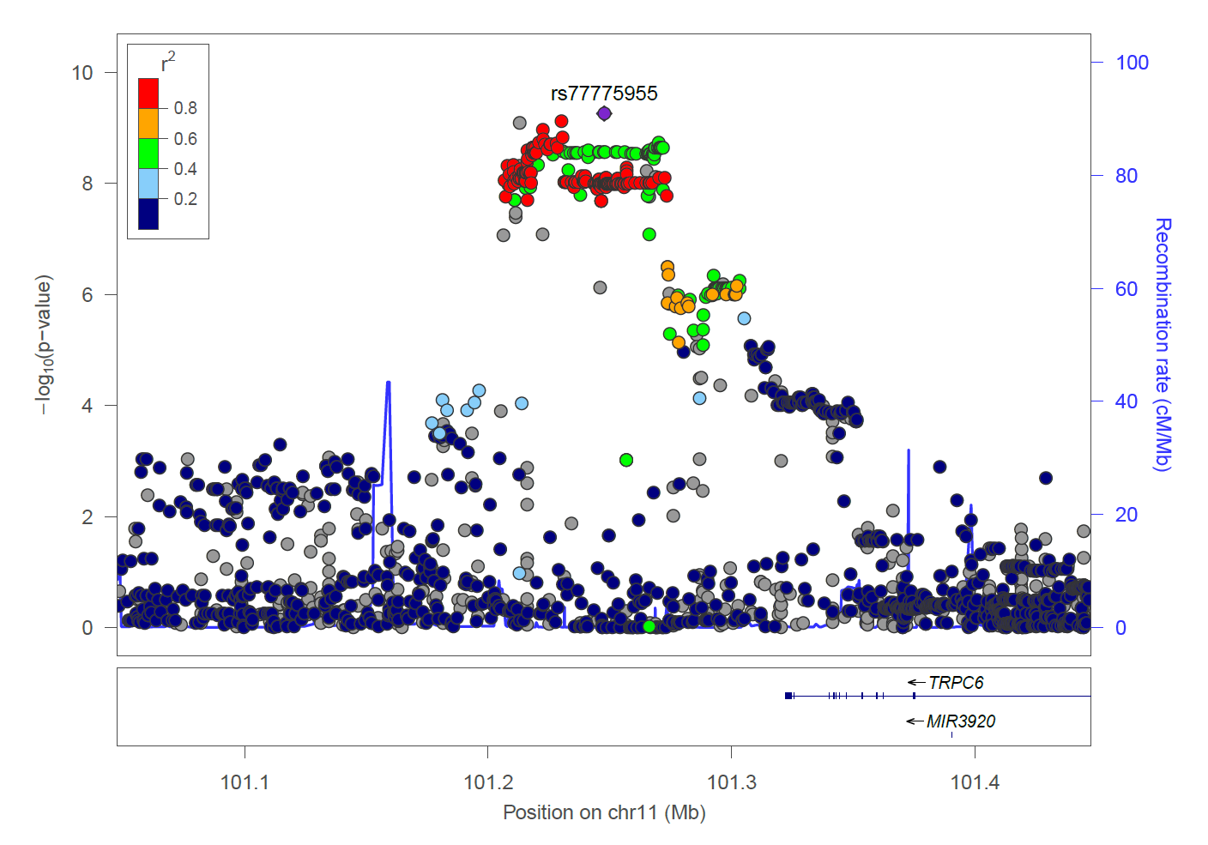
Fig. S1b. The LocusZoom plot for 11q22.1 (rs77775955) at the discovery stage (binary 4)

Slide 3
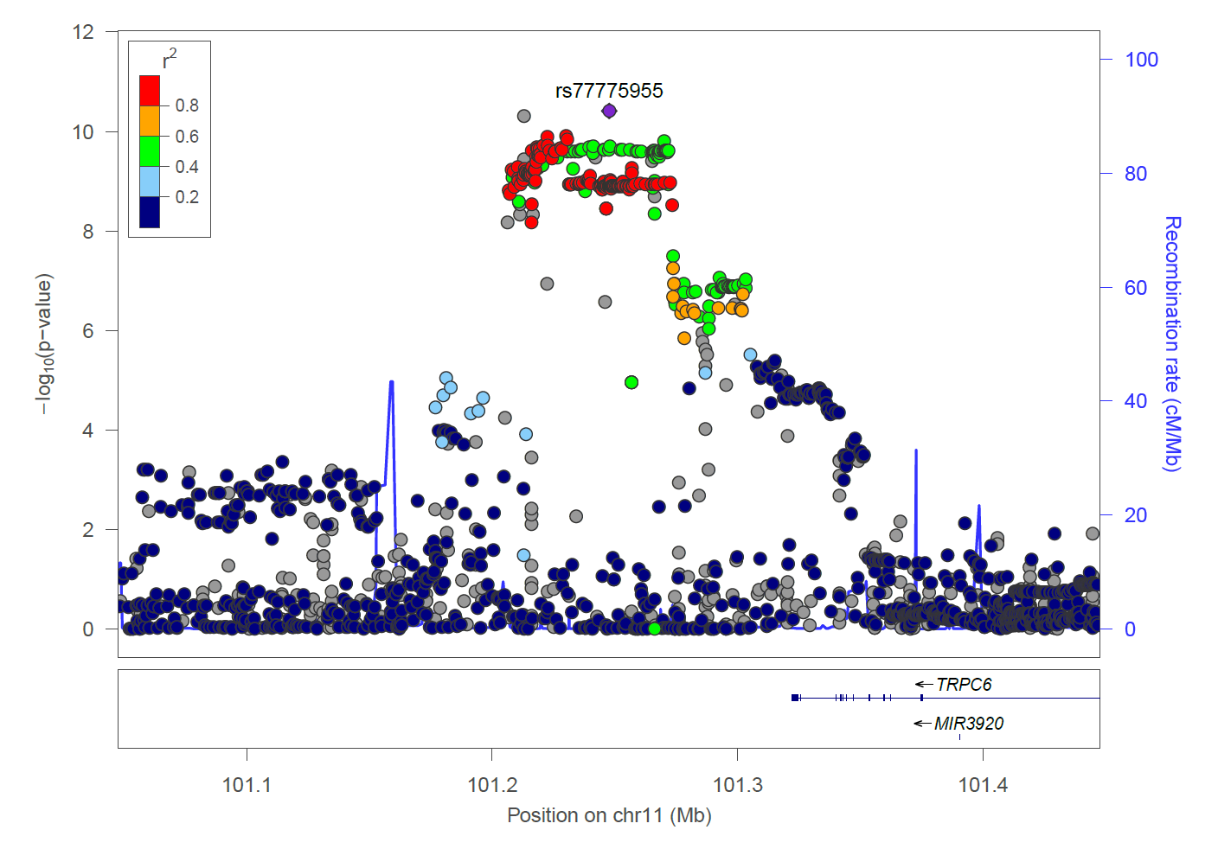
Fig. S1c. The LocusZoom plot for 11q22.1 (rs77775955) at the discovery stage (continuous)

Slide 4
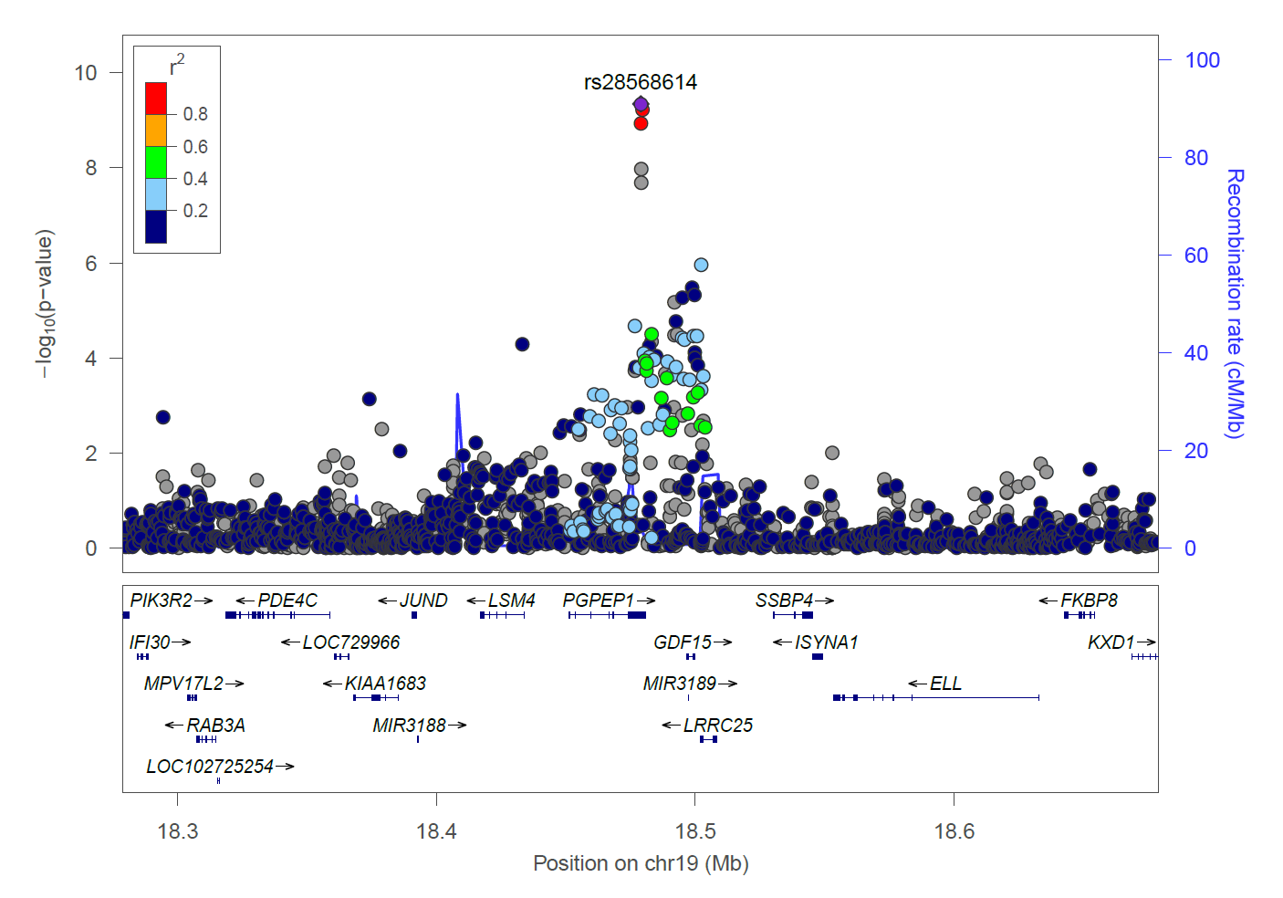
Fig. S1d. The LocusZoom plot for 19p13.11 (rs28568614) at the discovery stage (continuous)

Slide 5
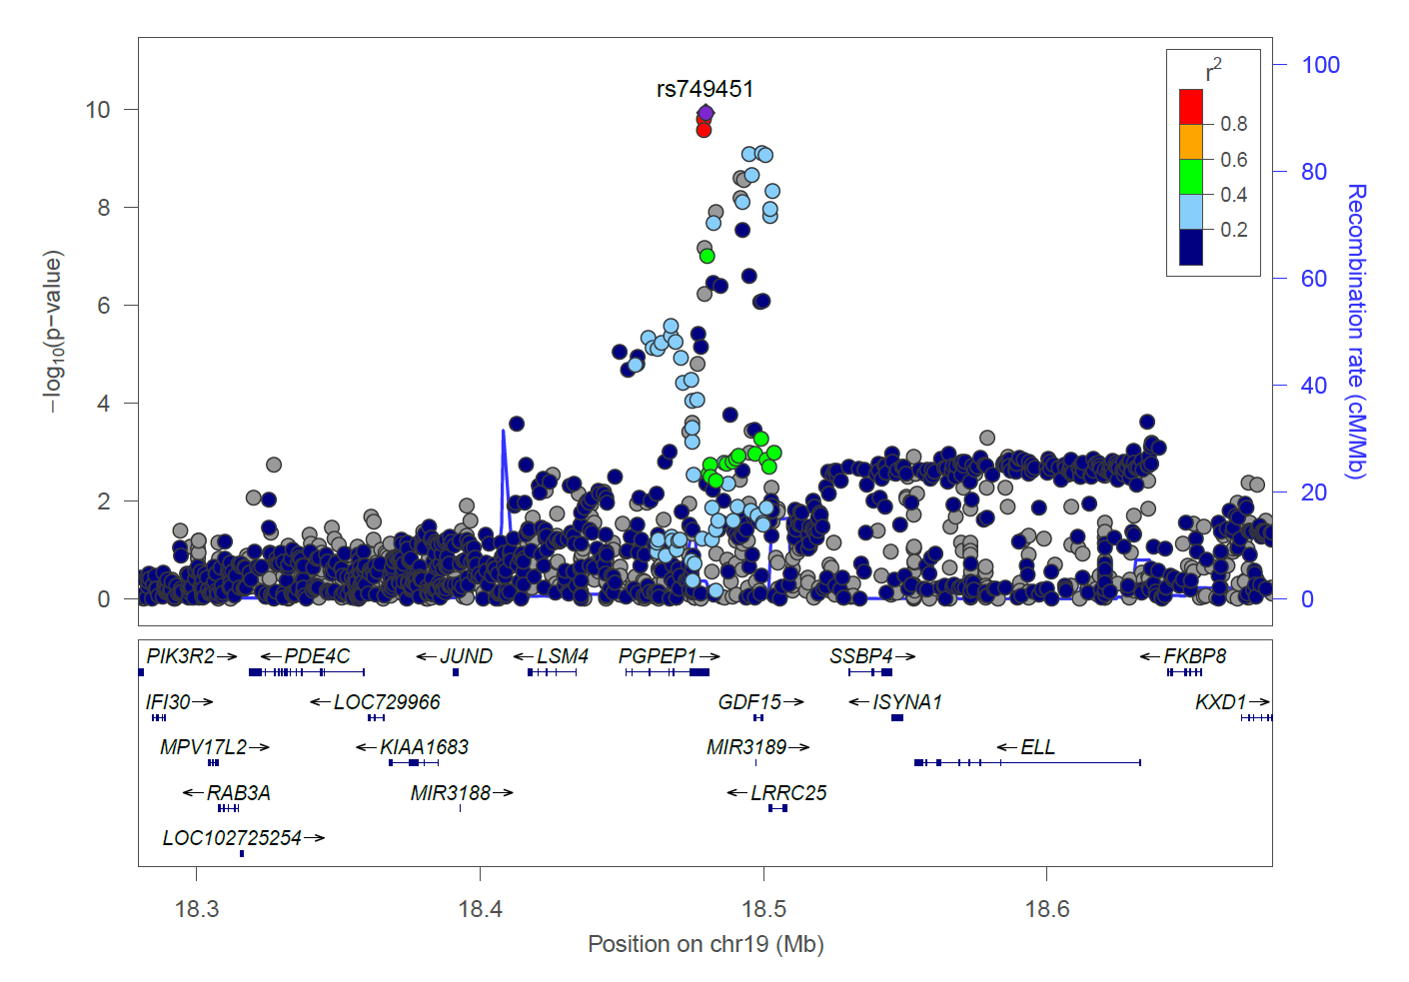
Fig. S1e. The LocusZoom plot for 19p13.11 (rs749451) at the replication stage (binary 2)

Slide 6
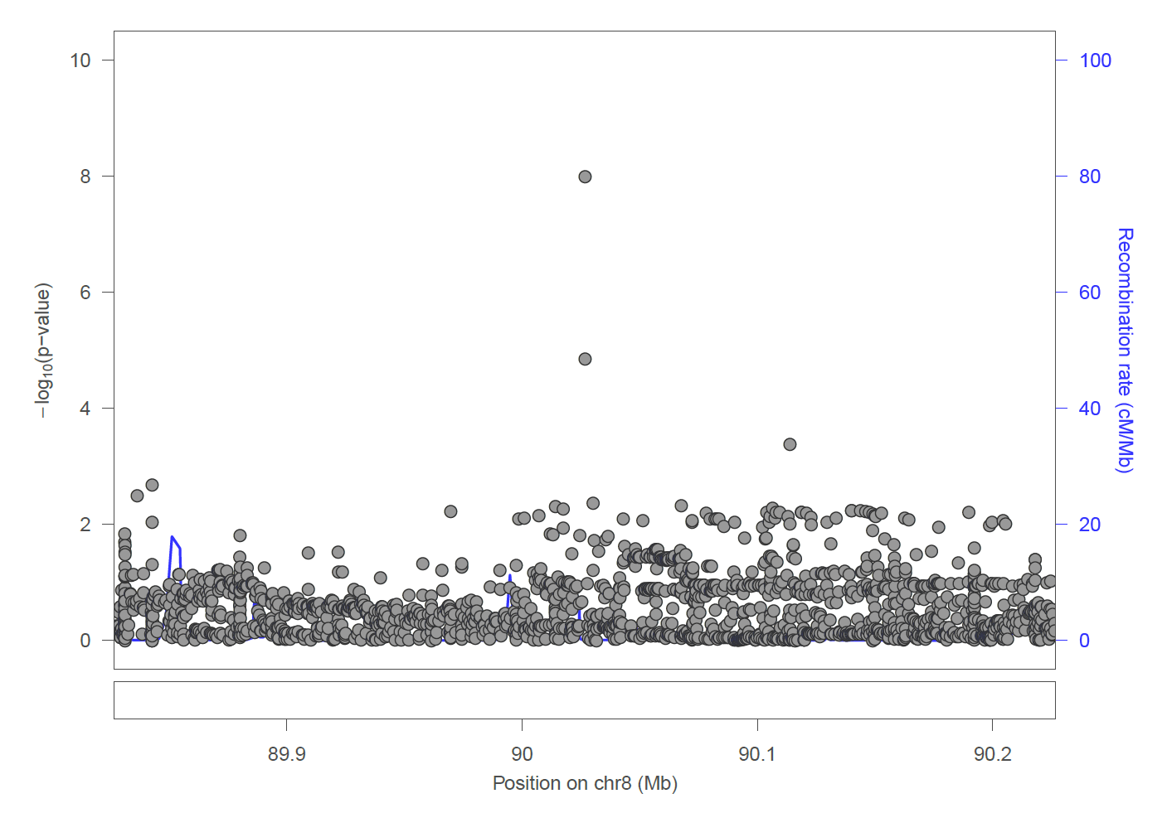
Fig. S1f. The LocusZoom plot for 8q21.3 (rs149783780) at the replication stage (binary 2)

Slide 7
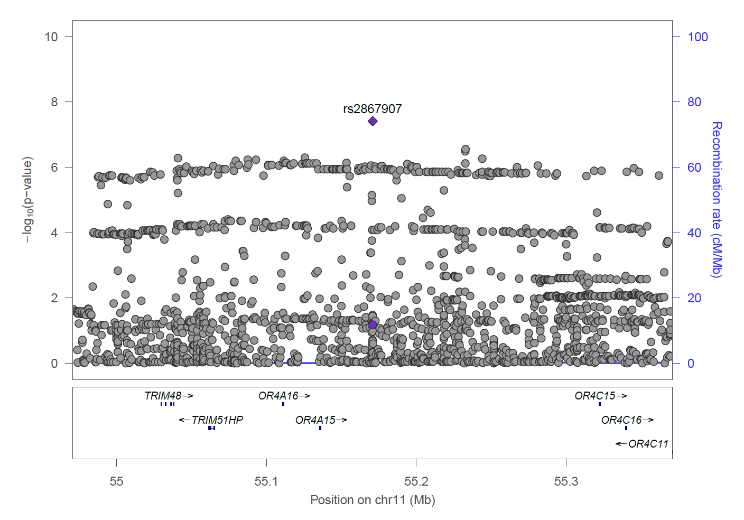
Fig. S1g. The LocusZoom plot for 11q11 (rs2867907) at the replication stage (binary 2)

Slide 8
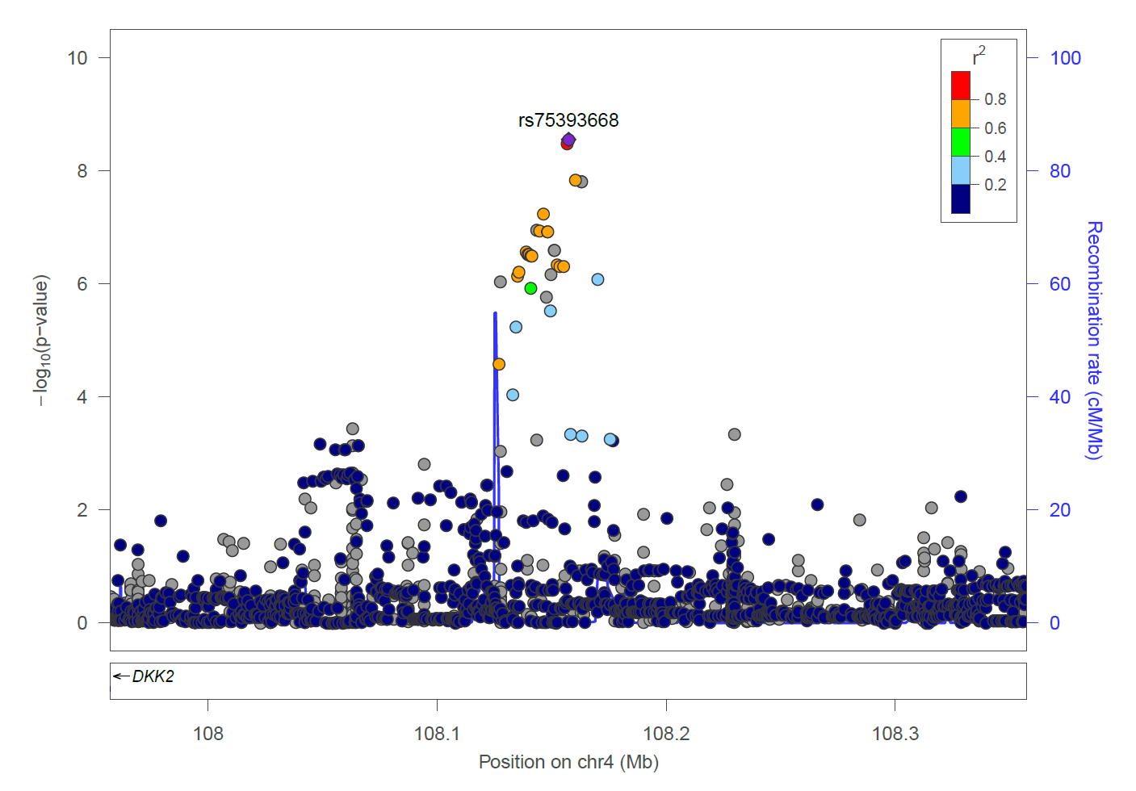
Fig. S1h. The LocusZoom plot for 4q25 (rs75393668) at the replication stage (binary 3)

Slide 9
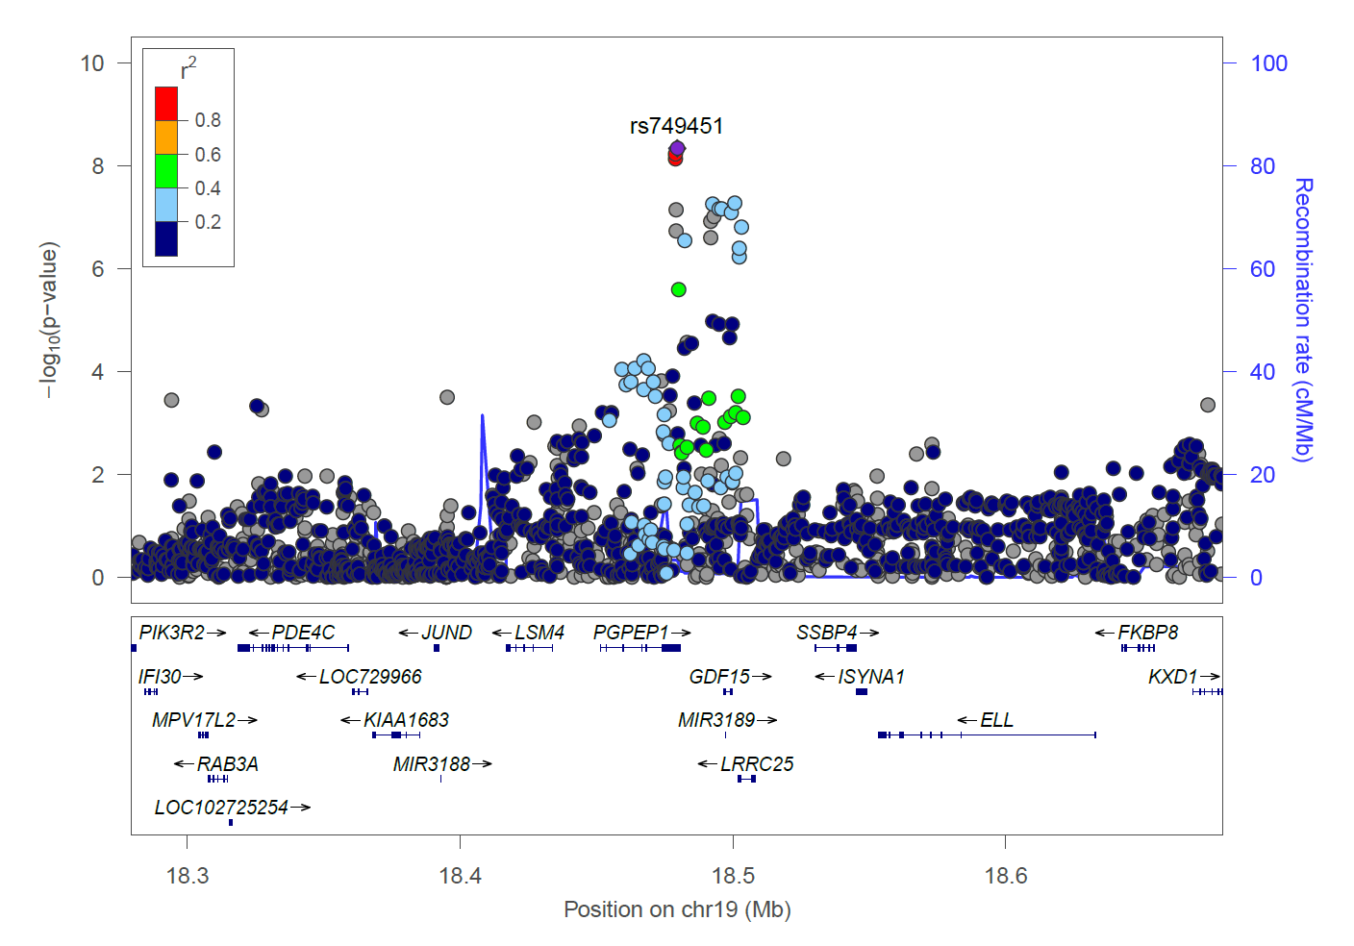
Fig. S1i. The LocusZoom plot for 19p13.11 (rs749451) at the replication stage (binary 4)

Slide 10
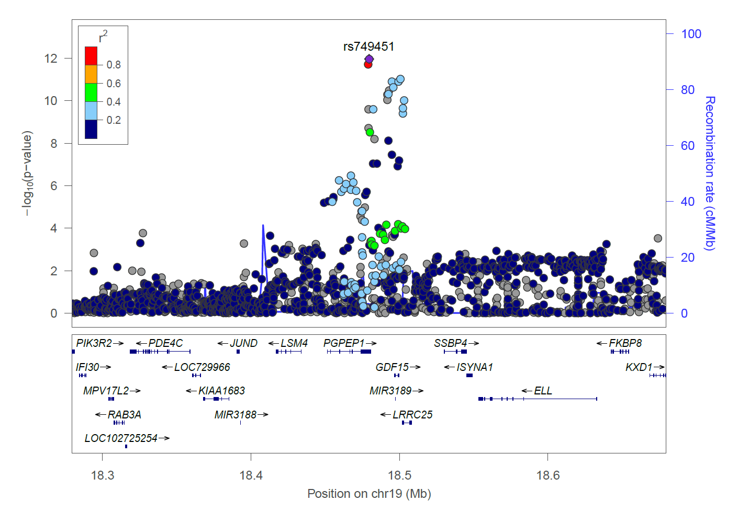
Fig. S1j. The LocusZoom plot for 19p13.11 (rs749451) at the replication stage (continuous)

