Slide 1
Raw Western and gel images
Patil et al

Slide 2
Uncut and unprocessed images of Western blot used in Figure 4 (n=3)

Slide 3
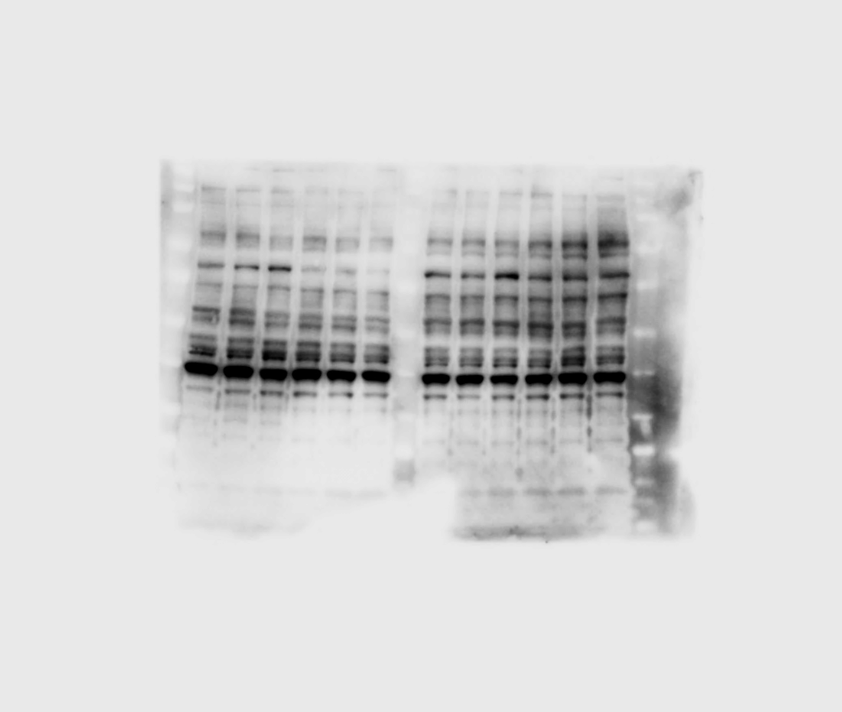
LV
AAV2
Null Cr-MYOC
Null Cr-MYOC
1 2 3 1 2 3 1 2 3 1 2 3
MYOC

Slide 4
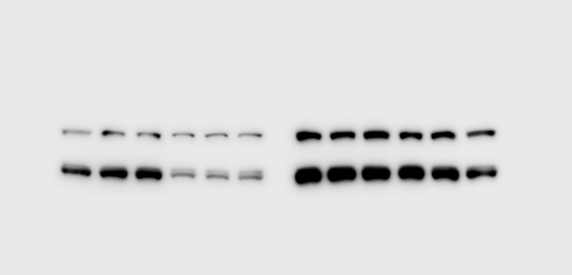
LV
AAV2
Null Cr-MYOC
Null Cr-MYOC
1 2 3 1 2 3 1 2 3 1 2 3
GRP94
GRP78

Slide 5
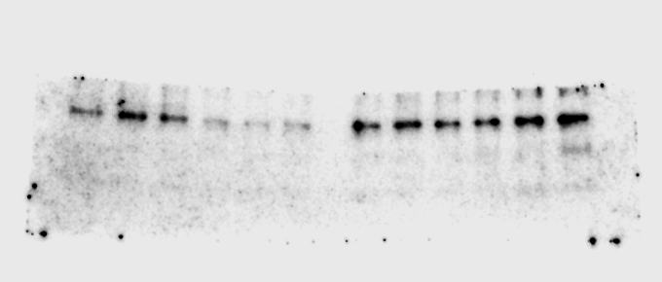
LV
AAV2
Null Cr-MYOC
Null Cr-MYOC
1 2 3 1 2 3 1 2 3 1 2 3
CHOP

Slide 6
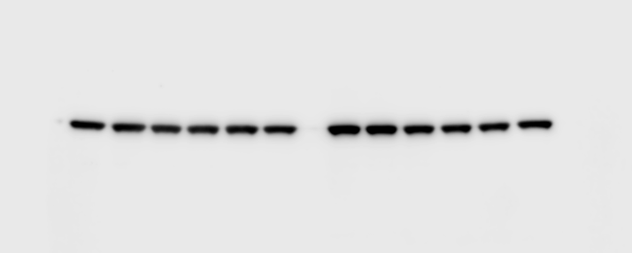
LV
AAV2
Null Cr-MYOC
Null Cr-MYOC
1 2 3 1 2 3 1 2 3 1 2 3
GAPDH

Slide 7
Unprocessed gel image of SURVEYOR Assay shown in SI II.
___NT___ AAV2_Null AAV2_crMYOC LV_Null LV_crMYOC
- + - + - + - + - + T7E1

