Slide 1
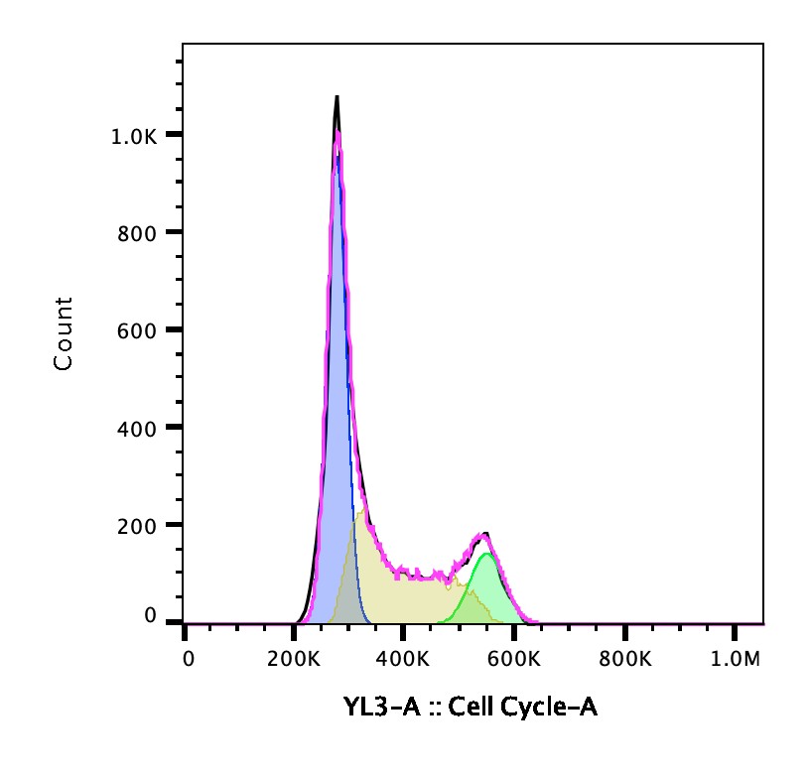
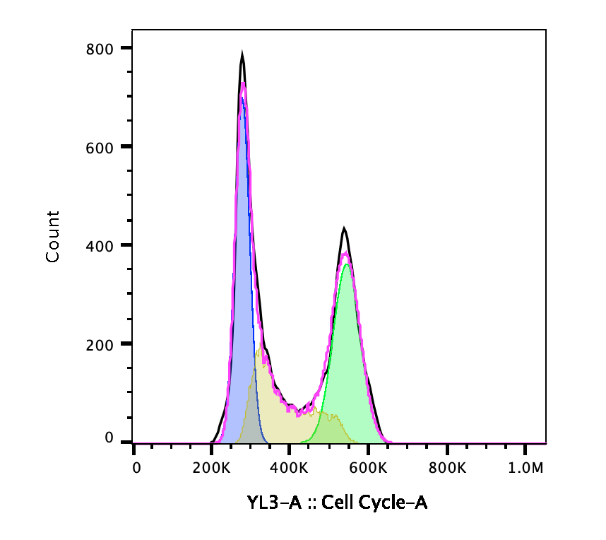
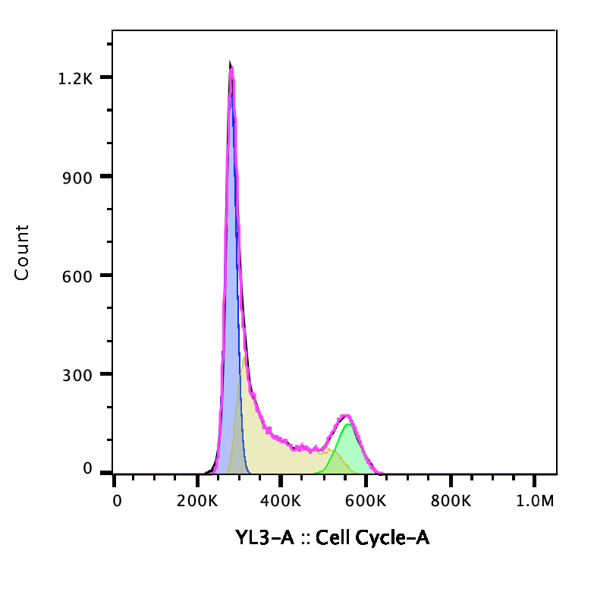
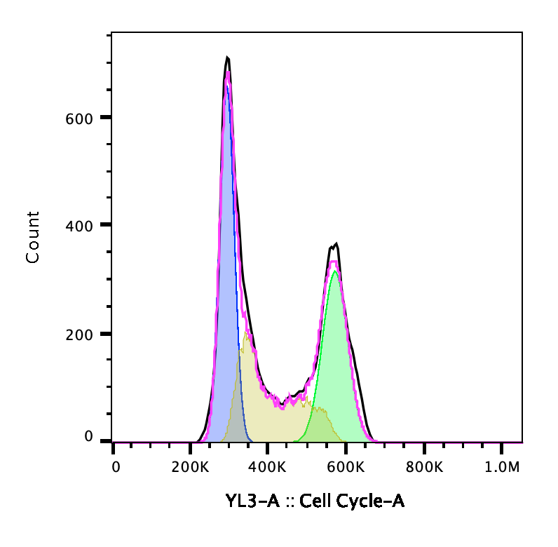
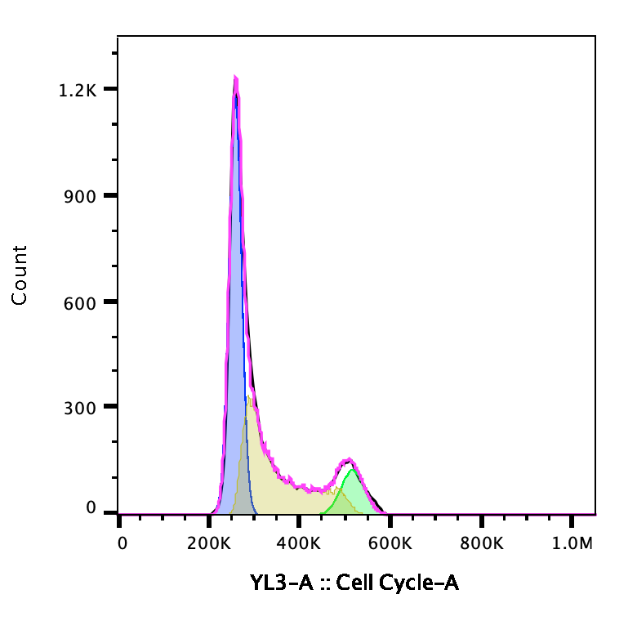
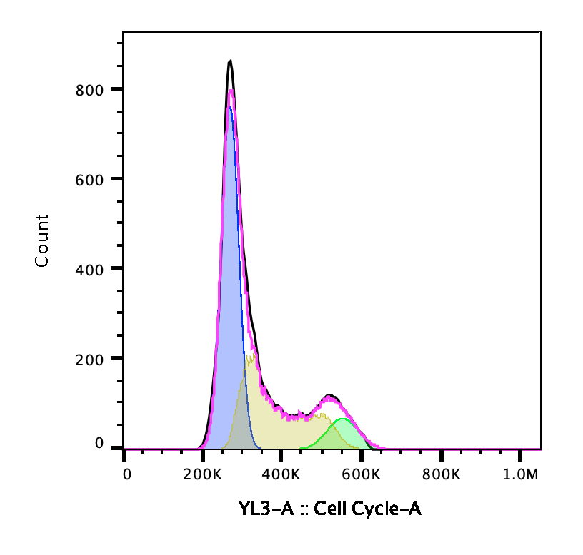
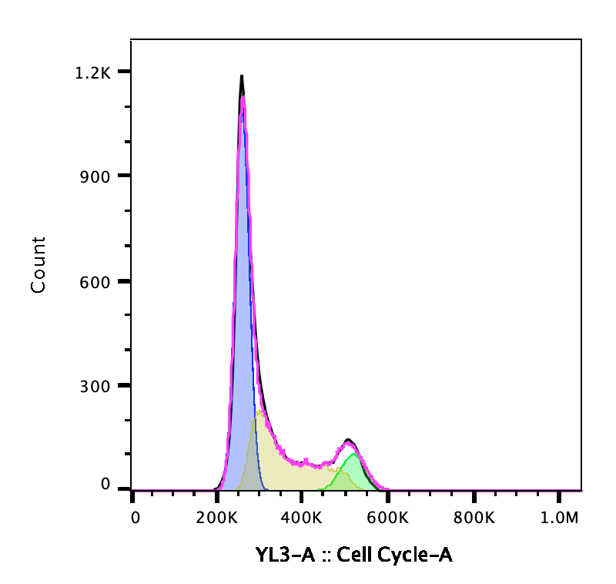
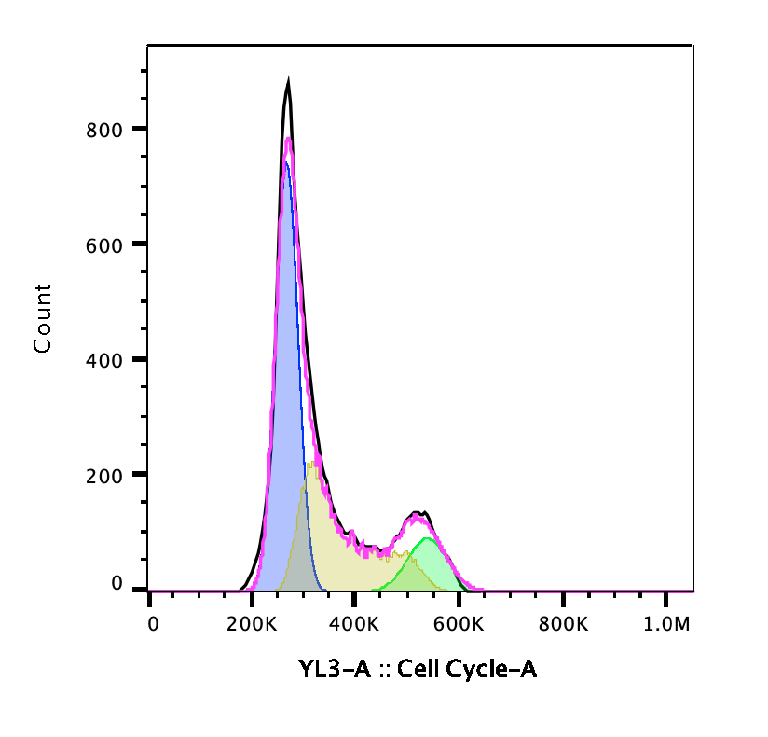
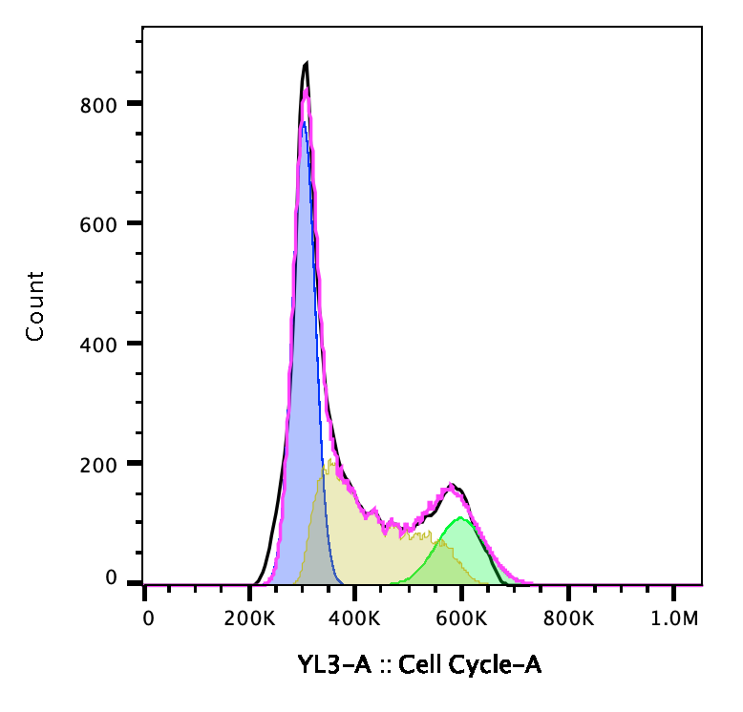
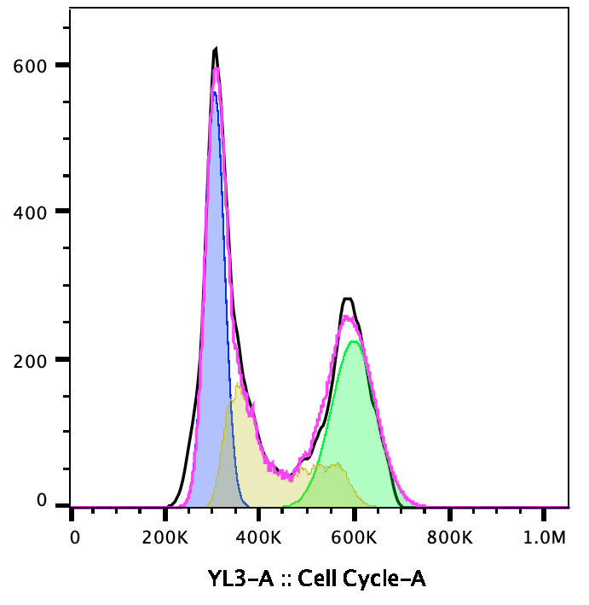
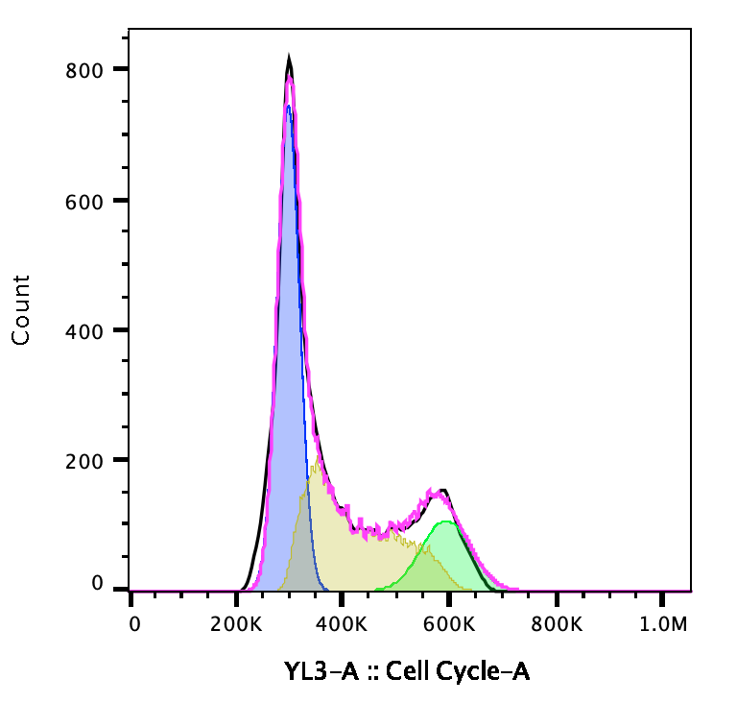
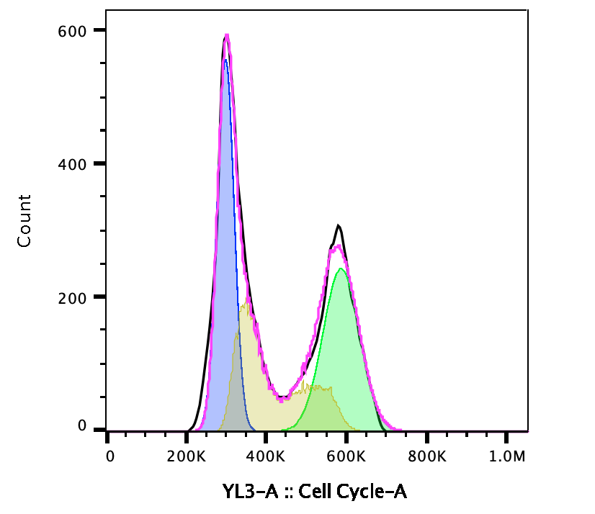
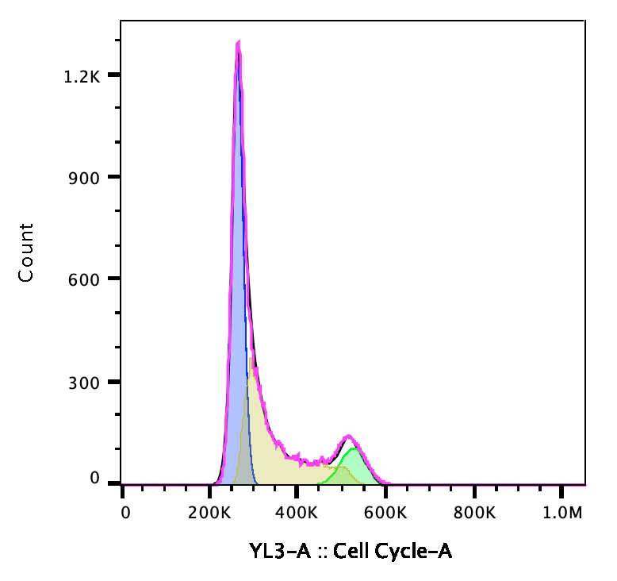
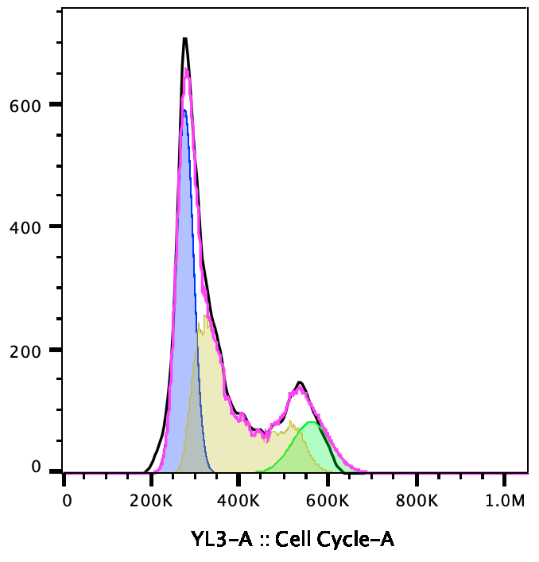
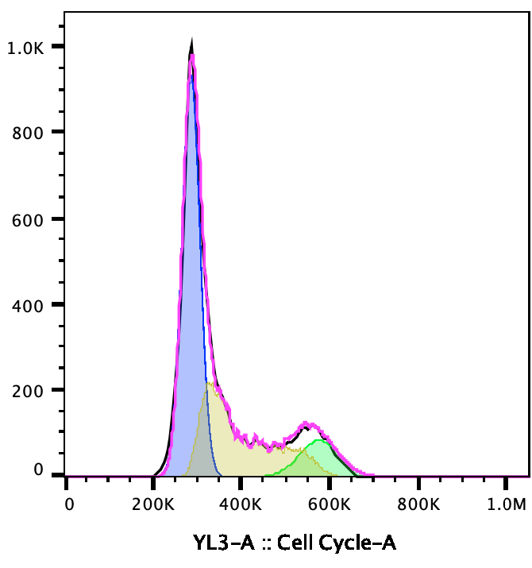
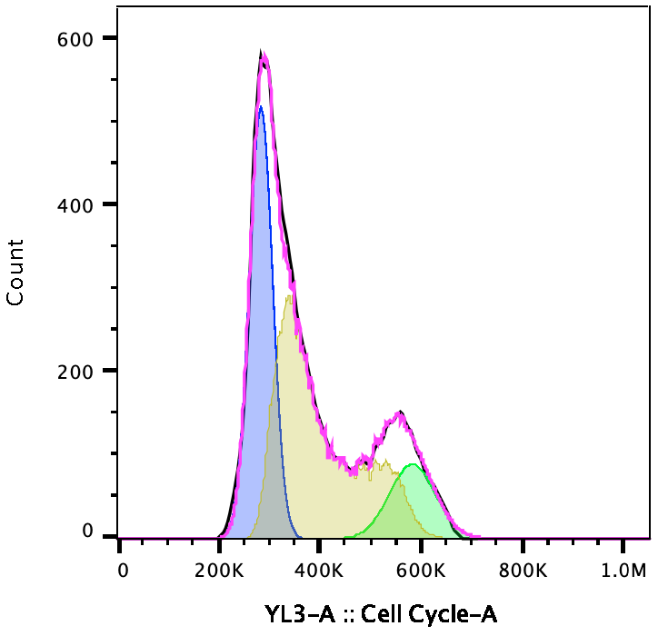
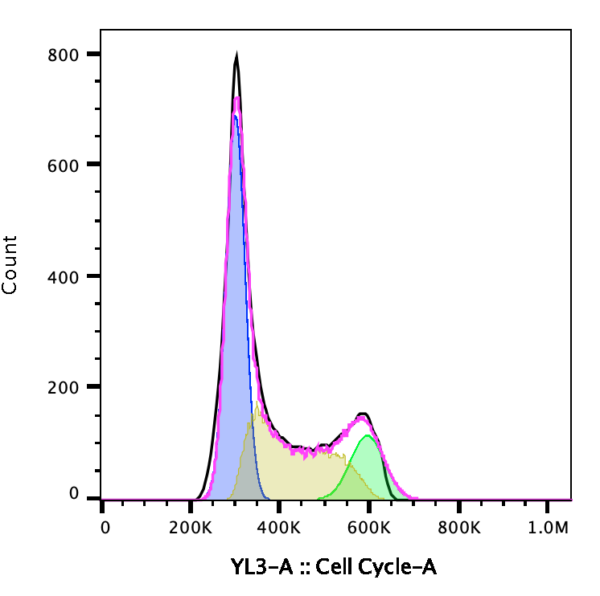
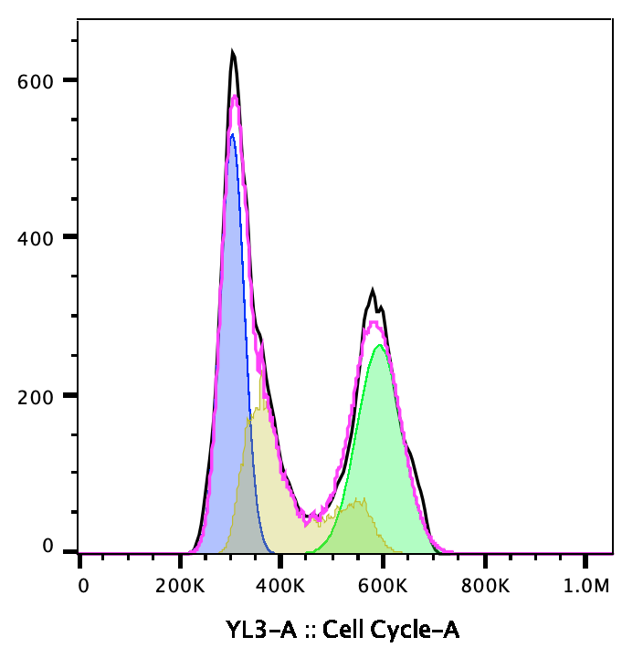
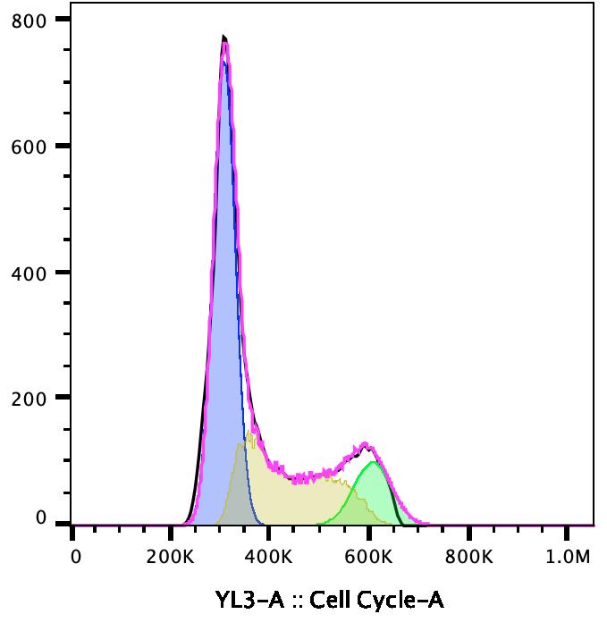
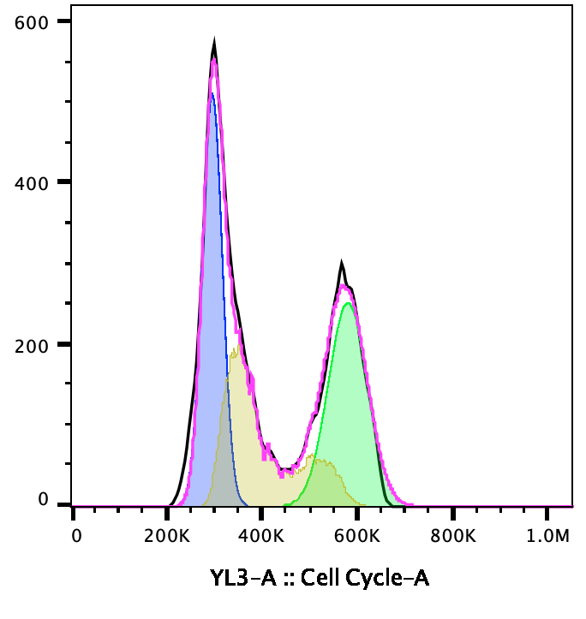
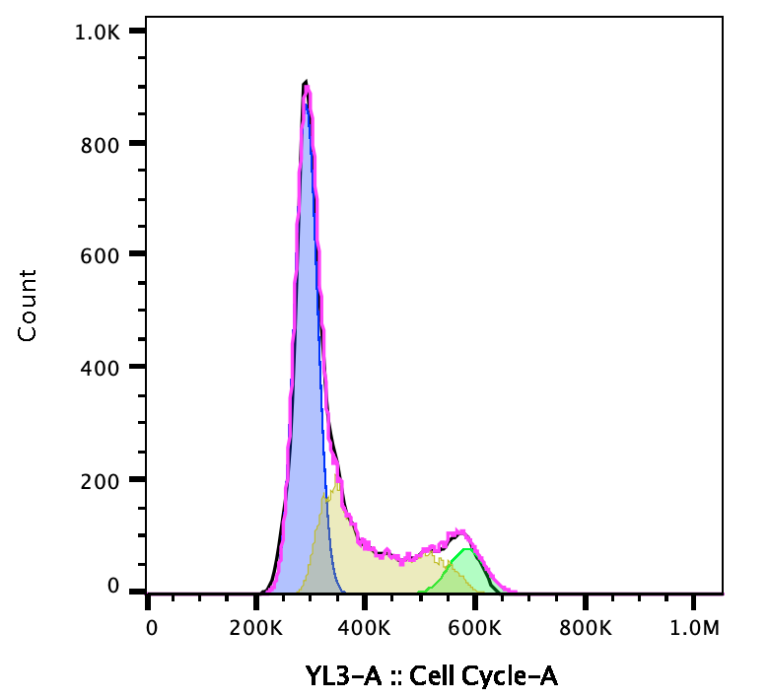
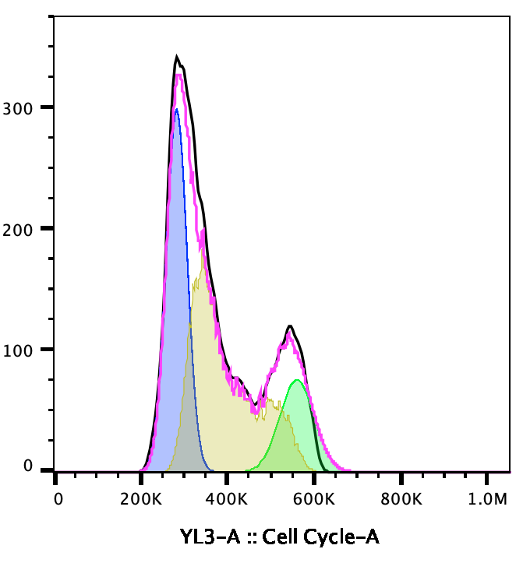
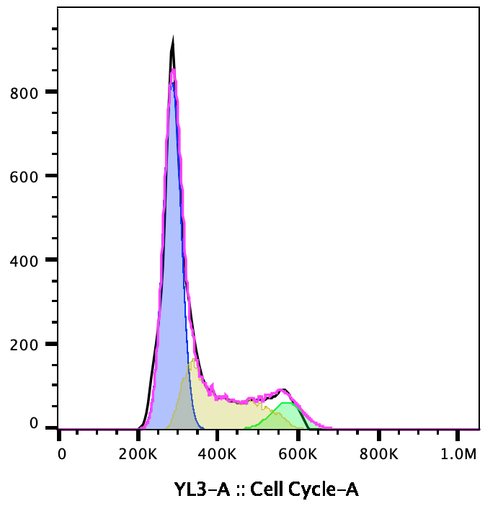
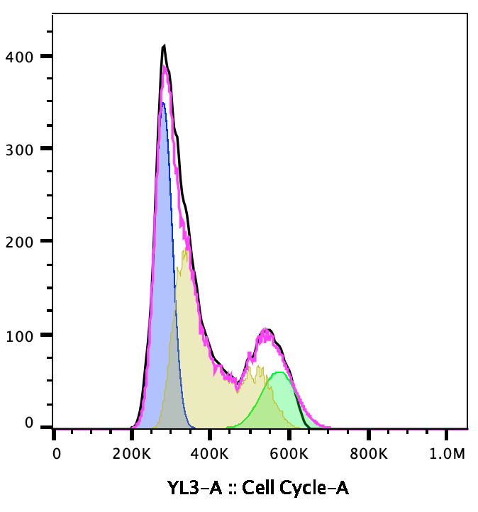
A
CTRL
BTZ
RTX
BTZ+RTX
STS
BTZ+STS
RTX+STS
BTZ+RTX+STS
B
CTRL
BTZ
RTX
BTZ+RTX
STS
BTZ+STS
RTX+STS
BTZ+RTX+STS
C
CTRL
BTZ
RTX
BTZ+RTX
STS
BTZ+STS
RTX+STS
BTZ+RTX+STS
SM-Fig. 4 – A-C, Impact of STS and BTZ on cell cycle progression. A-C, Representative distributions of propidium iodide (PI) staining, as measured through flow cytometry analysis, in MEC1 cells exposed to the indicated treatment conditions (CTRL, STS, BTZ, RTX, STS+RTX, STS+BTZ, BTZ+RTX, or STS+BTZ+RTX) for 36 hours (A), 42 hours (B) or 48 hours (C). These distributions were used to estimate the proportion of cells in each cell cycle phase; results of cell cycle analyses with replicates are summarized in Figure 3A-C. .

