Slide 1
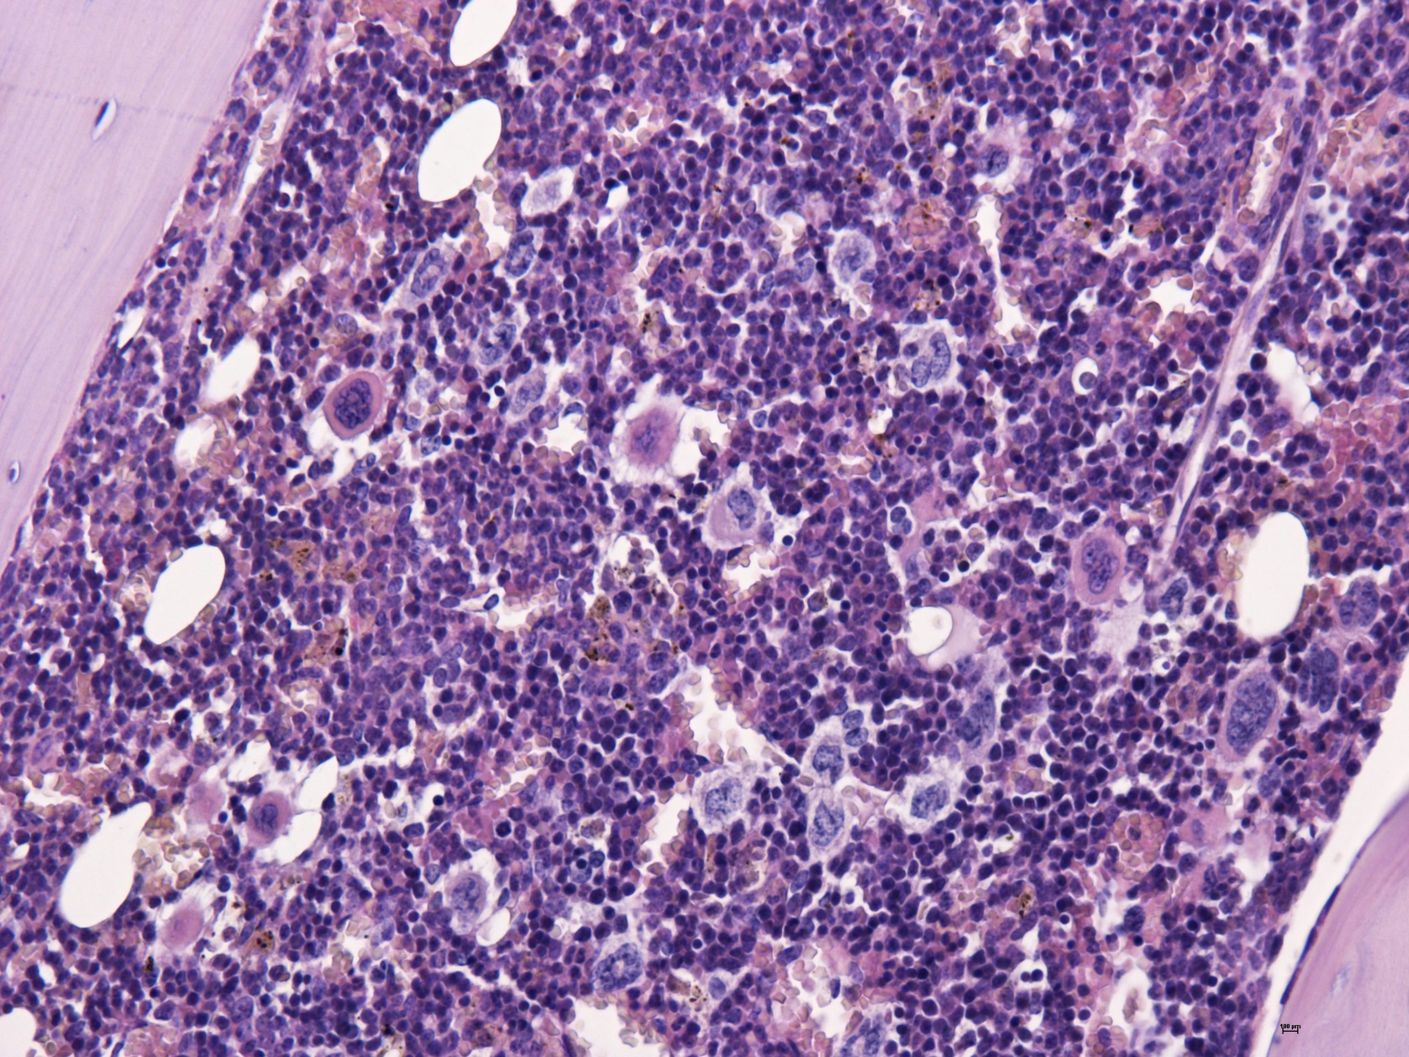
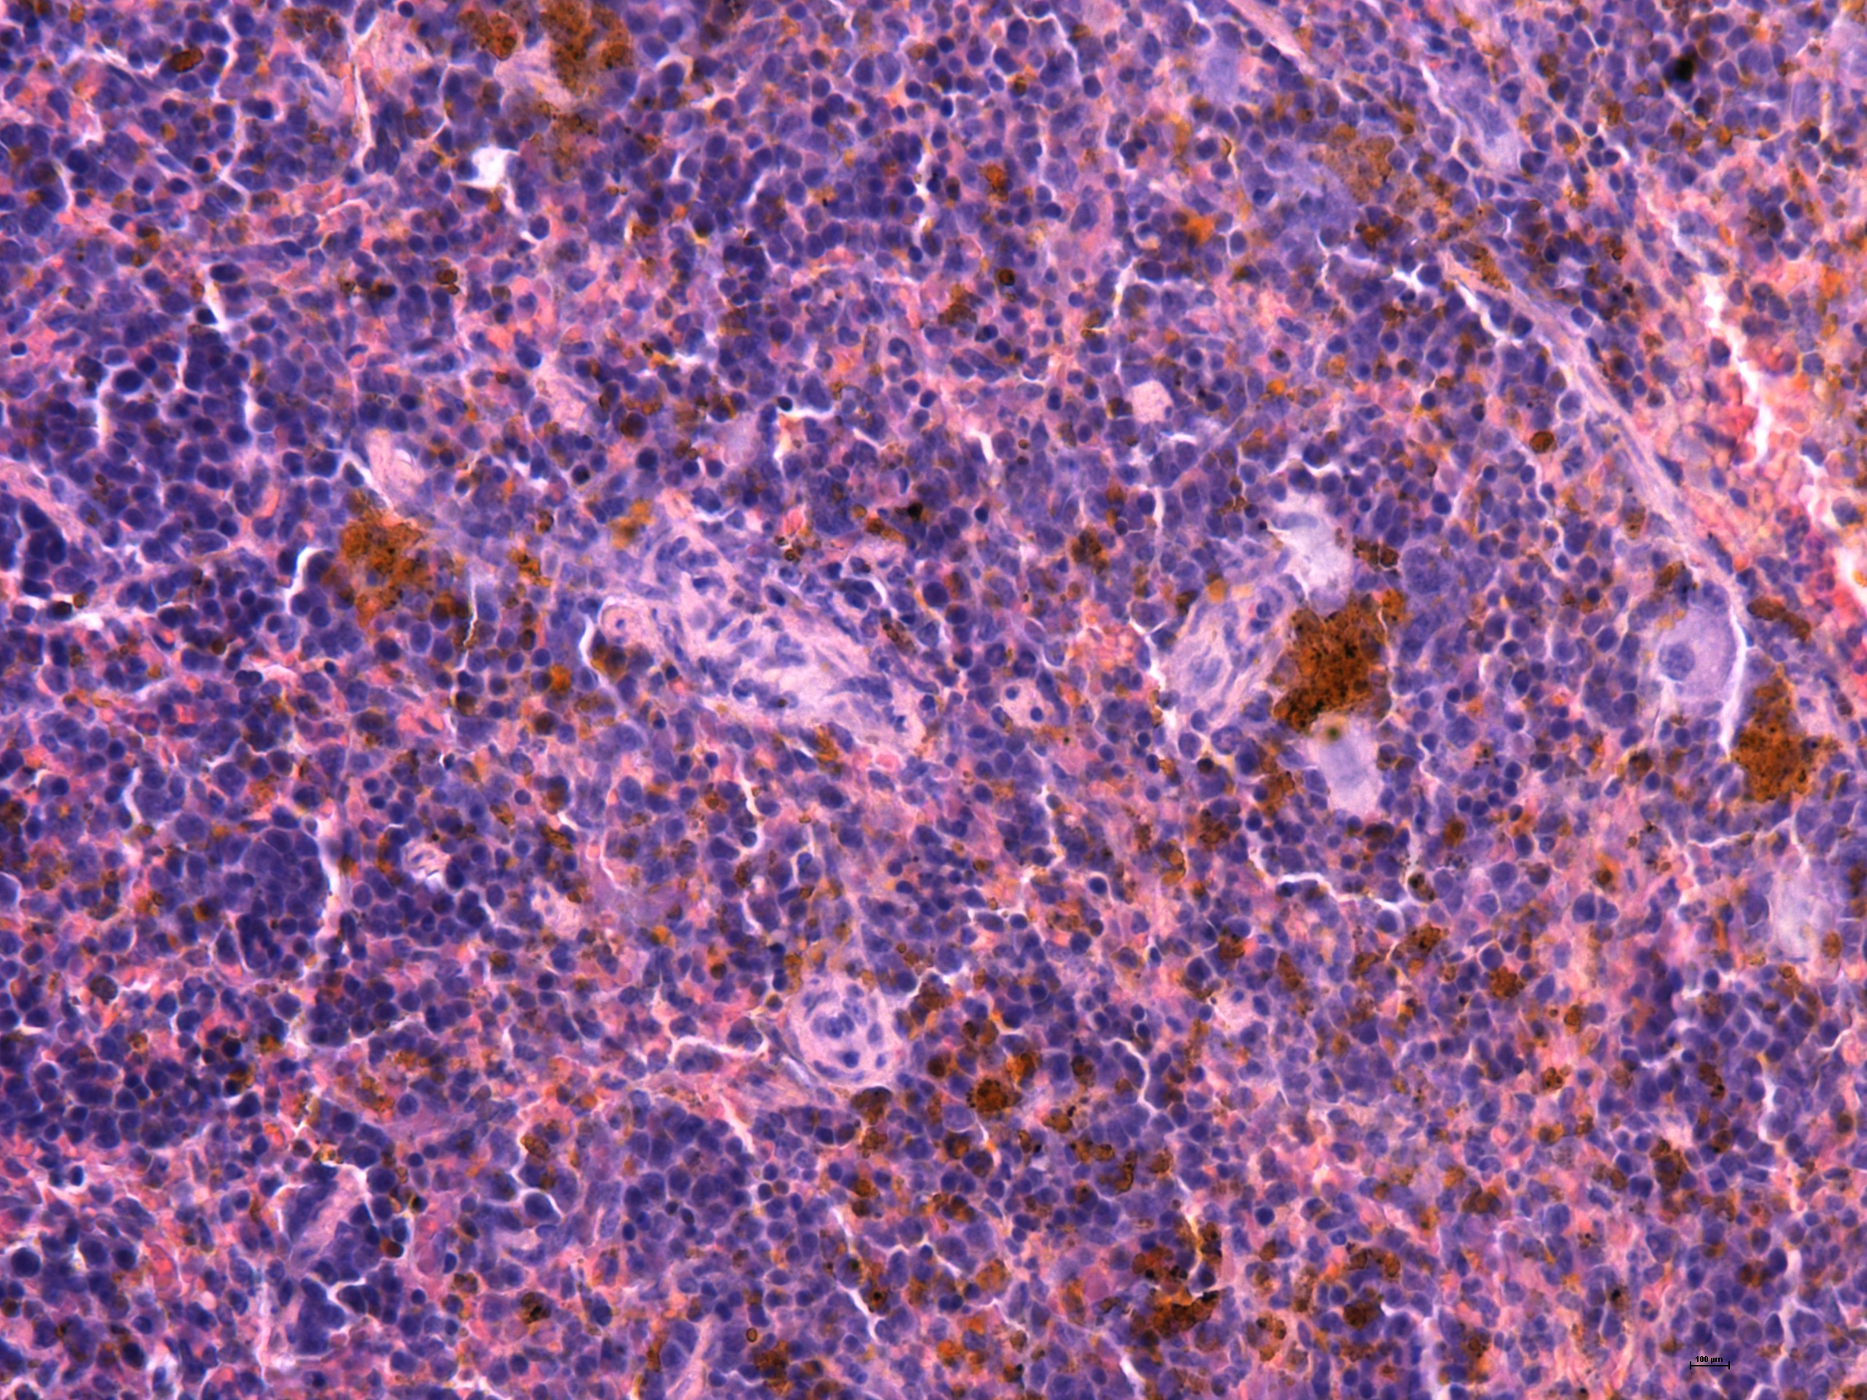
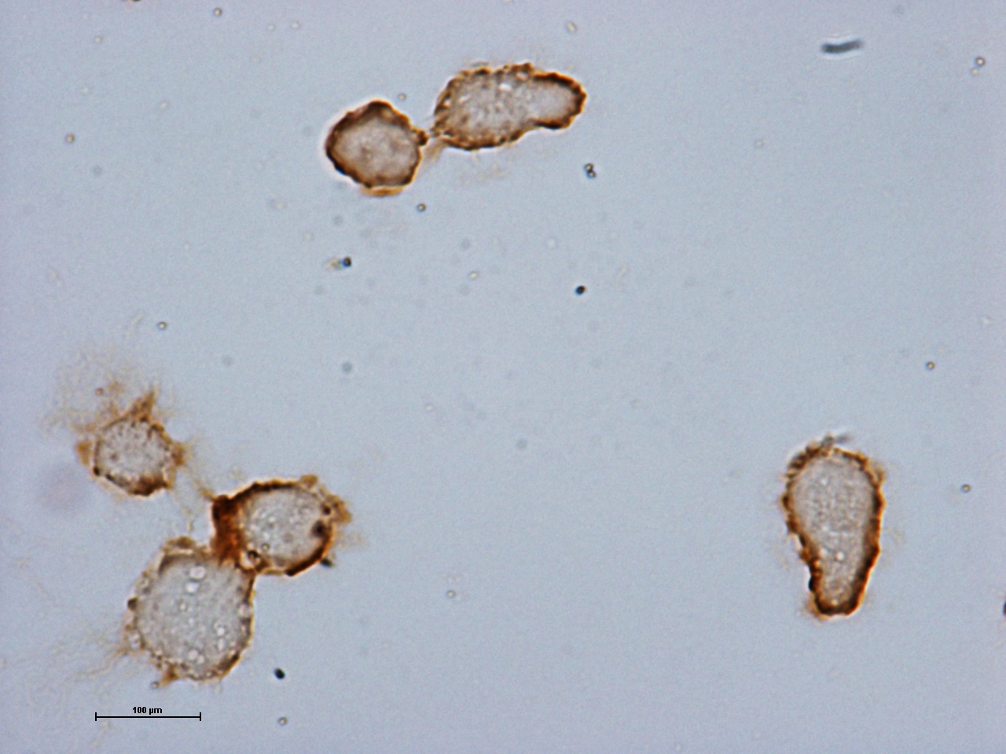
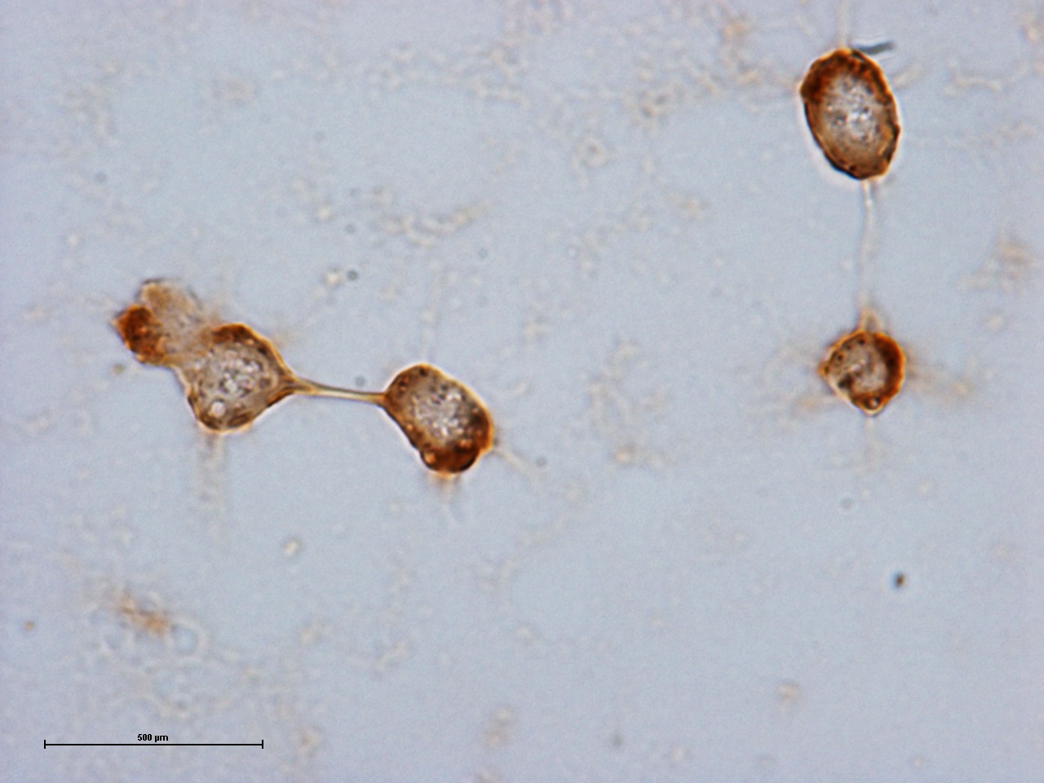
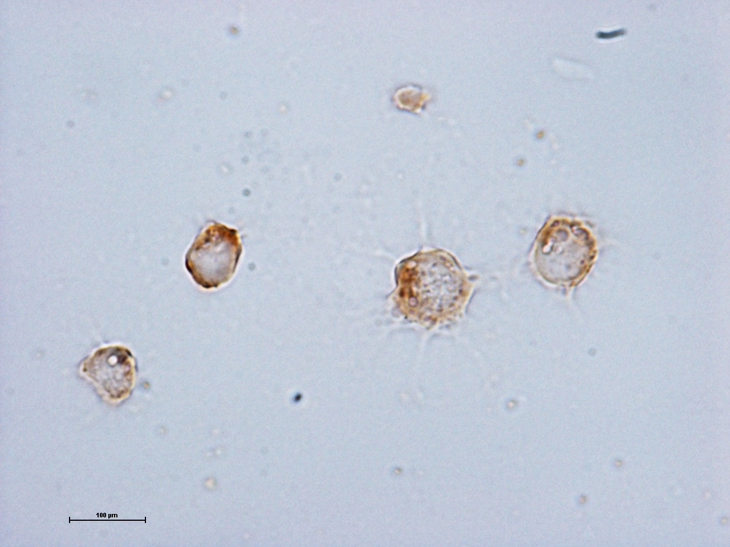
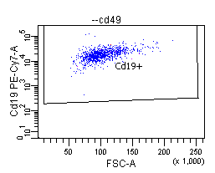
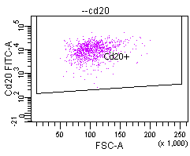
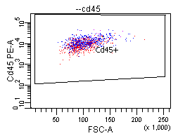
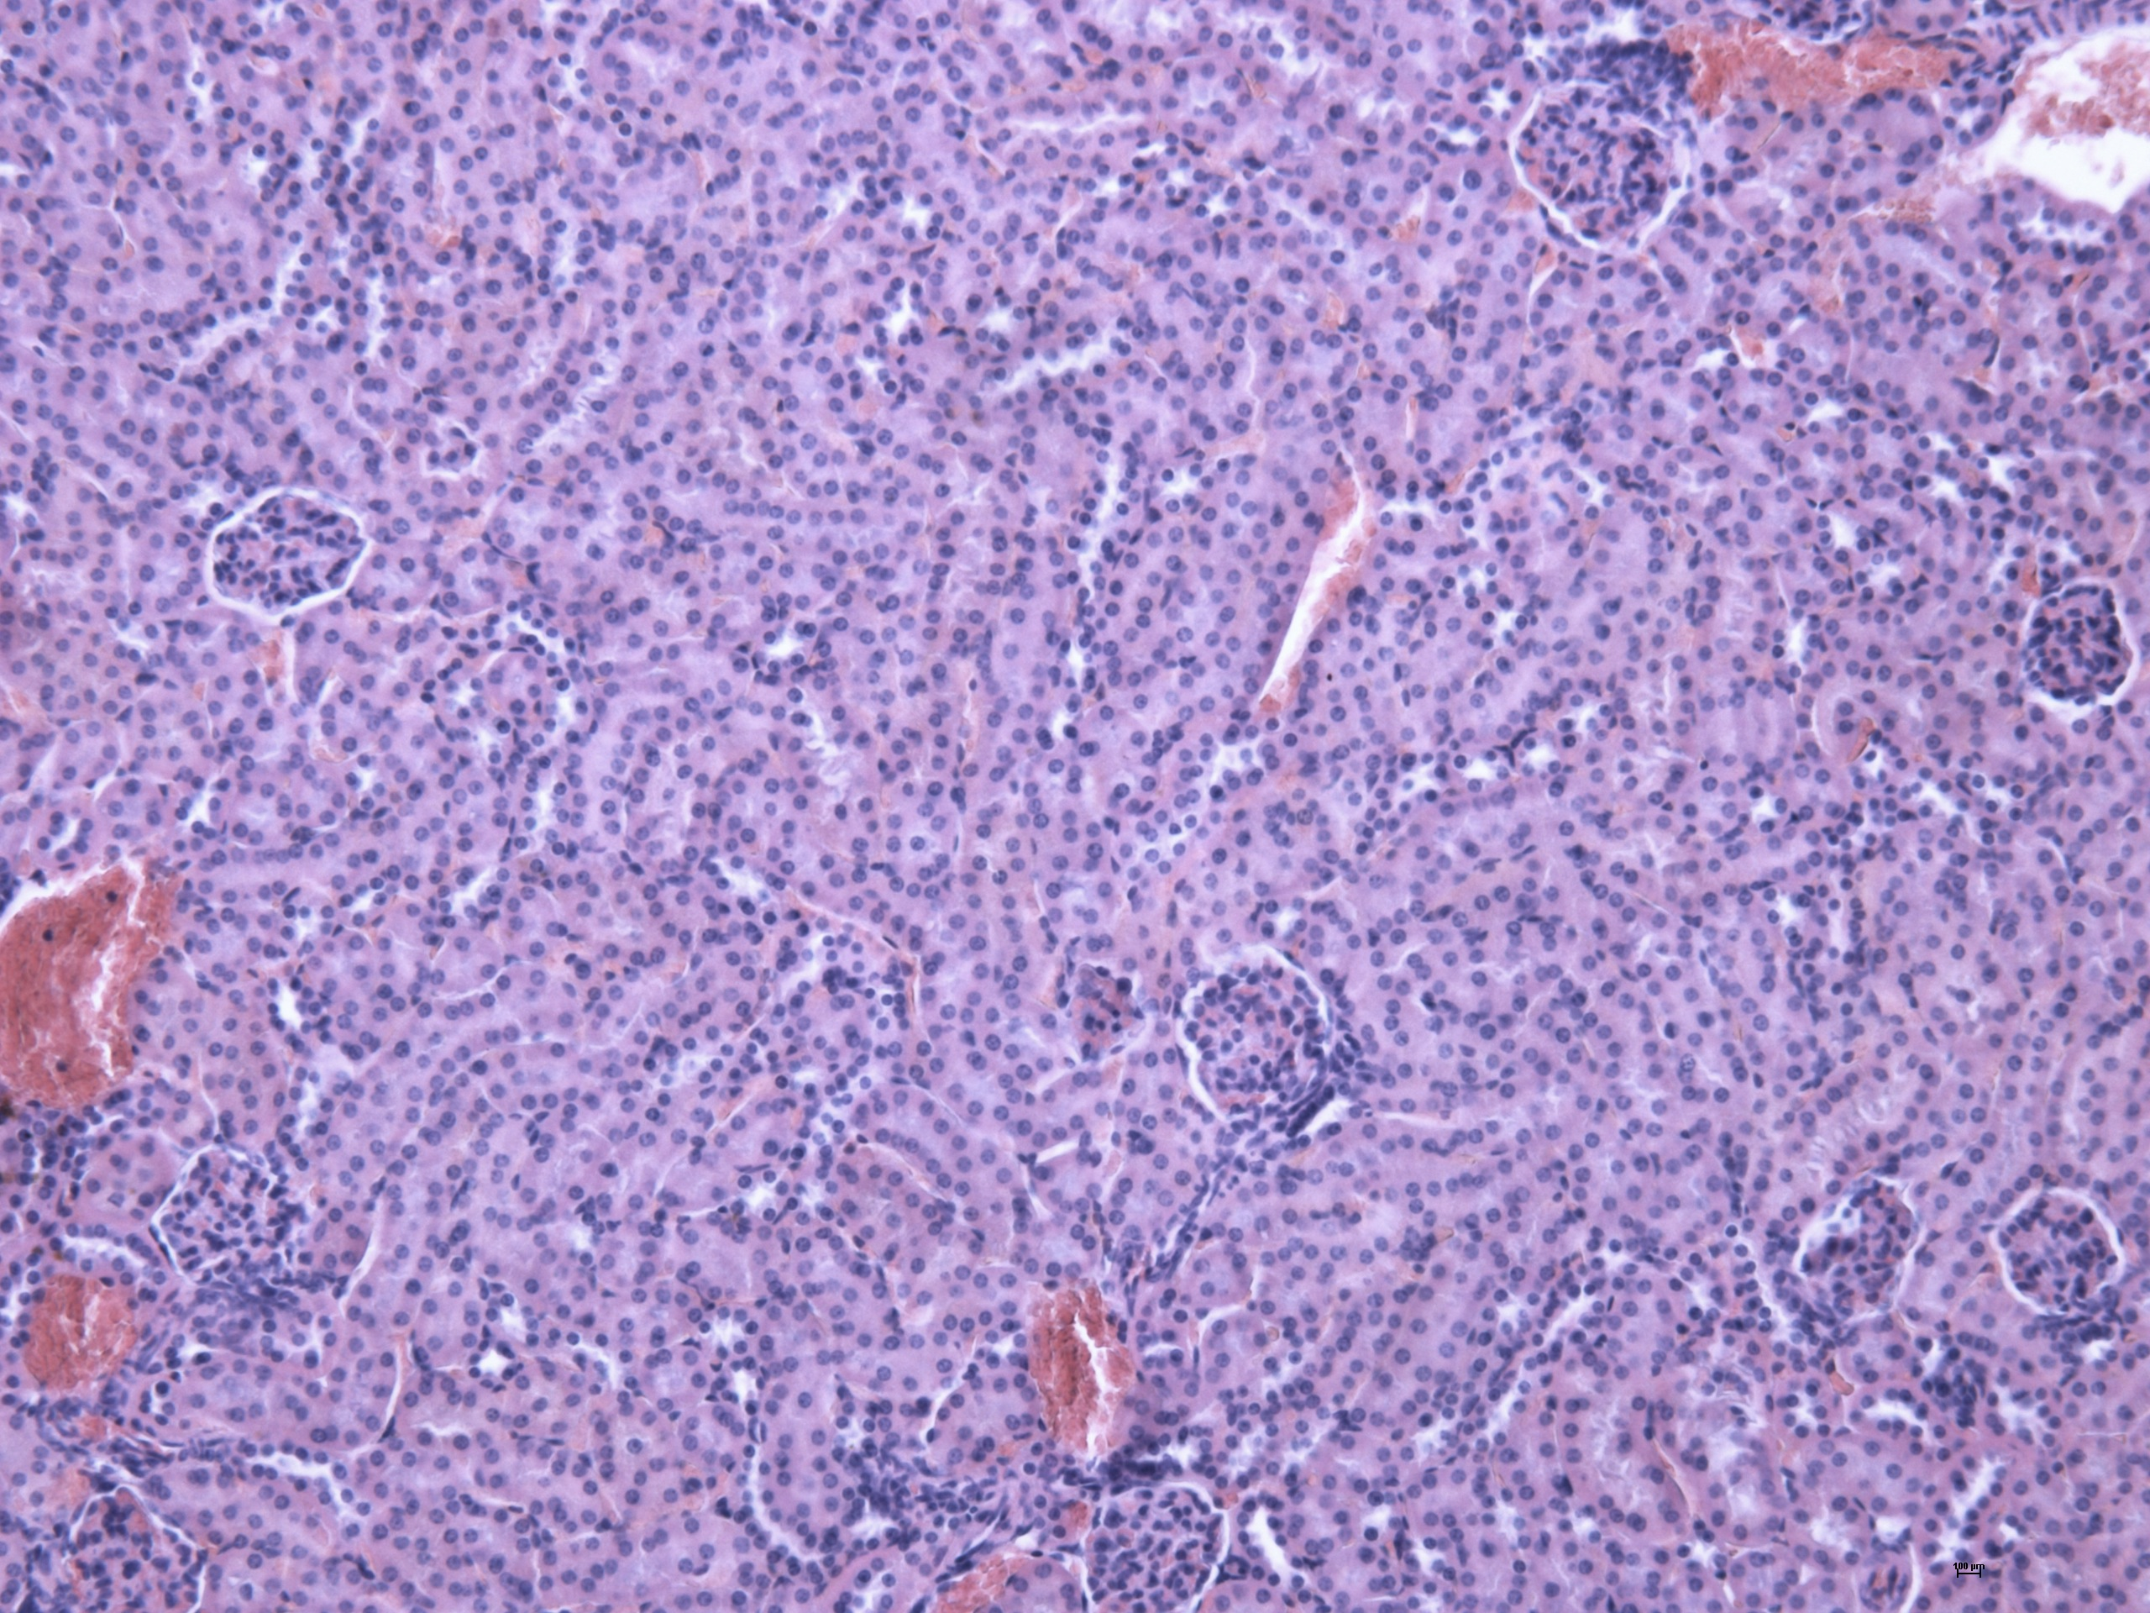
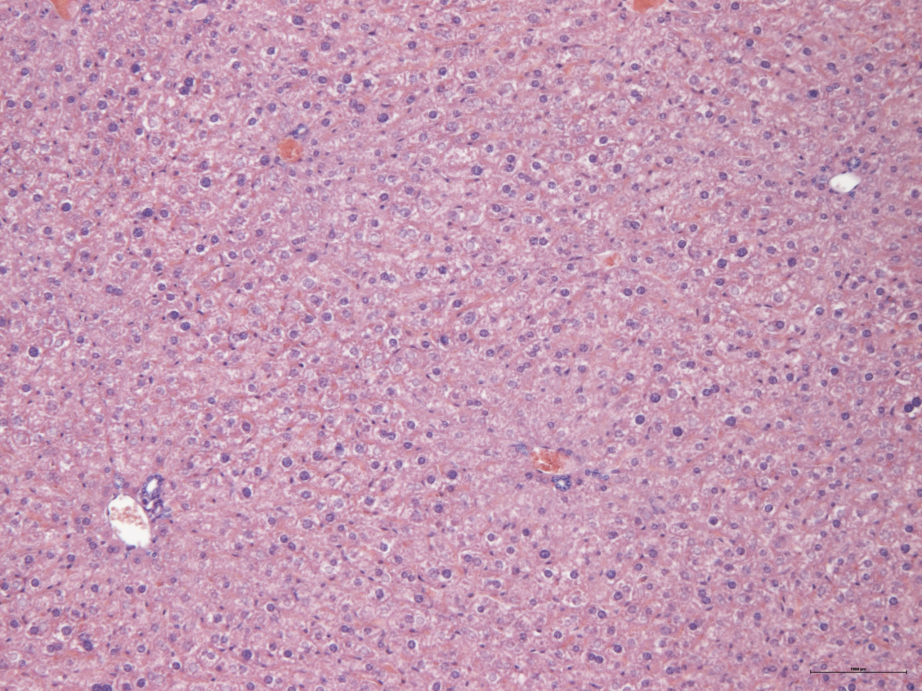
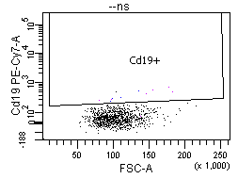
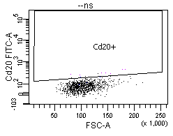
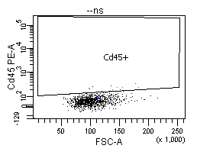
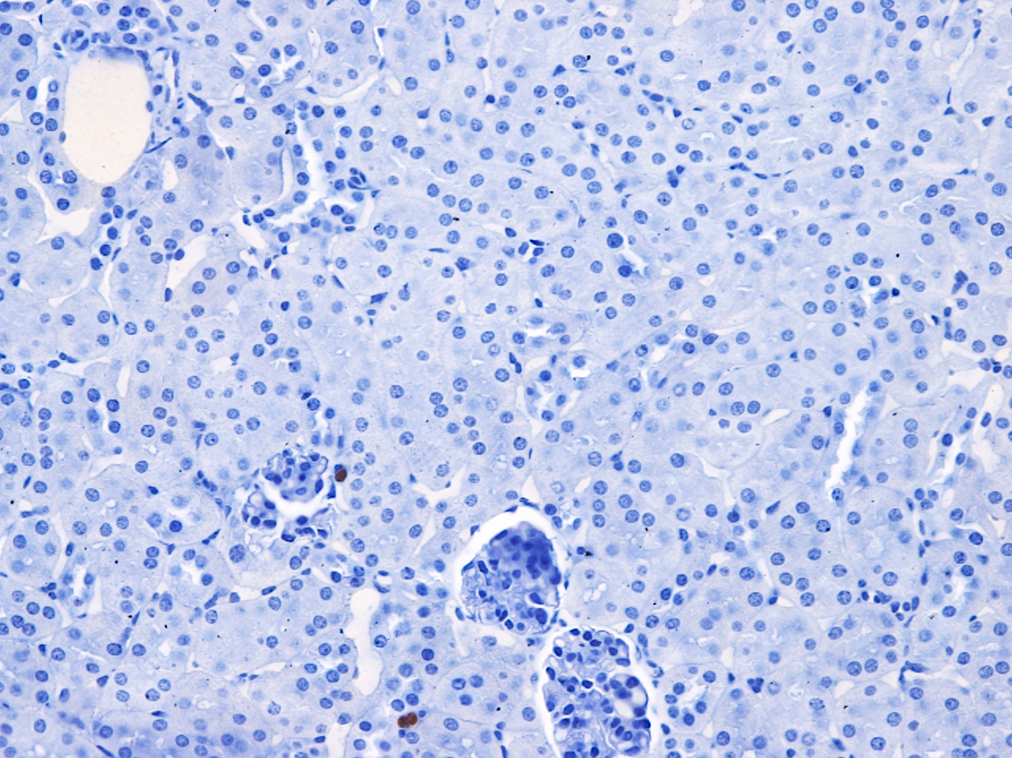
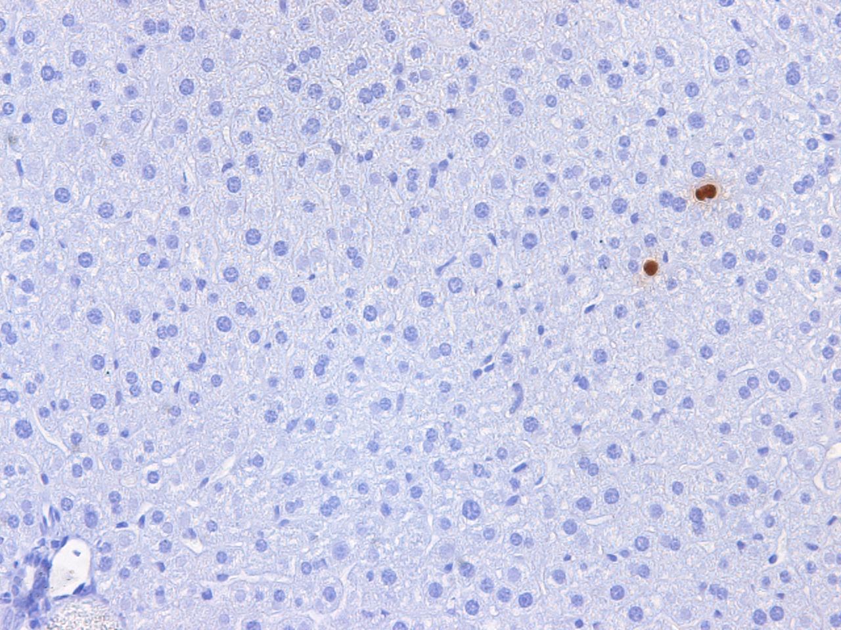
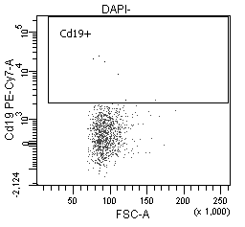
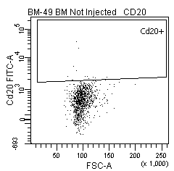
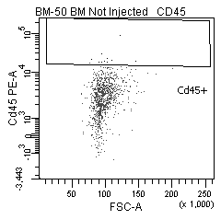
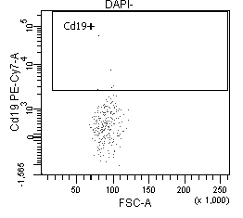
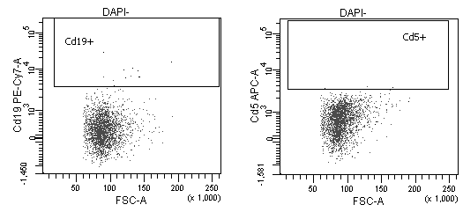
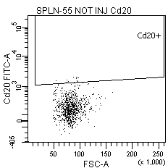
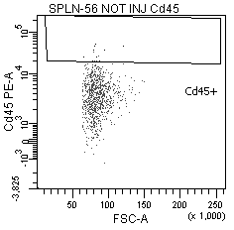
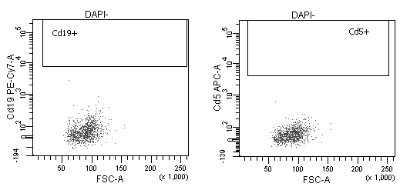
A
HEALTHY MICE
C
CD19
CD20
CD45
500µm
500µm
500µm
Bone marrow
50µm
Spleen
50µm
Single staining
99%
99%
99%
Negative CTRL
Kidney
50µm
Liver
50µm
B
D
Kidney
Liver
BONE MARROW
BLOOD
CD19
CD20
CD45
CD19
HEALTHY MICE
SPLEEN
PERITONEAL FLUID
50µm
50µm
CD19
CD20
CD45
CD19
E
Tumor
Injection
(s.c.)
Tumor
palpable
F
Sacrifice
Days
0
10
Cycle 1
Cycle 2
Cycle 3
Days
STF
STF
STF
STF
0
10
11
12
18
19
24
25
Days
0
10
+drug
+drug
+drug
RTX+BTZ
12
19
25
Days
STF
STF
STF
STF+RTX+BTZ
0
10
11
12
18
19
24
25
+drug
+drug
+drug
SM-Fig. 6. Staining of healthy mouse tissues for human CLL markers. A, Haematoxylin/eosin (H/E) staining of the indicated tissues or organs in healthy mice. Bar=100μm. B, Picture showing nuclear staining (at high magnification) through anti-human nuclei antibody of MEC1 cells in the kidney or liver of eight-week-old female NODSCID ilrg-/- mice injected i.v. with MEC1 cells (intravenous CLL model). C-D, The specificity and cross-activity of the indicated antibodies was evaluated by FACS analysis in MEC1 cells by immunocytochemistry (C) or in the indicated tissues or organs collected from healthy mice (not injected with MEC1 cells) (D, negative control). E, Experimental scheme of STF, BTZ+RTX and STF+BTZ+RTX in subcutaneous (s.c.) mouse CLL model (MEC1 cells). Each of the indicated treatments was administered for 3 cycles. F, Body weight modification (gr) over the time, and under the indicated treatment conditions, are represented.

