Slide 1
A
B
C
D
E
F
Supplemental Figure 1. vvTD-IL36γ increased IL-36γ production in MC38 peritoneal carcinomatosis tissue. Two days after oncolytic virotherapy, RNA and intra- and extracellular fluid were extracted from peritoneal carcinomatosis homogenates. Each mouse represents one data point. ELISA analysis revealed that IL-36γ was significantly increased in intra- and extracellular fluid of tumor homogenates from cytokine-expressing virus in comparison to parental virus and PBS control on day 2 (A) and maintained elevated on day 6 following immunotherapy in the cytokine-expressing virus treatment group (D). Consistent with quantitative protein findings, RT-qPCR showed increased IL-36γ relative expression in total RNA of tumor homogenates 60 hours following virotherapy (B) but not on day 6 (E). This could be due to a decrease in expression that is not yet reflected in protein levels explained by the longer half-life. The expression of vaccinia virus-specific gene A34R was elevated two days following immunotherapy in cytokine-expressing virus treated animals (C) but normalized to untreated control animals on day 6 post therapy (F). Relative CD8a expression 60 hours past immunotherapy in tumor tissue was higher in the vvTD-IL36γ treated animals than in both other treatment groups. * p < 0.05. ** p < 0.01. *** p < 0.001.

Slide 2
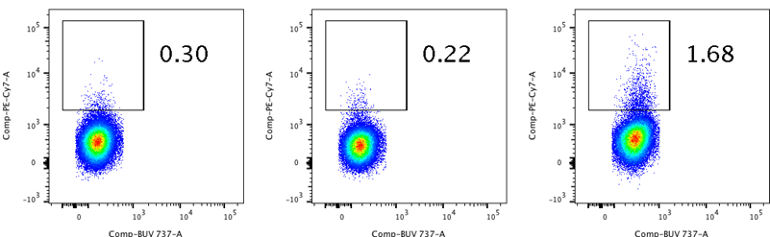
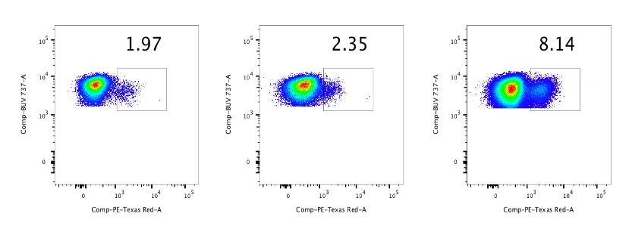
Supplementary Figure 2. FACS analysis of immune cells in lavage 6 days post OV therapy . A. lymphocytes based on Forward scatter and side scatter. B. IFN-γ⁺CD4⁺ T cells. C. CD4⁺Foxp3⁺Treg. D. Gr1^{hi}CD11b⁺ g-MDSCs and Gr1^{int}CD11b⁺ m-MDSCs. E. CD24⁻ F4/80⁺ TAMs and CD24⁺ F4/80⁻ DCs. GF CD206⁺ CD11b⁺ M2-like TAMs. G. CD49b⁺ NK cells.
PBS vvTK- vvTK-IL36γ
PBS vvTK- vvTK-IL36γ
A
Gated on live cells
E
Gated on CD45⁺CD11b⁺Gr1⁻MHCII⁺ cells
SSC
CD24
FSC
B
Gated on CD4⁺ T cells
F4/80
F
Gated on CD45⁺CD11b⁺Gr1⁻MHCII⁺CD24⁻F4/80⁺ cells
IFN-γ
CD4
CD11b
C
Gated on CD4⁺ T cells
CD206
CD4
G
Gated on CD4⁻ CD8⁻ γδTCR⁻ lymphocytes
Foxp3
CD49b
D
Gated on CD45⁺ cells
CD8
Gr-1
CD11b

Slide 3
A
B
C
D
Supplementary Figure 3. Analysis of immune cells in lavage specimen on day 6 and day 11 post immunotherapy. A. Tumor associated macrophages (TAM), defined as F4/80+ cells per CD45+ CD11b+ cells, were less prevalent in lavage from vvTD-IL36γ-treated animals when compared to parental virus-treated animals. B. NK cells were classified as CD45+ CD3- NK1.1+ cells and showed no difference in existence in lavage specimen on day 6 post immunotherapy. C. No significant difference in TAM presence was found on day 11 post therapy. D. NK cells were increased in lavage specimens of vvTD-IL36γ-treated animals in comparison to sham and parental virus treated animals. * p < 0.05. ** p < 0.01.

Slide 4
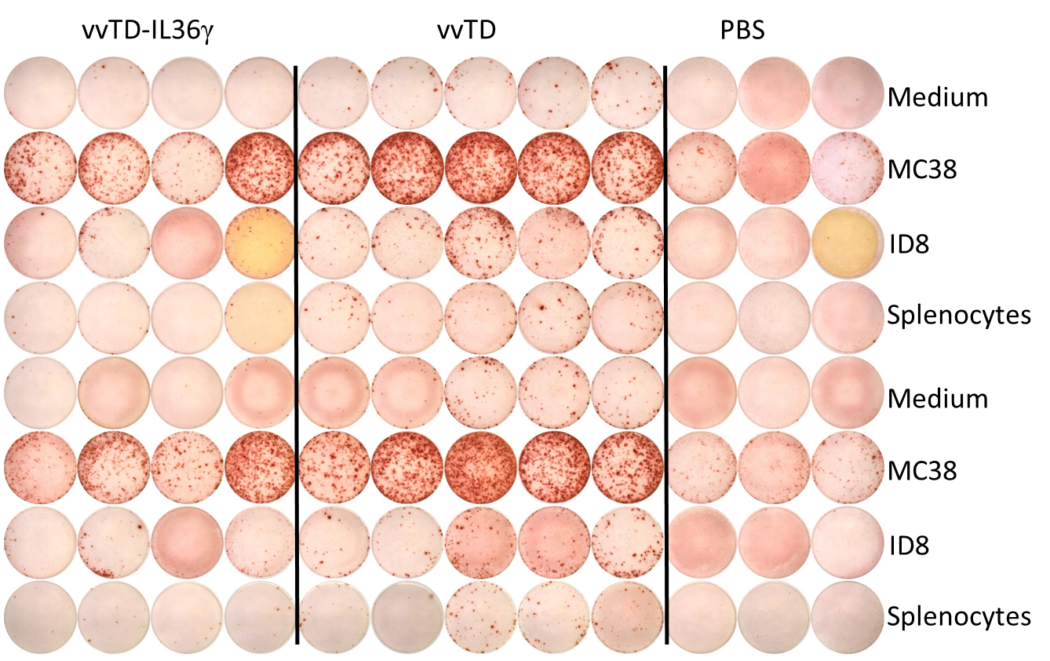
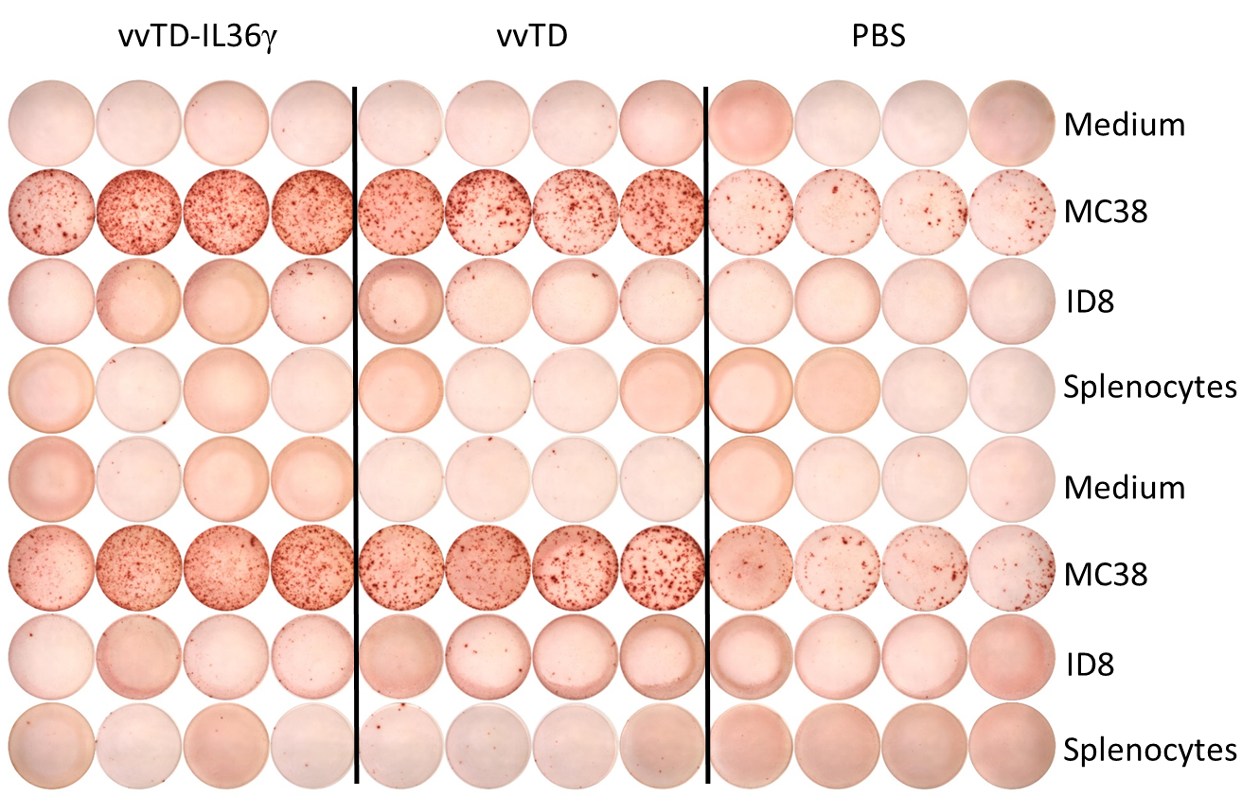
A
B
Supplementary Figure 4. vvTD-IL36γ induced MC38-spedific CD8⁺ T cells in the intraperitoneal space vanish after 11 days post oncolytic virotherapy in correspondence with cancer disappearance, while cultivating an enhanced systemic MC38-specific immune response in the spleen. A. Representative image of IFNγ ELISPOT of 2x10⁴ CD90.2⁺ T cells isolated from lavage specimens on day 11 post oncolytic virotherapy and co-cultured 1:1 with specific (MC38) and unspecific (medium, ID8, splenocytes) target cells and analysis of ImmunoSpot™ counted spots. B. Representative image of IFN-γ ELISPOT of 10⁵ CD90.2⁺ T cells isolated from the spleen on day 11 post oncolytic virotherapy and co-cultured 1:1 with specific (MC38) and unspecific (medium, ID8, splenocytes) target cells and analysis of ImmunoSpot™ counted spots. ** p < 0.01. *** p < 0.001. **** p < 0.0001.

