Slide 1
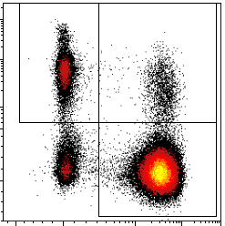
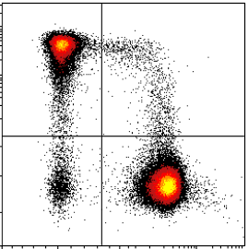
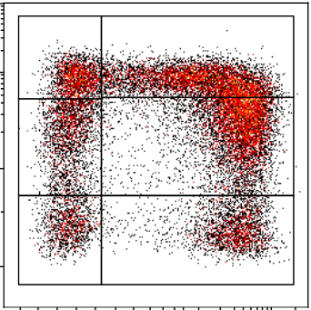
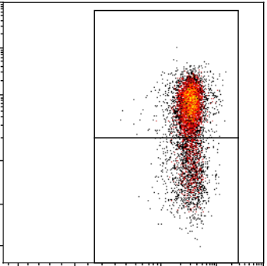
Supplementary Figure 1
Tumor cells
CD45⁻ cells
CD45⁺ cells
Leucocytes
SSC-A
SSC-A
SSC-A
DRAQ7
CD45
DRAQ7
NK
Leucocytes
T cells
CD56
SSC-A
Lymphocytes
SSC-A
CD3
CD45
FSC-A
T_{CD8}
CD8
CD226
PD1
T_{CD4}
CD4
TIGIT
CD3
T_{CD8}
CD96
FMO
CD45
Count
CD96

Slide 2
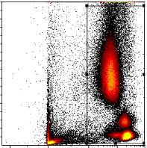
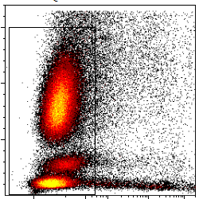
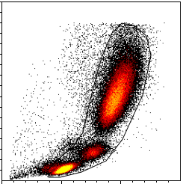
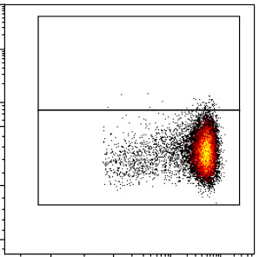
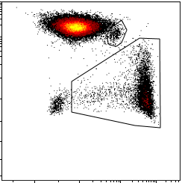
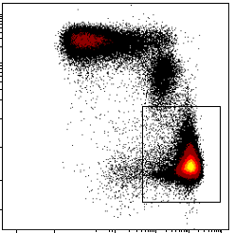
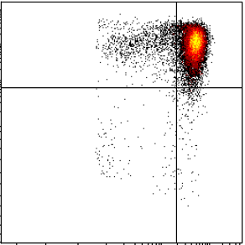
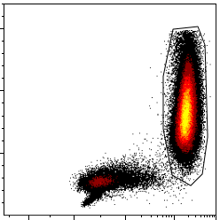
Supplementary Figure 2
SSC-A
SSC-A
SSC-A
CD45
DRAQ7
FSC-A
Macrophages
gMDSC
Monocytes
CD163
CD15
CD14⁺ CD15⁻
Lineage
Myeloid
cells
CD14
Conventional
monocytes
CD14
CD11b
Inflammatory
monocytes
Granulocytes
HLA-DR
SSC-A
mMDSC
CD14
CD15
Infl monocytes
Infl monocytes
Infl monocytes
Infl monocytes
FMO
FMO
FMO
FMO
Count
PD-L1
CD111
CD112
CD155

Slide 3
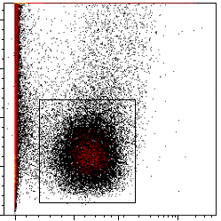
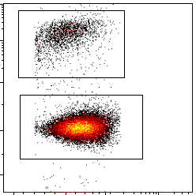
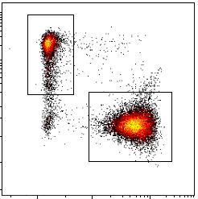
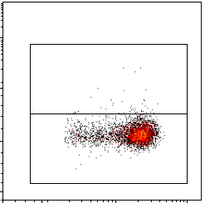
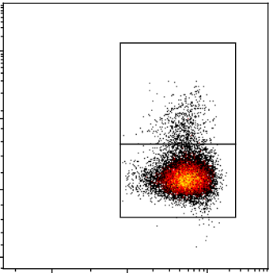
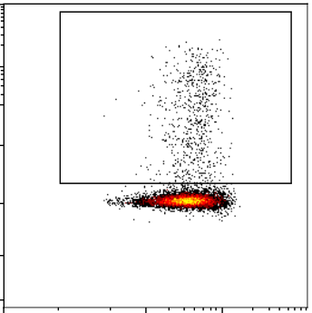
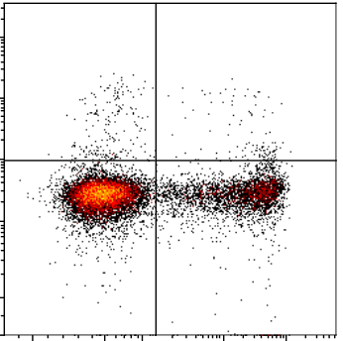
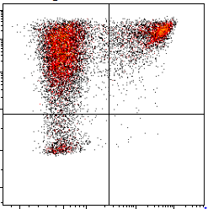
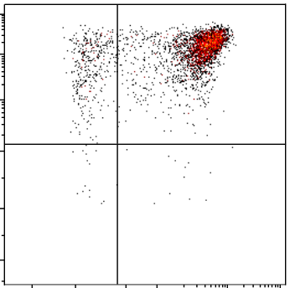
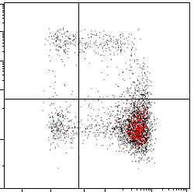
Supplementary Figure 3
T CD8
TILs
SSC-A
CD45
CD8
Lymphocytes
T CD4
CD3
CD3
CD4
T CD8reg
Treg
Foxp3
Foxp3
T CD4_{conv}
T CD8_{conv}
CD8
CD4
Th2
Th17
Th1/17
IL-4
IL-17A
TNFα
Th1
CD4
IFNγ
IFNγ
TNFα
GrzB
IL-2
IL-2

Slide 4
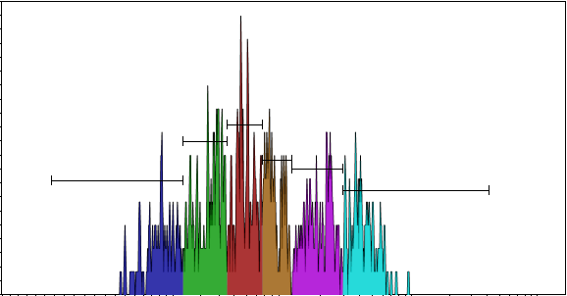
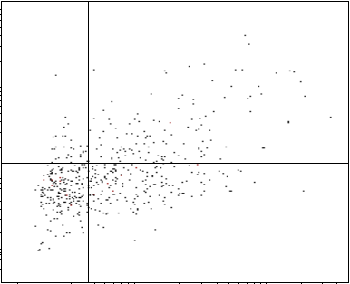
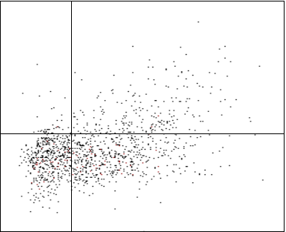
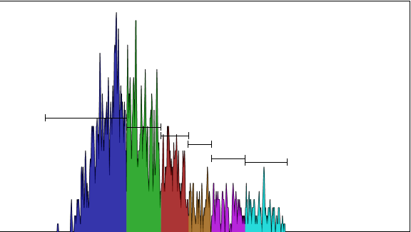
Supplementary Figure 4
Count
CTV
T CD8
IFNγ
TNFα
SSC-A
CD8
T CD3
T CD4
CD3
CD4
IFNγ
TNFα
Count
CTV

Slide 5
Supplementary Figure 5
A
B

Slide 6
Supplementary Figure 6
A
B

Slide 7
Supplementary Figure 7
A
B
C

Slide 8
Supplementary Figure 8
A
B
C
D

Slide 9
Supplementary Figure 9

Slide 10
Supplementary Figure 10

Slide 11
Supplementary Figure 11
A
B

