Slide 1
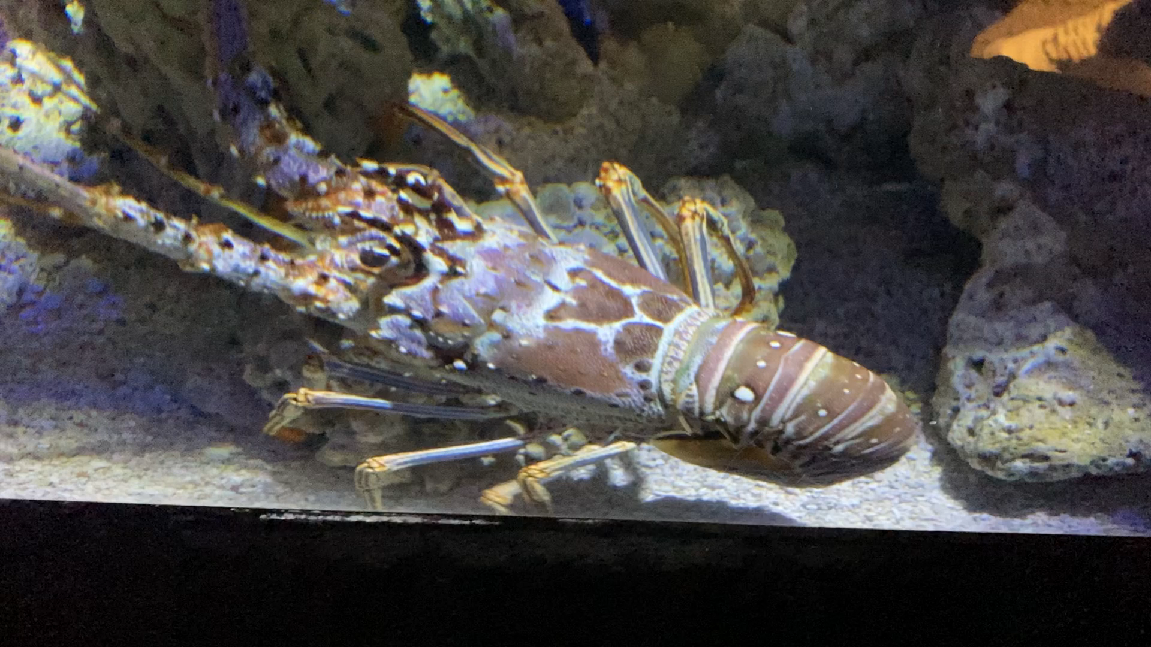
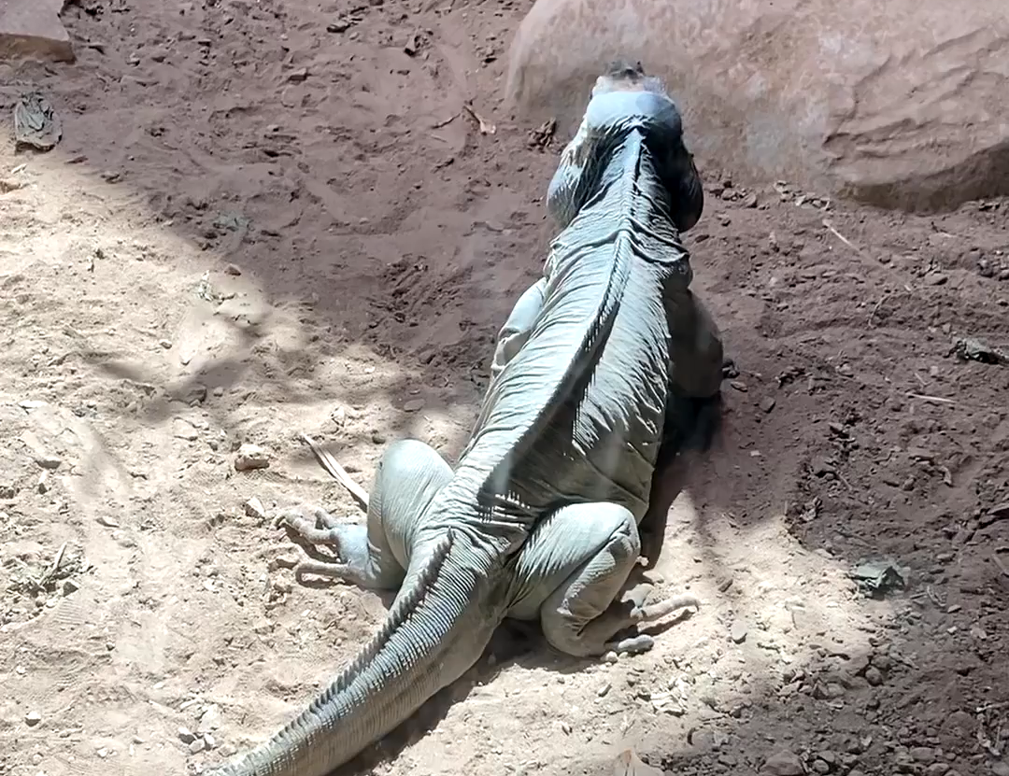
Supplemental Video 1
Volitional behavior in a Lobster and Iguana
a
b
Note. (a) A lobster takes deliberate steps forward, sensing its habitat with antennae as it does so. (b) An iguana looks to one side, then deliberately walks forward and changes direction at the end.

