Slide 1
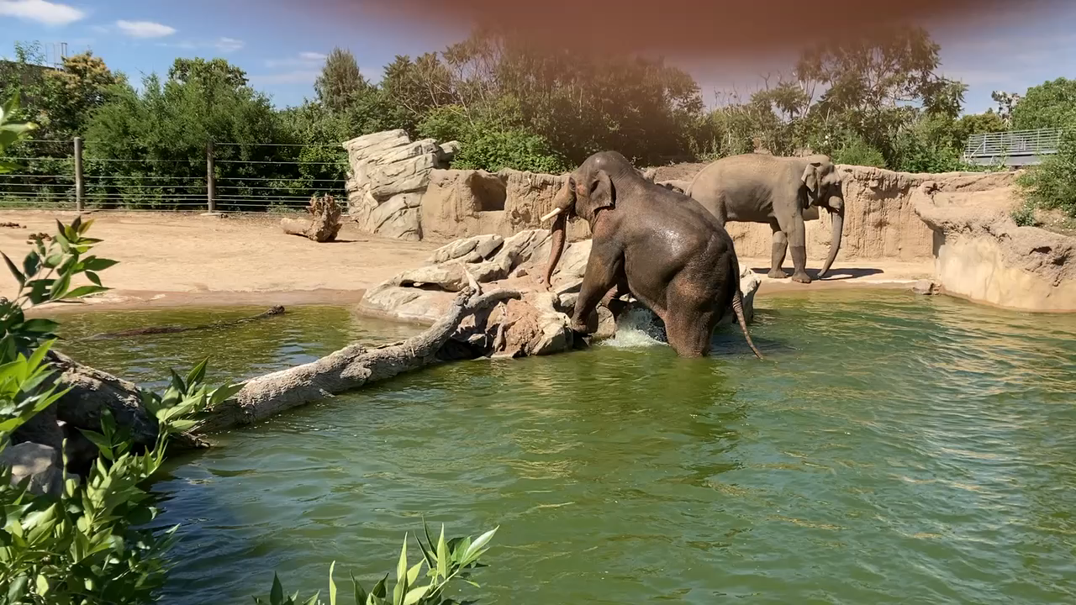
Supplemental Video 3
Volitional and interactive behavior in Elephants
Note. Two elephants deliberately approach one another, interact with their trunks, then walk away in different directions, ending with one diving into the water.

