Slide 1
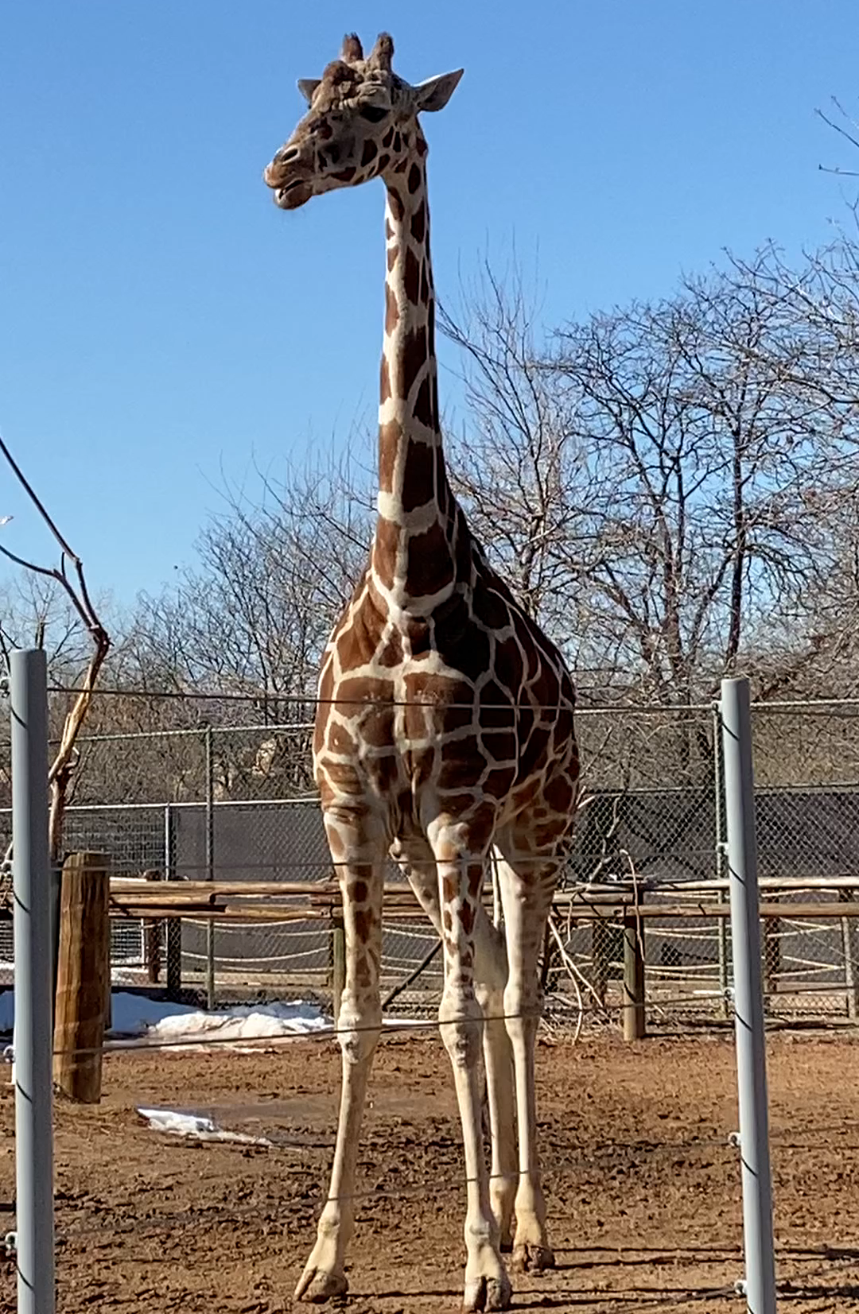
Supplemental Video 4
Egocentric and volitional behavior in a Giraffe
Note. Self-reflective movements of the mouth and tongue are followed by volitional movements that change the animal’s direction of

