Slide 1
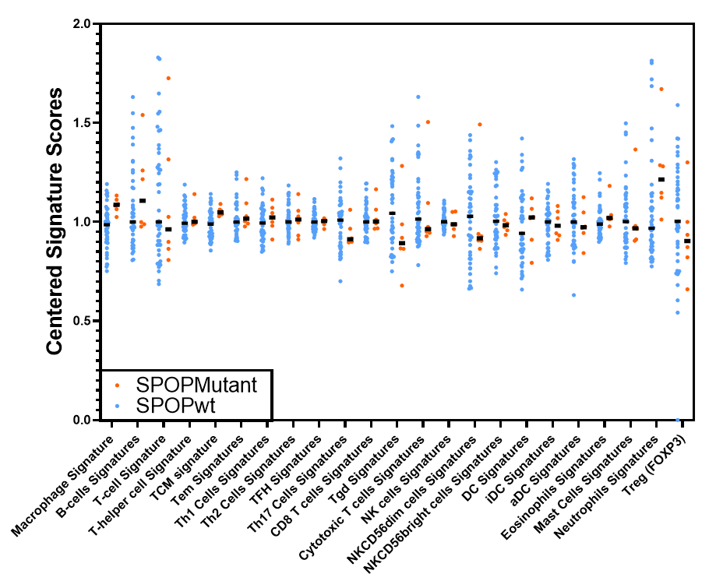
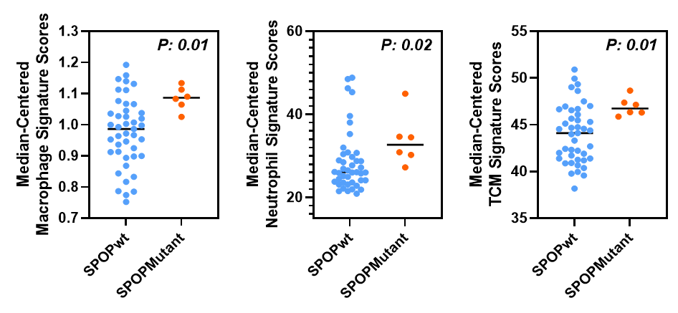
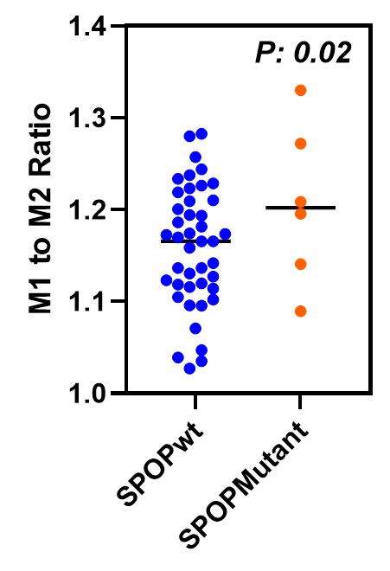
Supplementary Fig. S1
A
B
Supplementary Fig. S1. “Immunome” analysis of SPOPmut and SPOPwt from Beltran CRPC cohort using a compendium of publicly available data from purified immune subsets. A. Centered Signature Scores for comprehensive list of immune cells derived from SPOPmut and SPOPwt prostate cancers. B. Statistically significant Centered Signature Scores derived from Supplementary Fig. S1A showing median-centered macrophage signature score (upper left panel), also shown in Supplementary Fig. S1B, median-centered neutrophil signature scores (upper right panel), median-centered memory T cells (TCM) signature scores (lower left panel) and M1-to-M2 ratio (lower right panel).

