Slide 1

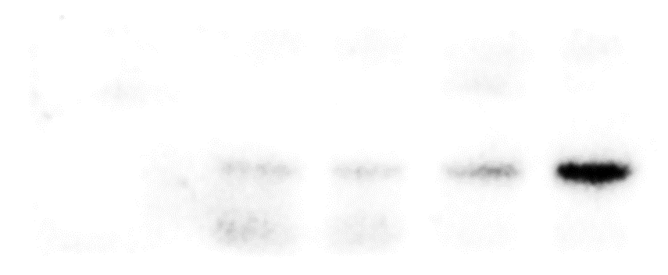
Supplementary Fig. S5
HA-SPOPwt
INPUT
V1-STING
Vinculin
IP-HA
IB-V1-STING
Supplementary Fig. S5. Original unedited IB images for representative Western blots experiments (n-2) used in Figure 3C. The red-boxed area on each unedited image indicates the exact image cropped and used in the Figure 3C.

