Slide 1
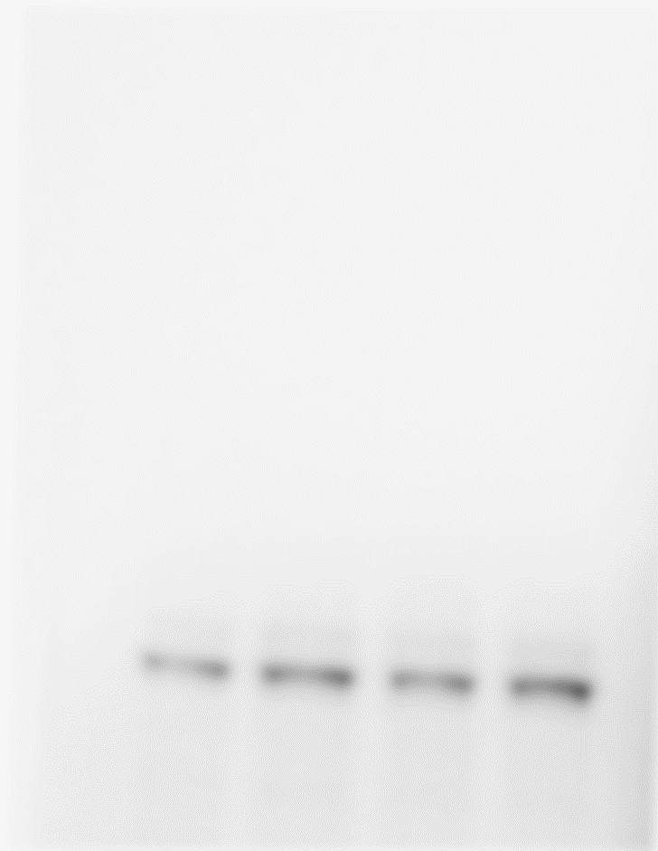
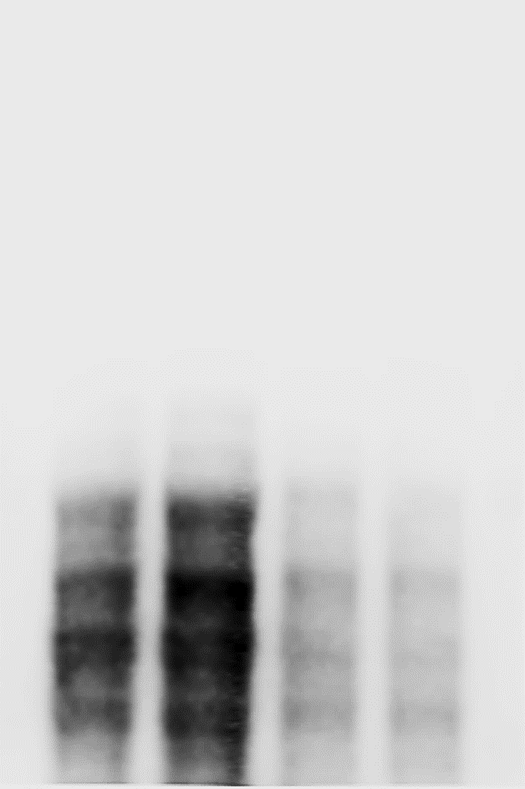
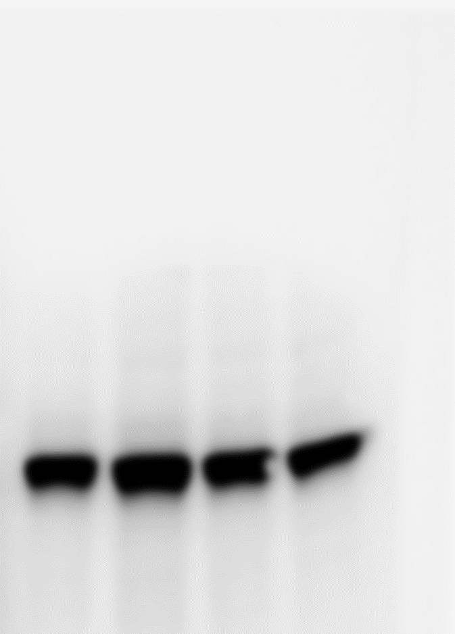
Supplementary Fig. S6
HA-SPOPwt
HA-SPOPF102C
HA-SPOPF133V
Recombinant
STING protein
+ ‡
+
+
+ ‡
+
+
+ ‡
+
+
-
+
-
50 KDa
35 KDa
STING+SPOPwt
SPOPs
STING
+
Anti-STING antibody
+
Anti-HA
antibody
Supplementary Fig. S6. Far western blotting assay to detect direct protein-protein interaction of SPOP and STING protein in vitro. Far western blotting assay was conducted as described in Supplementary Methods. Anti-STING antibody detected endogenous STING protein (Mw 35 KDa), and the protein band specifically represents increasing loading amount of SPOPwt, but not substrate-binding deficient SPOP mutations, SPOPF102C and SPOPF133V (Mw 45 KDa) when purified recombinant STING protein was presented to the membrane incubation during the membrane blotting assay.

