Slide 1
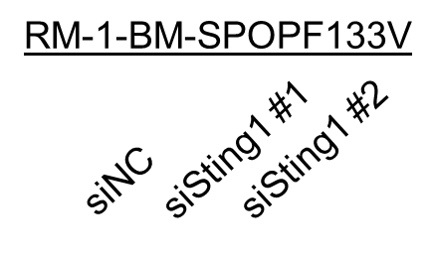
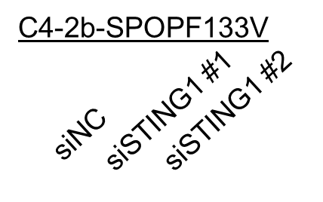
Supplementary Fig. S13
STING1
Sting1
IL-6
Il-6
Vincullin
Vincullin
Supplementary Fig. S13. Original unedited IB images for representative Western blots experiments (n-3) used in Supplementary Figure S12 The red-boxed area on each unedited image indicates the exact image cropped and used in the Supplementary Figure S12.

