Slide 1
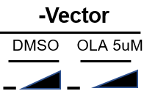
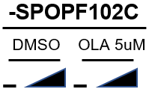
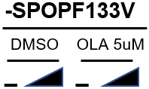
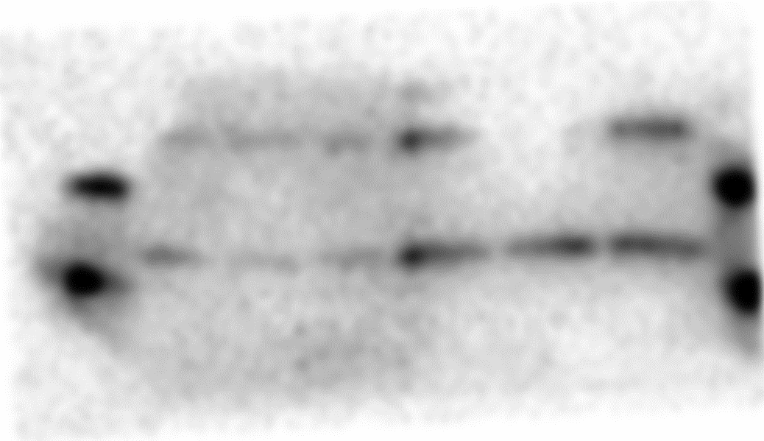
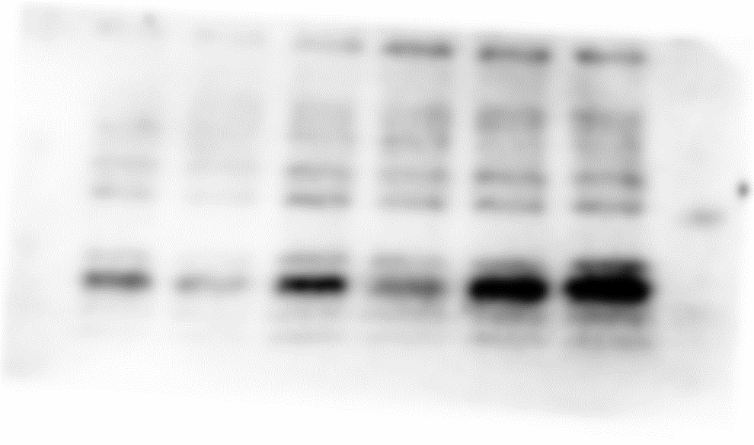
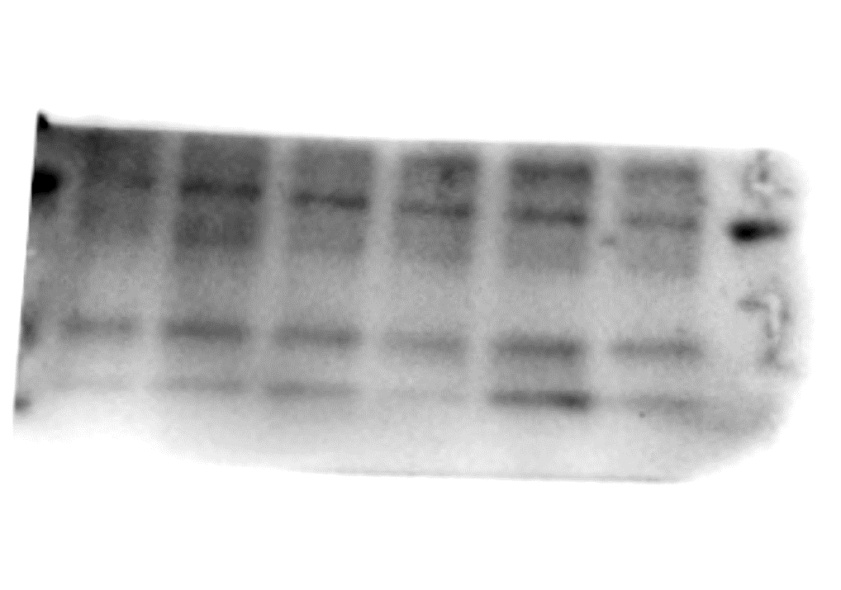
Supplementary Fig. S14
C4-2b-
Dox
ɣ-H2AX
p-STING
STING
p-IRF3
IRF3
IFN-β
Vinculin
Supplementary Fig. S14. Original unedited IB images for representative Western blots experiments (n-3) used in Figure 4D upper panels (C4-2b-EV/ inducible SPOPmuts). The red-boxed area on each unedited image indicates the exact image cropped and used in the Figure 4D upper panels.

