Slide 1
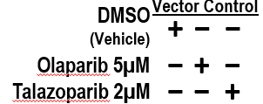
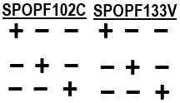
Supplementary Fig. S17
RM-1-BM-
r-H2AX
Cgas
p-Sting1
p-Tbk1
IFN-β
p-S754-Stat3
Stat3
Hmga1
Hmgb1
Hmgb3
p-Ikkα/β
P-Ikbα
IL-6
Cleaved Cas3
Cleaved Cas7
Vinculin
Supplementary Fig. S17. Original unedited IB images for representative Western blots experiments (n-2) used in Figure 4E right panels (RM-1-BM-EV/ SPOPmuts). The red-boxed area on each unedited image indicates the exact image cropped and used in the Figure 4E right panels.

