Slide 1
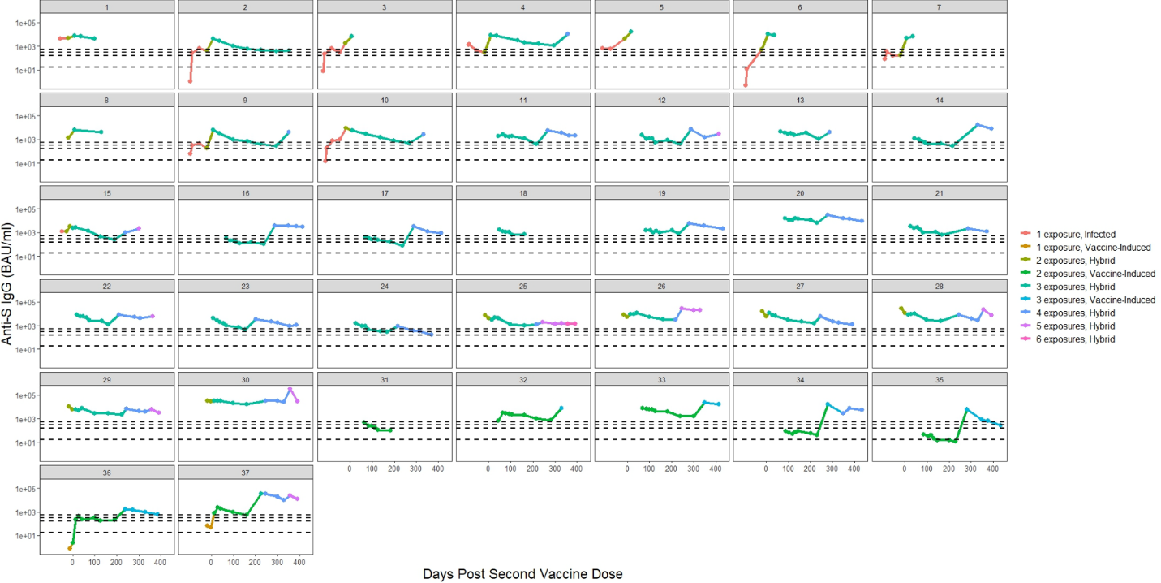
Figure S2: Longitudinal antibody responses for each participant in the nursing home cohort (N=37) — Georgia, December 2020–July 2022
Figure S2A: Anti-SARS-CoV-2 Spike (S) IgG
Notes:
Footnotes:
Participants who were identified to have moderate or severely immunocompromising condition (n=20) were: 1, 6, 7, 8, 10, 11, 12, 13, 17, 20 , 22, 24, 25, 26, 28, 31, 32, 35, 36, 37.
A moderate or severely immunocompromising condition included the following: recent or active malignancy, bone marrow transplant, solid organ transplant, primary or secondary immune deficiency, or the use of oral or intravenous steroids for more than a month or any immunosuppressant drugs.
This graph shows the titers of measured anti-S IgG antibodies.
Seropositivity thresholds were defined by the manufacturer and listed in the kit insert as follows: anti-S IgG 17.66 BAU/mL (lowermost dashed line).
Calibration of the SARS-CoV-2 antibody assays to the 1st WHO international standard for anti-SARS-CoV-2 Ig allowed us to visually assess antibody concentrations in our evaluation to those associated with a computed average overall protective threshold of 154 BAU/mL for wild type, 95% Pfizer BNT162b2 VE against COVID-19 (for two doses against wild type 530 anti-S IgG BAU/mL; Goldblatt, 2022) and 90% Moderna mRNA-1273 VE against COVID-19 (for two dose against wild type, 298 anti-S IgG BAU/mL and 775 anti-RBD IgG BAU/mL; Gilbert, 2022) — as indicated by the three upper dashed lines

Slide 2
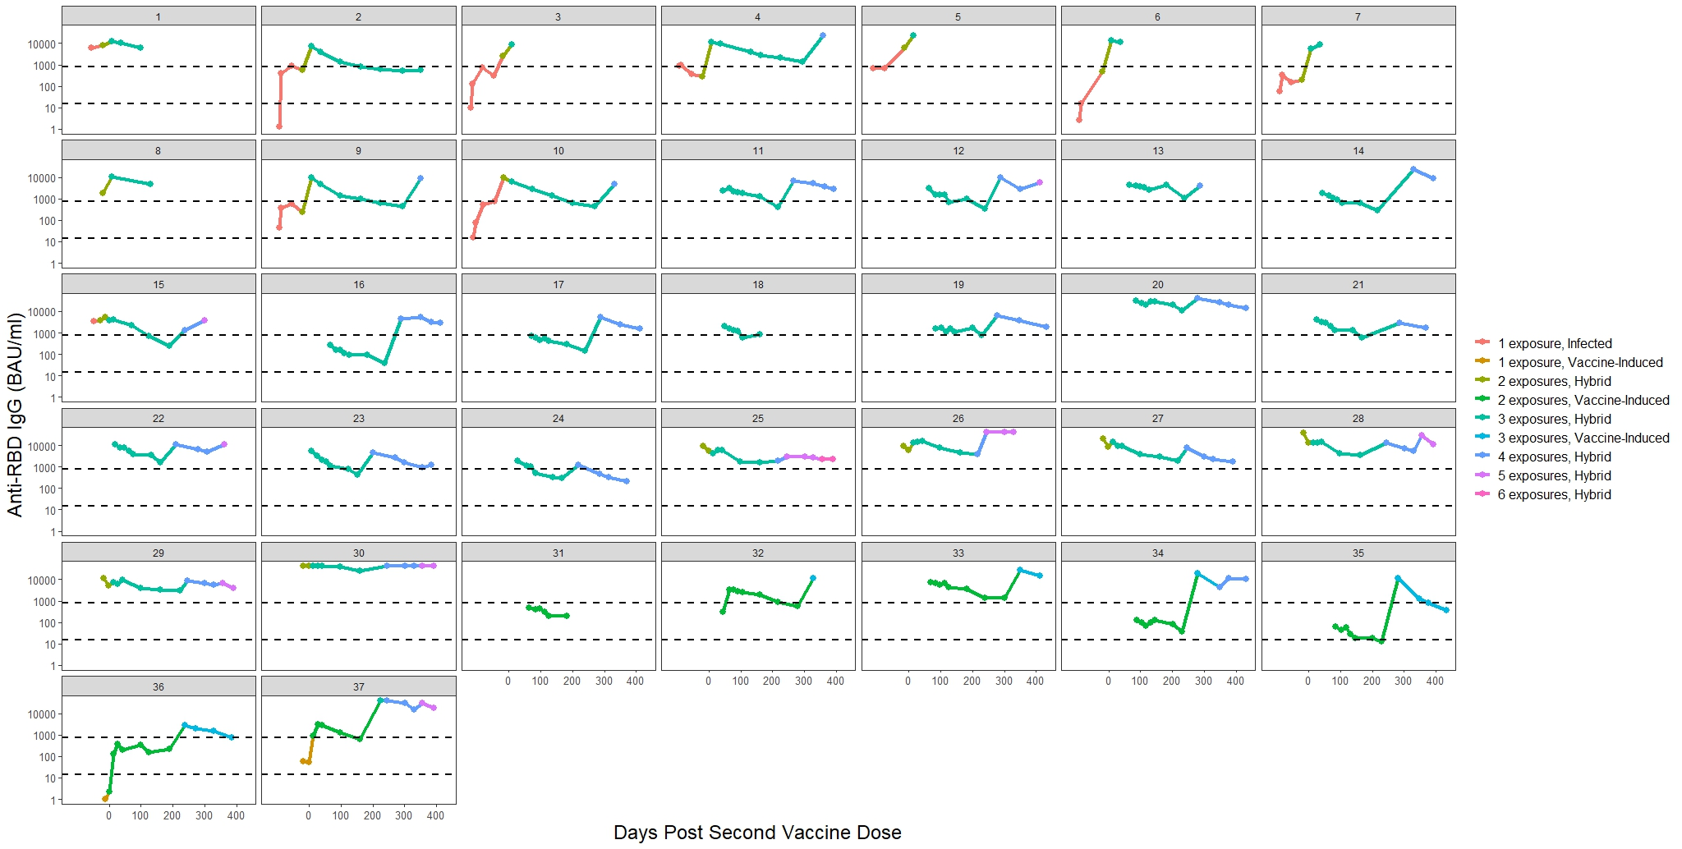
Figure S2: Longitudinal antibody responses for each participant in the nursing home cohort (N=37) — Georgia, December 2020–July 2022
Figure S2B: Anti-SARS-CoV-2 Receptor Binding Domain (RBD) IgG
Notes:
Footnote:
This graph shows the titers of measured anti-RBD IgG antibodies.
Seropositivity thresholds were defined by the manufacturer and listed in the kit insert as follows: anti-RBD IgG 14.64 BAU/mL as indicated by the lower dashed line. Calibration of the SARS-CoV-2 antibody assays to the WHO 1st international standard for anti-SARS-CoV-2 immunoglobulin allowed us to compare antibody concentrations in our evaluation to those associated with 90% Moderna mRNA-1273 VE against COVID-19 (775 anti-RBD IgG BAU/mL — as indicated by the upper dashed line; Gilbert, 2022).

Slide 3
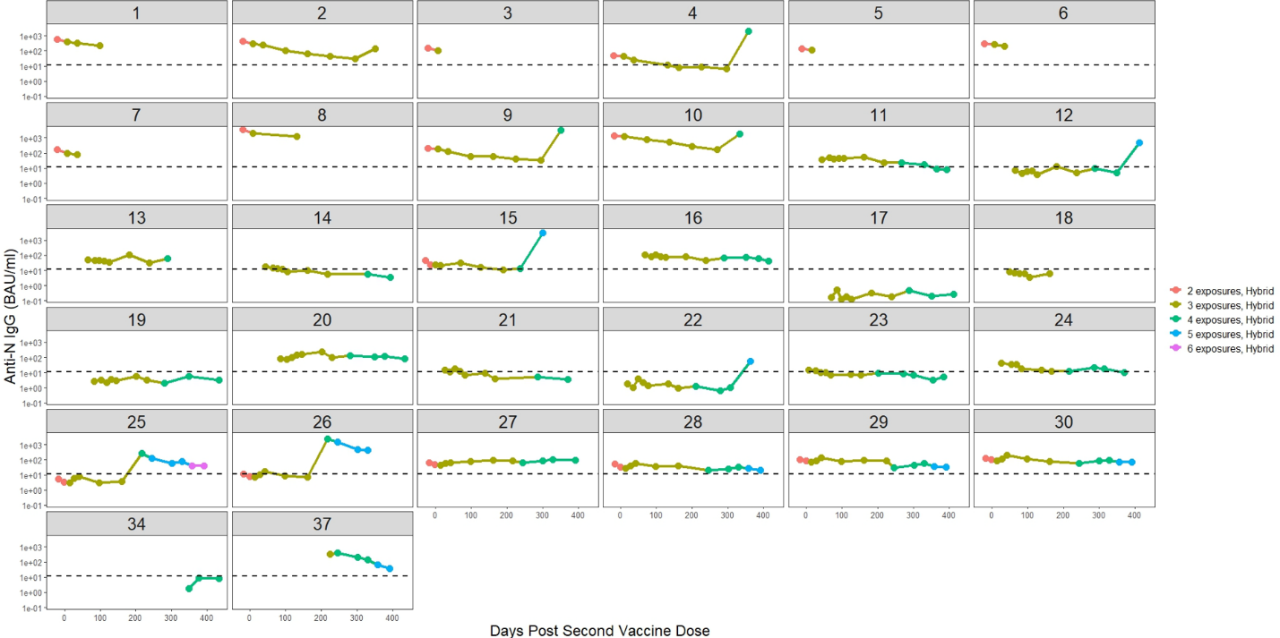
Figure S2C: Anti-SARS-CoV-2 Nucleocapsid IgG for those with hybrid immunity
Notes:
Footnote:
This graph shows the titers of measured anti-N IgG antibodies

Slide 4
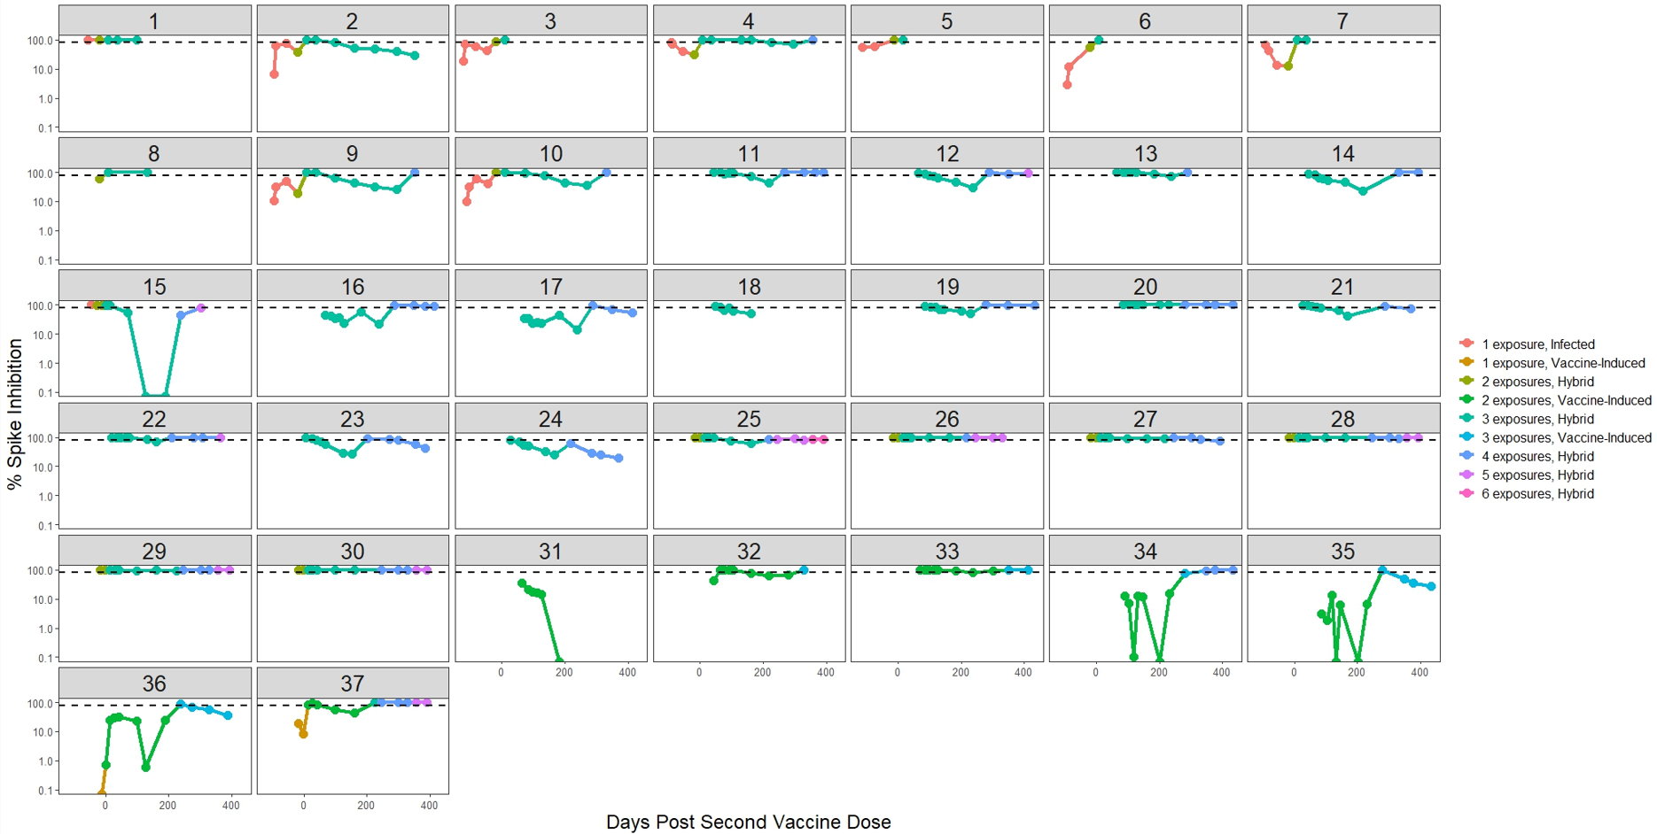
Figure S2D: Percent Spike Inhibition (virus neutralization capacity)
Notes:
Footnote:
Virus neutralizing capacity = percent spike inhibition; Y axis in %

