Slide 1
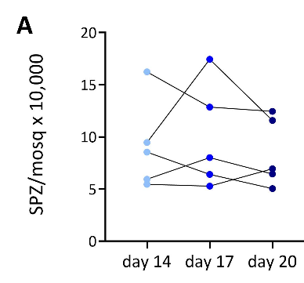
Additional file 1. SPZ number

