Slide 1
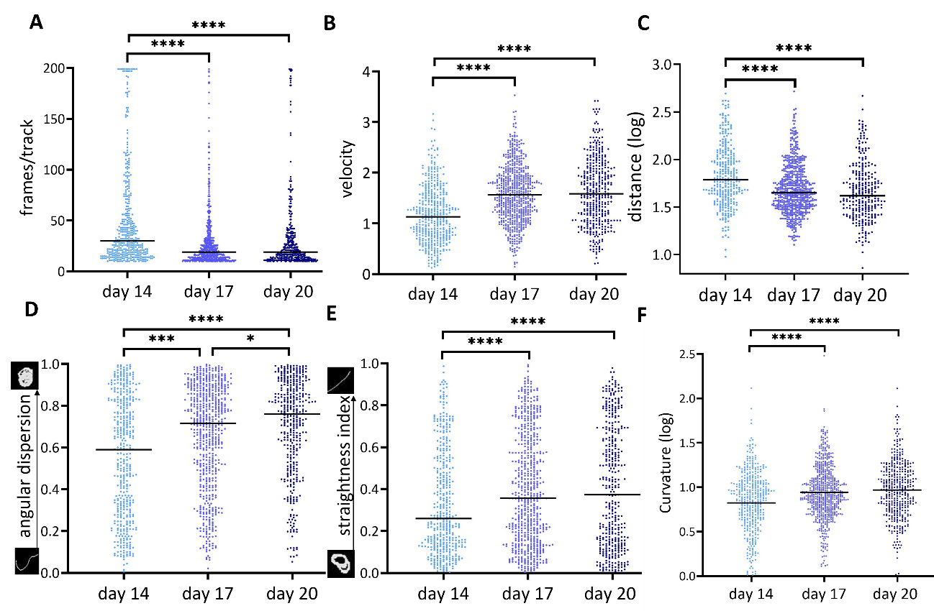
Additional file 2. Motility analyzed by SMOOT

