Slide 1
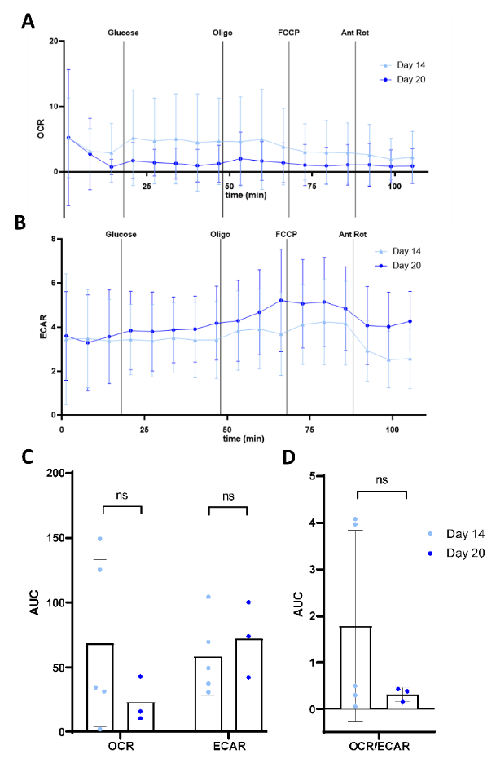
Additional file 3. Sporozoite metabolic activity

