Slide 1
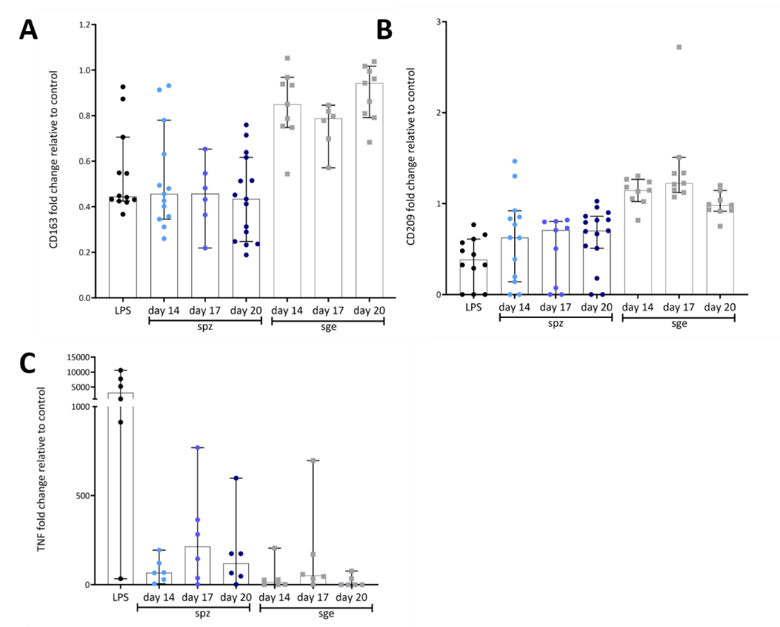
Additional file 4. Immunogenicity

