Slide 1
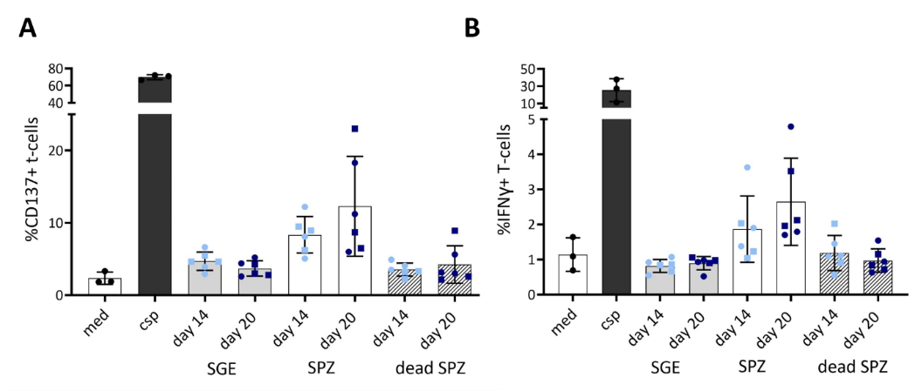
Additional file 5. CD8⁺ T-cell responses

