Slide 1
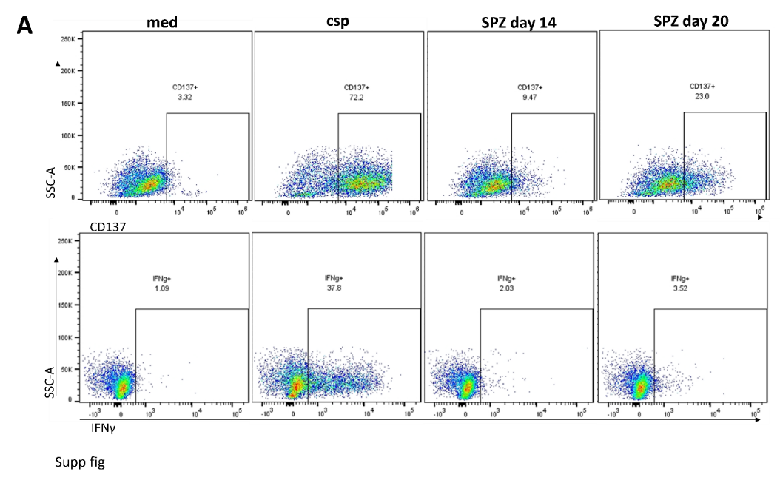
Additional file 6. CD8⁺ T-cells co-culture

