Slide 1
Supplemental Figure 1.
A.
B.
C.
D.
Suppl. Figure 1: Blood cholesterol distribution in lipoproteins in female (A and B) and male (C and D) mice. Results for mice without bone marrow transplant are shown in A and C, and results for mice with bone marrow transplants are shown in B and D. In each panel, cholesterol content in each FPLC-fraction was shown on the left and the bar graph for lipoprotein cholesterol content is shown on the right. HPLC was performed with samples pooled from 2-3 mice (n=6~8). Statistical analysis was performed with 2-way ANOVA with Tukey’s multiple comparisons test. *, p<0.05; **, p<0.01; ***, p<0.001; ****, p<0.0001.

Slide 2
Supplemental Figure 2.
A.
B.
C.
D.
Suppl. Figure 2: Blood triacylglycerol (TG) distribution in lipoproteins in female (A and B) and male (C and D) mice. Results for mice without bone marrow transplant are shown in A and C, and results for mice with bone marrow transplants are shown in B and D. In each panel, TG content in each FPLC-fraction was shown on the left and the bar graph for lipoprotein TG content is shown on the right. HPLC was performed with samples pooled from 2-3 mice (n=6~8). Statistical analysis was performed with 2-way ANOVA with Tukey’s multiple comparisons test. *, p<0.05; **, p<0.01; ***, p<0.001; ****, p<0.0001.

Slide 3





Supplemental Figure 3.
♀︎
♂︎
A.
♀︎
fl/fl_Con’
Δhep_ Con’
Δhep_Ifnγ^{-/-}
B.
♂︎
fl/fl_Con’
Δhep_ Con’
Δhep_Ifnγ^{-/-}
pACC
pACC
PGC1α
PGC1α
pAKT
pAKT
AKT
AKT
β-Actin
β-Actin
Suppl. Figure 3: Western blots of pACC, PGC1α, and AKT and its phosphorylation (pAKT) are shown in A for female and in B for male mice. Quantification of blots is shown underneath the respective blots in each panel (n=6). Statistical analysis was performed with a Student’s t-test for each protein. *, p<0.05; **, p<0.01.

Slide 4
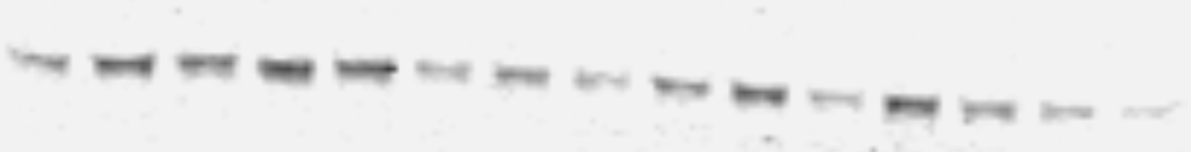
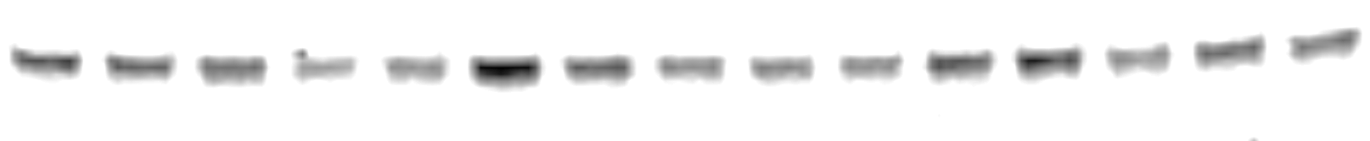



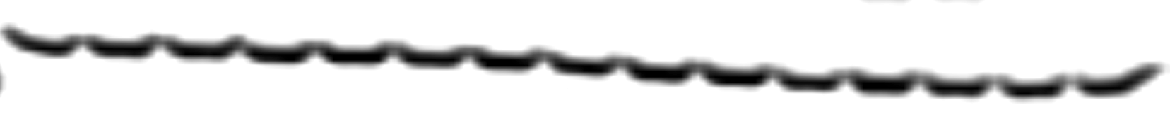




Supplemental Figure 4.
♀︎
♂︎
A.
♀︎
fl/fl_Con’
Δhep_ Con’
Δhep_Ifnγ^{-/-}
B.
♂︎
fl/fl_Con’
Δhep_ Con’
Δhep_Ifnγ^{-/-}
pAMPKα
pAMPKα
pAMPKβ
pAMPKβ
AMPKβ
AMPKβ
β-Actin
β-Actin
C.
♀︎
fl/fl_Con’
Δhep_ Con’
Δhep_Ifnγ^{-/-}
D.
♂︎
fl/fl_Con’
Δhep_ Con’
Δhep_Ifnγ^{-/-}
pERK1/2
pERK1/2
ERK1/2
ERK1/2
β-Actin
β-Actin
Suppl. Figure 4: Western blots of pAMPKα, pAMPKβ, and AMPKβ are shown in A for female and in B for male mice. Western blots of pERK1/2, ERK1/2 are shown in C (females) and D (males). Quantification of blots is shown underneath the respective blots in each panel (n=6). Statistical analysis was performed with a Student’s t-test for each protein.

Slide 5
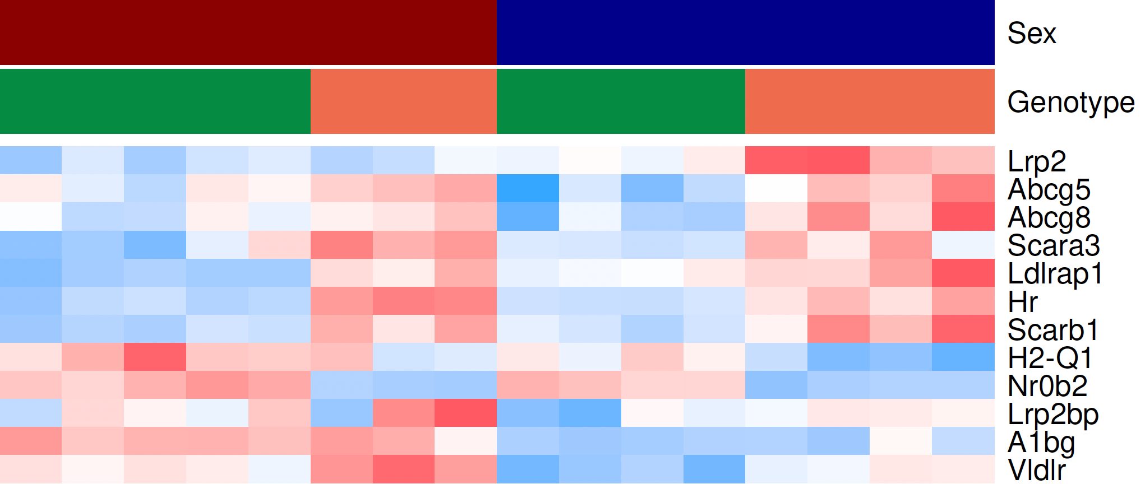
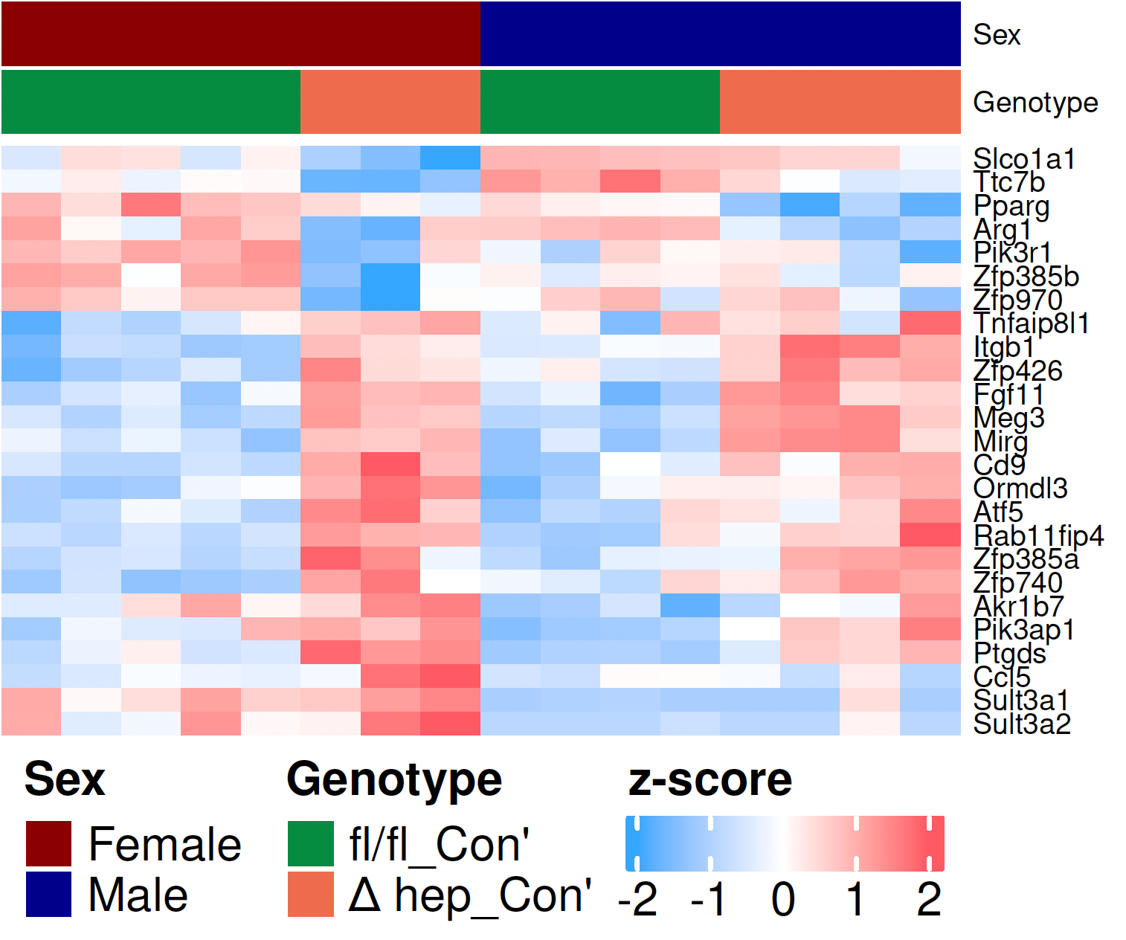
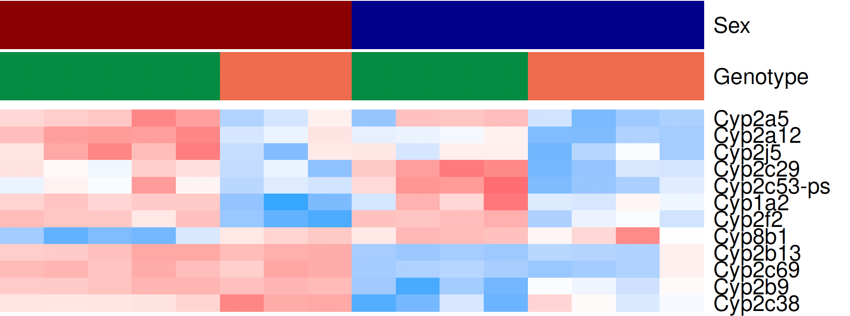
Supplemental Figure 5.
A.
C.
Ga
Ge
Gb
B.
Gf
Gc
Gd
Suppl. Figure 5. A. A heatmap of transcripts involved in lipid metabolism with Padj<0.05 in at least one sex, some of the transcripts have been shown in Fig. 7D. Transcripts in Ga were upregulated by hepatic SHP deletion and transcript of H2-Q1 was downregulated by the SHP deletion; transcripts in Gb were not influenced by the SHP deletion in either sex. B. A heatmap of CYP transcripts with Padj<0.05 in at least one sex. The CYP transcripts in group Gc were downregulated in the liver with SHP deletion in both sexes; the CYP transcripts in group Gd demonstrated the sex-biased regulation of monooxygenase activity, which was not affected by hepatic SHP deletion C. A heatmap of transcripts involved in inflammation and fibrogenesis with Padj<0.05 in at least one sex. Hepatic SHP deletion downregulated transcripts in group Ge and upregulated transcripts in group Gf in both sexes. The expression of Slco1a1 and Ttc7b was lower in female mice than in male mice, which was further lowered by the deletion of SHP in female mice. The expression of Sult3a1/2 was higher in female than male mice and was further upregulated by the hepatic SHP deletion in female mice.

Slide 6
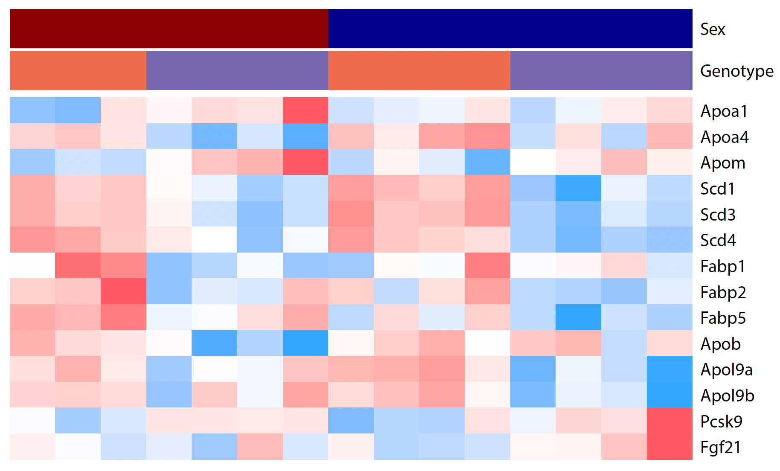
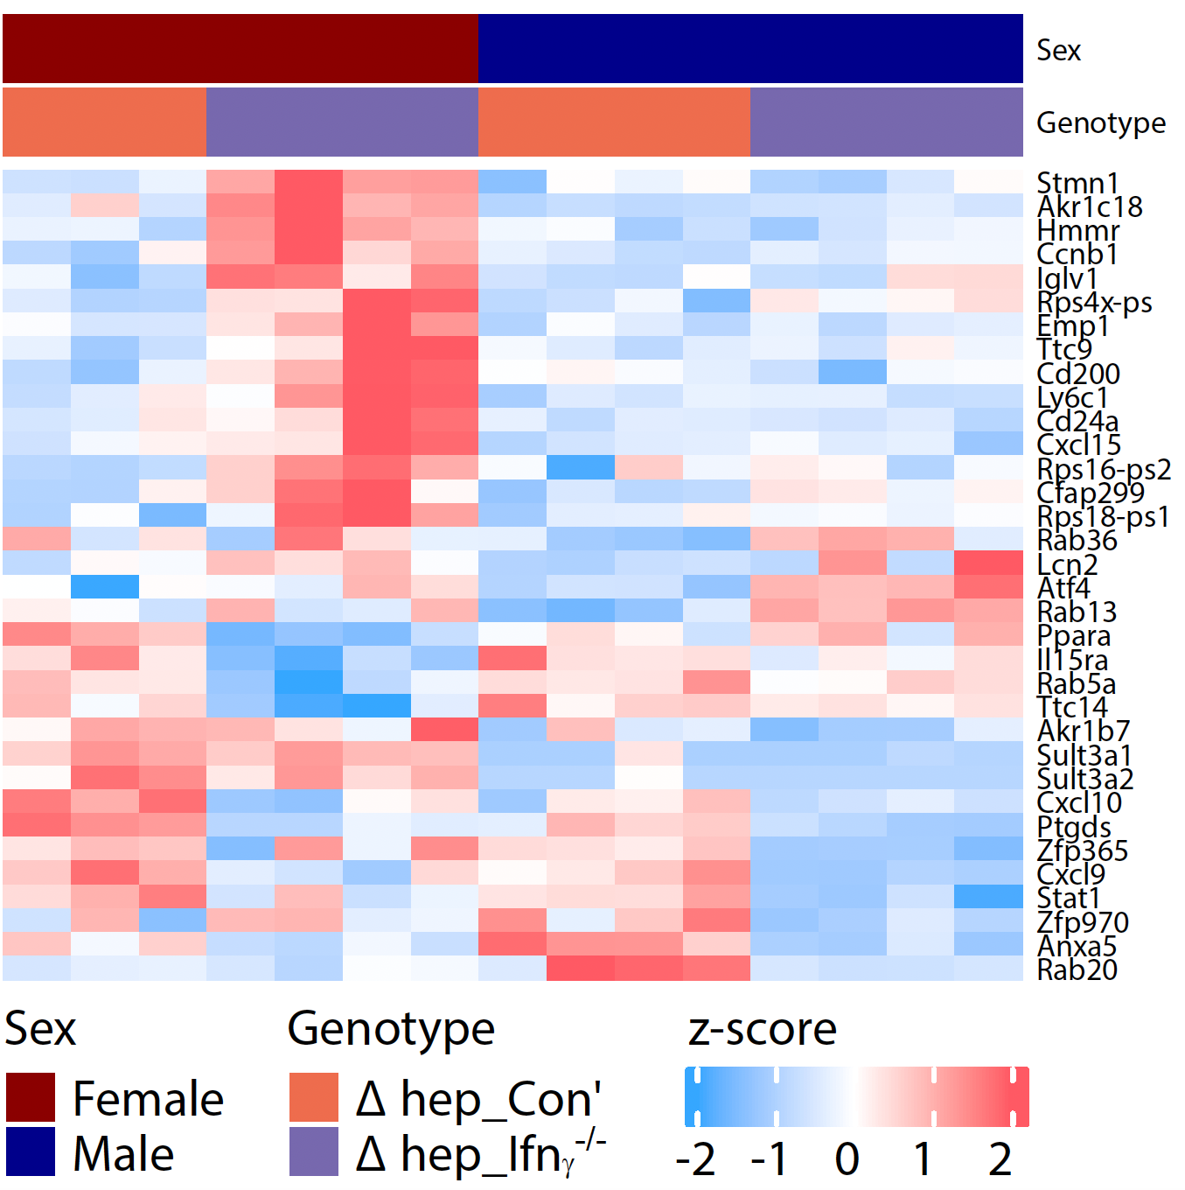
Supplemental Figure 6.
A.
B.
G1
G2
G3
G4
G5
Suppl. Figure 6. A heatmap of transcripts involved in liver lipid metabolism, inflammation, and fibrogenesis regulated by overlaying bone marrow-derived IFNγ^{-/-} myeloid cells with Padj<0.05 in at least one sex. A. Transcripts involved in lipid metabolism with Padj<0.05 in at least one sex. B. The expression of transcripts in G1 was upregulated by overlaying IFNγ^{-/-} myeloid cells in female mice. The expression of transcripts in G2 was upregulated by overlaying IFNγ^{-/-} myeloid cells in male mice. The expression of transcripts in G3 and G5 was downregulated mainly in female mice (G3) and in male mice (G5), respectively. The expression of transcripts in G4 was higher in female than male mice and were not changed by overlaying IFNγ^{-/-} myeloid cells.

Slide 7
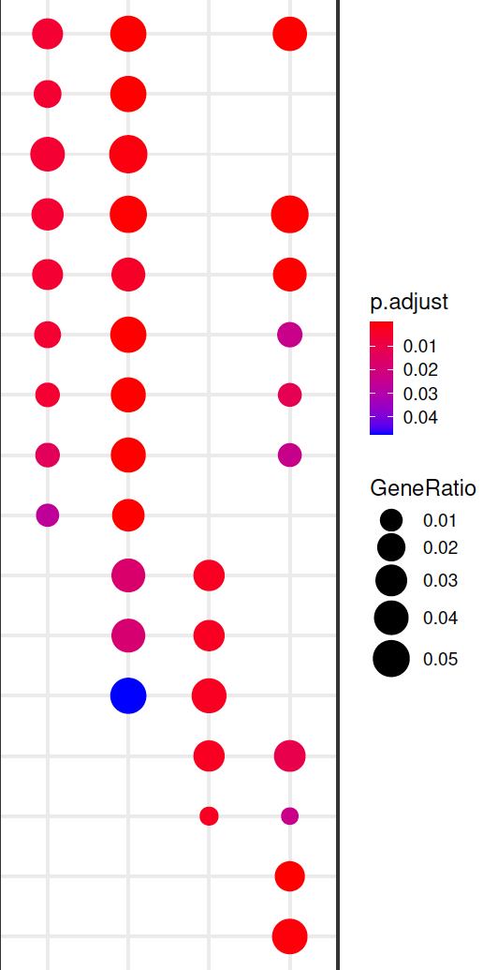
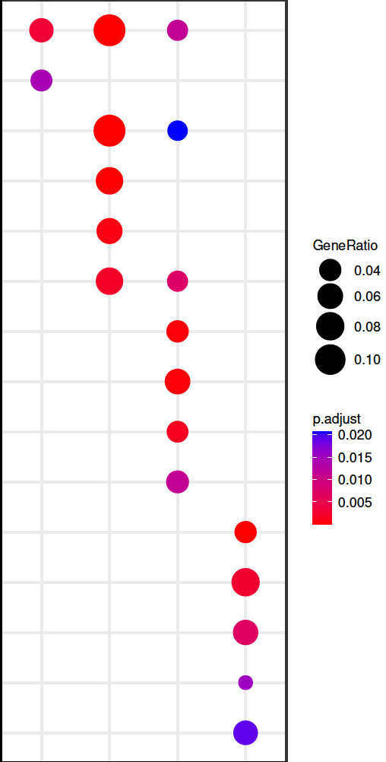
Supplemental Figure 7.
A. GO Enrichment
Monooxygenase activity
B. KEGG Enrichment
Bile secretion
Steroid hydroxylase activity
Cortisol synthesis and secretion
Active transmembrane transporter activity
Retinol metabolism
¹Oxidoreductase activity
ABC transporter
Iron ion activity
Cholesterol metabolism
²Oxidoreductase activity
Steroid hormone biosynthesis
*AA epoxygenase activity
Peroxisome
*AA monooxygenase activity
Protein processing in ER
Aromatase activity
PPAR signaling
Endopeptidase inhibitor activity
Alcoholic liver disease
Peptidase inhibitor activity
Steroid biosynthesis
Enzyme inhibitor activity
Epstein-Barr virus infection
Glycosaminoglycan binding
Measles
Semaphorin receptor activity
Terpenoid backbone biosynthesis
³Oxidoreductase activity
Fluid shear stress and atherosclerosis
GTPase activity
♀︎(236)
♂︎(97)
♀︎(372)
♂︎(227)
♀︎(476)
♂︎(216)
♀︎(702)
♂︎(435)
Δhep_Ifnγ^{-/-} vs Δhep_Con’
Δhep_Con’ vs fl/fl_Con’
Δhep_Con’ vs fl/fl_Con’
Δhep_Ifnγ^{-/-} vs Δhep_Con’
Suppl. Figure 7. GO enrichment (A) and KEGG enrichment (B) analysis of hepatic transcriptomes modified by hepatic deletion of SHP and by overlaying IFNγ^{-/-} myeloid cells in female and male SHP^{Δhep} mice. ¹, Oxidoreductase activity, acting on paired donors, with incorporation or reduction of molecular oxygen; ², Oxidoreductase activity, acting on paired donors, with incorporation or reduction of molecular oxygen, reduced flavin or flavoprotein as one donor, and incorporation of one atom of oxygen; ³, Oxidoreductase activity, acting on paired donors, with incorporation or reduction of molecular oxygen, NAD(P)H as one donor, and incorporation of one atom of oxygen. *, Arachidonic acid epoxygenase activity; **, Arachidonic acid monooxygenase activity.

Slide 8
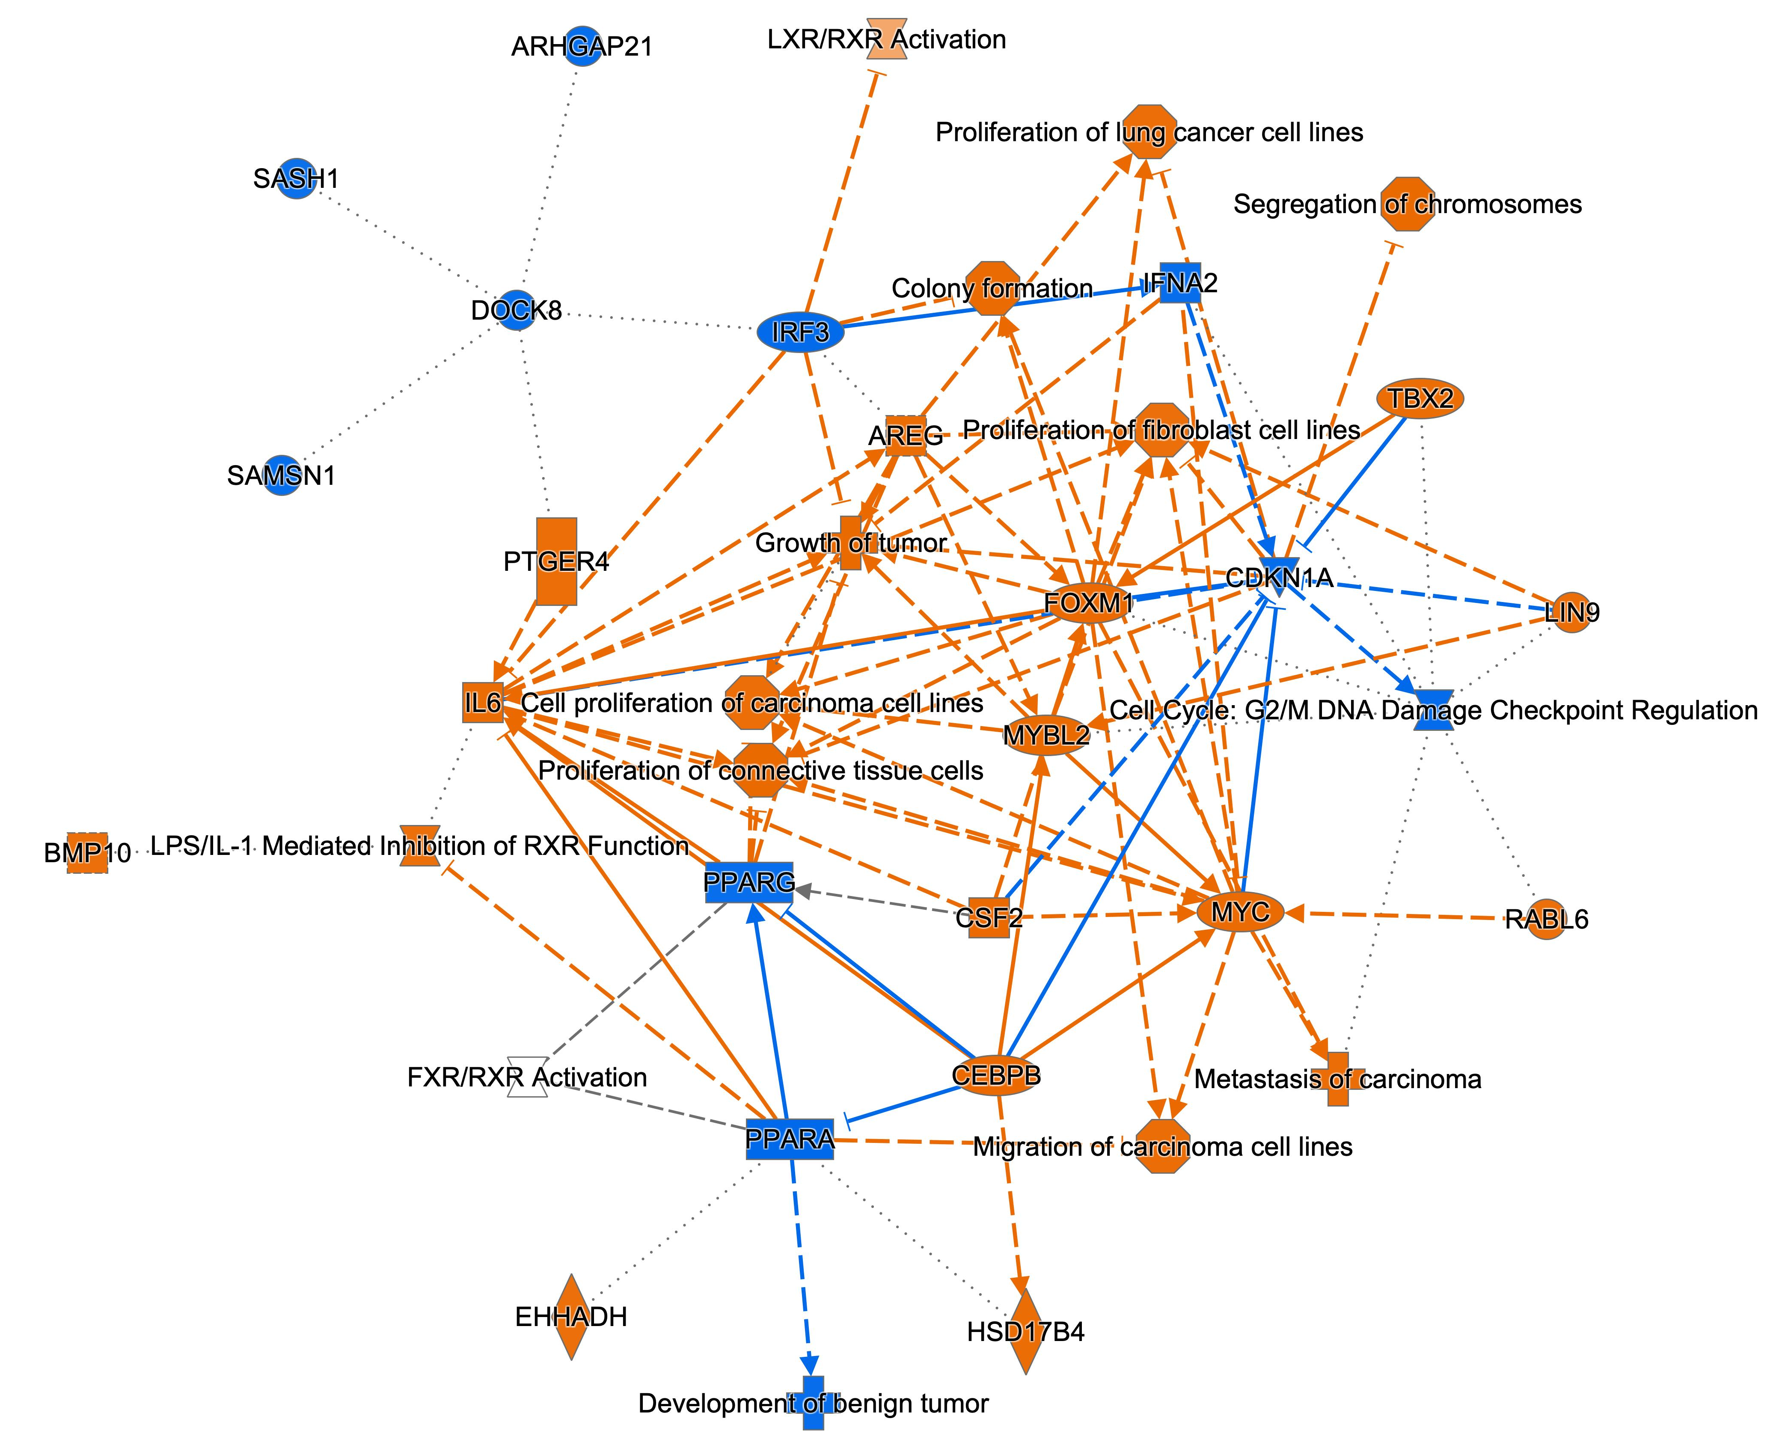
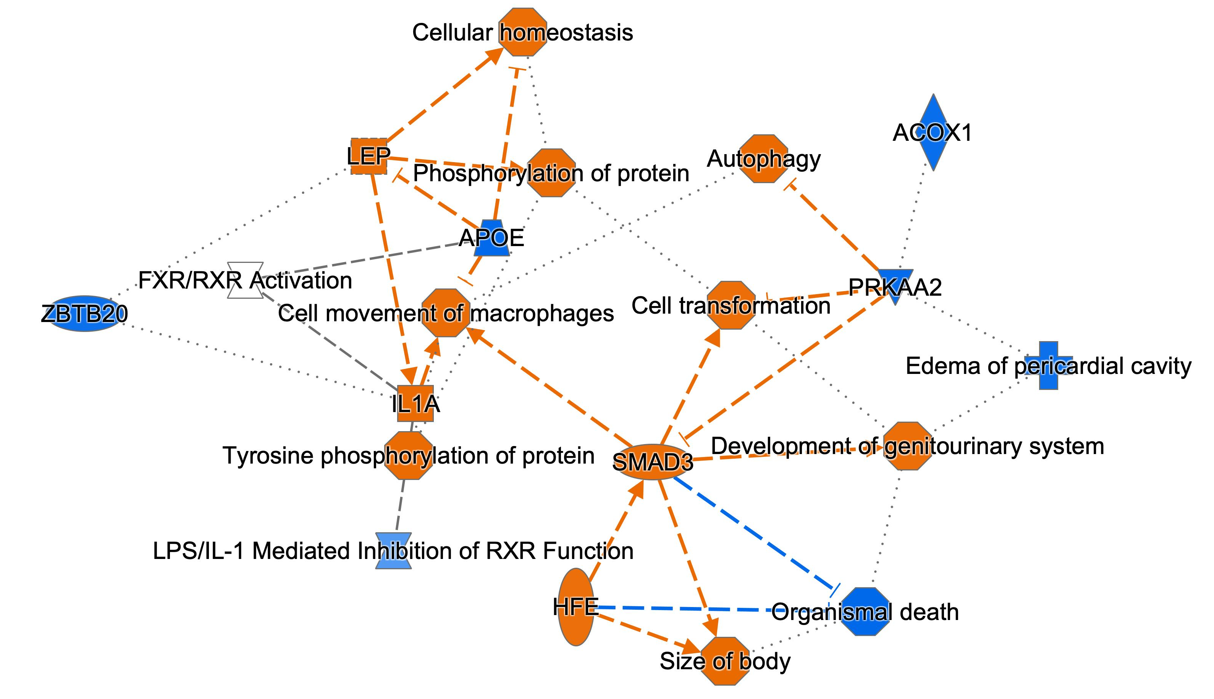
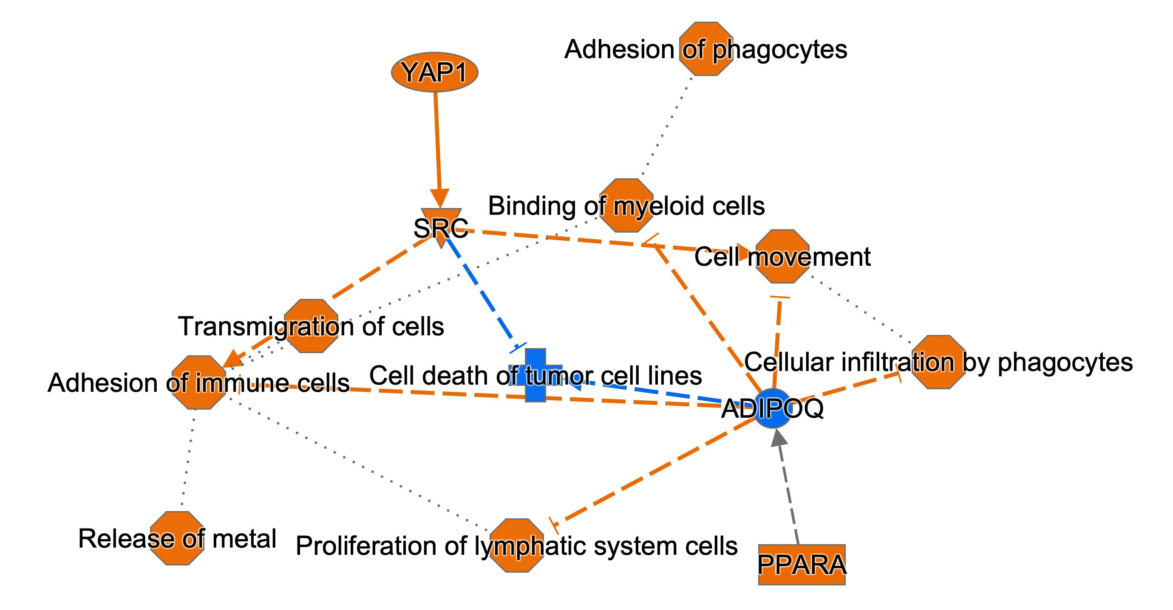
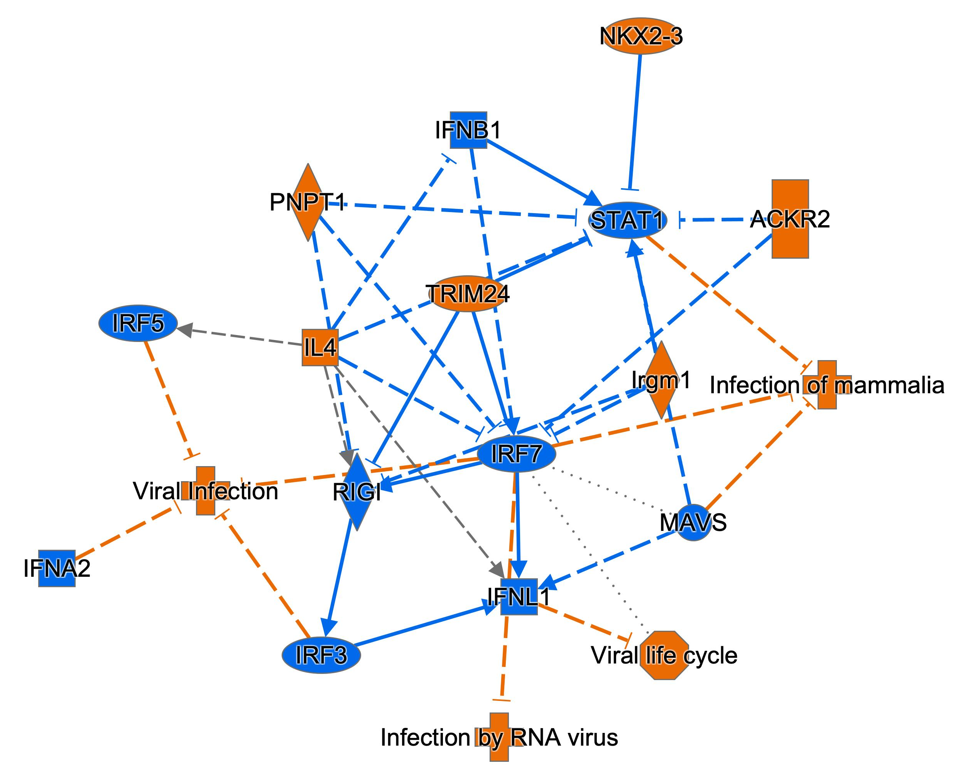
Supplemental Figure 8.
A. ♀︎: △hep_Con’ vs fl/fl_Con’
B. ♀︎: Δhep_Ifnγ^{-/-} vs △hep_Con’
C. ♂︎: △hep_Con’ vs fl/fl_Con’
D. ♂︎: Δhep_Ifnγ^{-/-} vs △hep_Con’
Suppl. Figure 8. Net work of pathway activities from the Qiagen Ingenuity Pathway Analysis with liver bulk RNAseq data. A. female △hep_Con’ vs fl/fl_Con’. B. female Δhep_Ifnγ⁻ vs △hep_Con’. C. male △hep_Con’ vs fl/fl_Con’. D. male Δhep_Ifnγ⁻ vs △hep_Con’. Graphic summary legend: predicted activation is in orange and predicted inhibition is in blue; solid lines indicate direct interaction and dashed lines indicate indirect interaction. For detailed IPA legend, please go to https://qiagen.my.salesforce-sites.com/KnowledgeBase/KnowledgeNavigatorPage?id=kA41i000000L5rTCAS&categoryName=BioX

Slide 9
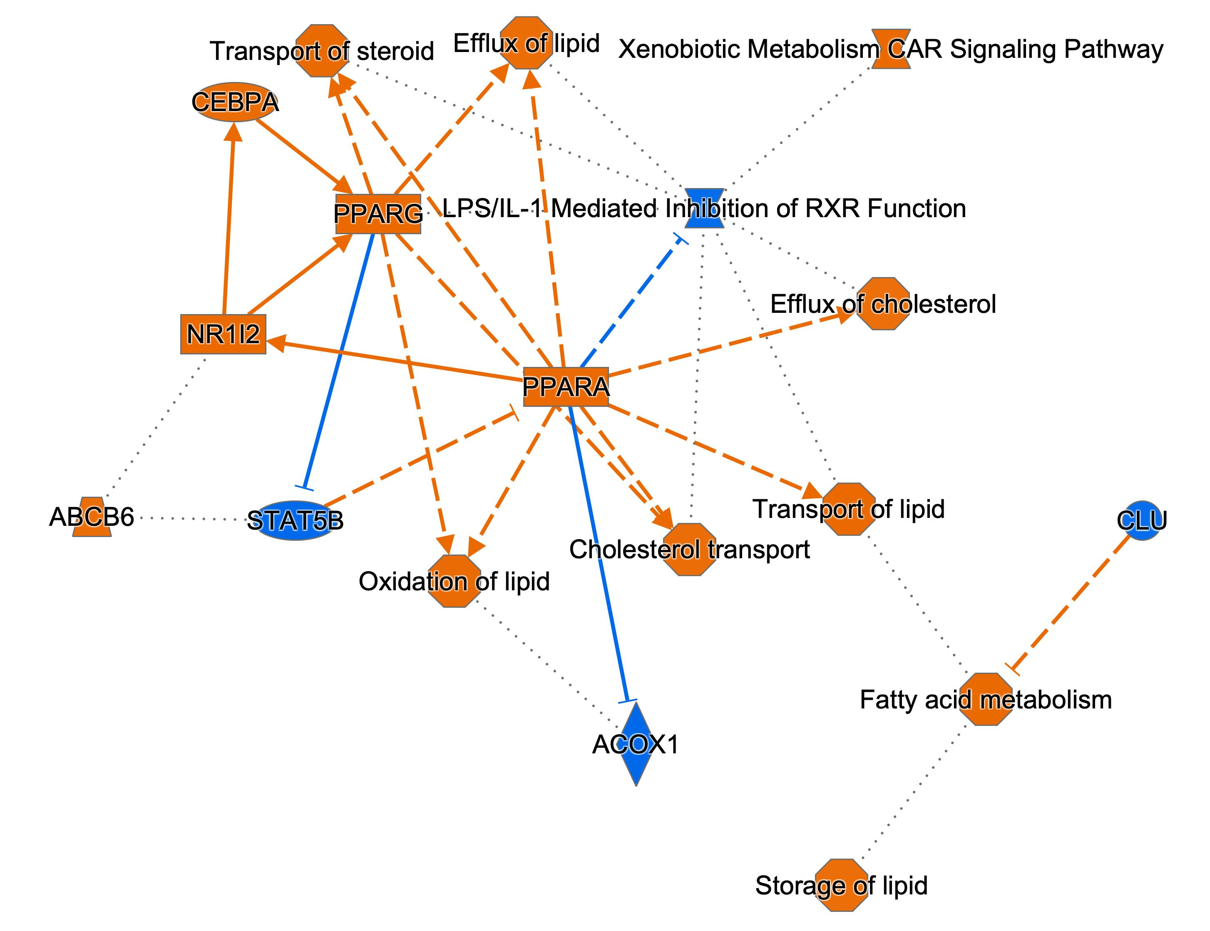
Supplemental Figure 9.
Suppl. Figure 9. Pathway activities changed in female mice in comparison to male mice from the Qiagen Ingenuity Pathway Analysis with liver bulk RNAseq data. Graphic summary legend: predicted activation is in orange and predicted inhibition is in blue; solid lines indicate direct interaction and dashed lines indicate indirect interaction. For detailed IPA legend, please go to https://qiagen.my.salesforce-sites.com/KnowledgeBase/KnowledgeNavigatorPage?id=kA41i000000L5rTCAS&categoryName=BioX

