Slide 1
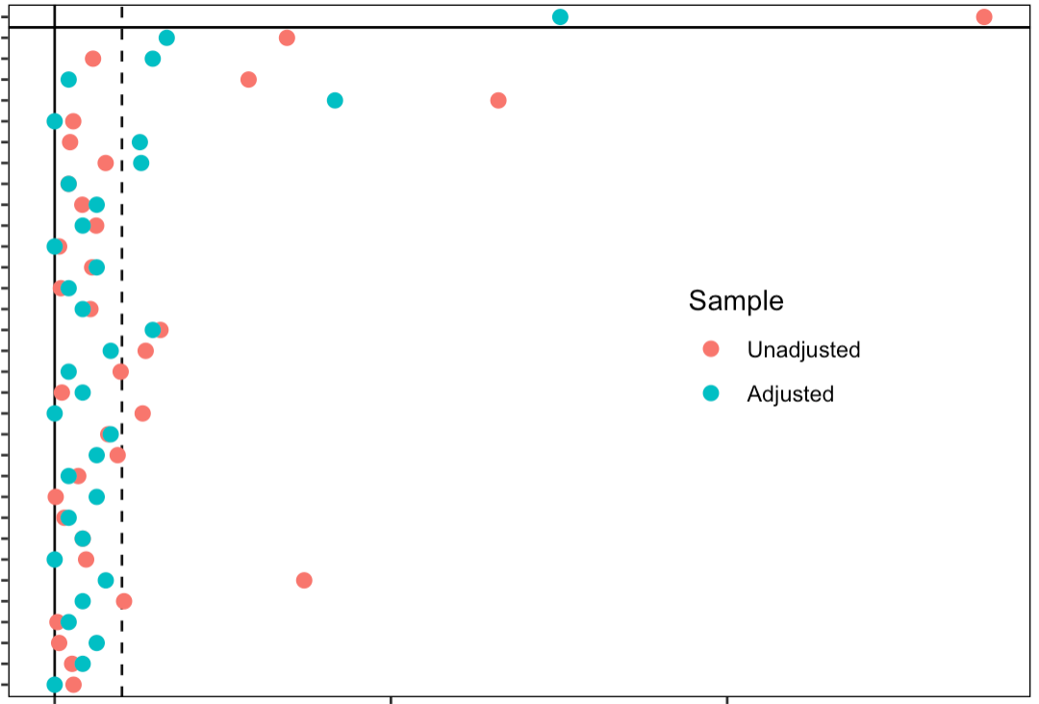
SI 1
Covariate Balance Before and After Propensity Score Matching
Distance
Institution: Baylor
Institution: Emory
Institution: Vanderbilt
Age at therapy start
Male
BSA
BMI
Anatomy: LV
Anatomy: RV
Anatomy: Unspecified
Fontan Type: AP
Fontan Type: LT
Fontan Type: ECC
Sample
Fontan Type: Other
Indication: Procedure
Unadjusted
Indication: Thrombosis
Indication: Arrhythmia
Adjusted
Indication: Other
Indication: Empiric
CHA₂DS₂-VASc: 0
CHA₂DS₂-VASc: 1
CHA₂DS₂-VASc: 2
CHA₂DS₂-VASc: 3
CHA₂DS₂-VASc: 4
CHA₂DS₂-VASc: 5
CHA₂DS₂-VASc: Unavailable
NYHA Classification
HAS-BLED: 0
HAS-BLED: 1
HAS-BLED: 2
HAS-BLED: 3
HAS-BLED: 4
0.0
0.5
1.0
Absolute Mean Differences

