Slide 1

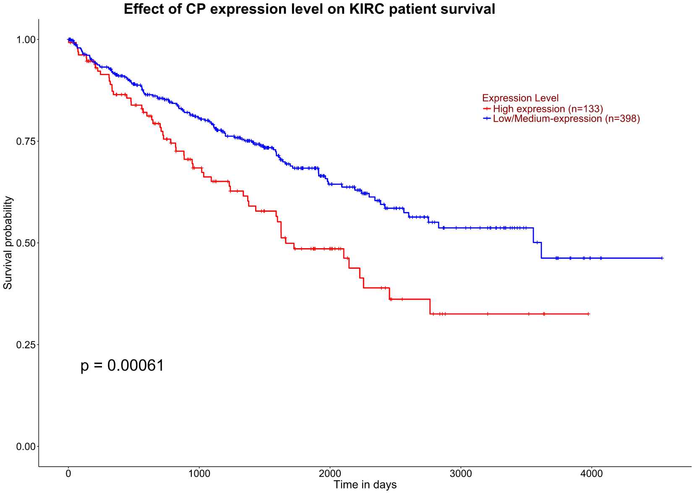
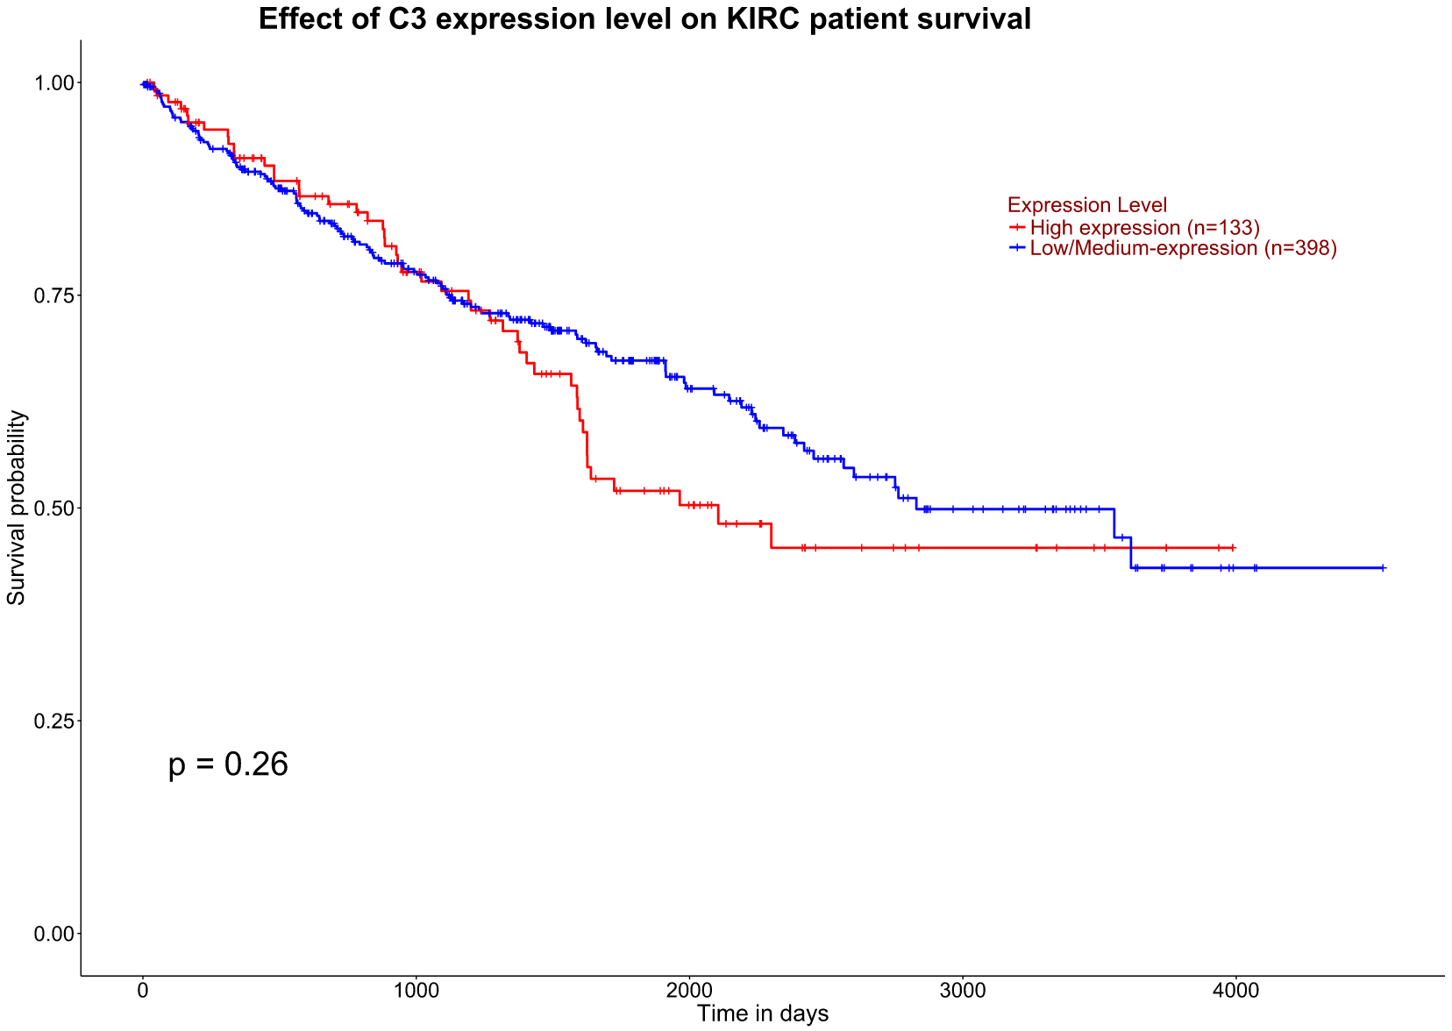
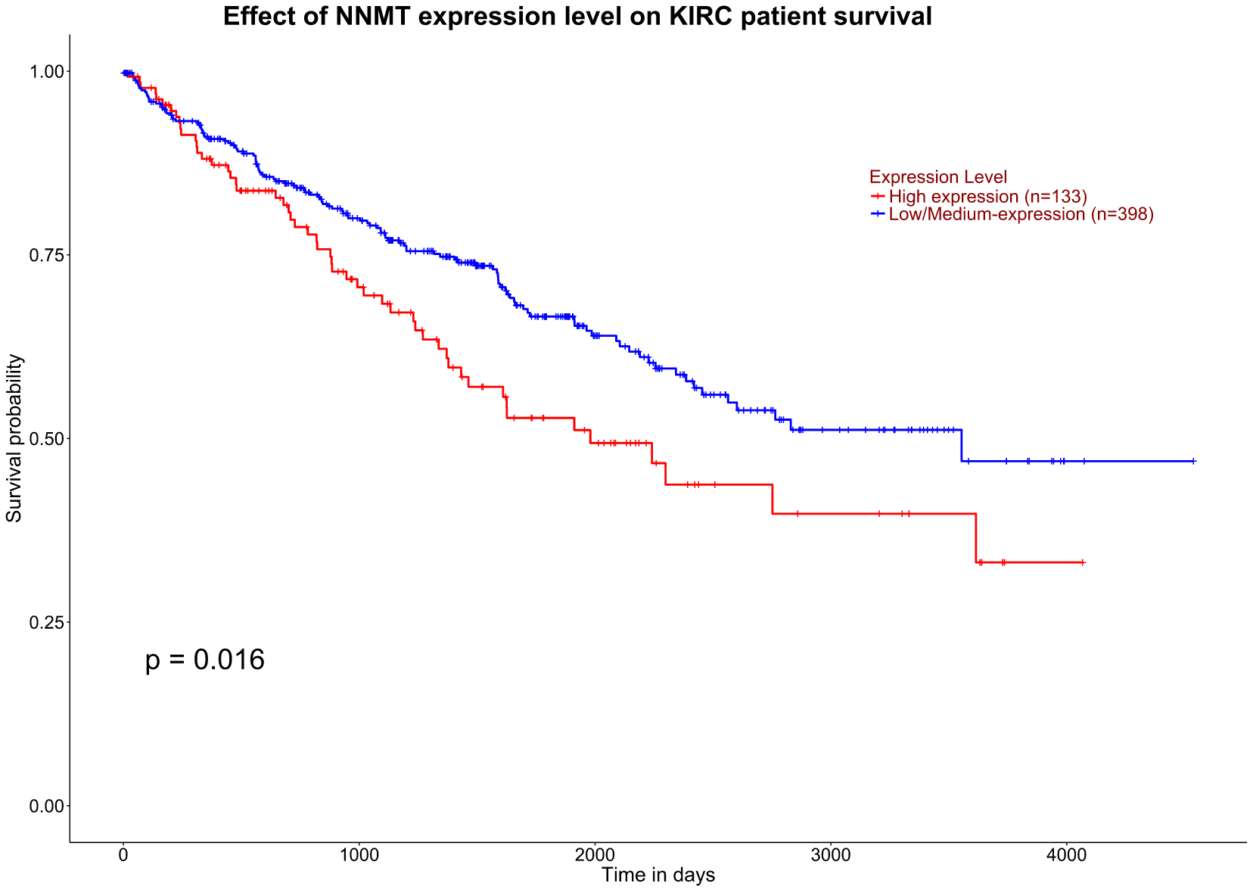
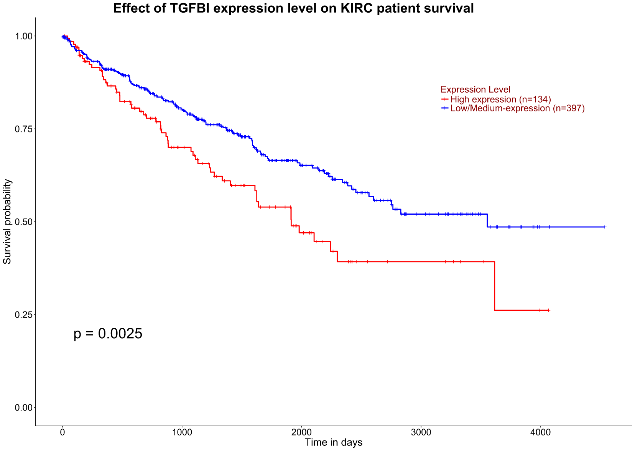
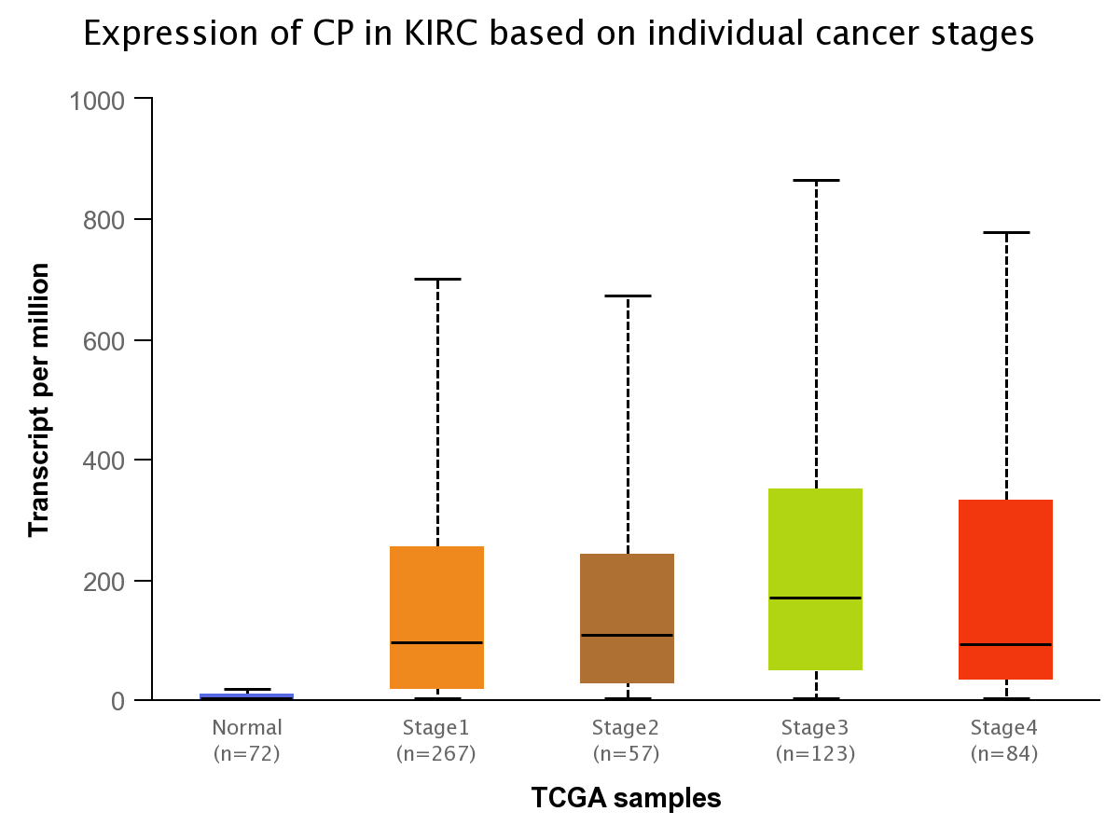
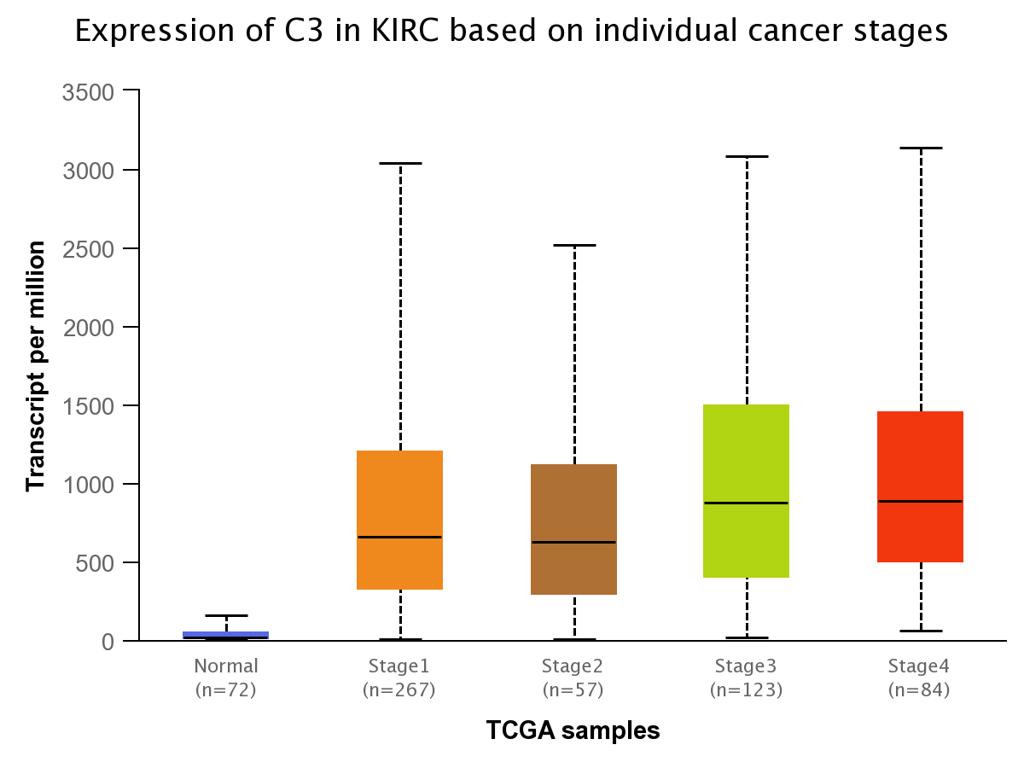
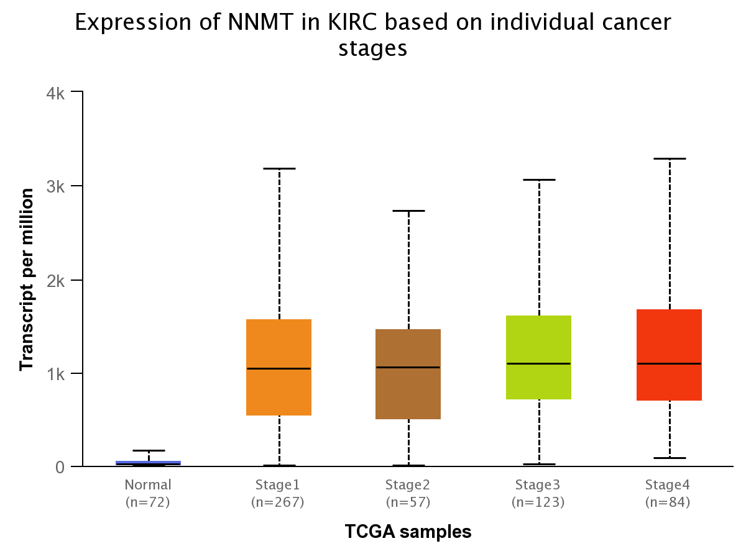
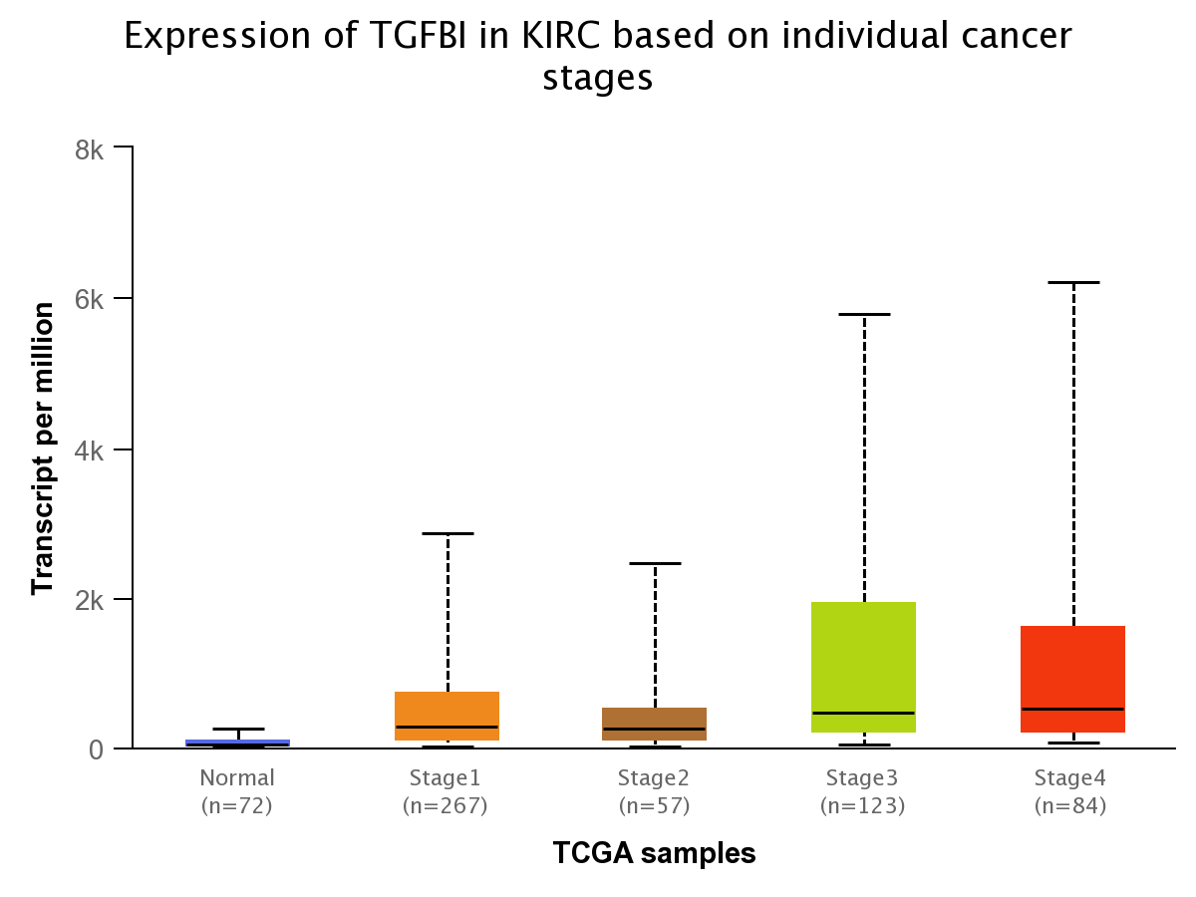
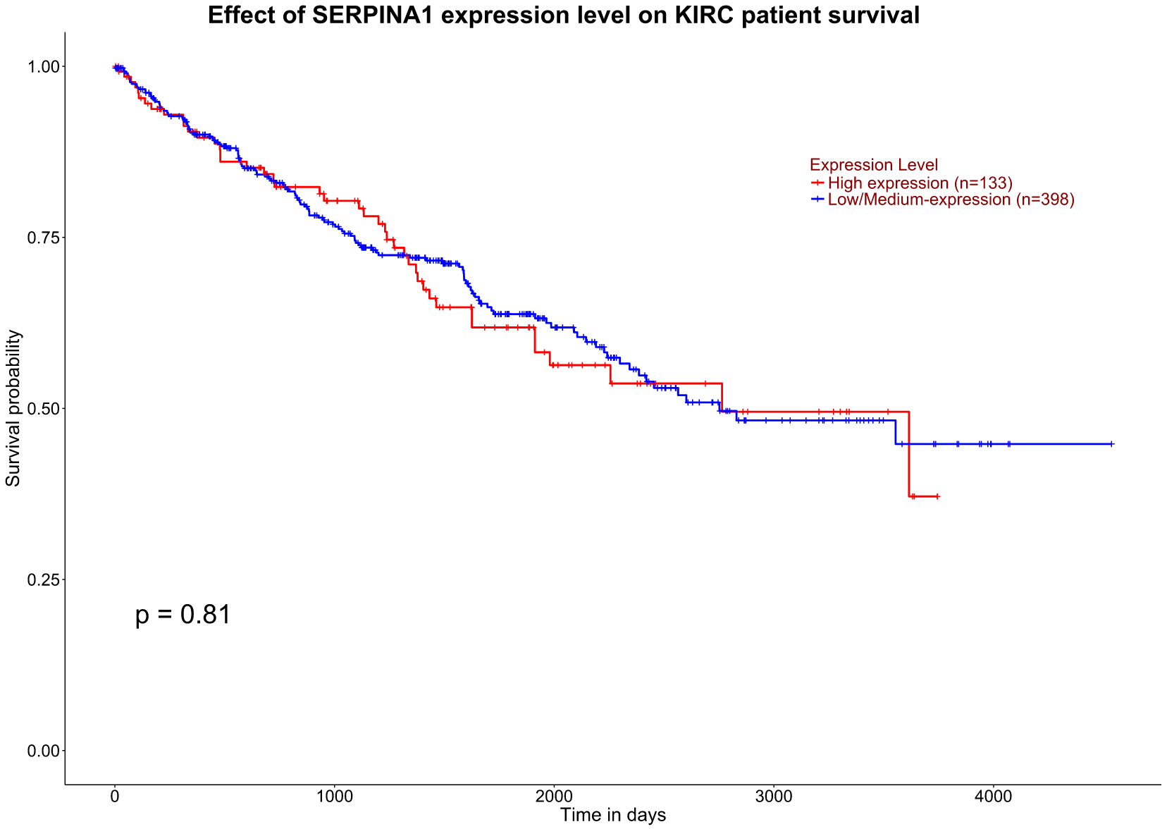
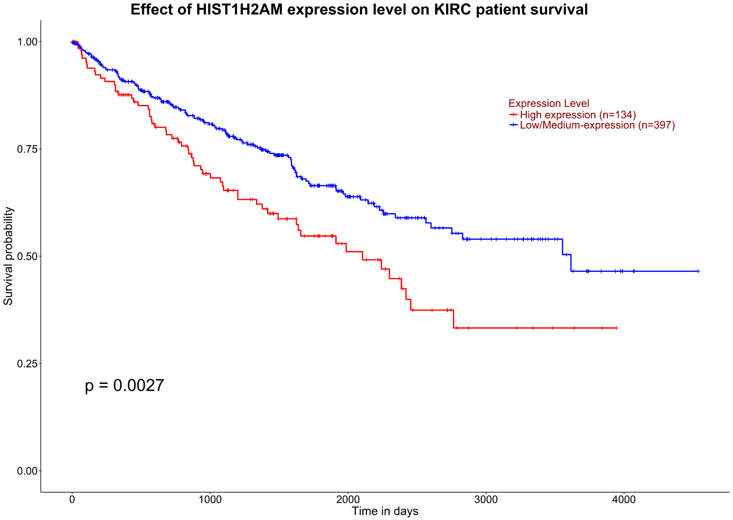
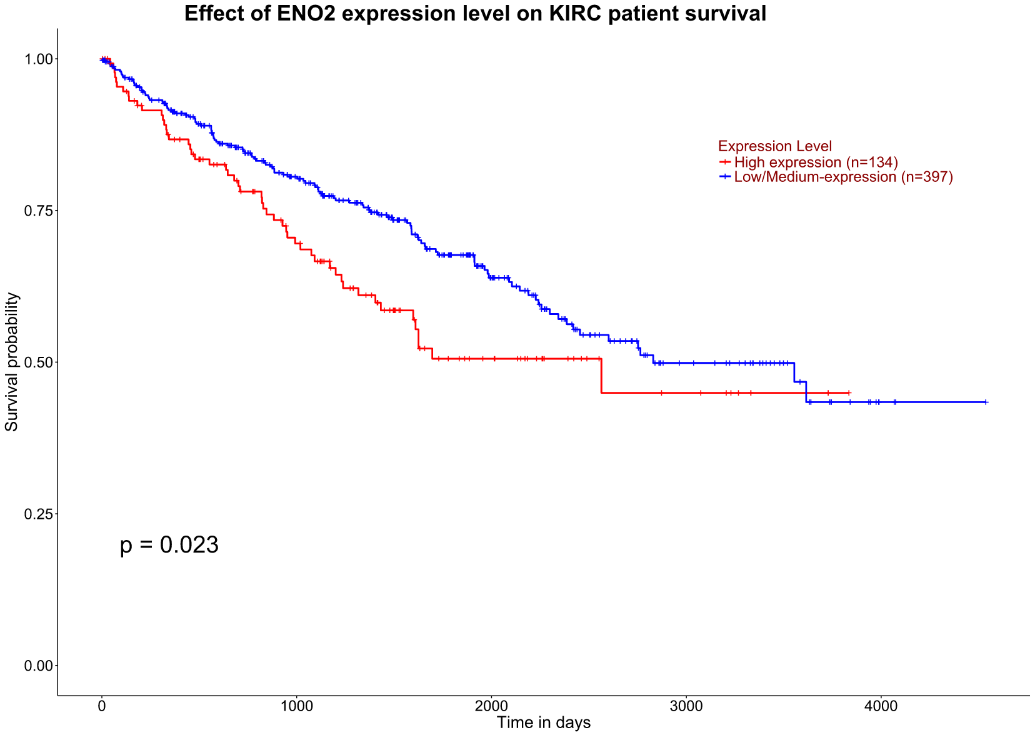

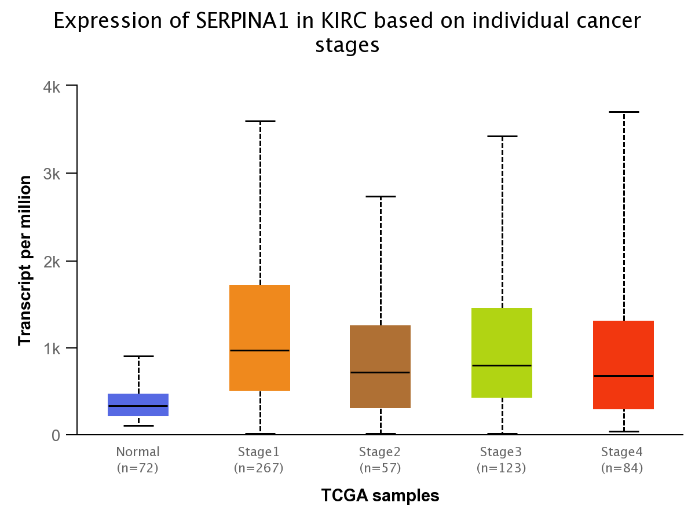
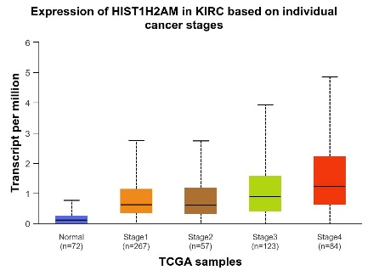
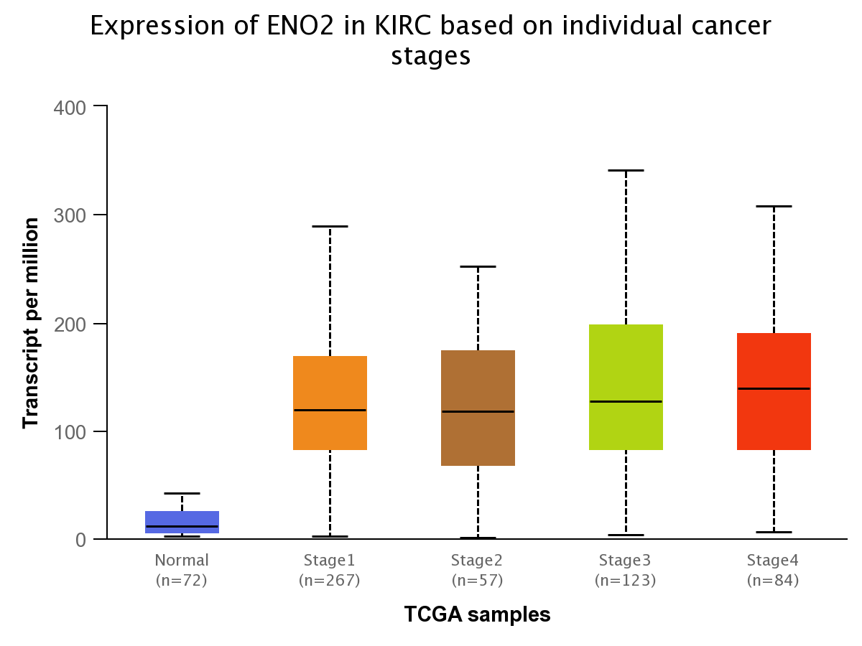
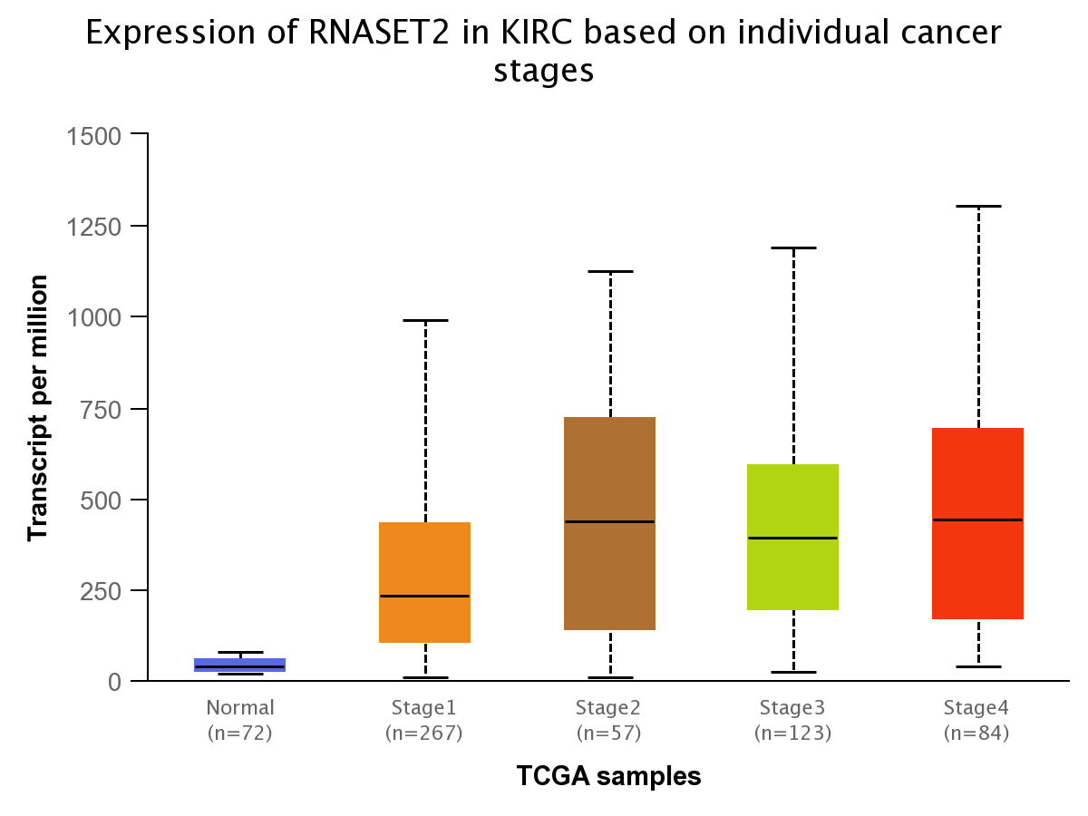

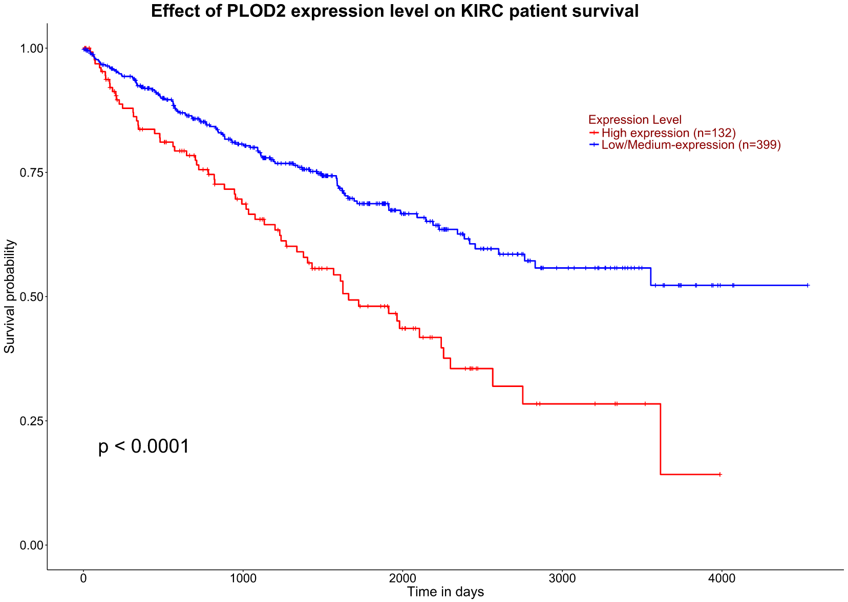
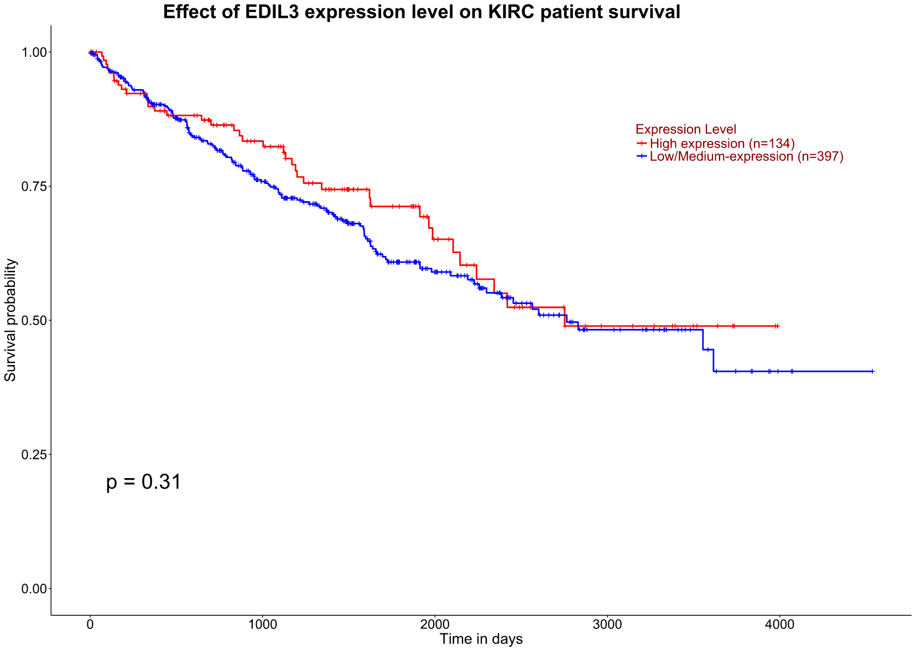

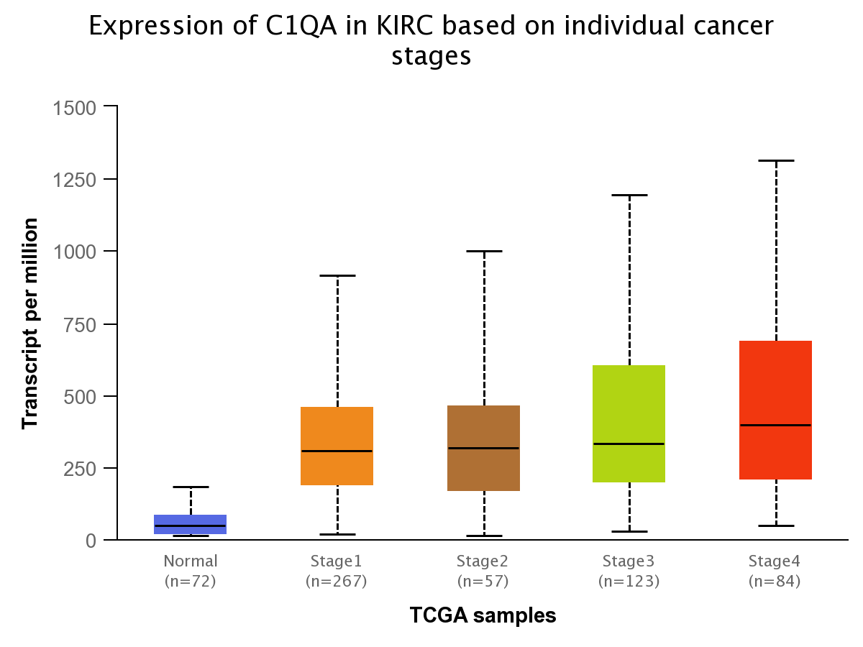
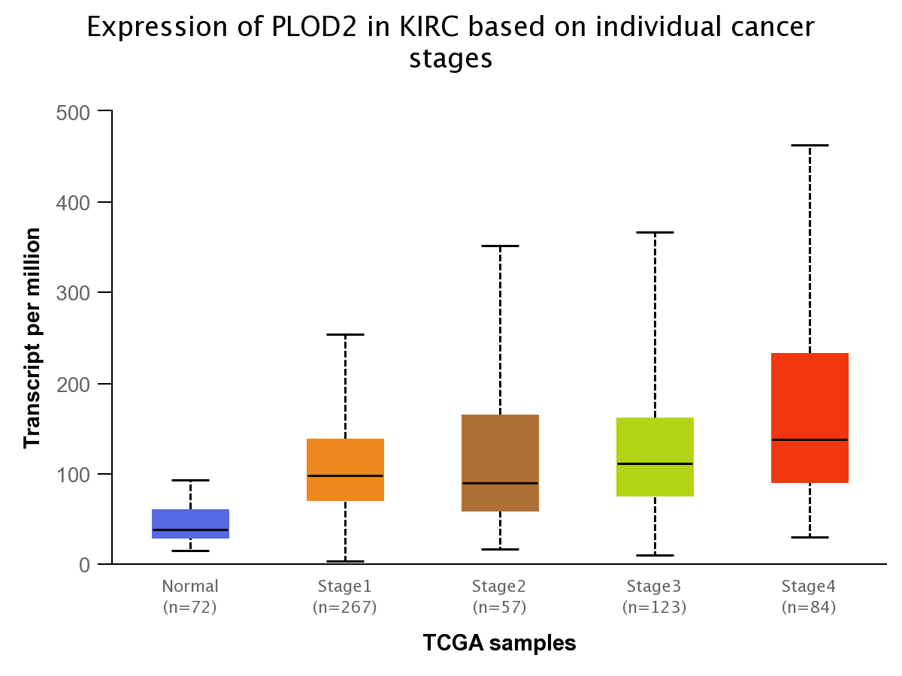
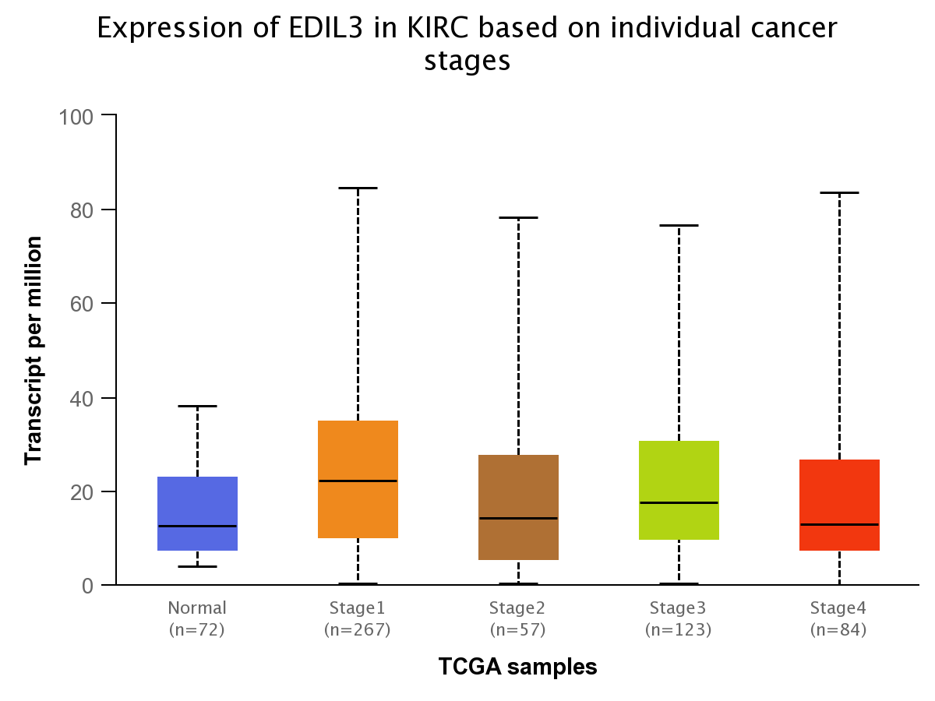
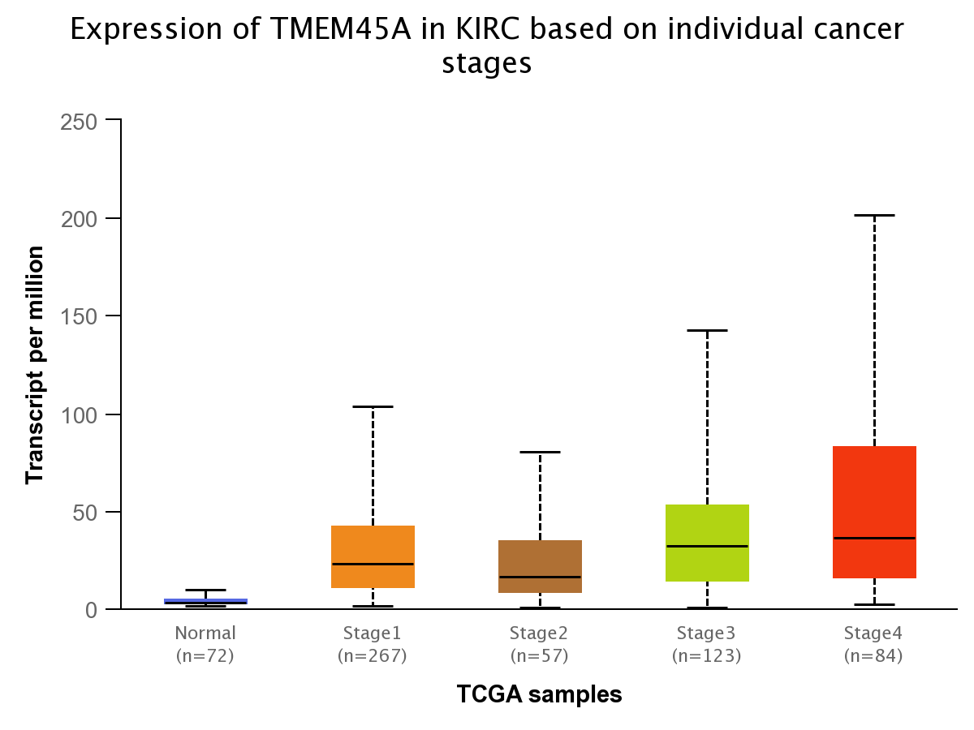
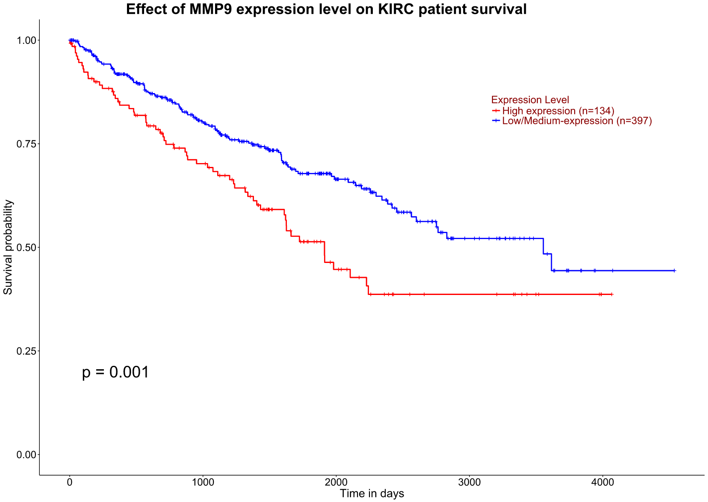

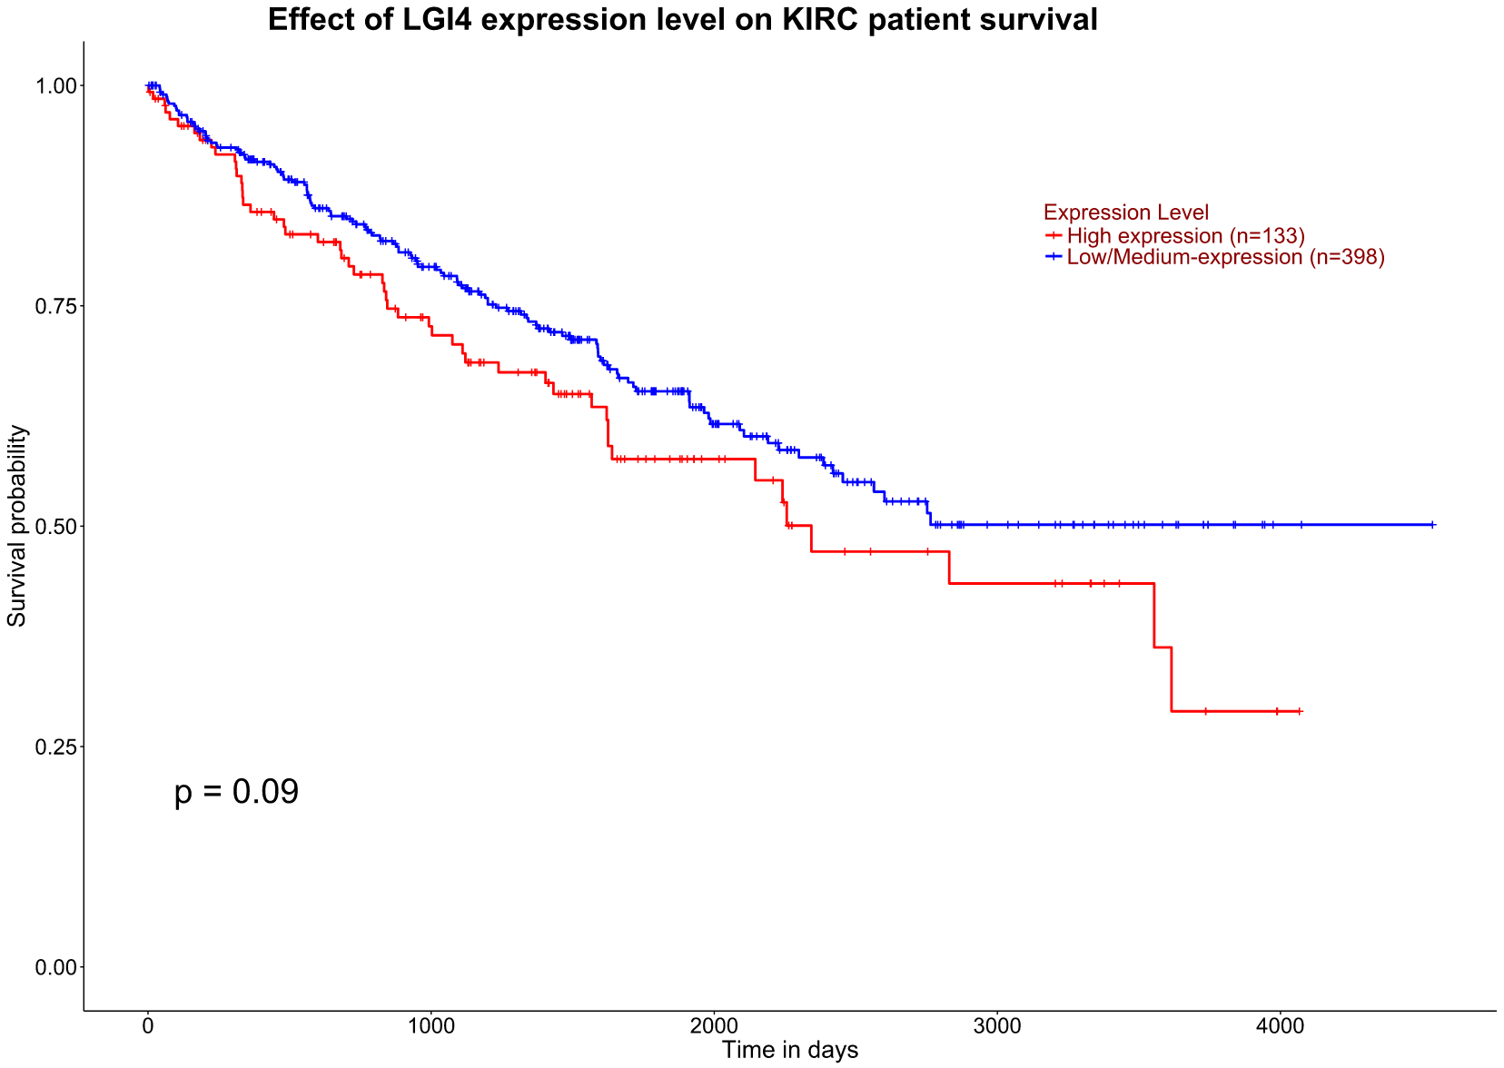
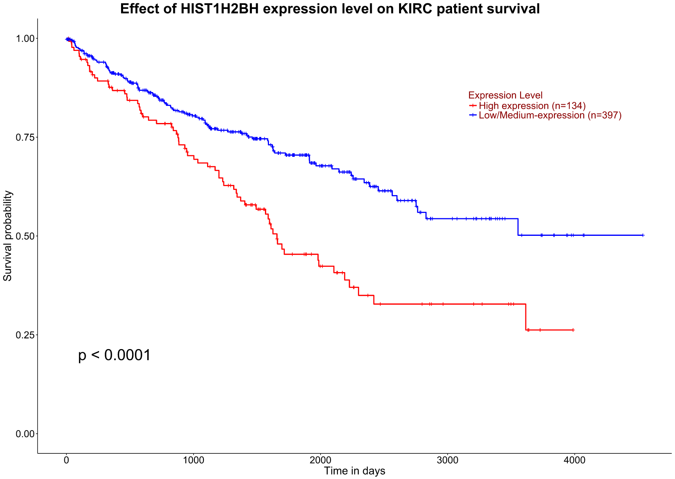
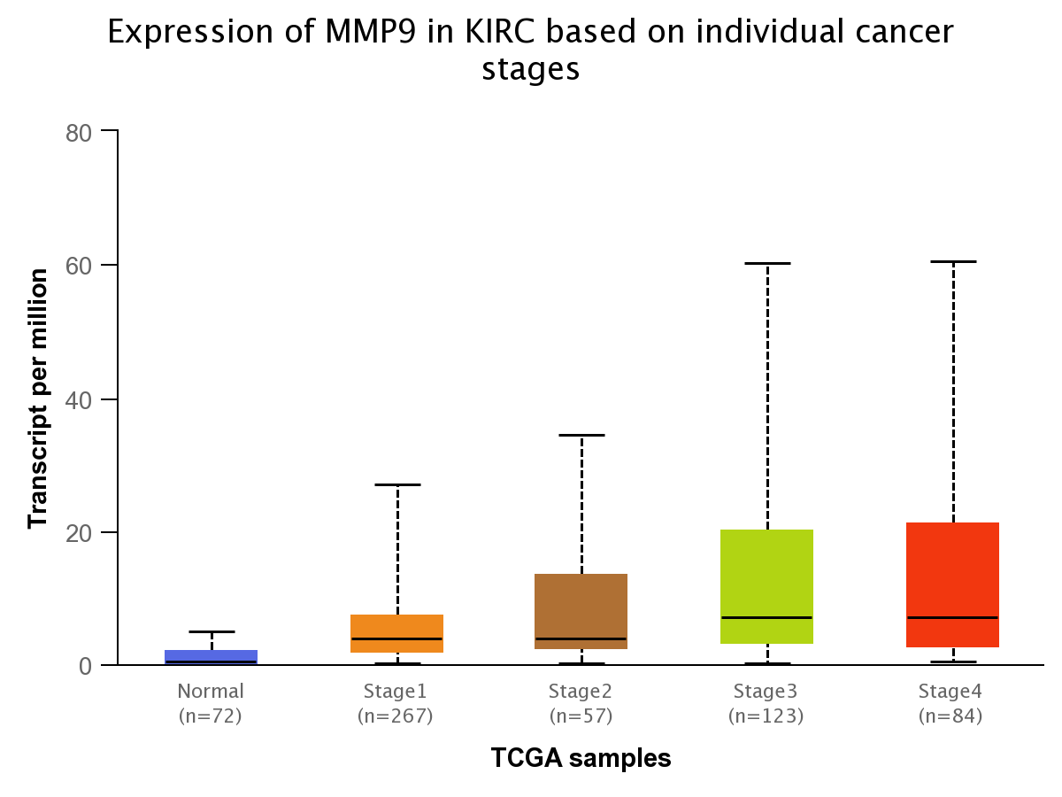
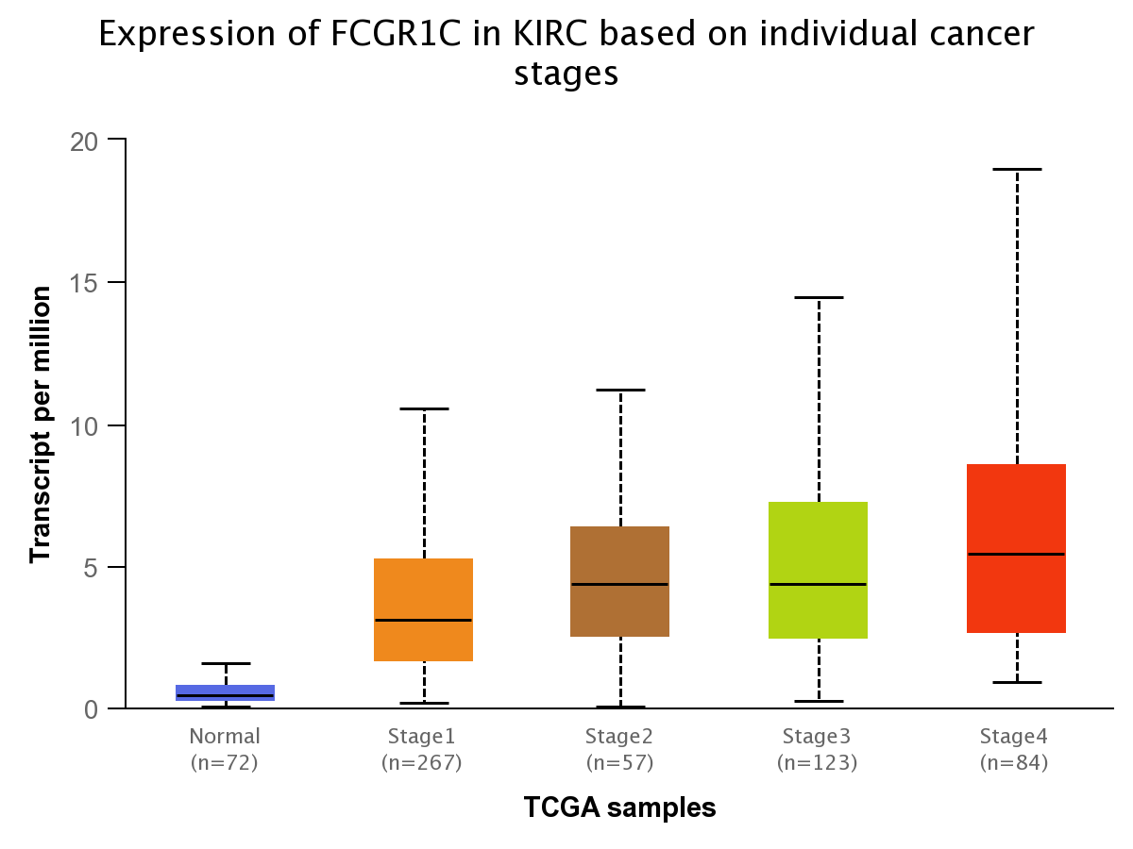
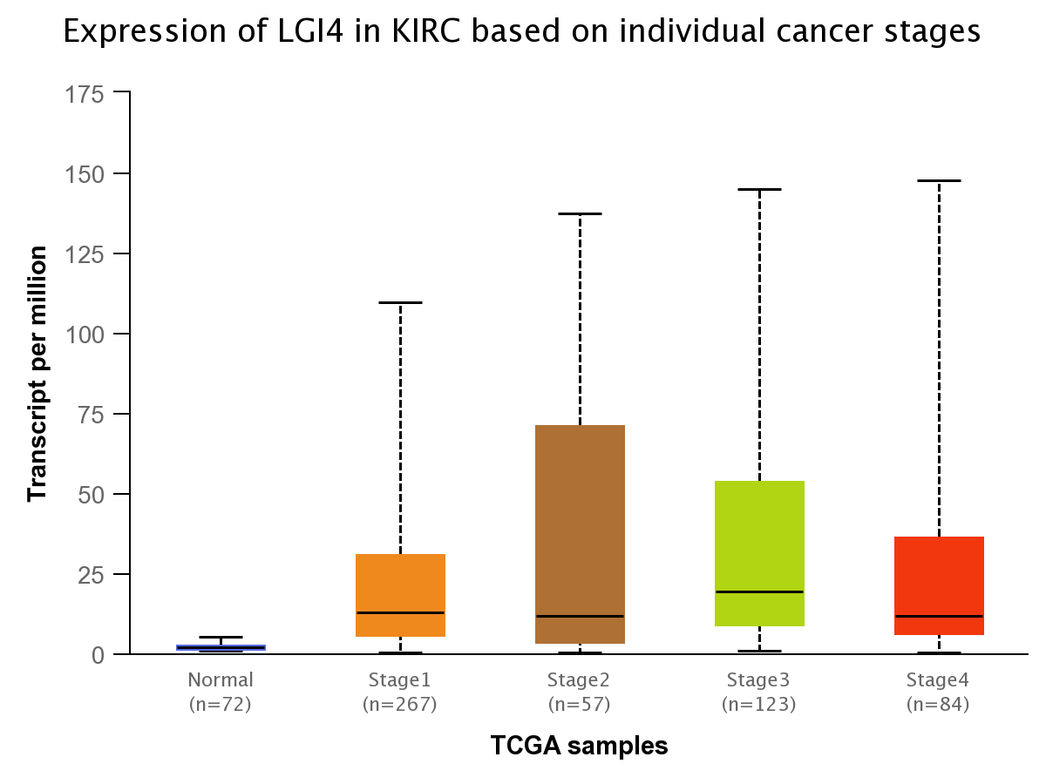
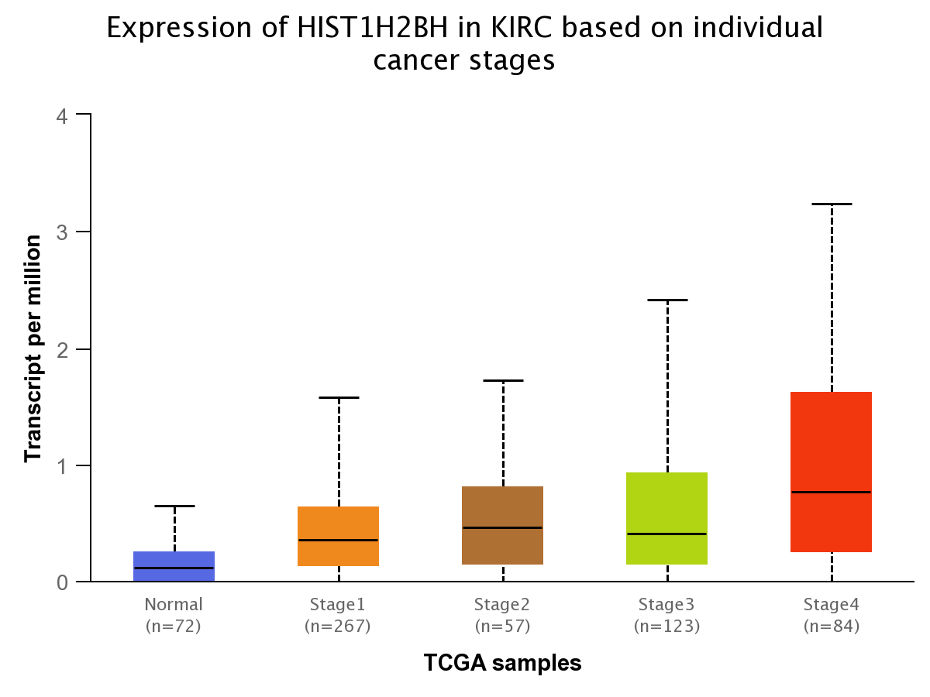
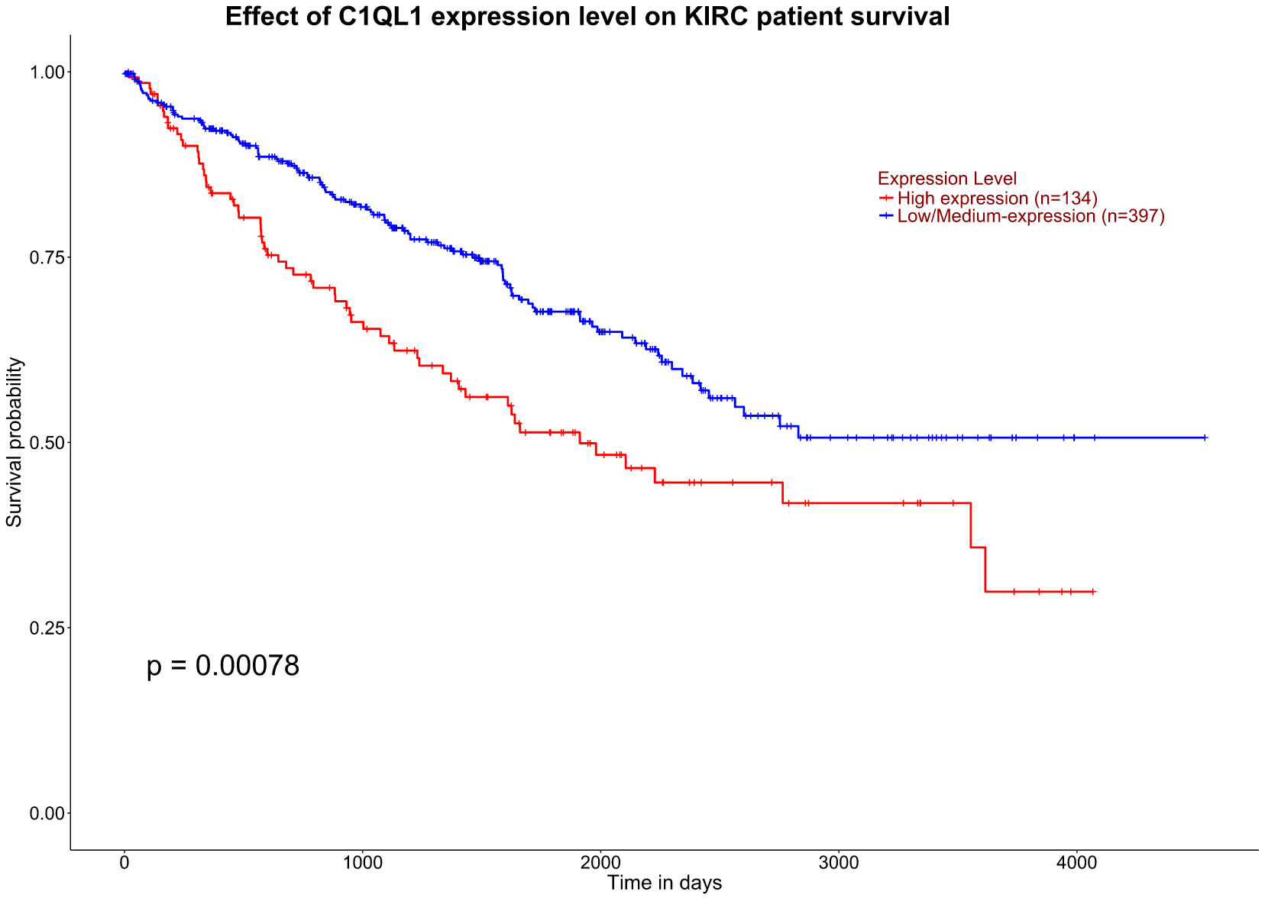
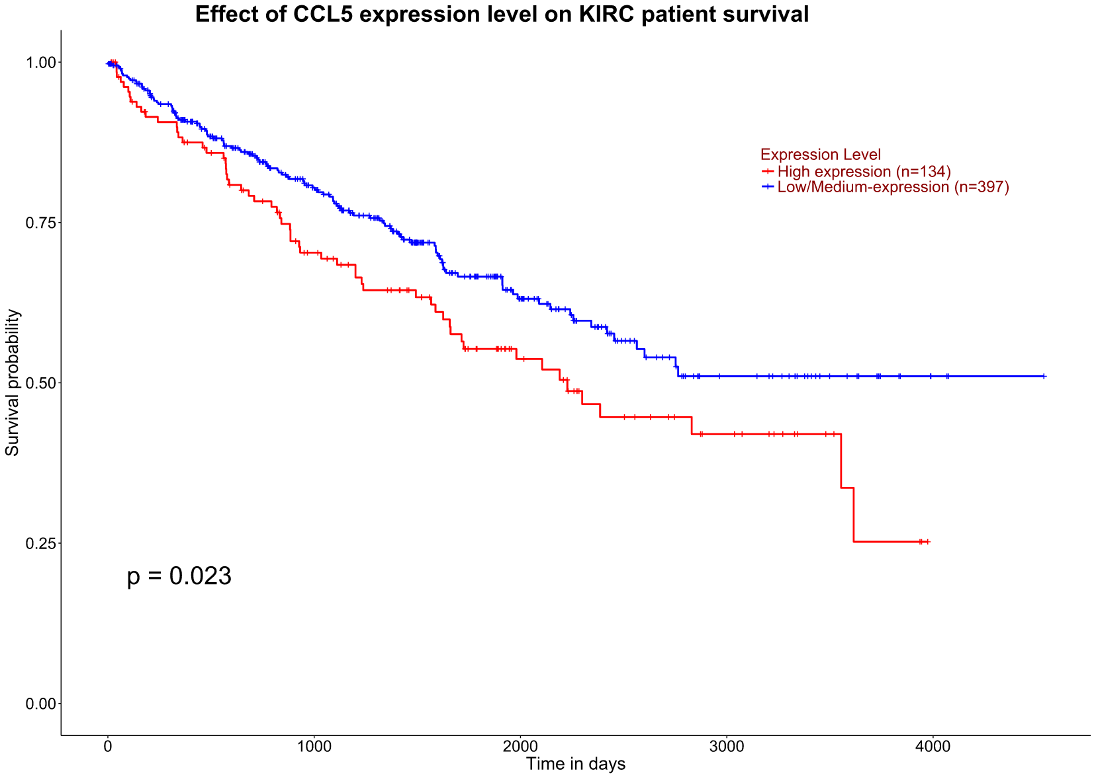


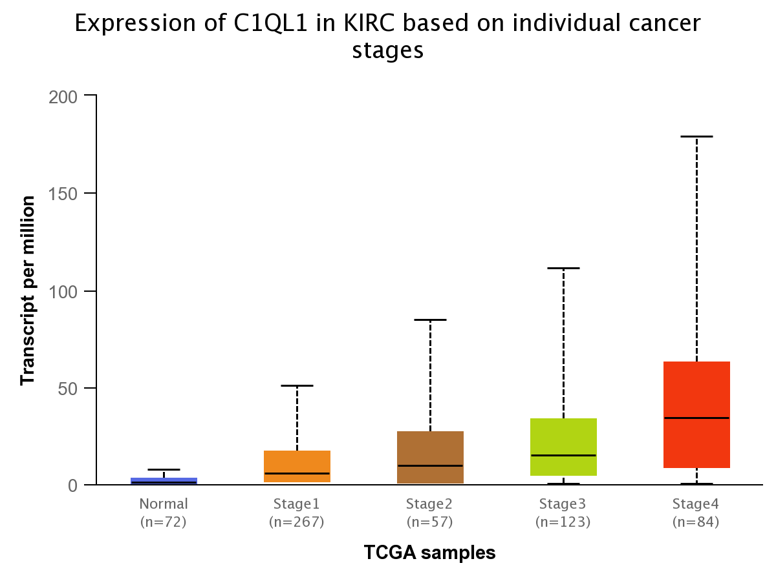
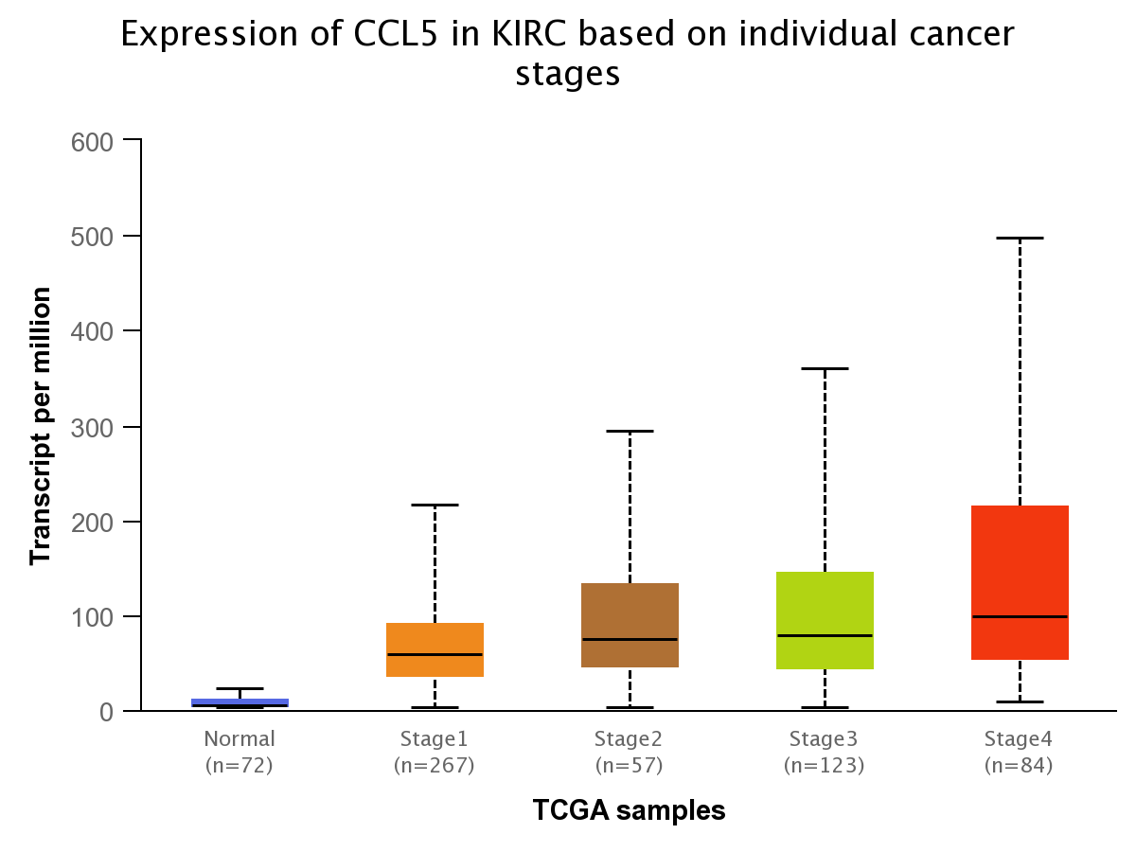
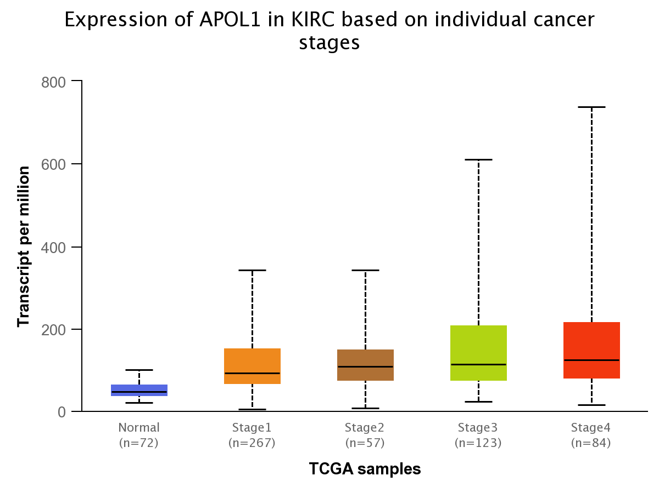
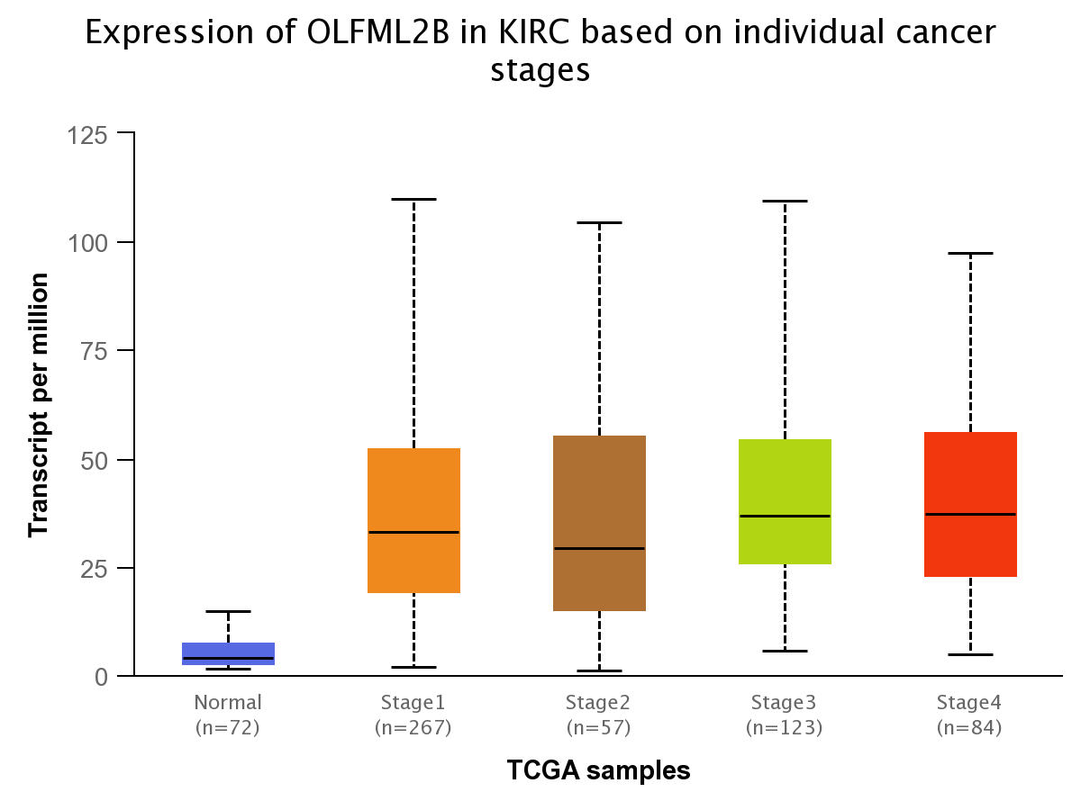
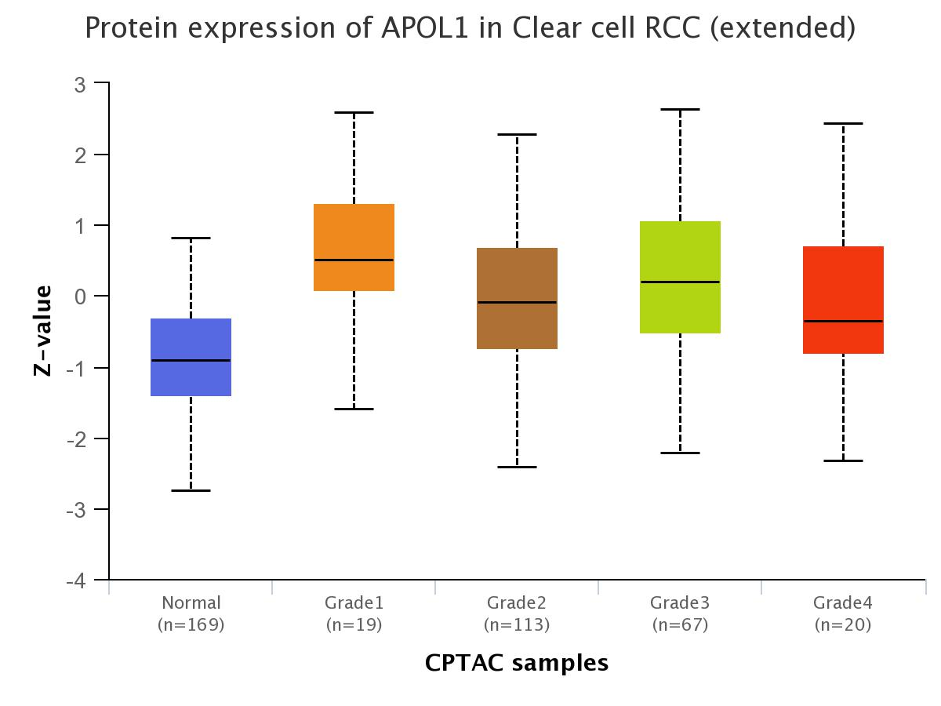
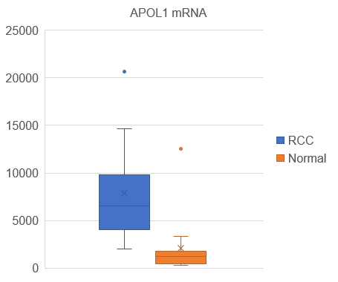
Figure S1
A
ccRCC
p < 0.05, |fc| > 2
C
Normal
List of DEG
(2390 genes)
TCGA-KIRC data set
p < 0.05
List of TCGA - KIRC
passed targets (459 genes)
212
upregulated genes
247
downregulated genes
B
No. | Gene | Fold change | p-value
1 | CP | 32.74 | 0.0018
2 | C3 | 22.60 | 0.0015
3 | NNMT | 17.77 | 0.0008
4 | TGFBI | 12.36 | 0.0026
5 | SERPINA1 | 10.29 | 0.0058
6 | HIST1H2AM | 10.17 | 0.0010
7 | ENO2 | 9.99 | 0.0006
8 | RNASET2 | 8.98 | 0.0006
9 | C1QA | 8.97 | 0.0033
10 | PLOD2 | 8.72 | 0.0031
11 | EDIL3 | 6.54 | 0.0012
12 | TMEM45A | 6.42 | 0.0033
13 | MMP9 | 6.40 | 0.0220
14 | FCGR1C | 6.17 | 0.0048
15 | LGI4 | 6.06 | 0.0144
16 | HIST1H2BH | 5.70 | 0.0004
17 | C1QL1 | 5.45 | 0.0174
18 | CCL5 | 5.34 | 0.0012
19 | APOL1 | 5.26 | 0.0045
20 | OLFML2B | 5.10 | 0.0028
D
E
G
H
F
786-O
Caki-1
Notes:
Figure S1. APOL1 expression in clear cell renal cell carcinoma.
A. Analytical procedure of RNA-seq data from patient ccRCC tumors and their adjacent normal tissues.
B. List of top 20 upregulated genes in DEGs between ccRCC tumors and their adjacent normal tissues.
C. The survival analysis and expression of 20 upregulated genes by the stages in TCGA-KIRC dataset.
D. APOL1 mRNA expression in RNA-seq of 9 patient ccRCC tumors compared to their adjacent normal tissues.
E. qRT-PCR analysis of APOL1 mRNA in tumors of A-498, 786-O and Caki-1 cells. Actin served as an internal control.
F. Immunohistochemistry of APOL1 expression in tumors of 786-O and Caki-1 cells.
G. APOL1 expression by cancer stages in patient ccRCC tumors.
H. APOL1 protein expression by cancer grades in Clinical Proteomic Tumor Analysis Consortium (CPTAC) samples of ccRCC.

Slide 2
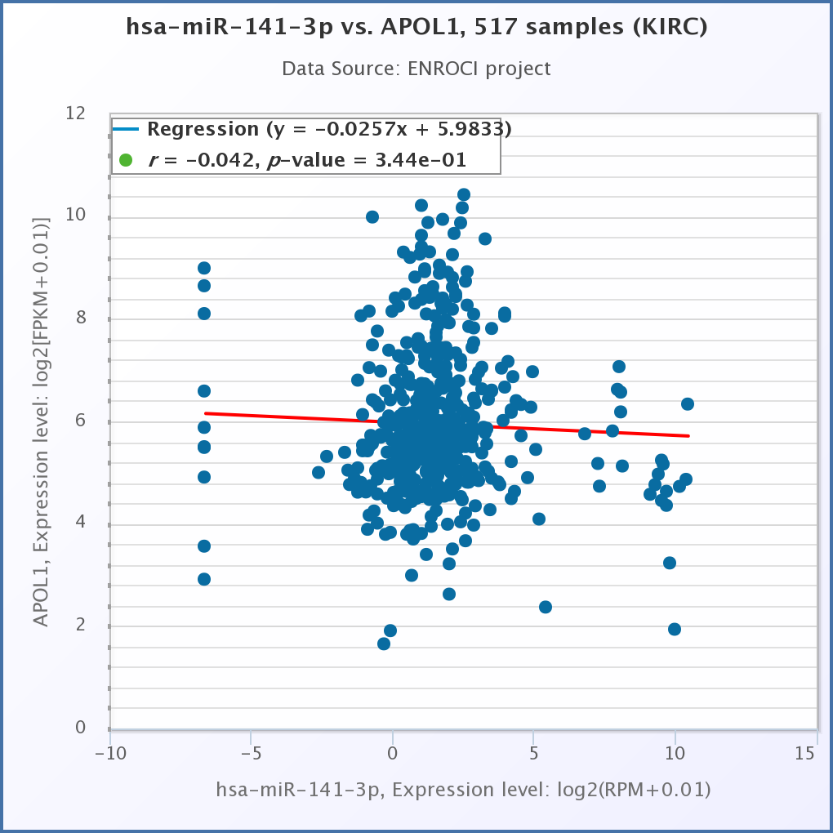
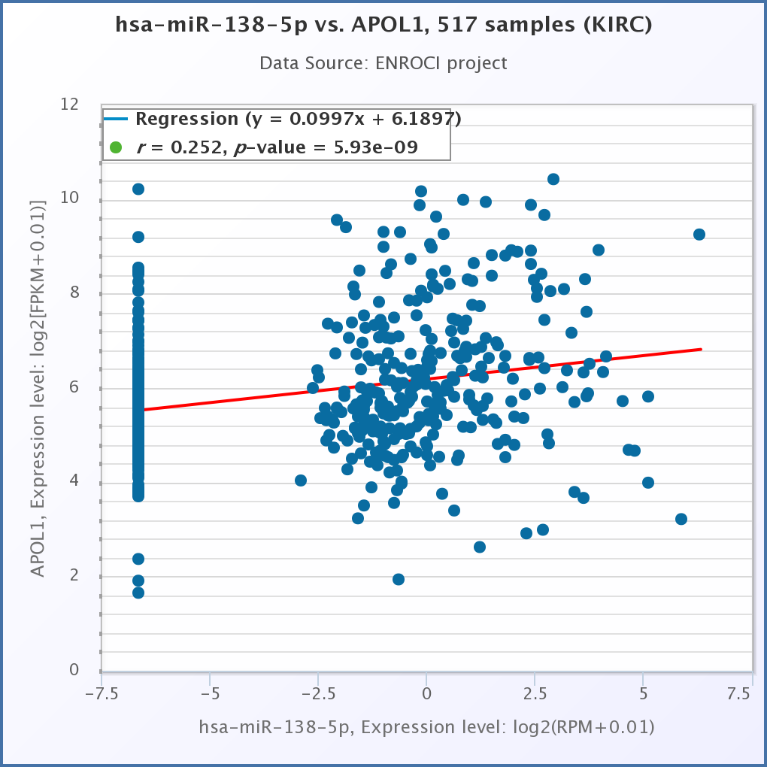
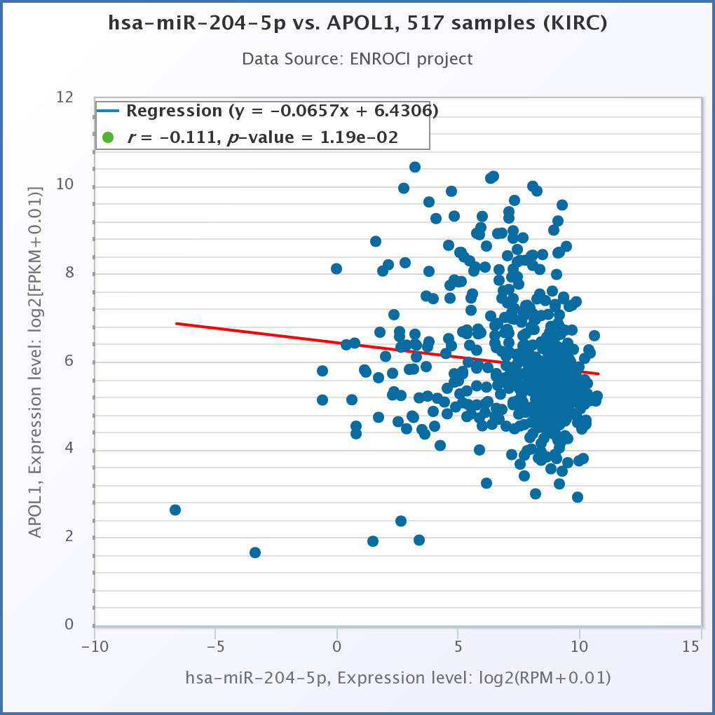
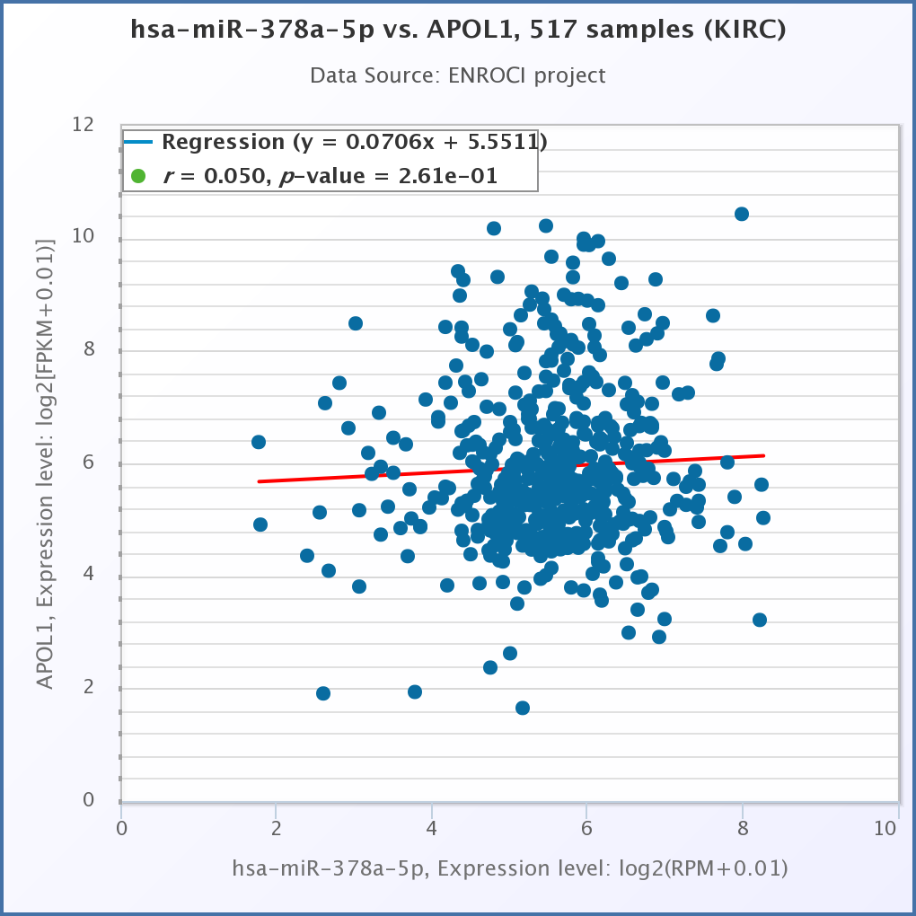
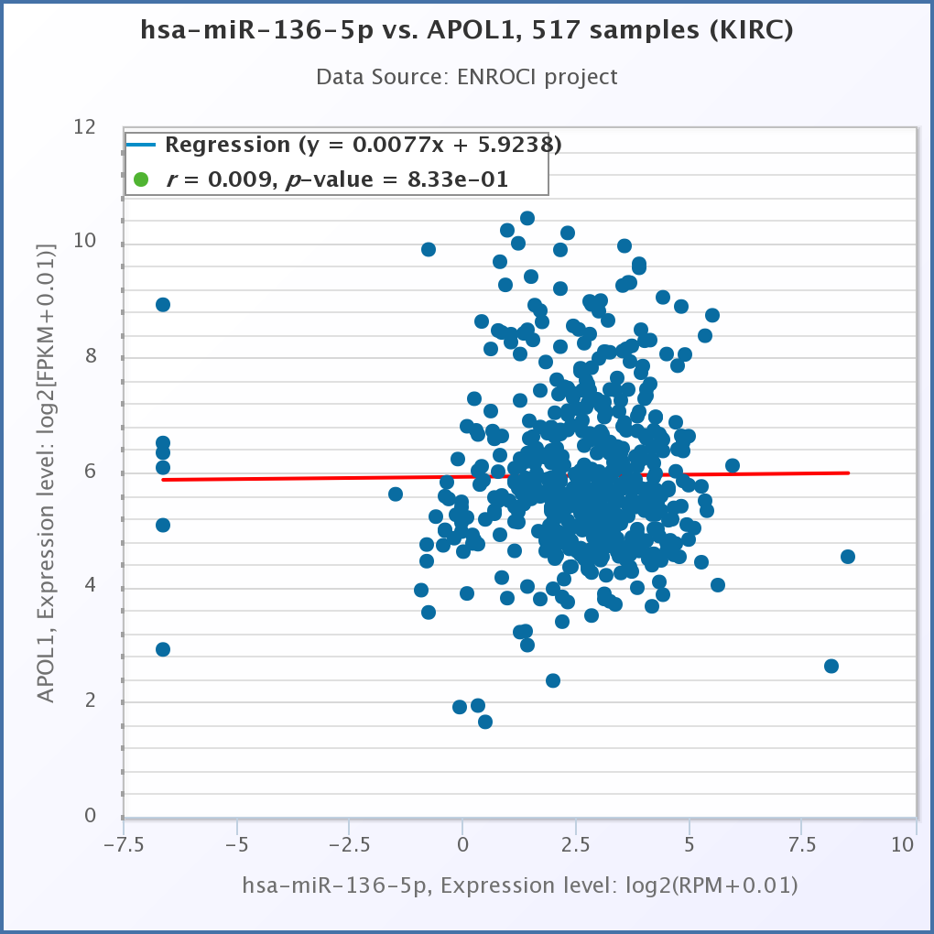
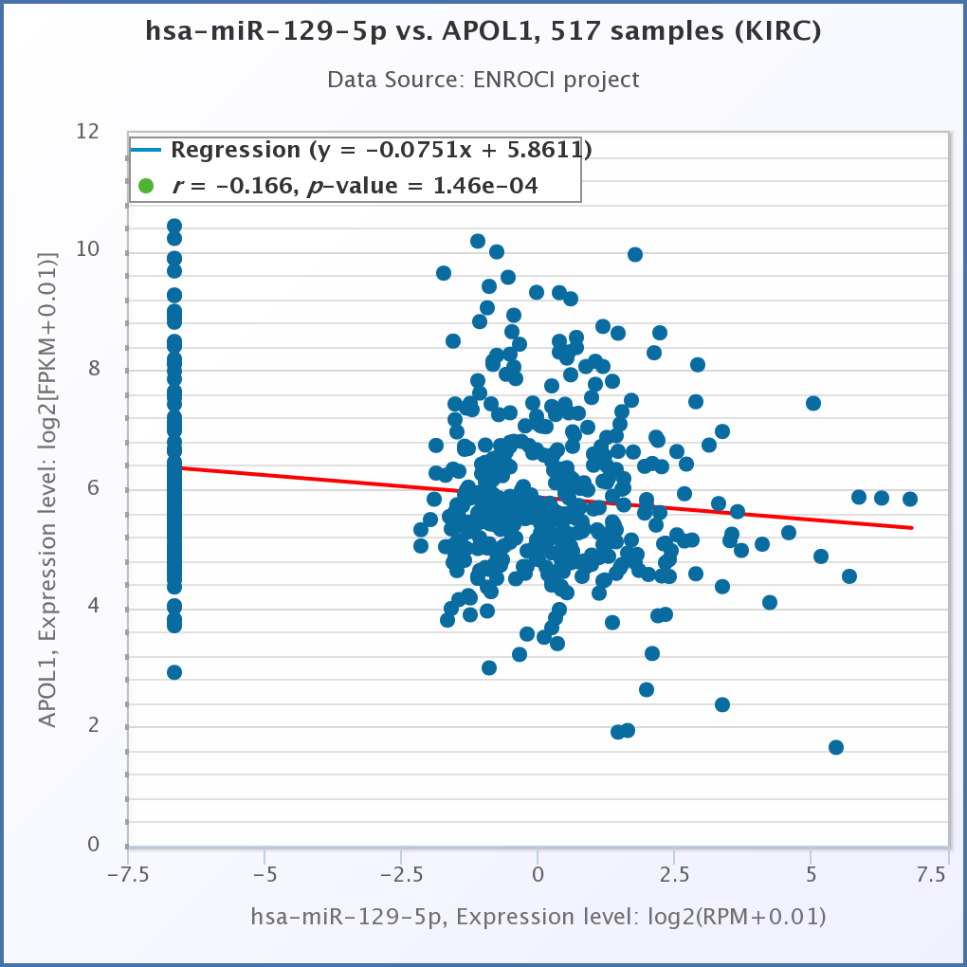
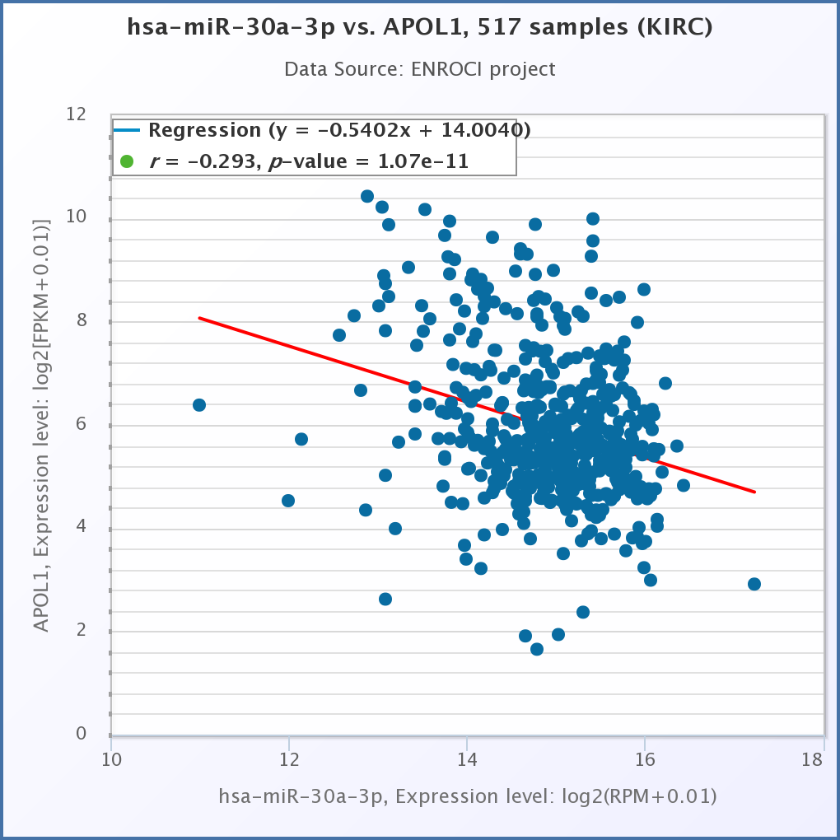
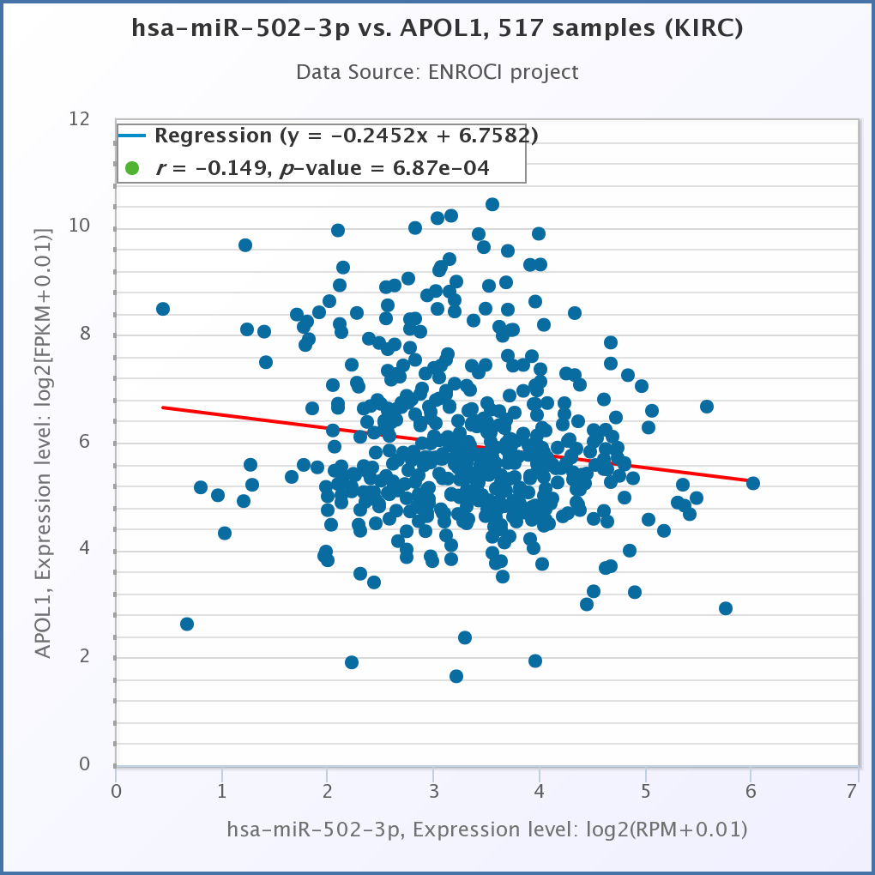
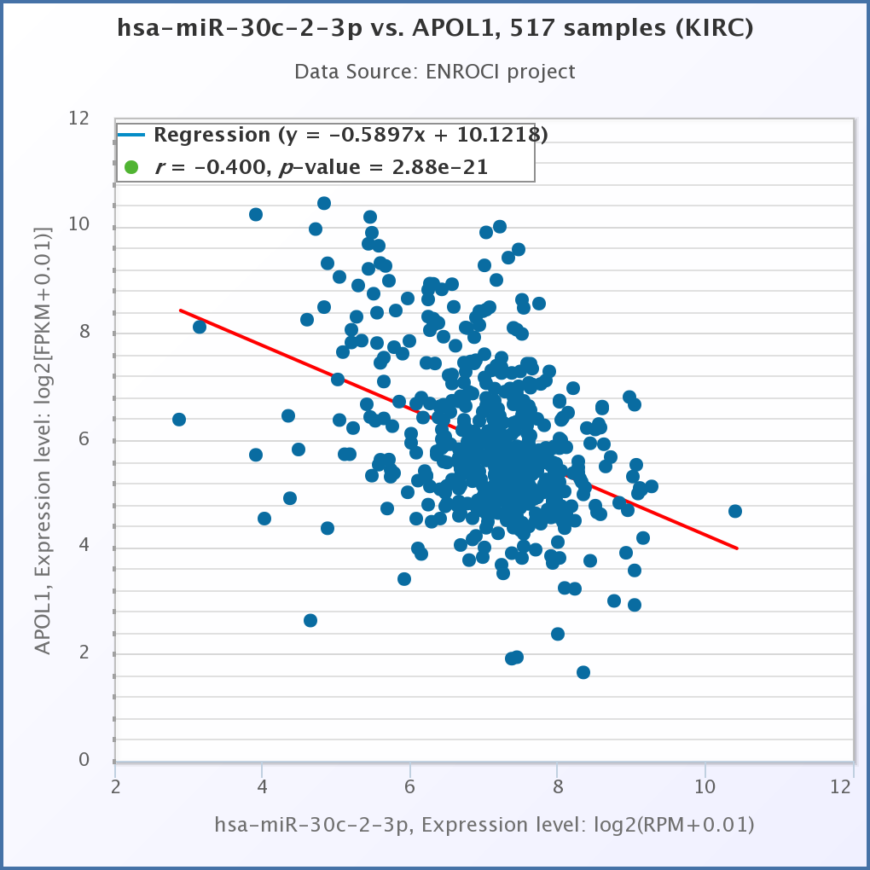
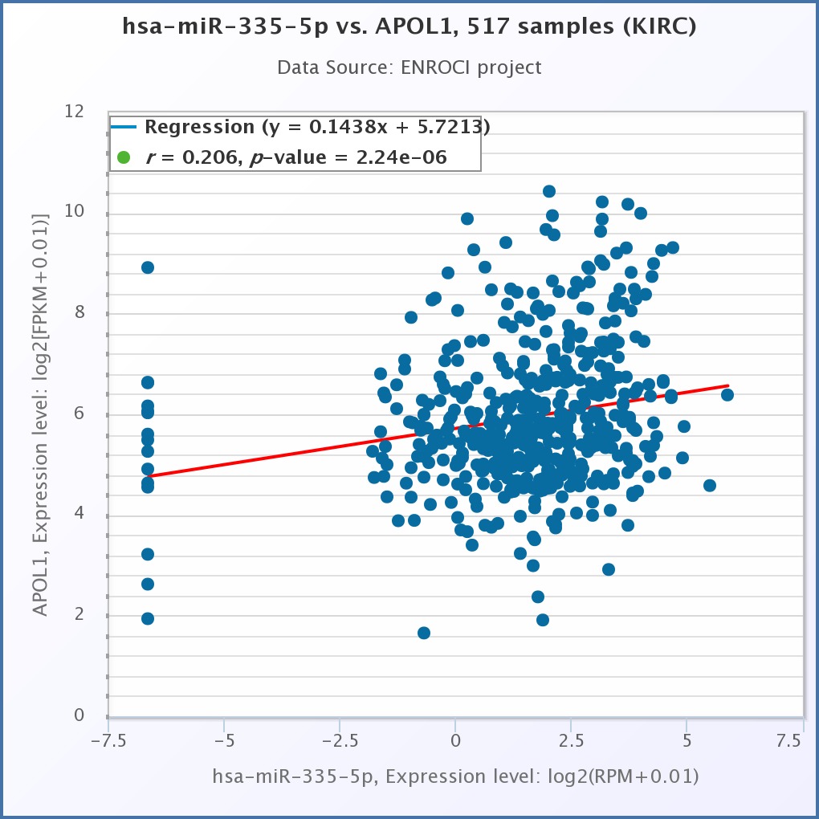
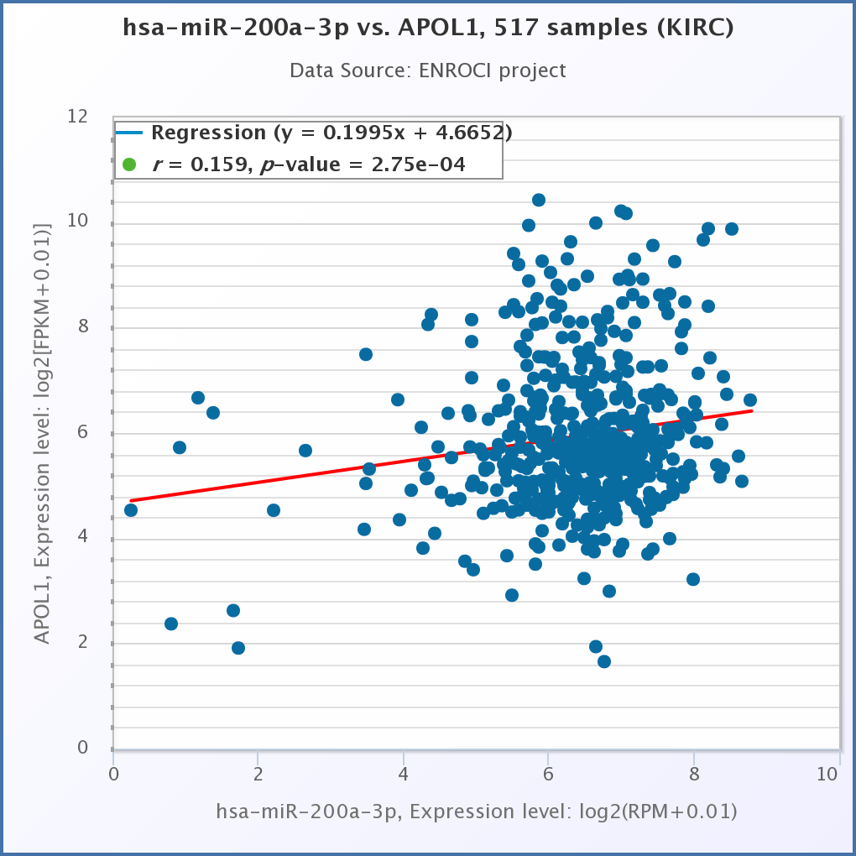
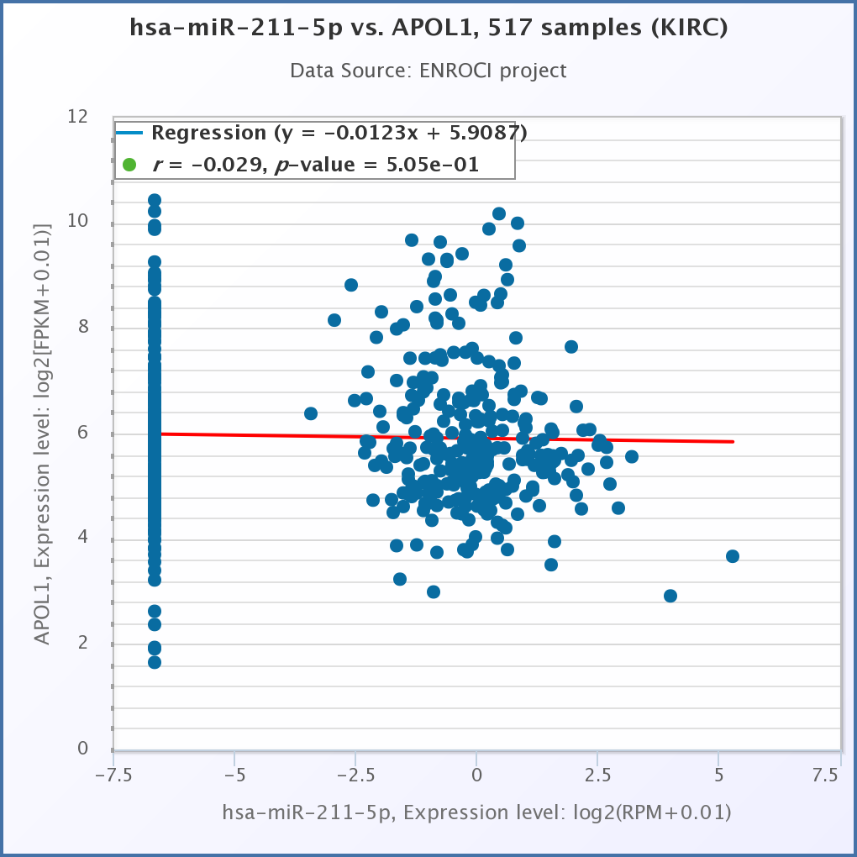
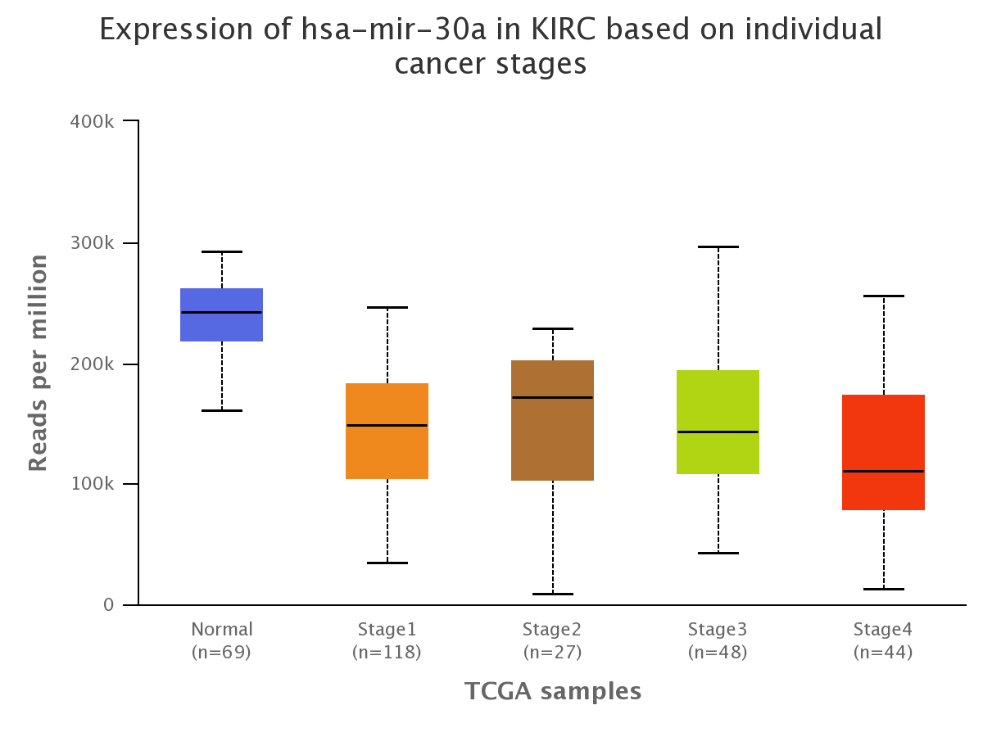
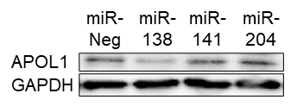

Figure S2
A
ccRCC
p < 0.05, |fc| > 2
B
No. | miRNA | Fold change | p-value
1 | miR-141-3p | -12.89 | 0.0199
2 | miR-138-5p | -5.07 | 0.0261
3 | miR-204-5p | -4.68 | 0.0267
4 | miR-378a-5p | -3.75 | 0.0143
5 | miR-136-5p | -3.69 | 0.0188
6 | miR-129-5p | -3.10 | 0.0209
7 | miR-30a-3p | -2.84 | 0.0212
8 | miR-502-3p | -2.56 | 0.0188
9 | miR-30c-2-3p | -2.52 | 0.0403
10 | miR-335-5p | -2.46 | 0.0403
11 | miR-200a-3p | -2.38 | 0.0211
12 | miR-211-5p | -2.12 | 0.0489
Normal
List of DE miRs
(103 miRs)
TargetScan
(miRs target APOL1)
List of 28 miRs
16
upregulated miRs
12
downregulated miRs
C
D
y = -0.1889x + 6.346
r = -0.3927, p = 0.2958
y = 0.0135x + 5.004
r = 0.0138, p = 0.9719
y = -0.1452x + 6.588
r = -0.1917, p = 0.6213
y = 0.9152x + 4.195
r = 0.1468, p = 0.7063
y = -0.1530x + 5.431
r = -0.1541, p = 0.6922
y = 0.0357x + 5.028
r = 0.0673, p = 0.8634
y = 0.4316x + 3.024
r = 0.3158, p = 0.4077
y = -0.2368x + 6.480
r = -0.1469, p = 0.7061
y = 0.1762x + 4.435
r = 0.2139, p = 0.5805
y = -0.2087x + 6.590
r = -0.2114, p = 0.5851
y = -0.1558x + 5.158
r = -0.2481, p = 0.5198
E
F
G
H
I
J
APOL1 3’ UTR miR-30a-3p | 5'...CAGGAAAAGAAAGAGCUGAAAAU...3’ |||||| 3'CGACGUUUGUAGGCUGACUUUC-5’
K
Notes:
Figure S2. miRNA expression in clear cell renal cell carcinoma.
A. Analytical procedure of miRNA-seq data from patient ccRCC tumors and their adjacent normal tissues.
B. List of 12 downregulated miRNAs that targeting 3’UTR of APOL1.
C, D. Pearson correlation analysis between downregulated miRNA candidate and APOL1 in TCGA-KIRC dataset (C) and patient ccRCC tumors (D).
E. The inverse correlation between APOL1 and miR-30a-3p in 9 patient ccRCC samples.
F. miR-30a-3p expression in RNA-seq of 9 patient ccRCC tumors compared to their adjacent normal tissues.
G. qRT-PCR analysis of miR-30a-3p in tumors of A-498, 786-O and Caki-1 cells. RNU48 served as an internal control.
H, I. miR-30a-3p expression by cancer stages in TCGA-KIRC dataset (H) and patient ccRCC tumors (I).
J. Sequences of miR-30a-3p and the potential binding site of miR-30a-3p at the 3’ UTR of APOL1.
K. Western blot analysis of APOL1 protein in control and miR-138, miR-141, miR-204 transfected A-498 cells. GAPDH served as an internal control.

Slide 3
Figure S3
A
B
sh-Con
A-498
D5 D3 D1 D0
sh-Con
786-O
D5 D3 D1 D0
Con
Caki-1
D5 D3 D1 D0
C
sh-APOL1
A-498
sh-APOL1
786-O
APOL1
Caki-1
CSFE
Notes:
Figure S3. APOL1 expression did not change proliferation.
A. qRT-PCR analysis of APOL1 mRNA in control and APOL1 knockdown A-498 cells, APOL1 knockdown 786-O cells and APOL1 overexpressing Caki-1 cells.
B. CSFE cell proliferation analysis of control and APOL1 knockdown A-498 cells, APOL1 knockdown 786-O cells and APOL1 overexpressing Caki-1 cells. D0 to D5: day 0 to day 5.
C. Weight of mice intravenously injected with control and APOL1 overexpressing Caki-1 cells.

Slide 4



Figure S4
Notes:
Figure S4. GO enrichment analysis of RNA-seq data from patient ccRCC tumors and their adjacent normal tissues.

