Slide 1
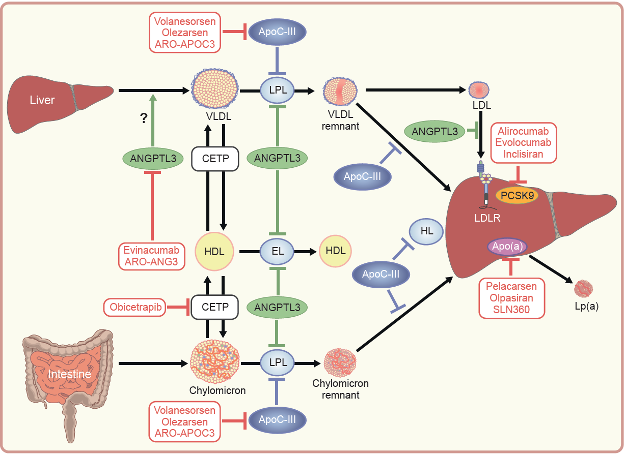
Newly approved and potential future therapies targeting circulating lipoparticle metabolism
Béliard et al (2024) Diabetologia DOI 10.1007/s00125-024-06100-z
© The Author(s), under exclusive licence to Springer-Verlag GmbH Germany, part of Springer Nature 2024

