Slide 1
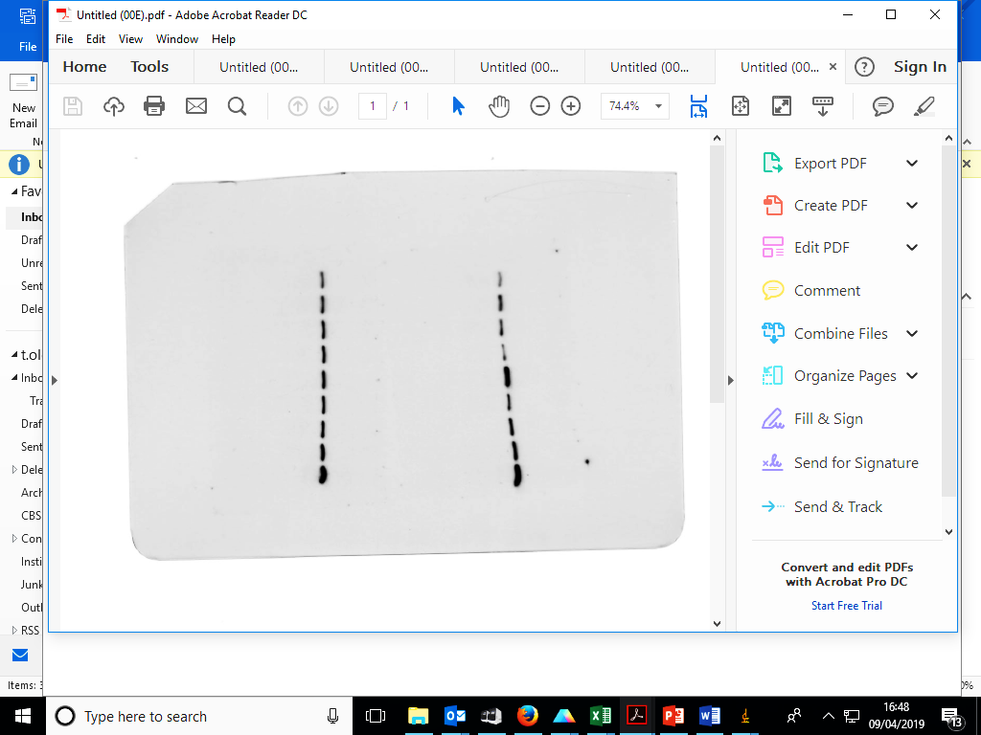
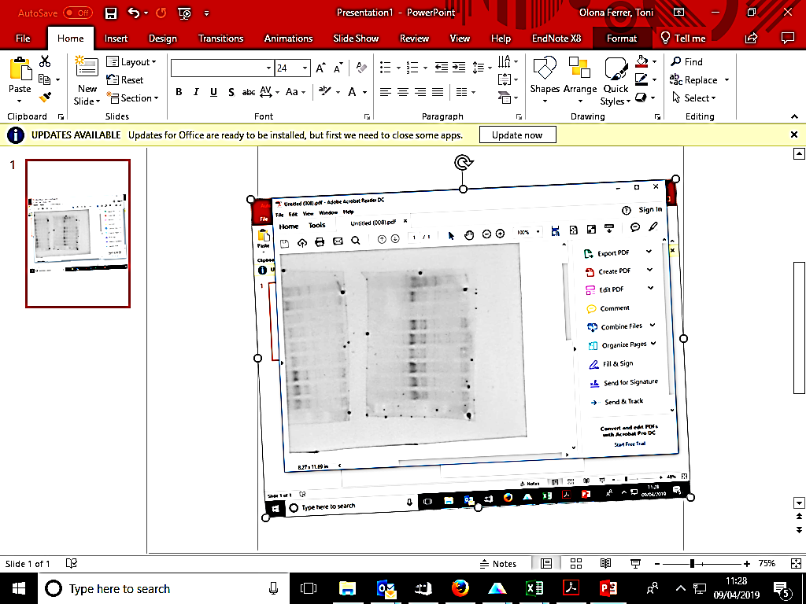
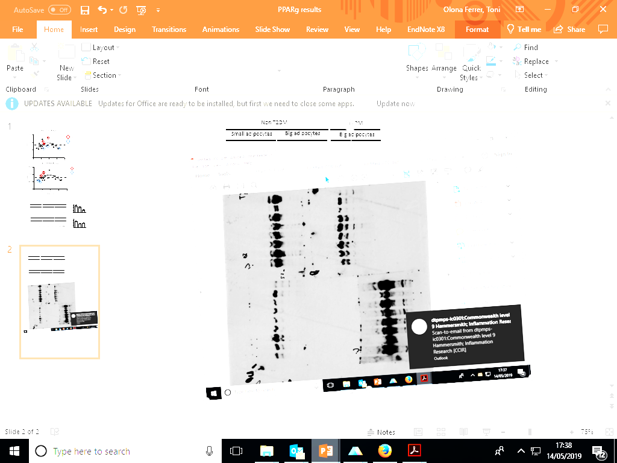
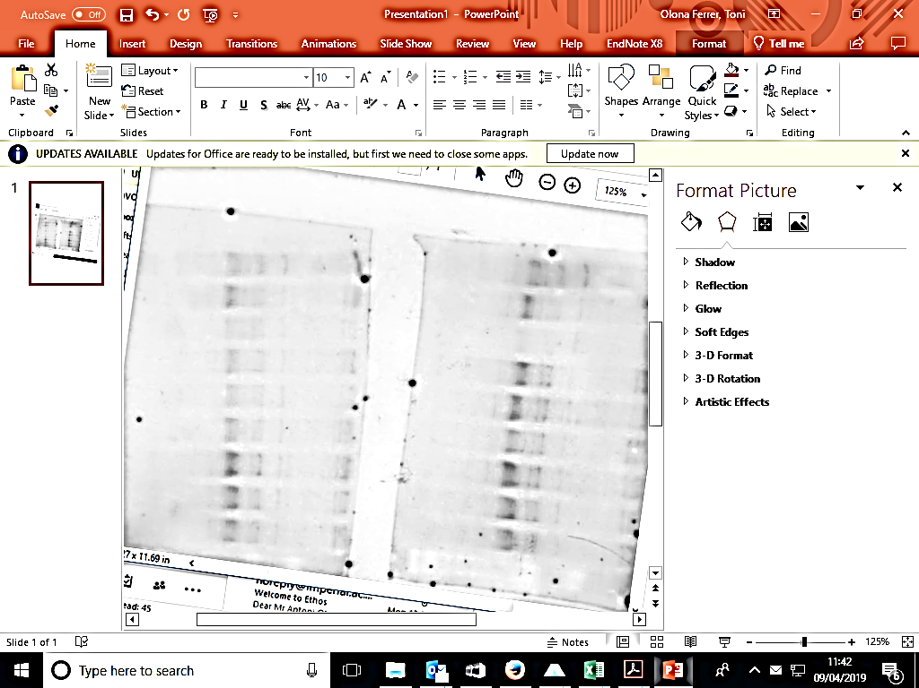
Figure 1c
CEBP𝛼
PPAR𝛾
β-Actin
Obese
Obese + T2DM
Obese
Obese + T2DM
Obese
Obese + T2DM
Small adipocytes
Small adipocytes
Large adipocytes
Small adipocytes
Small adipocytes
Large adipocytes
Small adipocytes
Small adipocytes
Large adipocytes
42 kDa
42kDa
57 kDa
28kDa
53 kDa
PPAR𝛾
β-Actin
CEBP𝛼
Obese
Obese + T2DM
Obese
Obese + T2DM
Obese
Obese + T2DM
Small adipocytes
Large adipocytes
Large adipocytes
Small adipocytes
Large adipocytes
Large adipocytes
Small adipocytes
Large adipocytes
Large adipocytes
57 kDa
53 kDa
42kDa
42kDa
28kDa

