Slide 1
7353 Young CPT1 hom Pax8
Old CPT1 Hom Pax8
Old CPT1 Hom Pax8 LC1
2395
7762
2582
2578
2394
2397
7602
7763
150
100
75
CPT1a
50
37
Beta-actin (mouse)
25
20
Figure 1H

Slide 2
7353 young mouse
Old CPT1 Hom Pax8
Old CPT1 Hom Pax8 LC1
2395
7762
2582
2578
2394
2397
7602
7763
75
50
37
25
GAPDH
20
15
Membrane was originally blotted for alpha tubulin and GAPDH (above), then membrane cut to save on antibody and blotted for p16 below.
20
p16
Figure 3I

Slide 3
uninjured
injured
2755
2912
2914
2915
3269
2265
4449
4663
150
100
See next slide for loading control
75
uninjured
injured
2912
2915
3185
4506
2266
3182
4672
3184
3269
CPT1a
Figure 4 A

Slide 4
Blot had previously been stained for VDAC1 which is higher band (not included in the manuscript)
37
GAPDH
Figure 4A

Slide 5
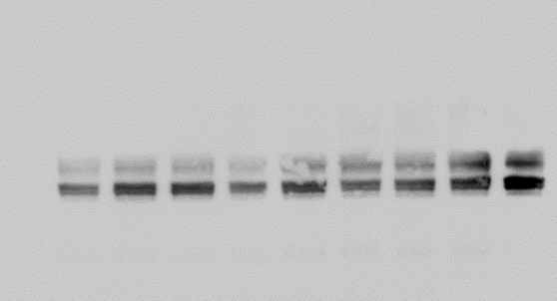
Aged mice
Cpt1a fl/fl
Cpt1a ^{CKO}
50
Cplx V
37
Cplx III
Cplx IV
25
Cplx II
20
Cplx I
15
50
β-actin
37
Figure 7 C

Slide 6
Cpt1a fl/fl + AA
Cpt1a CKO+ AA
heart
50
Cplx V
37
Cplx III
Cplx IV
25
Cplx II
20
Cplx I
15
50
b-actin
37
Figure 4E

Slide 7
UUO injured
Cpt1a WT
Cpt1a CKO
50
Cplx V
Cplx III
37
Cplx IV
25
Cplx II
20
Cplx I
15
50
b-actin
37
Figure 4G

Slide 8
Old mice
Heart sample
Cpt1a^{fl/fl}
Cpt1a^{CKO}
Heart sample
150
100
Cpt1-b
75
37
GAPDH
Supplemental 4B

Slide 9
AA mice
heart
Cpt1a^{fl/fl}
Cpt1a^{CKO}
100
75
Cpt1-b
37
GAPDH
Supplemental 4E

Slide 10
UUO mice
heart
heart
Cpt1a^{fl/fl}
Cpt1a^{CKO}
100
75
Cpt1-b
50
37
GAPDH
Supplemental 4D

Slide 11
Young CPT1 hom Pax8
Old CPT1 Hom Pax8
Old CPT1 Hom Pax8 LC1
50
37
GAPDH
50
B-actin
37
Supplemental 4F

